Slide 1

Social Security:
With You Through Life’s Journey…
Produced at U.S. taxpayer expense
Notes:
2026 Universal PowerPoint – updated 1/7/2026 (SY)
BEGINNING OF SPEAKER’S FORMAL SCRIPT:
For 90 years, Social Security has helped secure today and tomorrow by providing benefits and financial protection for millions of people throughout their life’s journey.
Social Security touches the lives of every American, both directly and indirectly. As you consider the information that you are about to receive, I encourage you to think about all the ways Social Security has been linked to your life – and the lives of your loved ones.

Slide 2
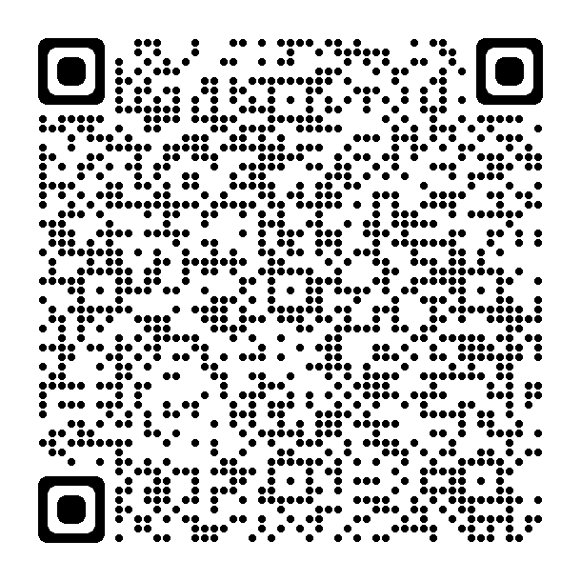
Social Security Number and Card
Applying online is the fastest way to request a Social Security card. Just go to ssa.gov/number-card and answer a few questions to find out the best way to apply.
You can:
Request a Social Security number for the first time.
Request a replacement Social Security card.
Update or correct your personal information
(e.g., name, date of birth).
You may be able to apply completely online. In some cases, you can start the process online and complete it at a local Social Security office or Card Center. You may also have the option to self-schedule an in-office appointment online to finish the process. If you are unable to self-schedule online, please call
1-800-772-1213 to make an appointment to come into a local office. If you are deaf or hard of hearing, please call our TTY number, 1-800-325-0778.
Notes:
If you lost your card, you may not need a replacement. In most cases, simply knowing your Social Security number (SSN) is enough. But, if you do need a replacement, you can complete your application online or in-person. Once you complete your application (online or in-person), you will receive your Social Security card in the mail. There is no charge for a Social Security card.
Slide updated 3/14/2025 (SY)

Slide 3
What is FICA?
Stands for Federal Insurance Contributions Act
  May show on paycheck as OASDI or Social Security
Federal payroll tax deducted from workers’ paychecks, matched by employer, and reported by employer to IRS
Total FICA tax = 15.3% of gross wages. You and your employer each pay 7.65%
  6.2% for Social Security
  1.45% for Medicare
FICA taxes help fund Social Security retirement, disability, survivor benefits and Medicare health insurance
Notes:
Most employers collect a federal payroll tax known as FICA, Federal Insurance Contributions Act, and report your earnings electronically.
This tax is collected from both employees and employers to fund Social Security and Medicare — federal programs that provide benefits for retirees, people with disabilities, and survivors.
The total FICA tax is 15.3% of your gross wages. You and your employer each pay 7.65% for FICA, 6.2% for Social Security and 1.45% for Medicare.
The current Social Security system works like this: when you work, you pay taxes into Social Security. The amount of taxes is based on your earnings, up to a certain amount. In 2026, that amount is $184,500.
You pay the Medicare tax on all your earnings. There is no taxable maximum.
The money you pay in taxes is not held in a personal account for you to use when you get benefits. We use your taxes to pay people who are getting benefits right now.
Source(s):
2026 COLA Fact Sheet: ssa.gov/news/en/cola/factsheets/2026.html
Speaker Notes updated 12/16/2025 (SY)

Slide 4
How Do You Become Eligible for Retirement Benefits?
By earning “credits” when you work and pay Social Security taxes
You need 40 credits (10 years of work) and you must be 62 or older
In 2026, each $1,890 in earnings gives you one credit
You can earn a maximum of 4 credits per year
Note: To earn 4 credits in 2026, you must earn at least $7,560.
ssa.gov/benefits/retirement/planner/credits.html
Notes:
Credits are the "building blocks" Social Security uses to find out whether you have the minimum amount of covered work to become eligible for each type of Social Security benefit. If you stop working before you have enough credits to be eligible for benefits, your credits will stay on your record. If you return to work later, you can add more credits so you can become eligible. No benefits can be paid if you do not have enough credits.
In 2026 you must earn $1,890 in covered earnings to get one Social Security or Medicare work credit and $7,560 to get the maximum four credits for the year.
When you work and pay Social Security taxes, you earn up to a maximum of four "credits" for each year.
During your lifetime, you will probably earn more credits than the minimum number you need to be eligible for benefits; however, these extra credits do not increase your benefit amount.
Your average earnings during your working years determine how much your monthly payment will be.
Publications:
ssa.gov/pubs/EN-05-10003.pdf (Update)
ssa.gov/pubs/EN-05-10072.pdf (How You Earn Credits)
Slide and Speaker Notes updated 12/16/2025 (SY)

Slide 5
Year of Birth Full Retirement Age
1937 or earlier 65
1938 65 & 2 months
1939 65 & 4 months
1940 65 & 6 months
1941 65 & 8 months
1942 65 & 10 months
1943 – 1954 66
1955 66 & 2 months
1956 66 & 4 months
1957 66 & 6 months
1958 66 & 8 months
1959 66 & 10 months
1960 or later 67

Slide 6
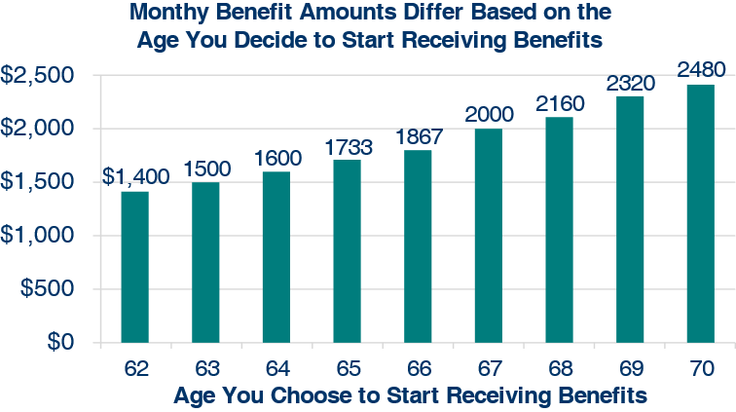
What Is the Best Age to Start Receiving Social Security Retirement Benefits?
Note: This example assumes a benefit of $2,000 at a full retirement age of 67
Notes:
Choosing when to retire is an important and personal decision. Financial experts say you’ll need 70-80% of your pre-retirement income to have a comfortable retirement. You’ll want to choose a retirement age based on your circumstances, so you’ll have enough income when you need it.
As you can see on this chart, your monthly retirement benefit will be higher if you delay starting it. We calculate your basic Social Security benefit — the amount you would receive at your full retirement age — based on your lifetime earnings.
However, the actual amount you receive each month depends on when you start receiving benefits. You can start your retirement benefit at any point from age 62 up until age 70, and your benefit will be higher the longer you delay starting it. This adjustment is usually permanent: it sets the base for the benefits you’ll get for the rest of your life.
You may receive an annual cost-of-living adjustments and, depending on your work history, may receive higher benefits if you continue to work.
Let’s say your full retirement age is 67 and your monthly benefit starting at that age is $2,000. If you choose to start getting benefits at age 62, we’ll reduce your monthly benefit 30% to $1,400, to account for the longer period of time you receive benefits. If you choose to delay getting benefits until age 70, you will increase your monthly benefit to $2,480. This increase is from delayed retirement credits you earn for your decision to postpone receiving benefits past your full retirement age. The benefit at age 70 in this example is 24% more than you would receive each month if you had chosen to start getting benefits at full retirement age.
I encourage you to read our publication #05-10147 - When To Start Receiving Retirement Benefits - ssa.gov/pubs/EN-05-10147.pdf
Slide and Speaker Notes updated 1/9/2023 (SY/JP)

Slide 7
Working While Receiving Benefits
If you are | In 2026, you can earn up to | If you earn more, some benefits will be withheld
Under Full Retirement Age | $24,480/yr. | $1 for every $2 earned above the limit
The Year Full Retirement Age is Reached | $65,160/yr. before month of full retirement age | $1 for every $3 earned above the limit
Month of Full Retirement Age and Above | No Limit | No Limit
Retirement Earnings Test Calculator:
ssa.gov/OACT/COLA/RTeffect.html
Notes:
The first thing we recommend is that you visit ssa.gov/pubs and search for the publication entitled, How Work Affects Your Benefits. It explains the rules you must follow in order to avoid an overpayment, and it gives some great examples for different scenarios that could apply to your individual situation.
You can get Social Security retirement or survivors benefits and work at the same time. However, if you’re younger than full retirement age, and earn more than certain amounts, your monthly benefit remains the same but the total amount of benefits you receive for the year will be reduced. The amount that your annual benefits are reduced, however, isn’t truly lost. Your monthly benefit will be increased at your full retirement age to account for benefits withheld due to earlier earnings.
Note that spouses and survivors who receive benefits because they have minor children or children in their care with a disability, don’t receive increased benefits at full retirement age if benefits were withheld because of work.
I should also mention that different rules apply if you work outside the United States, where benefit withholding may apply if you work more than a certain number of hours in a month. Contact us if you’re working (or plan to work) outside the country. You can also read how working outside the United States affects your benefits in the publication, Your Payments While You Are Outside the United States.
But for most of you, here’s how this works. If you work, and are full retirement age or older, you may keep all of your benefits, no matter how much you earn.
If you’re younger than full retirement age, there is a limit to how much you can earn and still receive full Social Security benefits. If you’re younger than full retirement age, we must deduct $1 from your benefits for each $2 you earn above the annual limit. For 2026, that limit is $24,480.
If you reach full retirement age during 2026, we must deduct $1 from your benefits for each $3 you earn above $65,160 until the month you reach full retirement age.
Starting with the month you reach full retirement age, there is no limit on how much you can earn and still receive all of your Social Security benefits.
Note: If some of your retirement benefits are withheld because of your earnings, your benefits will be increased starting at your full retirement age to take into account those months in which benefits were withheld.
Source(s):
OISP/OAESP ssa.gov/pubs/EN-05-10069.pdf (How Work Affects Your Benefits)
OISP/OSNIP ssa.gov/pubs/EN-05-10137.pdf (Your Payments While You Are Outside the United States) - Pages 12-16 contain the relevant information about the effect of work outside the U.S
Slide and Speaker Notes updated 12/16/2025 (SY)

Slide 8



Will I pay federal taxes on my benefits?
If you:
file a federal tax return as an individual and your combined income is
  between $25,000 and $34,000, you may have to pay income tax on up to 50% of your benefits.
  more than $34,000, up to 85% of your benefits may be taxable.
file a joint return, and you and your spouse have a combined income that is
  between $32,000 and $44,000, you may have to pay income tax on up to 50% of your benefits
  more than $44,000, up to 85% of your benefits may be taxable.
are married and file a separate tax return, you will probably pay taxes on your benefits.
ssa.gov/manage-benefits/request-withhold-taxes
Notes:
No one pays federal income tax on more than 85% of his or her Social Security benefits based on Internal Revenue Service (IRS) rules.
At the end of each year, we’ll mail you a Social Security Benefit Statement (Form SSA-1099, or Form SSA-1042S if you are not a U.S. citizen or resident) showing the amount of benefits you received. Use this statement when you complete your federal income tax return to find out if you must pay taxes on your benefits.
Although you’re not required to have Social Security withhold federal taxes, you may find it easier than paying quarterly estimated tax payments.
For more information, read Tax Guide for Seniors (IRS Publication No. 554) and Social Security and Equivalent Railroad Retirement Benefits (IRS Publication No. 915) at irs.gov/publications, or call the Internal Revenue Service’s toll-free telephone number, 1-800-829-3676.
NOTE: On the 1040 tax return, your “combined income” is the sum of your adjusted gross income plus nontaxable interest plus half of your Social Security benefits.
-----
Source(s):
ssa.gov/pubs/EN-05-10035.pdf (Retirement)
Slide contents verified 11/8/2023 (SY) – via: ssa.gov/benefits/retirement/planner/taxes.html

Slide 9
Taxation of Social Security Benefits
  Your adjusted gross income
  + Nontaxable interest
  + ½ of your Social Security benefits
  = Your “combined income”
Publication 554, Tax Guide for Seniors
Publication 915, Social Security and Equivalent Railroad Retirement Benefits
IRS.gov

Slide 10
my Social Security
  View retirement benefit estimates at different ages or dates when you want to start receiving benefits.
  Estimates are available if:
    You have enough Social Security credits at this time to be eligible for benefits and
    You are not:
      Currently receiving benefits on your own Social Security record;
      Waiting for a decision about your application for benefits or Medicare; or
      Age 62 or older and receiving benefits on another Social Security record.
Notes:
Slide updated 12/30/2025 (SY)

Slide 11
Advance Designation of Representative Payees
What is it?
Advance Designation of Representative Payees allows you to designate in advance up to three people who could serve as a representative payee for you, should the need arise.
Who is it for?
Adult and emancipated minor applicants and beneficiaries of Social Security or Supplemental Security Income, who do not have a representative payee.
Notes:
Social Security has an option to help protect your financial future. Advance Designation of Representative Payees allows you to designate in advance up to three people who could serve as a representative payee for you, should the need arise.
Advance Designation is not an appointment of a representative payee, nor a power of attorney. Participation is voluntary and you can update or withdraw the information at any time. If you choose to participate, we’ll send you a notice each year listing your advance designees for your review. We only contact advance designees if we determine that you need a representative payee to help you with managing your benefits.
With Advance Designation, you’ll have peace of mind knowing that someone you trust may be appointed to manage your benefits if the time comes when you are unable to manage, or direct the management of, your benefits in the future.
You can provide us your advance designation via your personal my Social Security account, by visiting your local field office, or calling 1-(800) 772-1213. If you are deaf or hard of hearing, you may call our TTY Number, 1-800-325-0778.
Source(s):
ssa.gov/payee/advance_designation.htm
Speaker Notes updated 10/26/2023 ^OISP Controls (SY)

Slide 12
Benefits for a Spouse
Maximum benefit = 50% of worker’s unreduced benefit
Reduction for early retirement
If spouse's own benefit is less than 50% of the worker's, benefits will be combined to equal 50% of the higher amount.
Does not reduce payment to the worker
Benefit is unreduced if claiming spouse is caring for the worker’s child who is under age 16 or who has a disability
Spouse benefits are not payable until worker collects
ssa.gov/family
Notes:
A spouse who has not worked or who has low earnings may be entitled to as much as one-half of the retired worker’s full benefit.
If you are eligible for both your own retirement benefits and for benefits as a spouse, we always pay your own benefits first. If your benefits as a spouse are higher than your retirement benefits, you will get a combination of benefits equaling the higher spouse benefit.
If a spouse wants to get Social Security retirement benefits before they reach full retirement age, the amount of the benefit is reduced. The amount of reduction depends on when the person reaches full retirement age.
The benefit is not reduced if the applying spouse is caring for a child who is under the age of 16 or who has a disability.
The benefit is only payable if the applying spouse’s own unreduced benefit rate, based on their earnings history, is less than 50% of the worker’s unreduced benefit rate. The claiming spouse must first file for their own benefit, based on their earnings history, which is subtracted from the full spousal benefit.
Slide URL updated 12/5/2024 (SY)

Slide 13
Benefits for Divorced Spouses
You may receive benefits on your former spouse's record (even if they have remarried) if:
  Marriage lasted at least 10 years
  You are unmarried
  You are age 62 or older
  Your ex-spouse is at least 62 and eligible for Social Security retirement or disability benefits, even if not collecting
  Benefit you would receive based on your own work is less than benefit you would receive based on ex-spouse’s work
ssa.gov/family/eligibility
Notes:
Your benefit as a divorced spouse is equal to one-half of your ex-spouse's full retirement amount (or disability benefit) if you start receiving benefits at your full retirement age. The benefits do not include any delayed retirement credits your ex-spouse may receive.
If you remarry, you generally cannot collect benefits on your former spouse's record unless your later marriage ends (whether by death, divorce or annulment).
If your ex-spouse has not applied for retirement benefits, but can be eligible for them, you may receive benefits on his or her record if you have been divorced for at least two years.
If you are eligible for retirement benefits on your own record and divorced spouse’s benefits, we will pay the retirement benefit first. If the benefit on your ex-spouse’s record is higher, you will get an additional amount on your ex-spouse’s record so that the combination of benefits equals that higher amount.
Slide URL updated 12/6/2024 (SY)

Slide 14
Deemed Filing
If you were born on or after January 2, 1954 and are eligible for both retirement and spouse’s (or divorced spouse’s) benefits, you must apply for both benefits. This is called “deemed filing.” If you file for one benefit, you are “deemed” to file for the other one, too, even if you don’t become eligible for it until later.
Applies to people at any age who turned age 62 after January 1, 2016.
Note: There are two exceptions.
ssa.gov/benefits/retirement/planner/claiming.html
Notes:
If you were born on or before January 2, 1954, are at least full retirement age and are eligible for your own retirement benefits and also spouse’s (or divorced spouse) benefits, you can choose to restrict your application, apply for one of the benefits, and delay applying for the other until a later date.
You may have heard or read about the various filing strategies available to married couples, when it comes to Social Security retirement and spousal benefits. Due to a change in the law, some of those options are changing.
The first change in the law says that now, if you become eligible for Social Security benefits both as a retiree and as a spouse (or divorced spouse), and you want to go ahead and claim your benefits, you must file for both benefits.
This is called “deemed filing,” and it used to apply only prior to Full Retirement Age. Based on the law change, deemed filing now applies at any age for people who turned age 62 after January 1, 2016.
However, there are two exceptions to the deemed filing provision:
Child-in-Care Benefits: When a beneficiary is entitled to spousal benefits based on the child-in-care requirements and is eligible for retirement benefits, he or she may delay filing for the retirement benefit.
Receiving Both Disability And Spouse’s Benefits: When a beneficiary is entitled to disability and spouse’s benefits, he or she may delay filing for retirement benefits. If the disability benefits terminate before converting to retirement benefits, deemed filing applies in the month of termination of the disability benefit.
You can find more details about this at: ssa.gov/benefits/retirement/planner/claiming.html
Slide updated 2/26/2024 (AW/SY)

Slide 15
Survivors Benefits
Child | May receive benefits if unmarried and younger than age 18, or between ages 18 and 19 and a full-time high school student
Disabled Child | May receive benefits after age 18 if unmarried and has a disability that started before age 22
Surviving Spouse or Divorced Surviving Spouse Note: Remarriage after age 60 will not affect benefits. | May receive full benefits at full retirement age or reduced benefits: as early as age 60 as early as 50 and has a disability at any age if caring for a child of a deceased worker who is under age 16, has a disability, and receives child's benefits
ssa.gov/survivors
Notes:
Let’s take a look at how people become eligible for Social Security survivor benefits.
A child may receive benefits on a deceased parent’s record if they are not married and are under age 18, or between ages 18 and 19 and a full-time high school student.
A child with a disability may receive benefits beyond age 18 if they are not married and have a disability that started before age 22.
A surviving spouse or divorced surviving spouse may receive full benefits at full retirement age – or reduced benefits at age 60 – or as early as age 50 if they have a disability – or at any age if caring for child under 16 or a child with a disability.
The length of marriage requirement for a surviving spouse to be eligible for benefits is 9 months, and for a surviving divorced spouse it is 10 years. There are exceptions to the duration of marriage requirements.
Generally, you cannot get surviving spouses benefits if you remarry before age 60. But remarriage after age 60 (or age 50 if you have a disability) will not prevent you from getting benefit payments based on your former spouse’s work. Also, at age 62 or older, you may get benefits based on your new spouse’s work, if those benefits would be higher.
Slide updated: OAESP 11/8/2022 (SY/JP)
Slide updated 2/26/2024 (AW/SD/SY)

Slide 16
Survivors Benefits
When you pass away, your surviving spouse may:
  Claim survivors benefits as early as age 50 if they have a disability, otherwise any age between 60 and full retirement age;
  At age 60, receive 71.5% of your full benefit and increases each month they wait up to 100% if they start at full retirement age; or
  At full retirement age, receive 100% of your unreduced benefit.
Notes:
Next, let’s talk about how survivors benefits are calculated.
Your surviving spouse can claim survivor’s benefits once they reach age 60 (or as early as age 50 if they have a disability). If they start receiving survivors benefits at age 60, they will get 71.5% of your basic benefit amount. The longer they wait to start benefits, the higher the percent they receive – up to 100% of your basic benefit if they begin receiving survivors benefits at their full retirement age.
If you waited until past your full retirement age to start receiving your retirement benefits, the amount your surviving spouse receives will be based on that higher benefit amount.
This is general information and there may be other factors based on each person’s situation.
Slide and Speaker Notes updated 11/6/2023 OAESP (SY)

Slide 17

Auxiliary Benefits for Children
A child must have:
  A parent entitled to benefits due to disability or retirement; or
  A parent who died after having worked long enough in a job where they paid Social Security taxes.
The child must also be:
Unmarried;
Younger than age 18;
18-19 years old and a full-time high school student;
18 or older and have a disability that started before age 22.
ssa.gov/family
Notes:
Your unmarried child can get benefits if they are younger than age 18, between ages 18 and 19 and a full-time high school student; or age 18 or older with a disability that began before age 22.
Under certain circumstances, we can also pay benefits to a stepchild, grandchild, step-grandchild, or adopted child.
Within a family, a child can receive up to one-half of the parent’s full retirement or disability benefit. If a child receives survivors' benefits, they can get up to 75% of the deceased parent’s basic Social Security benefit.
There is a limit to the amount of money we can pay to a family. The family maximum can be from 150% to 180% of the parent’s full benefit amount. If the total amount payable to all family members exceeds this limit, we reduce each person’s benefit proportionately (except the worker’s) until the total equals the maximum allowable amount.
Source
ssa.gov/pubs/EN-05-10085.pdf
Speaker notes updated 12/1/2021 OISP/OAESP (JP)
Slide updated 2/26/2024 (SD/SY)

Slide 18
Other Survivors Benefits
Lump Sum Death Payment of $255 is a one-time payment to surviving spouse or child(ren) who meet certain requirements.
Parents’ Benefits are for a parent age 62 or older who was receiving at least one-half support from their child.
ssa.gov/survivors
Notes:
We also have two other types of survivors benefits:
A surviving spouse or child may receive a one-time lump-sum death payment of $255 if they meet certain requirements.
The other survivors benefit is the Parents’ Benefits for a parent who is at least age 62 and was receiving at least one-half of his or her financial support from their child who died. Although parents’ benefits are included in our survivors benefit program, the number of people who receive Parents’ Benefits is relatively small.
Visit ssa.gov/survivors to learn more.
Speaker Notes updated 11/5/2024 (SY)

Slide 19
What is the Social Security Fairness Act?
The Social Security Fairness Act (Act) was signed into law on January 5, 2025.
The Act ends the Windfall Elimination Provision (WEP) and Government Pension Offset (GPO). This law increases Social Security benefits for certain types of workers, including some:
  teachers, firefighters, and police officers in many states;
  federal employees covered by the Civil Service Retirement System; and
  people whose work had been covered by a foreign social security system.
To learn more below about the steps the Social Security Administration is taking to implement the law, visit:
ssa.gov/benefits/retirement/social-security-fairness-act.html
Notes:
For someone already receiving benefits affected by WEP or GPO, how far back might they receive increased benefits under the Social Security Fairness Act?
December 2023 is the last month that WEP and GPO will apply. This means that those rules no longer apply to benefits payable for January 2024 and later.
Important Reminder: Social Security benefits payable for January 2024 would generally have been received in February 2024.
If you never applied for retirement, spouse's, or surviving spouse's benefits because of WEP or GPO:
You may need to file an application. The date of your application might affect when your benefits begin and your benefit amount. However, each case is different, and all other Social Security laws and policies, such as benefit reductions for claiming benefits before the full retirement age, the retirement earnings test, and others, still apply.
The most convenient way to apply for retirement or spouses' benefits is online at www.ssa.gov/apply.
The survivor benefit application is not available online.
We will take an application by telephone for people who did not previously apply for retirement benefits because of WEP or spouse's or surviving spouse's benefits because of GPO. If you meet these conditions, call 1-800-772-1213 Monday through Friday, from 9:00 a.m. to 6:00 p.m. ET. When the system asks, "How can I help you today?", say "Fairness Act." Then, you'll be asked a few questions. Your answers will help us connect you to a WEP-GPO trained representative to take your claim.
To learn more about WEP or GPO, please review our publications on ssa.gov/pubs:
Publication No. 05-10045 “Windfall Elimination Provision” (ssa.gov/pubs/EN-05-10045.pdf)
Publication No. 05-10007 “Government Pension Offset” (ssa.gov/pubs/EN-05-10007.pdf)
Source(s):
ssa.gov/benefits/retirement/social-security-fairness-act.html
Speaker Notes updated 1/5/2026 AESIP (SY)

Slide 20
Medicare
Original Medicare | Medicare Advantage (aka Part C)
Part A (Hospital Insurance) Part B (Medical Insurance) | Part A (Hospital Insurance) Part B (Medical Insurance)
You can add: Part D (Prescription Drug Coverage) | Most plans include: Part D (Prescription Drug Coverage) Extra Benefits (e.g., vision, hearing, dental, and more)
You can also add: Supplemental insurance coverage (Medigap) | Some plans also include: Lower out-of-pocket costs
Medicare.gov
Notes:
Medicare is our country’s health insurance program for people age 65 or older. People younger than age 65 with certain disabilities, or permanent kidney failure, or amyotrophic lateral sclerosis (Lou Gehrig’s disease), can also be eligible for Medicare. You have choices for how you get Medicare coverage – Original Medicare and Medicare Advantage.
Original Medicare includes Hospital (Part A) and Medical (Part B) insurance. If you want drug coverage, you can add a separate drug plan (Part D). You can also add a Medicare Supplement Insurance (Medigap) policy to help pay your out-of-pocket costs.
A Medicare Advantage Plan is an all-in-one alternative to Original Medicare. These "bundled" plans include Part A, Part B, and usually Part D. Most plans offer extra benefits— like vision, hearing, dental, and more.
Medicare has 4 parts:
Part A is Hospital Insurance which helps cover inpatient care in hospitals, skilled nursing facility care, hospice care, and home health care. The 2026 deductible for Part A is $1,736 for each inpatient hospital benefit period.
Part B is Medical Insurance which covers 80% of doctor bills & other outpatient medical expenses after your first $283 in approved charges. The 2026 standard monthly premium is $202.90 per month. There is no monthly premium for Part A if you are insured for retirement benefits. After you retire, your health insurance may require for Medicare to pay first. Many supplemental plans require you to sign up for Medicare Part B. The Medicare premium most beneficiaries pay represents 1/4 of the actual cost, and the Federal government covers the balance of the cost.
Medicare Advantage — also known as Part C — is an “all in one” alternative to Original Medicare. These “bundled” plans include Part A, Part B, and usually Part D. These plans may also have lower out-of-pocket costs and may offer extra benefits that Original Medicare doesn’t cover— like vision, dental, and more.
Part D is Drug coverage, which covers a major portion of your prescription drug costs. Your out-of-pocket costs—monthly premiums, annual deductible and prescription co-payments—will vary by plan. You enroll with a Medicare-approved prescription drug provider, not by contacting Social Security. Each Medicare Advantage plan can charge different out-of-pocket costs, but they must follow rules established by Medicare. Medicare-approved prescription drug plans cover a major portion of your prescription drug costs.
Learn more with our publication, Medicare, 05-10043. To learn more about Original Medicare, Medigap, or Medicare Advantage plans, visit medicare.gov/publications to view CMS’ publication Choosing a Medigap Policy, Product #02110, and Understanding Medicare Advantage Plans, Product #12026.
Source(s):
medicare.gov/basics/costs/medicare-costs
cms.gov/newsroom/fact-sheets/2026-medicare-parts-b-premiums-deductibles
Speaker Notes updated OISP/OEEMP 12/16/2025 (SY)

Slide 21
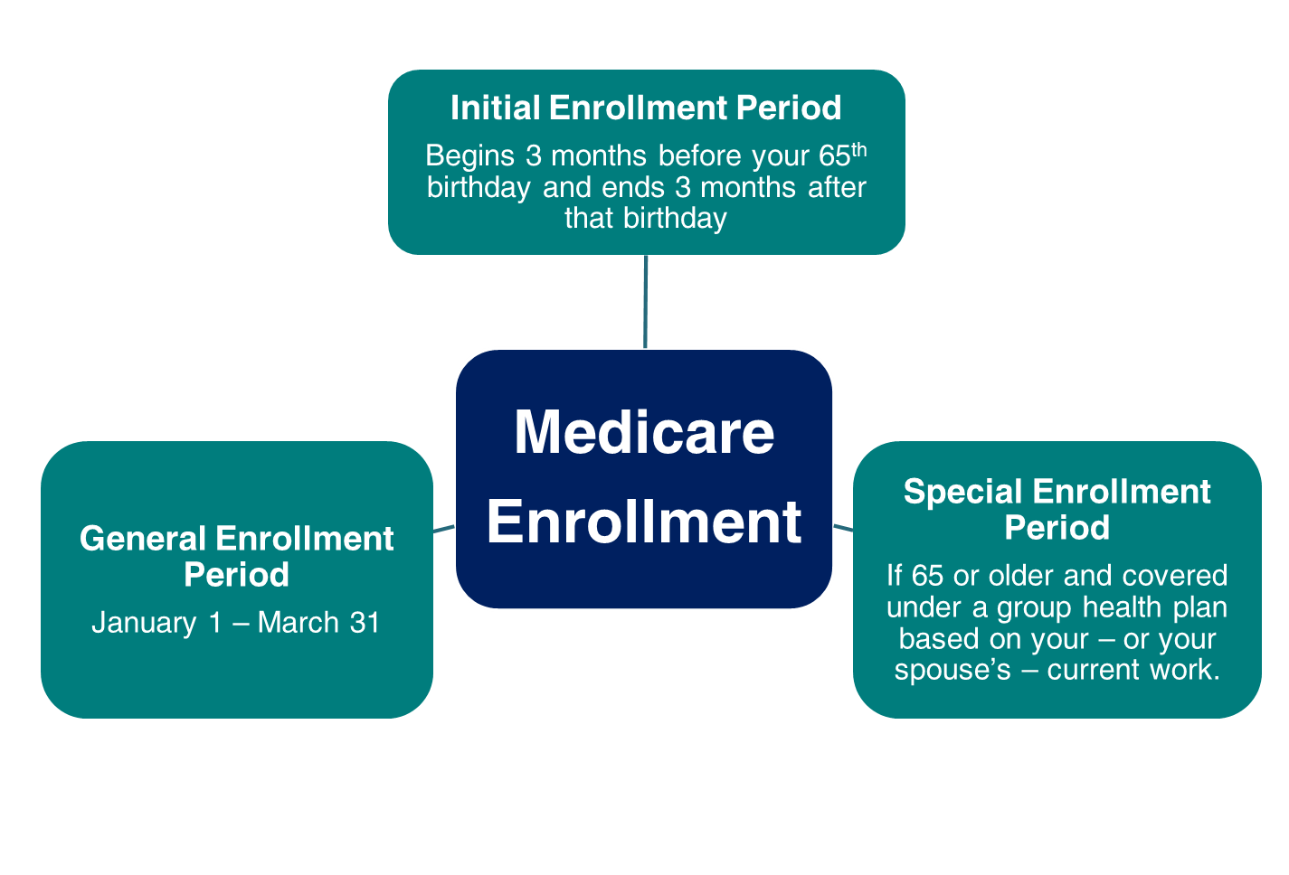
Medicare Enrollment
Notes:
Medicare has three enrollment periods:
Initial Enrollment Period – This is a 7-month period that begins three months before your 65th birthday, includes the month you turn age 65, and ends three months after that birthday.
Special Enrollment Period – If you are age 65 or older, you or your spouse are still working and you are covered under a group health plan based on that current employment, you may not need to apply for Medicare Part B at age 65. You may be eligible for a "Special Enrollment Period" (SEP) that will let you sign up for Part B at the time you retire without a penalty for delayed enrollment.
General Enrollment Period – If you didn't sign up for Part A and/or Part B when you were first eligible, and you aren’t eligible for a Special Enrollment Period, you can sign up during the General Enrollment Period between January 1–March 31 each year. Coverage begins the month after you enroll. You may have to pay a late enrollment penalty for as long as you have Part B coverage.
You can file for Medicare if you are delaying cash benefits.
Health Savings Account (HSA) Information: You should not contribute to an HSA if you are enrolled in Medicare as there may be negative tax implications.
[Note to Speaker: If a person states they missed an enrollment period due to an exceptional condition that prevented them from enrolling, state they can contact SSA to see if they are eligible for a Special Enrollment Period due to Exceptional Conditions.]
Speaker notes updated OISP/OEEMP 10/13/2022 (SY/JP)
Speaker notes updated 12/6/2022 (SY/JP)

Slide 22
Medicare Enrollment Periods
Enrollment Period: | When the period occurs:
Initial Enrollment Period – Your first opportunity to enroll | 3 months before you turn age 65, the month you turn age 65, and 3 months after you turn age 65
General Enrollment Period | Annually, January 1 – March 31
Special Enrollment Period | During any month you remain covered under the group health plan and your, or your spouse's, current employment continues; or In the eight-month period that begins with the month your group health plan coverage or the current employment it is based on ends, whichever comes first.
Notes:
IEP, GEP, and SEP
Updated OISP/OEEMP 1/31/2023 (JP/SY)

Slide 23
Medicare Part B Coverage - IEP
If you enroll during your Initial Enrollment Period: | Your Part B Medicare coverage starts:
One to three months before you turn age 65 | The month you turn age 65
The month you turn age 65, or one to three months after you turn age 65 | The first day of the month after you sign up
Notes:
This chart shows when your Medicare will become effective if you apply during your initial enrollment period.
If you apply during the 3-month window prior to the month you turn age 65, your Medicare is effective on the 1st day of the month you turn age 65.
Slide updated OISP/OEEMP 11/6/2024 (SY)

Slide 24
Medicare Part B Coverage - GEP
If you enroll during the General Enrollment Period: | Your Medicare Part B coverage starts:
January 1 to March 31 (You might pay a late enrollment penalty) | The first day of the month after you sign up
Notes:
If you choose not to sign up for Medicare Part B but then decide to do so later, your coverage could be delayed. You may have to pay a higher monthly premium for as long as you have Part B. Your monthly premium will go up 10% for each 12-month period you were eligible for Part B but didn’t sign up for it.
If you don’t sign up for Medicare Part B during your IEP, you have another chance each year to sign up during the “General Enrollment Period” (GEP) from January 1 through March 31. Your coverage starts the 1st day of the month after you sign up. Read our publication, “Medicare” for more information.
Publication:
Medicare - ssa.gov/pubs/EN-05-10043.pdf
Slide updated OISP/OEEMP 11/6/2024

Slide 25
Medicare Part B Coverage - SEP
If you enroll during your Special Enrollment Period: | Your Medicare Part B coverage starts:
Any time while you or your spouse have a group health plan based on current employment, or during the first full month you are no longer covered or employed | • On the first day of the month you enroll, or • By your choice, on the first day of any of the following 3 months
During any of the remaining 7 months of the SEP | The first day of the month after you sign up.
Notes:
You may have medical insurance coverage under a group health plan based on your or your spouse's current employment. In this case, you may not need to apply for Medicare Part B at age 65. You may be eligible for an "SEP”.
If you apply online for Medicare Part A only – and refuse Part B (which does have a monthly premium) – you can enroll in Part B later anytime you are still covered by your employer’s group health plan or within 8 months after your coverage or employment ends.
Updated OISP/OEEMP 1/31/2023 (JP/SY)

Slide 26
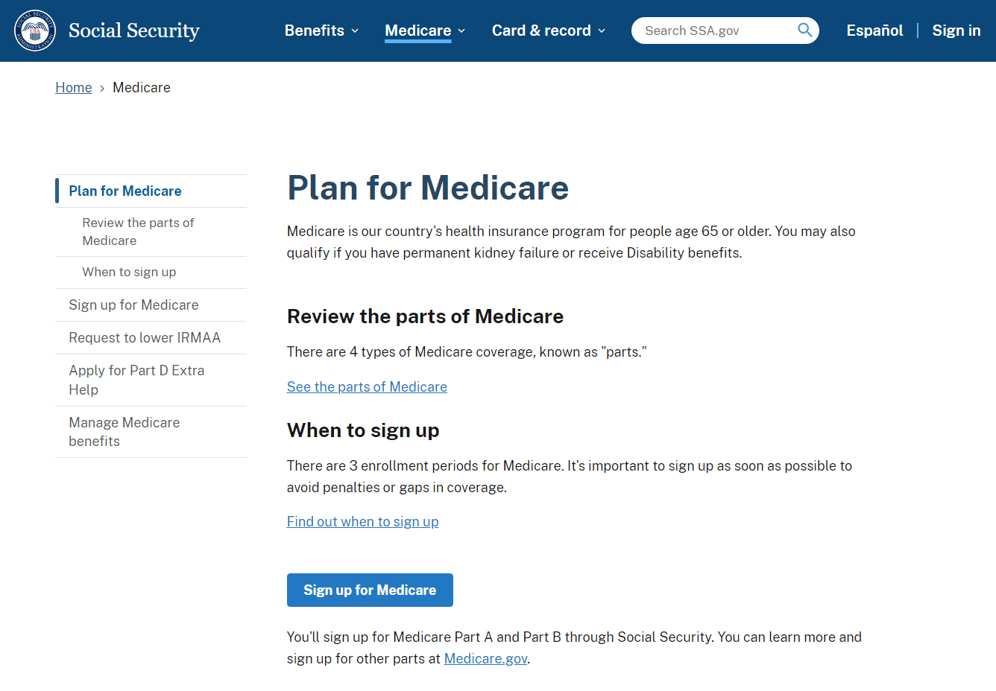
Medicare Applications
If you already have Medicare Part A and wish to add Medicare Part B, complete the online application, or fax or mail completed forms CMS-40B and CMS-L564 to your local Social Security office.
ssa.gov/medicare
Notes:
You can use our website to apply for Medicare Parts A and B along with Social Security retirement benefits. Most people apply for Medicare Part A along with their retirement benefits because you are required to enroll for Medicare Part A at the same time you start retirement benefits. (Medicare Part A has no monthly premium for those who have 40 work credits.) If you apply online for Medicare Part A only – and refuse Part B (which does have a monthly premium) – you can enroll in Part B later anytime you are still covered by your employer’s GHP or within 8 months after your coverage or employment ends, or during the General Enrollment Period (GEP), Jan-March of the current year. Your Part B coverage starts the first day of the month after you sign up.
If you don’t enroll in Medicare Part B during your initial enrollment period, you have another chance each year to sign up during a “general enrollment period” from January 1 through March 31. Your coverage begins the month after you enroll. Read our Medicare publication for more information – ssa.gov/pubs/EN-05-10043.pdf
If you are already enrolled in Medicare Part A and later you want to add Part B under the Special Enrollment Period, you have three options. You can visit ssa.gov/Medicare-PartB-SEP to complete the online application. You can also fax your completed CMS-40B, Application for Enrollment in Medicare – Part B (Medical Insurance) and CMS-L564 (Request for Employment Information), and proofs to your local Social Security office. Refer to “HI 00805.295 Evidence of GHP or LGHP Coverage Based on Current Employment Status” for secondary proofs if the CMS-L564 cannot be provided. Lastly, you can also mail your completed forms to your local Social Security office. The two forms are available on our homepage. Just click on the Forms button at the bottom of the page.
Field Office Locator: secure.ssa.gov/ICON/main.jsp
Slide (screenshot) updated OISP/OEEMP 11/3/2023 (SY)
Note from OISP/OEEMP 11/2024: We are exploring new ways to intake the 40B and L564, however, the online application link is still available for now.

Slide 27
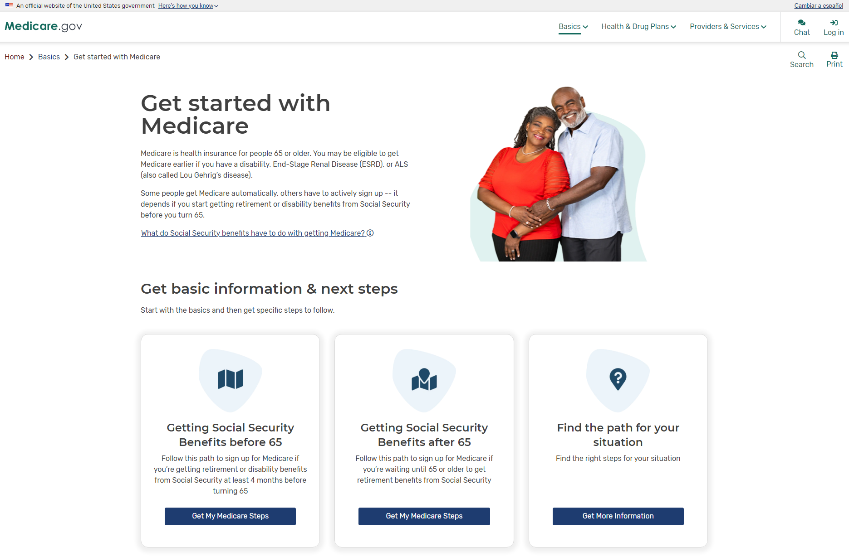
Medicare.gov
Create an account at Medicare.gov
Notes:
Medicare has a free, secure online service for accessing personalized information about your Medicare benefits and services. Create an account at Medicare.gov to get started.
After you create an account, you can fill out the Initial Enrollment Questionnaire (IEQ), view claims information, get quality information about your providers, and more.
For more information or help with the site, please contact the Centers for Medicare & Medicaid Services at 1-800-MEDICARE (1-800-633-4227).
Source(s):
medicare.gov/basics/get-started-with-medicare
Slide updated OISP/OEEMP 11/3/2023 (SY)

Slide 28



How to Apply for Benefits
File online for Retirement, Spouse, Lump Sum Death
Payment, Disability, or Medicare Only
If you have a disability, you can file for Retirement and Disability with same application if you are at least 62 but not yet FRA.
Survivor* application is not available online.
Schedule a phone appointment at 1-800-772-1213, 8 a.m. – 7 p.m. Monday through Friday.
Schedule an in-office appointment at 1-800-772-1213.
*Child and survivor claims can only be done by phone or in the office.
Notes:
You have three options, when it comes time to file:
Apply online at ssa.gov. This is the most convenient way to apply.
Call Social Security to schedule an appointment to apply over the telephone on a day and time that is convenient for you.
Call Social Security to schedule an appointment to apply in-person at your local Social Security office with a face-to-face interview.
You cannot file online for auxiliary child’s benefits, disabled adult child benefits, or survivor’s benefits.
Applying online is still the most convenient way to apply for benefits. You can apply for retirement benefits in as little as 15 minutes.
Slide updated 1/5/2026 AESIP (SY)

Slide 29
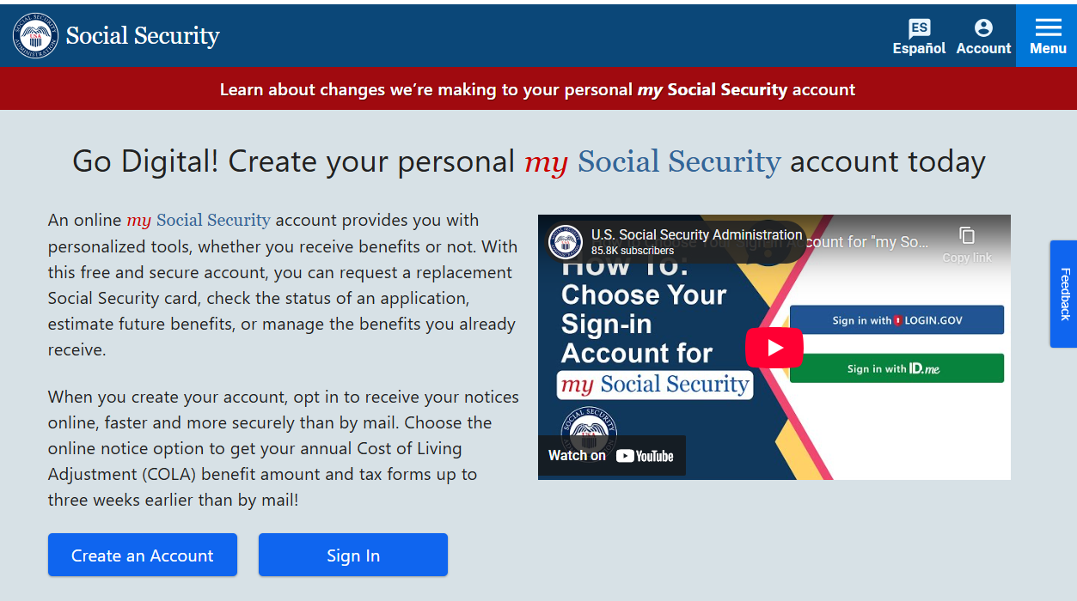
my Social Security
ssa.gov/myaccount
Notes:
my Social Security is a convenient and secure suite of online services designed to put you in control of your personal Social Security information. It also helps you manage your benefits when you start receiving them. Your account gives you the information you need at your convenience - all without calling or visiting a local office.
We’re making changes to the way you access your personal my Social Security account:
If you created a Social Security username before September 18, 2021, you will need to transition to a Login.gov or use an ID.me account to have continuous access to our online services. If you created your personal my Social Security account on or after September 18, 2021, no action is necessary because you already have the right setup. These changes simplify your sign-in experience and align with federal authentication standards. At the same time, we’re continuing to provide safe and secure access to our online services. Be sure to visit ssa.gov/myaccount/account-transition-faqs.html to find answers to Frequently Asked Questions for Transitioning Your Social Security Username to Login.gov.
Sources:
ssa.gov/myaccount
ssa.gov/myaccount/account-transition-faqs.html
YouTube Video: “How To: Transition Your Personal my Social Security Account” https://www.youtube.com/watch?v=ntUtk160MtY
Slide updated 1/5/2026 (SY)

Slide 30
my Social Security Services
If you receive benefits or have Medicare, you can:
  Opt out of mailed notices for those available online
  Request a replacement Social Security card if you meet certain requirements
  Report your wages if you work and receive Social Security Disability Insurance (SSDI) and/or Supplemental Security Income (SSI) benefits
  Get a benefit verification letter as proof that you are getting benefits
  Check your earnings record, benefit, and payment information
  Update your contact information
  Start or change direct deposit of your benefit payment (Social Security beneficiaries only)
  Submit your advance designation of representative payee request*
  Request a replacement Medicare card
  Get a replacement SSA-1099 or SSA-1042S for tax season
  Complete the Medical Continuing Disability Review Report (SSA-454)
  ssa.gov/myaccount/what.html
Notes:
So, what can you do with your my Social Security account? Your online my Social Security account provides a wealth of information to help you and your family plan for your financial future.
*We offer advance designation to capable adults and emancipated minors who are applying for or receiving Social Security benefits, Supplemental Security Income, or Special Veterans Benefits. Please note that having Medicare-only coverage is not eligible for an individual to submit advance designation of representative payee.
Slide updated 3/14/2025 (SY)

Slide 31
my Social Security Services
If you do not receive benefits, you can:
  View retirement benefit estimates at different ages or dates when you want to start receiving benefits
  View possible spouse’s benefits
  Request a replacement Social Security card if you meet certain requirements
  Check the status of your application or appeal
  Get a benefit verification letter as proof that you are not getting benefits
  Get your Social Security Statement to:
    View estimates of your future benefits;
    Verify your earnings; and
    View the estimated Social Security and Medicare taxes you’ve paid
  ssa.gov/myaccount/what.html
Notes:
Slide updated 12/29/2025 (SY)

Slide 32
Disclaimer
This information is current at the time of the presentation, but Social Security policy is subject to change. Please visit SSA.gov for up-to-date information on our programs.
Notes:
Slide added 1/9/2023 (SY/JP)

Slide 33

Q&A Session

