Slide 1

Advancing Policy for Older Mainers
33rd Maine Geriatrics Conference
Elizabeth Hopkins
Director
Office of Aging & Disability Services
Maine Department of Health and Human Services
May 20, 2026

Slide 2
Outline
  1. State & Federal Landscape
  2. Home and Community-Based Supports
  3. Long-Term Care
  4. Workforce Development
  5. Cabinet on Aging
  6. Future Direction

Slide 3

133rd Maine Legislature
  Passed 3 million in one-time discretionary funds toward services offered by the Area Agencies on Aging (AAA’s)
  Passed 3.07% COLA increase for Essential Support Workers -Implementation in January 2027
  Creation of Care Gap Advisory Committee & Report

Slide 4
Federal Landscape
Monitoring all federal funding activities Older Americans Act-funded services
Level–funded with a slight increase in
supportive services this year
Recent federal proposal for 2027
Level funding OAA
Level funding for State Health Insurance (SHIP) and Senior
Medicare Patrol
Slight decreases in Falls Prevention and Alzheimer's Disease

Slide 5

Home & Community-Based Supports

Slide 6

Home and Community-Based Supports: Experience of Care Survey
Across all waivers, Maine’s HCBS CAHPS® pilot (2023-2025) found most favorable items and areas with notable improvement overtime
Survey Item | 2023 | 2024 | 2025
Personal Safety & Respect | 99.40% | 99.80% | 99.70%
Helpful Case Manager | 85.80% | 90.90% | 93%
Community Assistance | 63.60% | 73.50% | 88.90%

Slide 7
Maine’s HCBS CAHPS® Pilot
Section 19 MaineCare Waiver Services Results
Survey Item | 2023 | 2024 | 2025
Personal Safety & Respect | 99.75% | 99.9% | 99.7%
Helpful Case Manager/ Care Coordinator | 85.05% | 88.8% | 91.65%
Community Assistance | 66.45% | 70.75% | 77.05%

Slide 8

Money Follows the Person- Homeward Bound
Provides individualized transition support and services to eligible Medicaid members residing in nursing facilities/hospitals who want to receive services in the community
Available supports may include
Food security
Housing procurement and tenancy supports
Purchase of household goods
Home modifications
199 Transitions to Date

Slide 9
Caregiver Supports: Respite for ME
  Department sponsored LD 709, “An Act to Establish the Respite for ME Program”, to codify lessons learned from the pilot program funded by the Maine Jobs and Recovery Plan in 2024
  Repealed the State Respite Care Program and replaced the state statute to build upon the well-documented success of the Respite for ME pilot by establishing family caregiver services that align with the National Family Caregiver Support Program.
  Signed by Governor Mills and became law late last year.
  In July of 2025 Maine Legislature approved $100,000.00 in additional funds for the program
  Program policies via the rulemaking process to be completed this year

Slide 10
Federal Home and Community-Based Access Rule
Summary
Federal rule finalized in May 2024
This rule includes provisions that apply to Medicaid home and community-based services (HCBS)
Updates current requirements as well as adds new requirements
Grievance Management
Quality Measures
Incident Management
CMS Access Rule: Ensuring Access to Medicaid HCBS Services Components
Beneficiary Engagement
Person-Centered
Planning
Rule Goals
Increase access to HCBS services
Improve quality of HCBS services
Provide opportunities for members to have their voices heard
Increase data and information sharing
HCBS Payment Adequacy
Website Transparency
Timeliness of Access

Slide 11

Quality Improvement Coalition (QIC)
  In 2026, OADS will be creating a group that helps improve the quality of services and supports in Maine:
    The QIC will be comprised of members, families, providers, and other members of the community
    A core QIC responsibility will include regular review of OADS quality assurance data, such as metrics found in the Centers for Medicaid and Medicare Services Quality Measure Set

Slide 12
Assisted Housing & Personal Care Rules
Updated Assisted Housing rule (10-144 C.M.R. Ch 113) was effective September 18, 2025.
Changes to the updated rule include requirement that facilities report staffing data to Division of Licensing & Certification (DLC) on a quarterly basis, for analysis and use in determining adequacy of staffing ratios.
Assisted Housing Program at DLC is also licensing Personal Care Agencies under a rule (10-144 C.M.R. Ch 129), which was effective 8/20/2024. Since 2023, there has been an almost 95% increase in the number of PCAs in Maine.
A separate rule for small HCBS settings supporting adults with intellectual/developmental disabilities was also adopted, effective December 3, 2025. This rule removes the HCBS settings from the assisted housing rule.

Slide 13
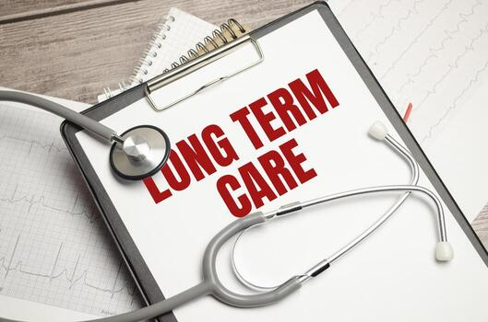

Slide 14
Nursing Home Rate Reform 2025
New rates implemented Jan 2025 with a gradual 3-year transition
Incentives to reduce use of temporary agency staffing
New rates allow for higher staffing levels
Value-based purchasing (VBP) component to reward quality
Technical assistance to support nursing homes in their quality improvement efforts

Slide 15

Value-Based Purchasing
& QuEST Technical Assistance
Staffing Levels
  Percent nursing staff turnover
Resident Experience of Care
  Resident & family CoreQ surveys
Clinical Measure
  Long-stay antipsychotic use

Slide 16

2025 Outcomes:
Rate Reform, VBP, & QuEST
75 of 77 earned their VBP payments
Average 140-150 participants per call
Participation and engagement levels remained high, even beyond the payment incentive
Reduction in contract staffing levels in Maine
Stabilization of nursing homes across the state
Garnered national excitement – FREE expert presenters
QuEST endorsed by the Nursing Home Administrators' Licensing Board

Slide 17

A Year of Firsts & Lessons Learned
Quality activities tied to payment​
Collaboration across DHHS, MHCA, & LTCOP​
Coordinated quality goals and technical assistance efforts​
Delivered performance data​
Visibility between providers and the Department​
Fostered peer-to-peer learning and connections​
Offered a COVID "reset"​ & opportunities to learn from the past
State Culture Change Coalition reboot
Leaders are engaged!

Slide 18

Workforce Strategies

Slide 19
Workforce Initiatives Strategies:
Nurse Delegation
What Changed
The Board of Nursing adopted the final nurse delegation rule, as authorized by recent legislation
Clarifies roles for unlicensed assistive personnel (UAPs)
Establishes a framework for safe, effective delegation of certain nursing tasks
What this Does
Allows trained direct care workers to perform routine, stable health-related tasks under the supervision of a professional nurse
Expands access to care in shared living, IDD services, and aging services
Supports care delivery in rural and home-based settings

Slide 20
Workforce Initiatives Strategies:
Nurse Delegation Cont.
Why it Matters for Workforce
Extends nursing capacity across multiple settings
Reduces delays in care delivery
Strengthens the direct care workforce through skill-building and role clarity
Supports nurses practicing at the top of their license

Slide 21
Direct Service Worker (DSW)
Core Curriculum
DHHS created a baseline, portable credential for PSS and DSPs titled the Direct Service Worker (DSW) curriculum.
Current:
Future state:
PSS Training
DSW Course
Current:
Future state:
DSP Training
DSW Course
DSP Add-on
Notes:
(

Slide 22
Direct Service Worker (DSW)
Core Curriculum
DSW Course Overview
Hybrid model: 12 hours online and up to 8 hours hands-on
Interactive, narrated and translated, including ASL
Designed for accessibility and streamlining entry to the workforce
DSW Pilot
9 private pay provider agencies participated
Over 170 learners have completed the DSW credential
Agencies approved to train new staff
Over 100 new learners currently enrolled
Next Steps
Statewide rollout requires MaineCare rule changes

Slide 23
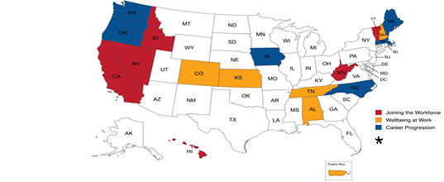

Workforce Initiative Strategies:
Advancing Career Pathways
Maine’s focus area is Career Progression
Builds on Direct Service Worker (DSW) Core curriculum and Direct Support Professional (DSP) add-on credentials
Developing micro-credential model to complement stackable pathway
Key Insights
Lessons from state implementation
Emphasis on scalable, sustainable strategies
Opportunities Ahead
Expand specialty training (i.e. dementia care)
Strengthen career pathways and workforce stability
Align with broader workforce priorities

Slide 24

Direct Care and Support Media Campaign
https://mainecareerswithpurpose.org/
The Careers with Purpose marketing campaign continued in 2025 to recruit and retain direct service workers in aging, intellectual disability, brain injury, physical disability and behavioral health. This campaign created ads to raise awareness and elevate the professional for HCBS job opportunities across the state.
‘Day in the Life’ videos were created as a part of the Careers with Purpose marketing campaign to spotlight direct service workers’ roles and are being utilized as recruitment tools.
Day in the Life CNA
Day in the Life PSS
Day in the Life DSP

Slide 25


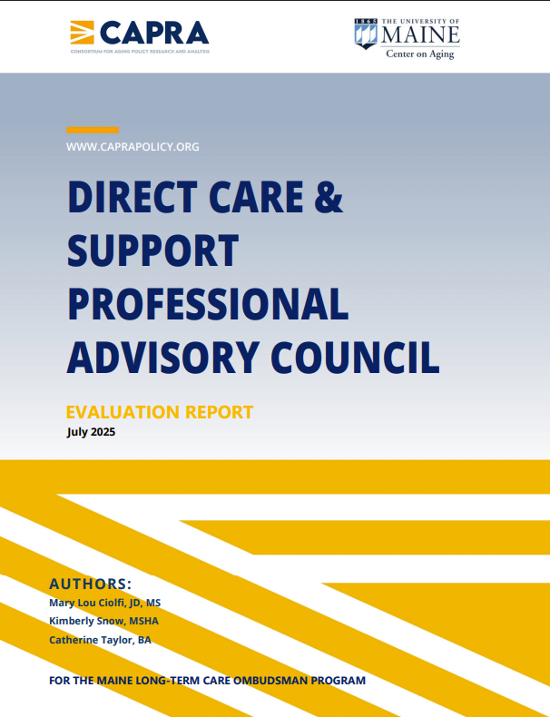
Maine’s First Direct Care and Support Professional Advisory Council
Direct Care and Support Professional Advisory Council
Established in 2022 to elevate direct care worker voices
Strengthens connections with policymakers and builds leadership capacity
Fosters peer exchange and shared learning across the workforce
Provides expertise and guidance on workforce policy and initiatives
Hosted second annual conference in 2025 with increased attendance
Engaged in advocacy through legislative testimony and media (op-eds)
2025 evaluation report highlights impact and ongoing opportunities
Evaluation report 2025

Slide 26
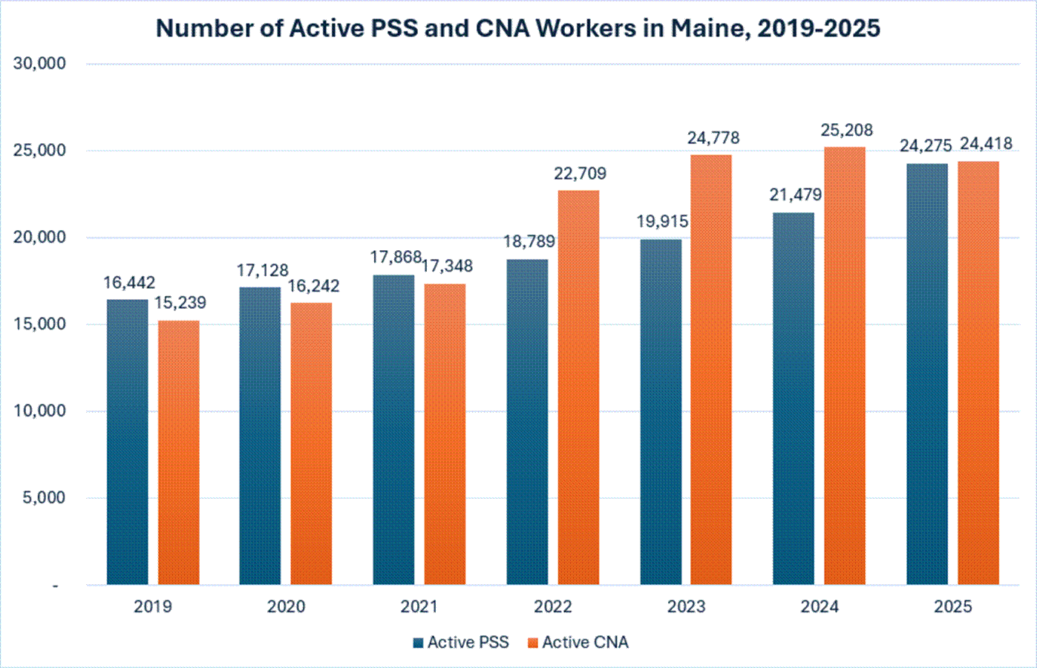
Personal Support and Certified Nursing Assistant Growth

Slide 27

Governor’s Cabinet on Aging
Established by Governor Mills by Executive Order in June 2022.
Supports Maine people in aging safely, affordably, and in ways and settings that best service individual needs.
Recognizes that Maine has an opportunity to lead on all issues aging.

Slide 28

Cabinet Membership
  The Commissioner of Health and Human Services *
  The Commissioner of Labor *
  The Commissioner of Public Safety
  The Commissioner of Transportation
  The Director of the Maine State Housing Authority
  The Commissioner of Administrative and Financial Services
  The Commissioner of Economic and Community Development
  The Commissioner of Professional and Financial Regulation
*Cabinet Co-Chairs
Notes:
.

Slide 29

Cabinet’s Role
Elevate the voices of older adults and opportunities for inclusion and engagement.
Promote communication and coordination across state agencies and community partners.
Incorporate an “aging lens” across state policies, programming, and planning (needs and opportunities)

Slide 30
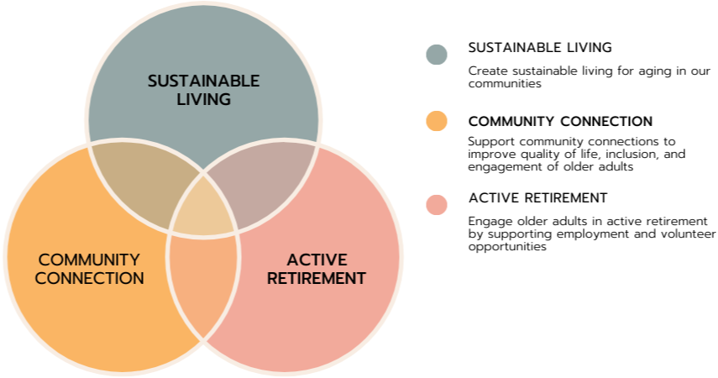
Cabinet Focus Areas

Slide 31
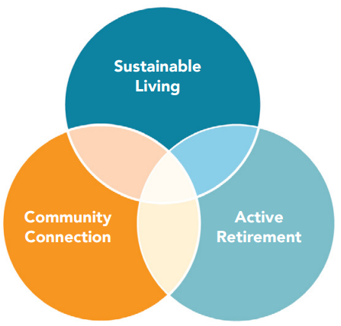
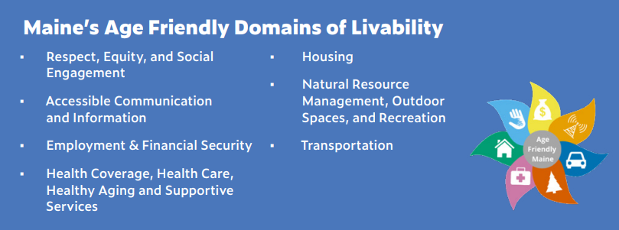
Builds on Maine as an Age-Friendly State

Slide 32

Annual Report:
For More Information
on Cabinet Activities
https://www.maine.gov/future/aging

Slide 33
Maine Adult Protective Services (APS) Report Trends & Outreach Impact (FY25)
APS Reports Continue to Increase
17,493 reports made to Maine APS Central Intake in FY25
Financial Exploitation Awareness Efforts Show Results
Reports from Broker-Dealers/Investment Advisors increased 200% from FY22–FY25
Maine$afe / Senior$afe Training Expansion
Addresses confidentiality and reporting concerns
Represents a 23% increase since FY22
Approximately 2 out of 3 reports came from mandated reporters
Most reports were made by phone
Increase likely reflects expanded outreach and awareness campaigns
Introduces local resources for responding to financial exploitation
Connects staff with local agencies and service providers

Slide 34
Key Findings from the APS 2026 Report
Who is Reporting?
Registered/Licensed Practical Nurses and Social Workers were the top mandated reporter professions
Most Common Vulnerability Factors (FY22–FY25)
Diminished physical functioning
Cognitive impairment/capacity concerns
Significant medical disorders
Most Common Allegations
Self-neglect: 34%
Caregiver neglect: 25%
Together account for 59% of all allegations
APS Client Demographics
Two-thirds of APS clients were age 60+
84% of clients did not receive Developmental Services

Slide 35
Future Direction
  Increase quality oversight across services
  Increase Access in Rural Communities with the use of Rural Health Transformation funds (RHTP)
  Create Technology Advisory Council
  Continue to support the work of Maine’s Cabinet on Aging

Slide 36


