Slide 1

33rd Annual Maine Geriatrics Conference:
Where Policy Meets Practice
Age-Friendly Everything: Building Connections Across the
Age-Friendly Ecosystem
May 19, 2026
Rani E. Snyder, MPA
President
The John A. Hartford Foundation

Slide 2

Who We Are
A private philanthropy based in New York City, established by family owners of the A&P grocery chain in 1929

Slide 3

Our Mission
Dedicated to improving the care of older adults.
Age-Friendly Health Systems
Priority Areas
Family Caregiving​
Serious Illness and End of Life

Slide 4
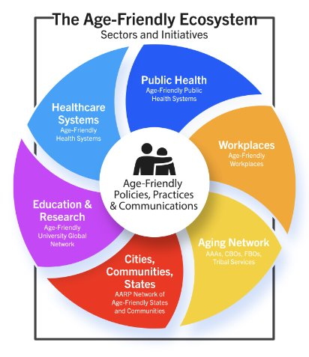
The Context: We All Need an Age-Friendly Society
Longevity is greatest success story of last century
As we age, we can make vital contributions and power up communities – with support
A just society requires us to make all sectors age-friendly

Slide 5
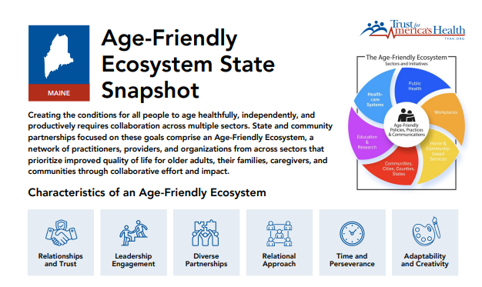

How Age-Friendly is Your State?
afaphs.org/age-friendly-ecosystem

Slide 6

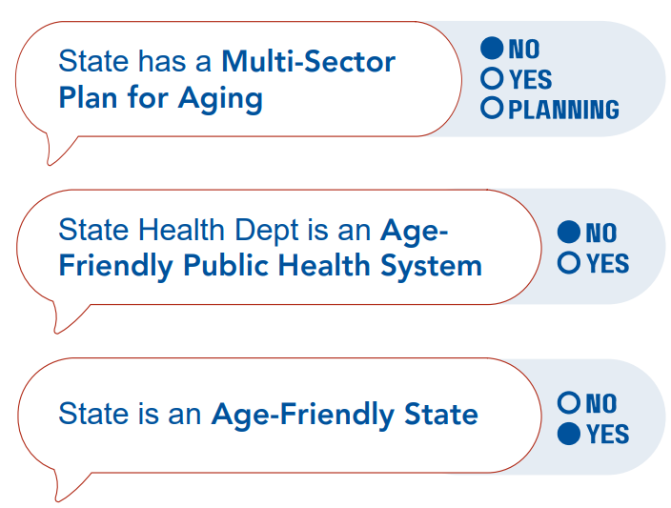
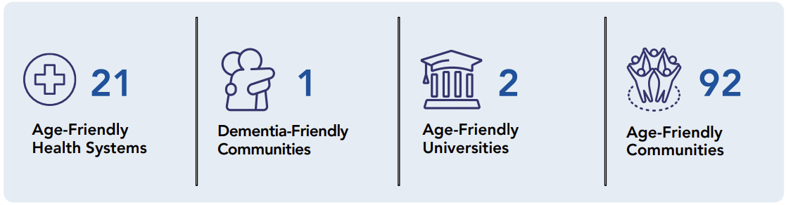
Maine: Age-Friendly Snapshot
afphs.org/ecosystem-maine

Slide 7

Ready or Not: An Age-Friendly State is Also Prepared for Emergencies
TFAH report: recommendations for emergencies
Older adults should be front and center
Maine example: working with LTC, practices and pharmacies to ensure vaccine access
Focus on: preparedness planning, policy advocacy and specific risks

Slide 8


Leadership Exchange on Ageism
MCOA and National Center to Reframe Aging launched Leadership Exchange on Ageism for health care leaders
Intensive, peer-learning leadership experience
Designed for executives in business, policy, research and community settings
Transforming how we understand and address ageism
400+ leaders have completed general program

Slide 9

Sandra: “I still have a lot to say”
Public Policy Lab and The SCAN Foundation. (2024). “Sandra” #19, The People Say, accessed April 20, 2026.

Slide 10

v
Age-Friendly Health Systems

Slide 11
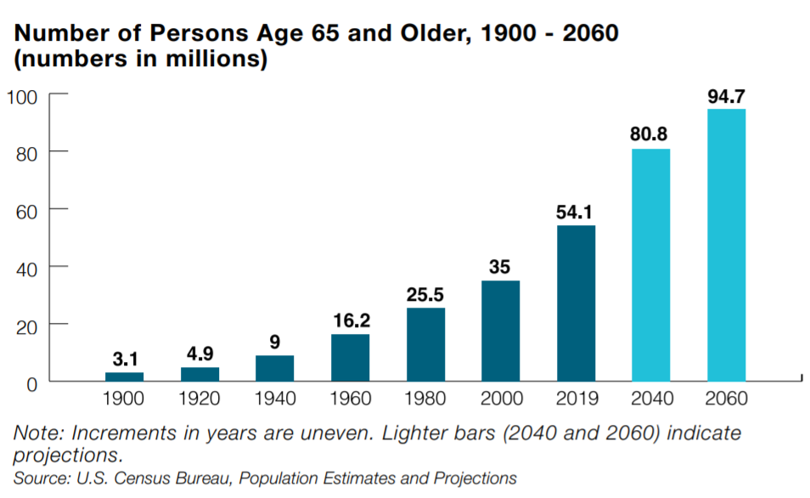
Why Age-Friendly Health Care
Demography: # of older adults rapidly growing, more diverse
Complexity: multiple chronic conditions, dementia, disability, isolation, social drivers of health
Disproportionate Harm: higher
rates of health care-related harm, discoordination, poor preparation for disasters

Slide 12
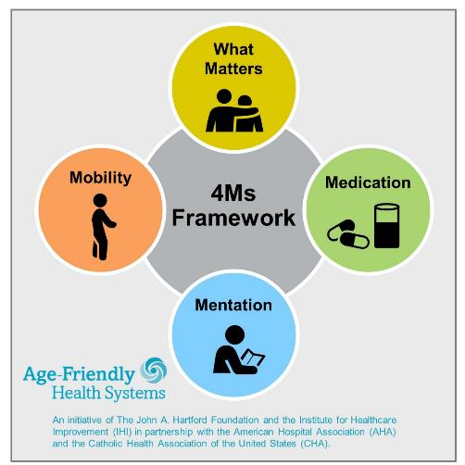
Age-Friendly Health Systems: Aim
Build a movement so all care with older adults is equitable and age-friendly:
Guided by an essential set of evidence-based practices (4Ms)
Causes no harm
Is consistent with What Matters to the older adult and their family
www.ihi.org/agefriendly
Fulmer, T., Mate, K. S., & Berman, A. (2018). The age‐friendly health system imperative. Journal of the American Geriatrics Society, 66(1), 22-24.

Slide 13
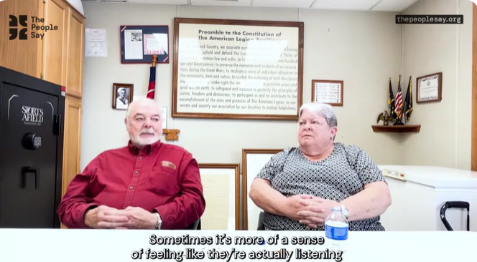
Jodie: “They’re going to not only listen but care.”
Public Policy Lab and The SCAN Foundation. (2024). “Jodie” #04, The People Say, accessed April 20, 2026.

Slide 14
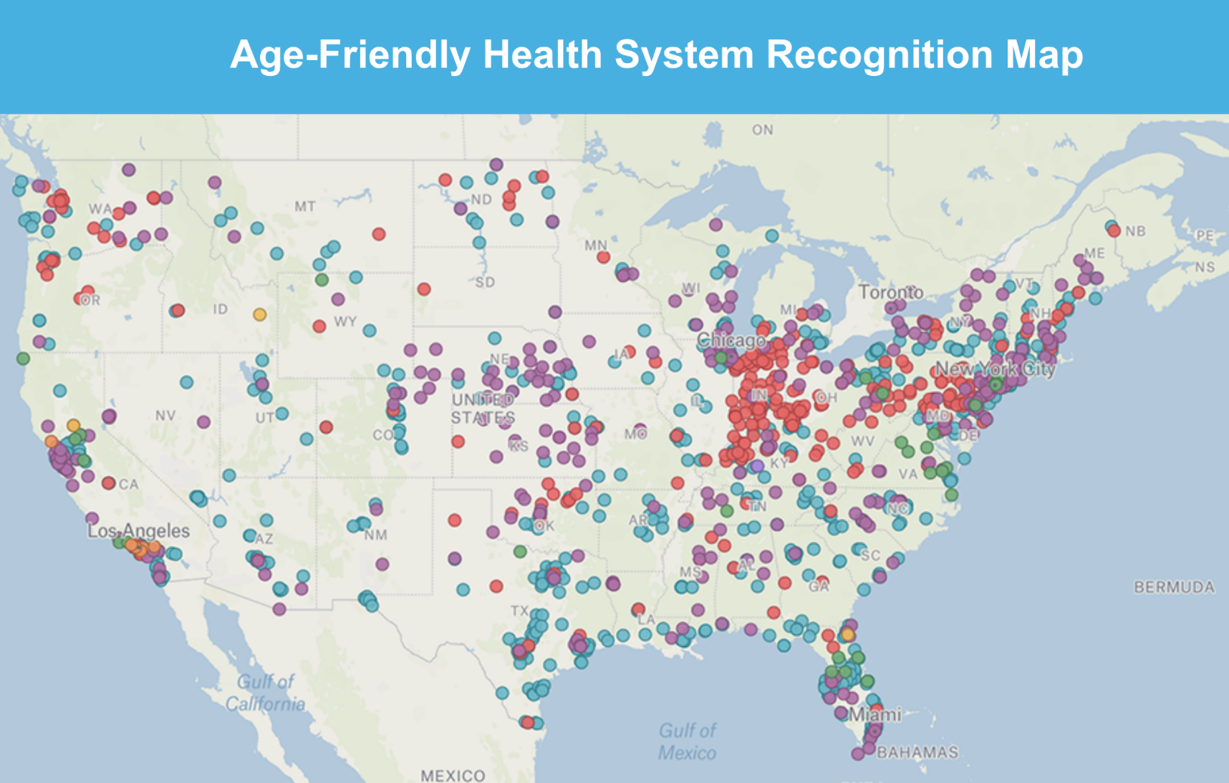

A Growing Movement!
5900+ hospitals, practices, convenient care clinics and nursing homes
(and growing globally)
As of April 2026
www.ihi.org/Engage/Initiatives/Age-Friendly-Health-Systems/Pages/Background.aspx

Slide 15

Global Reach of Age-Friendly Health Systems
Learners from 60 countries have taken IHI’s Age-Friendly Health Systems Open School course
Countries with recognized participants:
Australia
Brazil
Canada
Ireland
Lebanon
Portugal
Qatar
Saudi Arabia
South Korea
United Arab Emirates
United States
Japan
Trinidad & Tobago

Slide 16
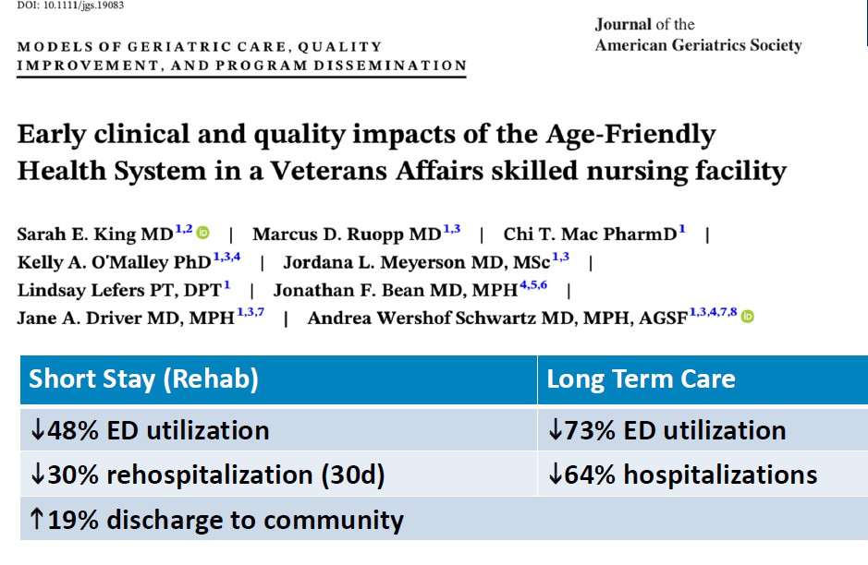


Outcomes: VA Boston SNF
Due June 1

Slide 17
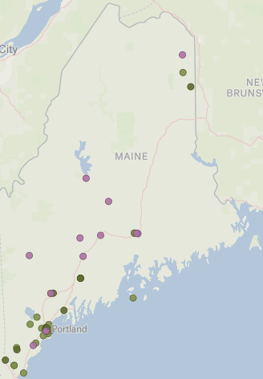

AFHS in Maine
46 AFHS sites in Maine
  27 are Level 2 “Committed to Care Excellence”
  5 VA facilities are AFHS
  Go Maine!!
bit.ly/AFHS_InteractiveMap

Slide 18
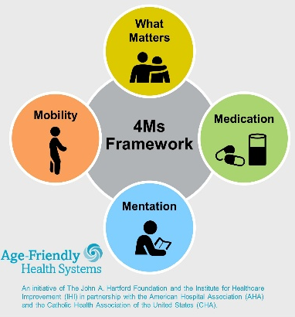

Integrating the Age-Friendly Health Systems Movement into Macro Environment
4Ms in Payment, Regulations and Measures
Workforce Educated to Deliver 4Ms
Alignment with Evidence-Based Programs Delivering 4Ms
Aim: 4Ms Framework becomes standard of care across health care system,
demanded by older adults and family caregivers
Alignment with Accreditation and other Recognitions Centered on 4Ms
Older Adults and Family Caregivers Demand 4Ms
4Ms Hard-Wired in EHR Functionality and Workflows

Slide 19

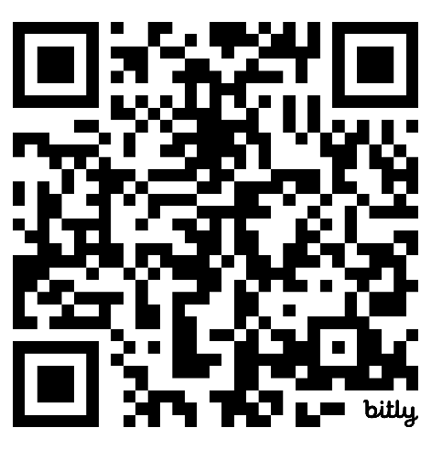
CMS Age Friendly Hospital Measure – Built on the 4Ms of Age-Friendly Care
FY2025 Hospital Inpatient Quality Reporting Program
Participating hospitals required to report on:
  Eliciting Patient Healthcare Goals (what Matters)
  Managing Medication
  Implementing Frailty Screening (Mentation & Mobility)
  Assessing Patient Vulnerability
  Designating Age-Friendly Care Leaders
Data will be public on Medicare Care Compare
Age-Friendly Health Systems and related initiatives help hospitals meet measure
bit.ly/CMS_AFMeasure

Slide 20

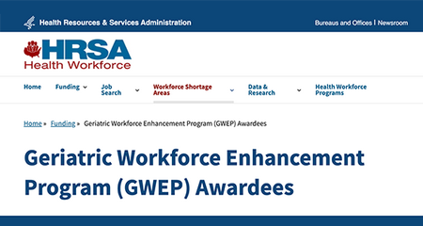
AFHS Embedded in Workforce Policy
Geriatrics Workforce Enhancement Program & Coordinating Center
Strengthens workforce by using AFHS principles
4Ms as program requirement
American Geriatrics Society partners with IHI on national learning
americangeriatrics.org/programs/gwep-coordinating-center

Slide 21

GWEP in Maine: AgingME
AgingME GWEP
Creating a more age-capable workforce in healthcare and LTSS
Partnering with academic institutions, health care organizations and CBOs
sites.une.edu/gwep

Slide 22

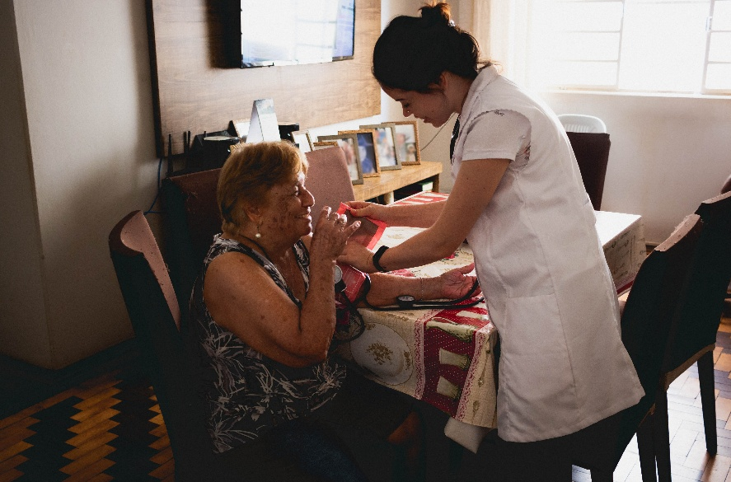
Payment Policy Critical to Advancing Age-Friendly Models
Hospital at Home
Acute hospital-level care at home
Safe, proven age-friendly model
CMS waiver 2020 – allowed payment equal to inpatient admissions
37 states, >300 sites, > 12k patients
hahusersgroup.org

Slide 23
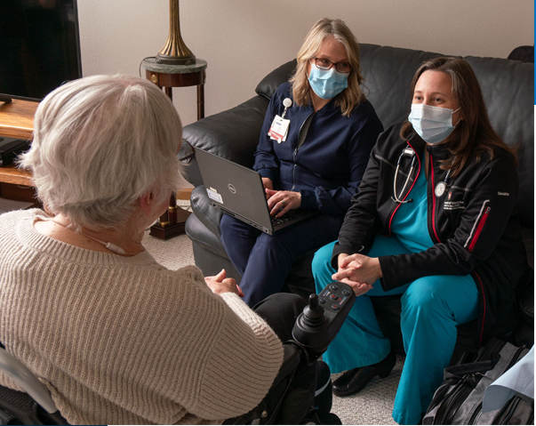
Advancing Hospital at Home
Waiver ended March 2025
New 5-year extension passed Dec 2025
JAHF funds HaH Users Group
  advocating for permanent payment
  sharing best practices
  researching and creating tools to support family caregivers
hahusersgroup.org

Slide 24
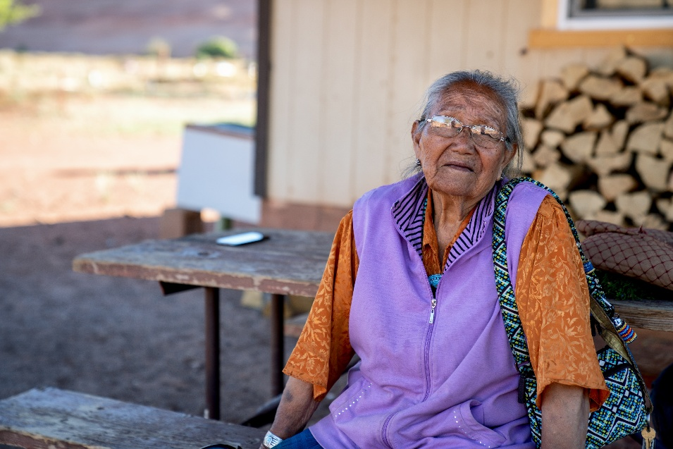
Leveraging New Policy Opportunities: Rural Health Transformation Program
Part of HR1, $50b to states over 5 years
Not meant to backfill federal funding changes, but to make forward-looking investments
National Rural Health Association developed recommendations to integrate age-friendly care

Slide 25
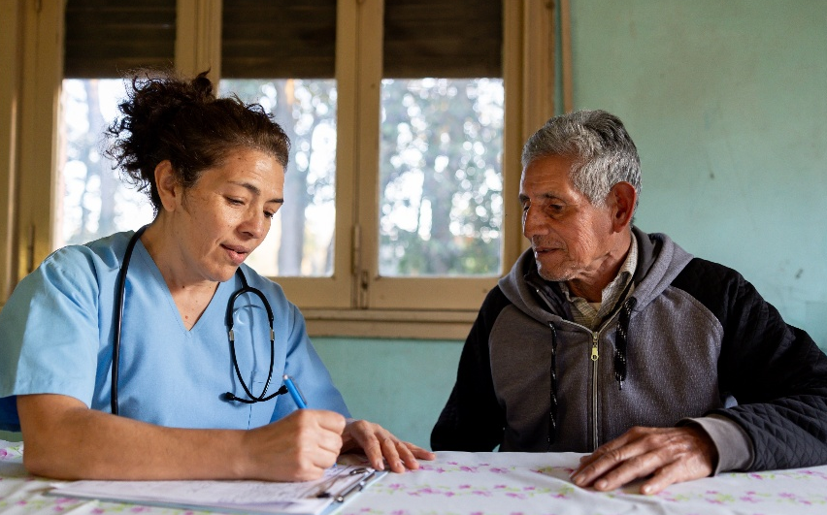
RHTP: Opportunities in Maine
Maine Awarded $190 Million in first year
Opportunities for Age-Friendly Care
  Expand CHW programs in rural Maine with age-friendly framework
  Integrate falls prevention, chronic care management, home-based interventions in remote monitoring
  Invest in broadband and digital literacy for older adults

Slide 26
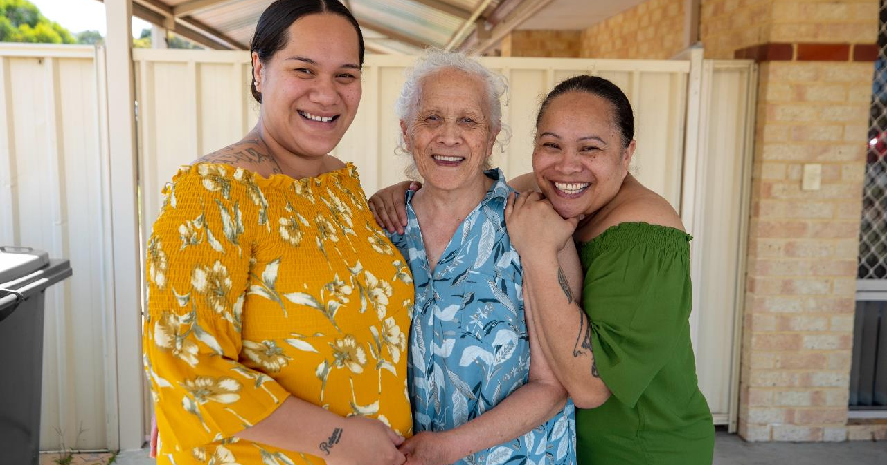
v
Family Caregiving

Slide 27


NASHP – RAISE Act & National Strategy to Support Family Caregivers
National Academy for State Health Policy
Advances National Strategy implementation
Partnership with JAHF/ACL/NASHP
Supports NASHP to engage states and partners, integrate caregiver lived experience and drive policy action nationwide
Leads national dissemination and communications
nashp.org/policy/aging-and-disabilities/family-caregiving

Slide 28

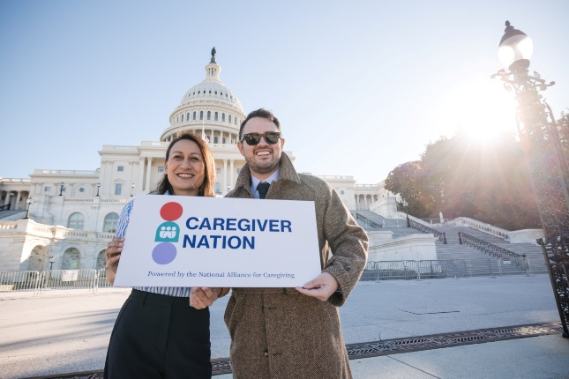
National Alliance for Caregiving: Caregiver Nation Coalition
Advancing the National Strategy to Support Family Caregivers
JAHF Grant Supports:
Expanding Medicare-funded caregiver training
Increasing funding for LTC
Improving financial supports
Engaging broad-based coalition to educate policymakers
Prioritizing caregivers with greatest need
caregivernationcoalition.org

Slide 29


CMS GUIDE Model – Payment Policy to Support Comprehensive Dementia Care
5 key aims for Medicare FFS model:
  Comprehensive care
  Monthly per-beneficiary payment
  Address unpaid caregiver needs
  Respite services ($2,500 / beneficiary / year)
  Screen for social needs

Slide 30

Supporting Successful GUIDE Policy Implementation
JAHF funds the National Dementia Care Collaborative
6 GUIDE-ready models
Sharing best practices with other sites
ndcc.edc.org/

Slide 31
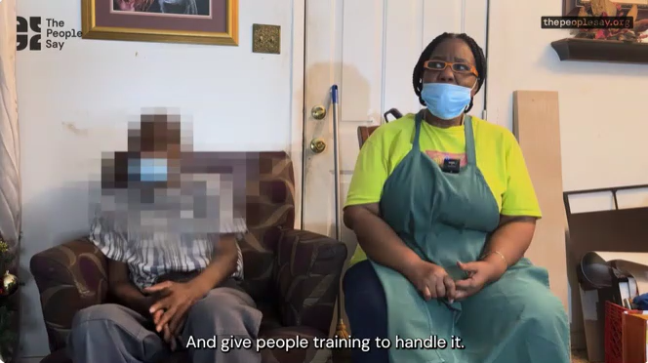
Sherrie: “People need training”
Public Policy Lab and The SCAN Foundation. (2024). “Sherrie” #07, The People Say, accessed April 20, 2026.

Slide 32

v
Serious Illness and
End of Life Care

Slide 33


Building State Policies to Improve Care for People with Serious Illness
National Academy for State Health Policy
Advances legislation & payment strategies
Developed tools, e.g., Palliative Care Cost Calculator, to help states design sustainable Medicaid palliative care benefits

Slide 34


NASHP's State Policy Institute
6 states participating
TA and peer learning
Supports sustainable, state-specific approaches to improving care
Maine is making progress!
Serious Illness Messaging Toolkit can help
nashp.org/policy/aging-and-disabilities/palliative-care
seriousillnessmessaging.org

Slide 35


Stay Connected & Use Our Resources
Visit johnahartford.org for the latest policy and practice news, tools and training
Scan to subscribe
Stay up to date on:
Age-friendly health systems/public health
Family caregiving
Serious illness & end-of-life care

Slide 36

v
Thank You!
Rani.Snyder@johnahartford.org
WWW.JOHNAHARTFORD.ORG

