Slide 1


Hosted by the Maine Council on Aging ● Funded by the Point32Health Foundation
Age-Positivity in Health and Healthcare: A Prevention Approach
Kimberly Snow, MHSA
Catherine Cutler Institute
University of Southern Maine
Rebecca Spear, DO, FACP
Maine-Dartmouth Family Medicine Residency
These slides include © copyrighted material. Please ask permission to reproduce. Permission is readily given.

Slide 2
Disclosures
I, Rebecca Spear, do NOT have any relevant financial disclosures
I, Kimberly Snow, do NOT have any relevant financial disclosures
NOTE: We both support the extraordinary work of the MCOA and the Power in Aging Project. Power in Aging is supported by the Point32Health Foundation. We do not work for the MCOA.

Slide 3
Learning Objectives
Describe at least three negative health impacts of ageism
Explain how health messaging can shift to be more health affirming
Identify at least one prevention strategy they will implement to support the creation of a more age-positive society

Slide 4
Who is in the room today?
GEMS
Healthcare
Aging Services
Policy and Community Planning
Research
Interested Individuals

Slide 5
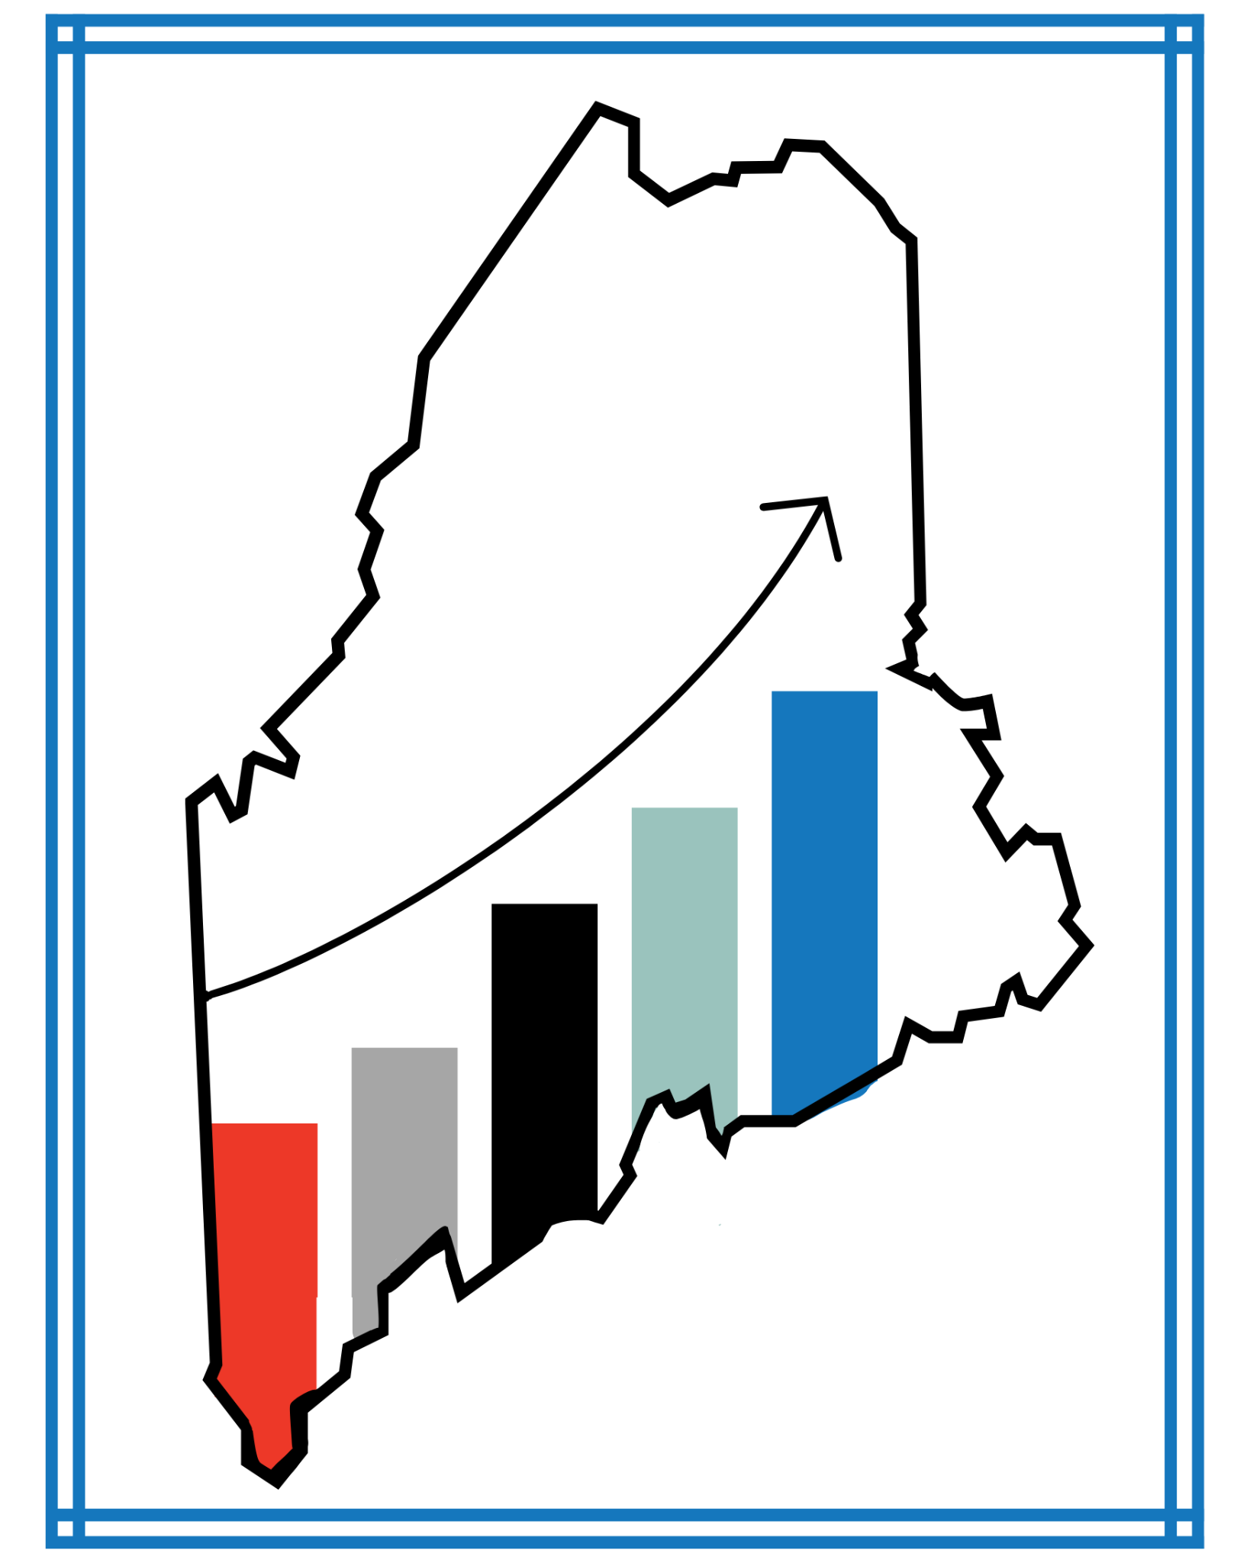
Maine is on the leading edge of a permanent demographic shift with big implications.

Slide 6
Demographics
Maine's median age is 45
US median age is 39, and 18% are 65+
American Community Survey 2024 1-Year data retrieved from Census Reporter.

Slide 7
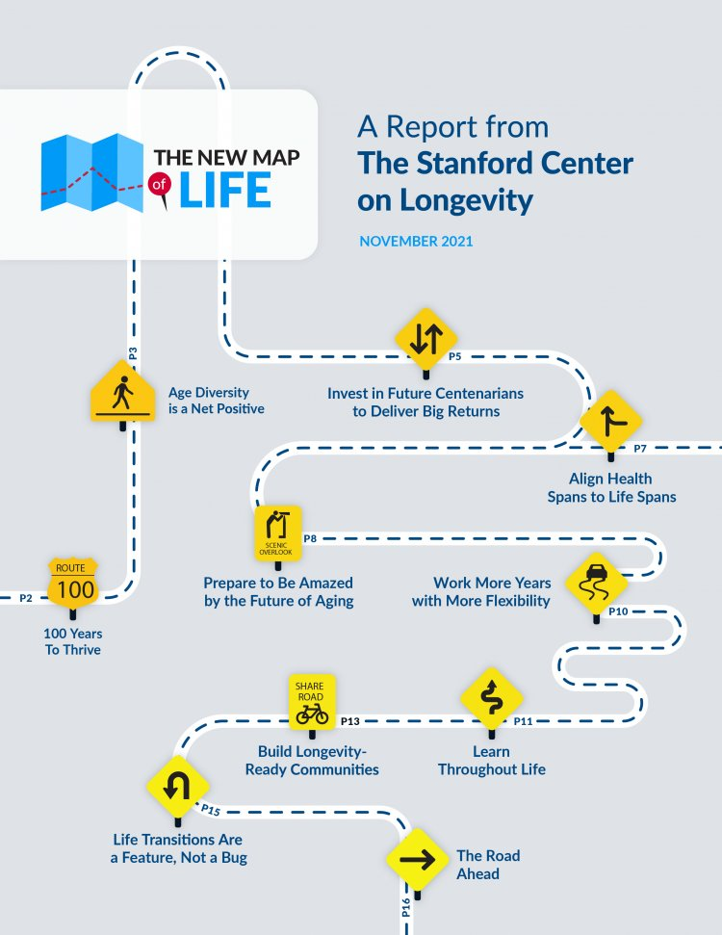
The New Map of Life
Aligning health span with life span

Slide 8
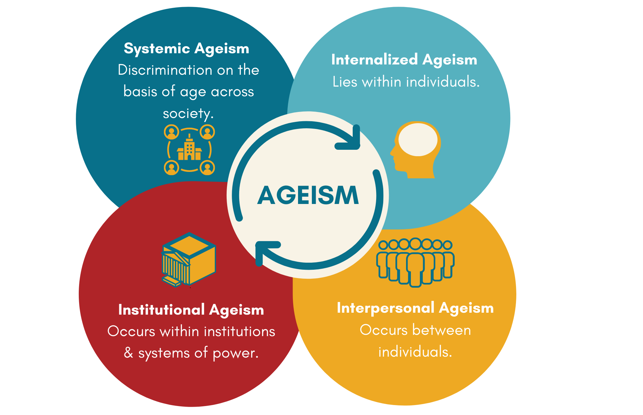
Ageism Reinforces Itself

Slide 9
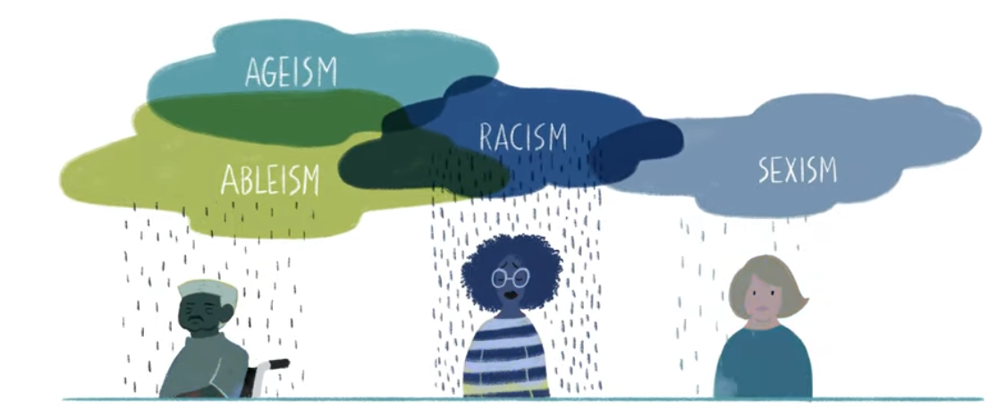
Intersectionality
Disparities from other systems of discrimination (race, gender, rurality, class, sexual orientation, ability, etc.) can be amplified by ageism

Slide 10

Impacts of Ageism on Health
drives poorer health outcomes for older adults
increases costs of healthcare
Image: Licensed from Adobe Stock

Slide 11

Treating Aging as a Disease
Undertreatment
Overtreatment
Systemic Issues
Poor Communication

Slide 12
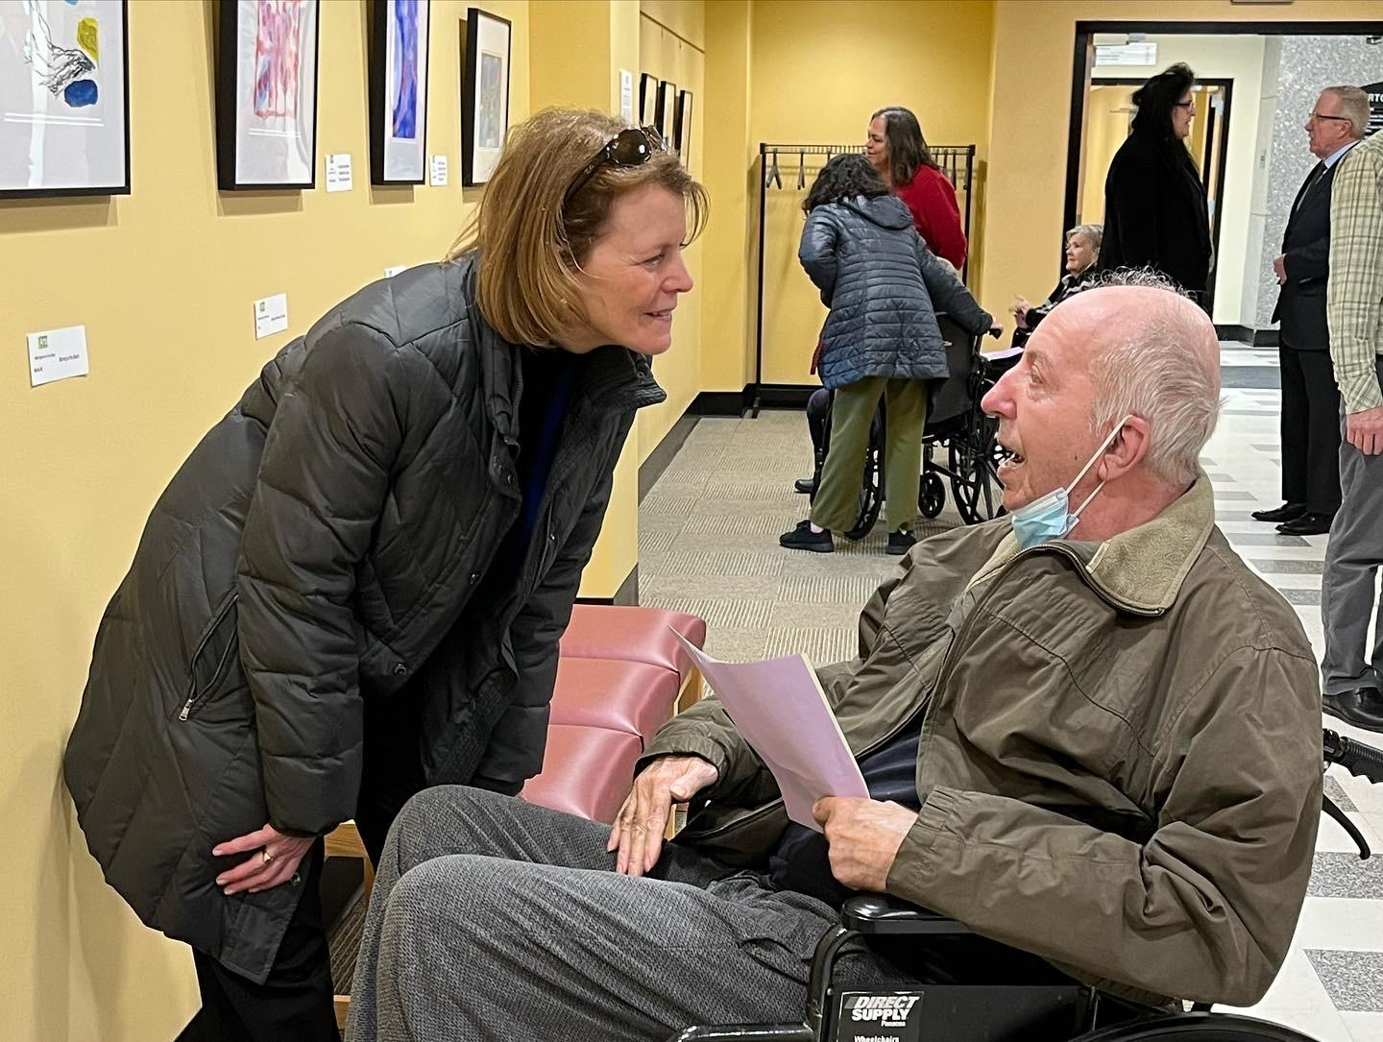
Elderspeak
Speaking to an adult as if they were a young child
Automatically speaking slowly & loudly
High-pitched voice
Terms of endearment: “honey” “dear” “sweetie”
Using the plural (i.e. “we” instead of “you”)
Speaking to the caregiver instead of the older person

Slide 13

Elderspeak
Why it’s a Problem
Implies incompetence
Shifts control and power
In dementia care:
  Increases resistiveness to care! (Williams et al, 2009)
  Improved with educational intervention (Williams et al, 2016)
Reducing Elderspeak
Awareness and actively work to avoid elderspeak
Focus on the older person as much as possible, even if they have limited capacity

Slide 14
Pair Share – Join a Quick Conversation
Reflect on an example of ageism you have experienced OR seen in a health care setting
With your partner, name the forms of ageism that are present

Slide 15
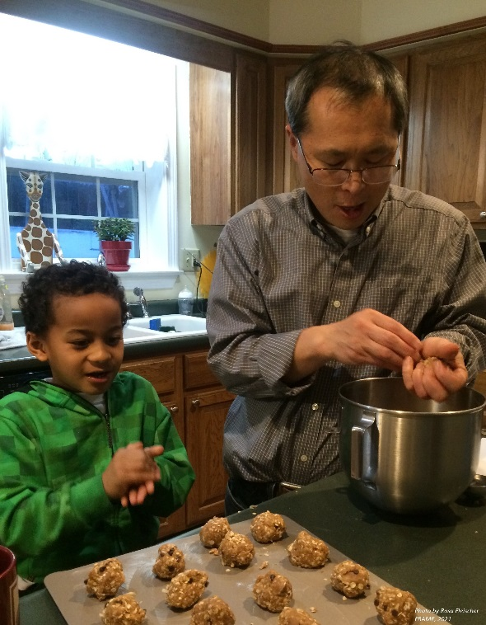

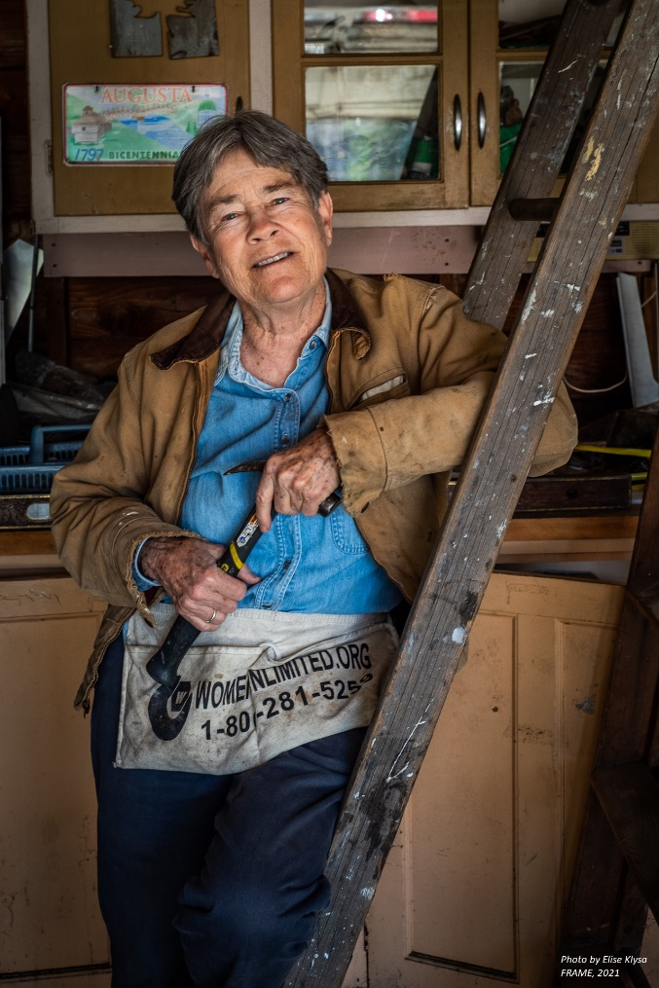
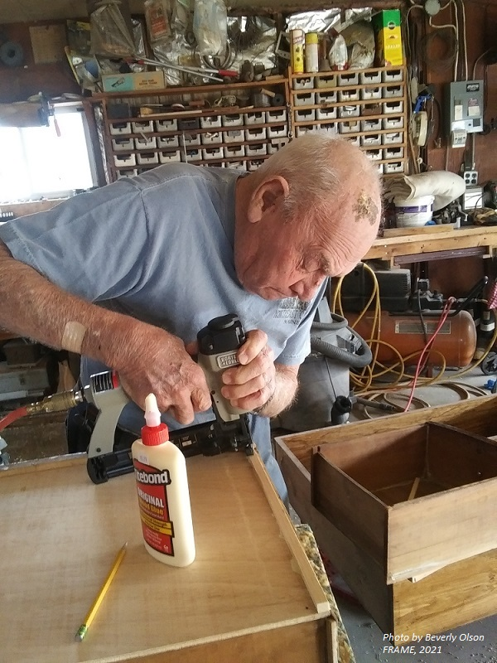
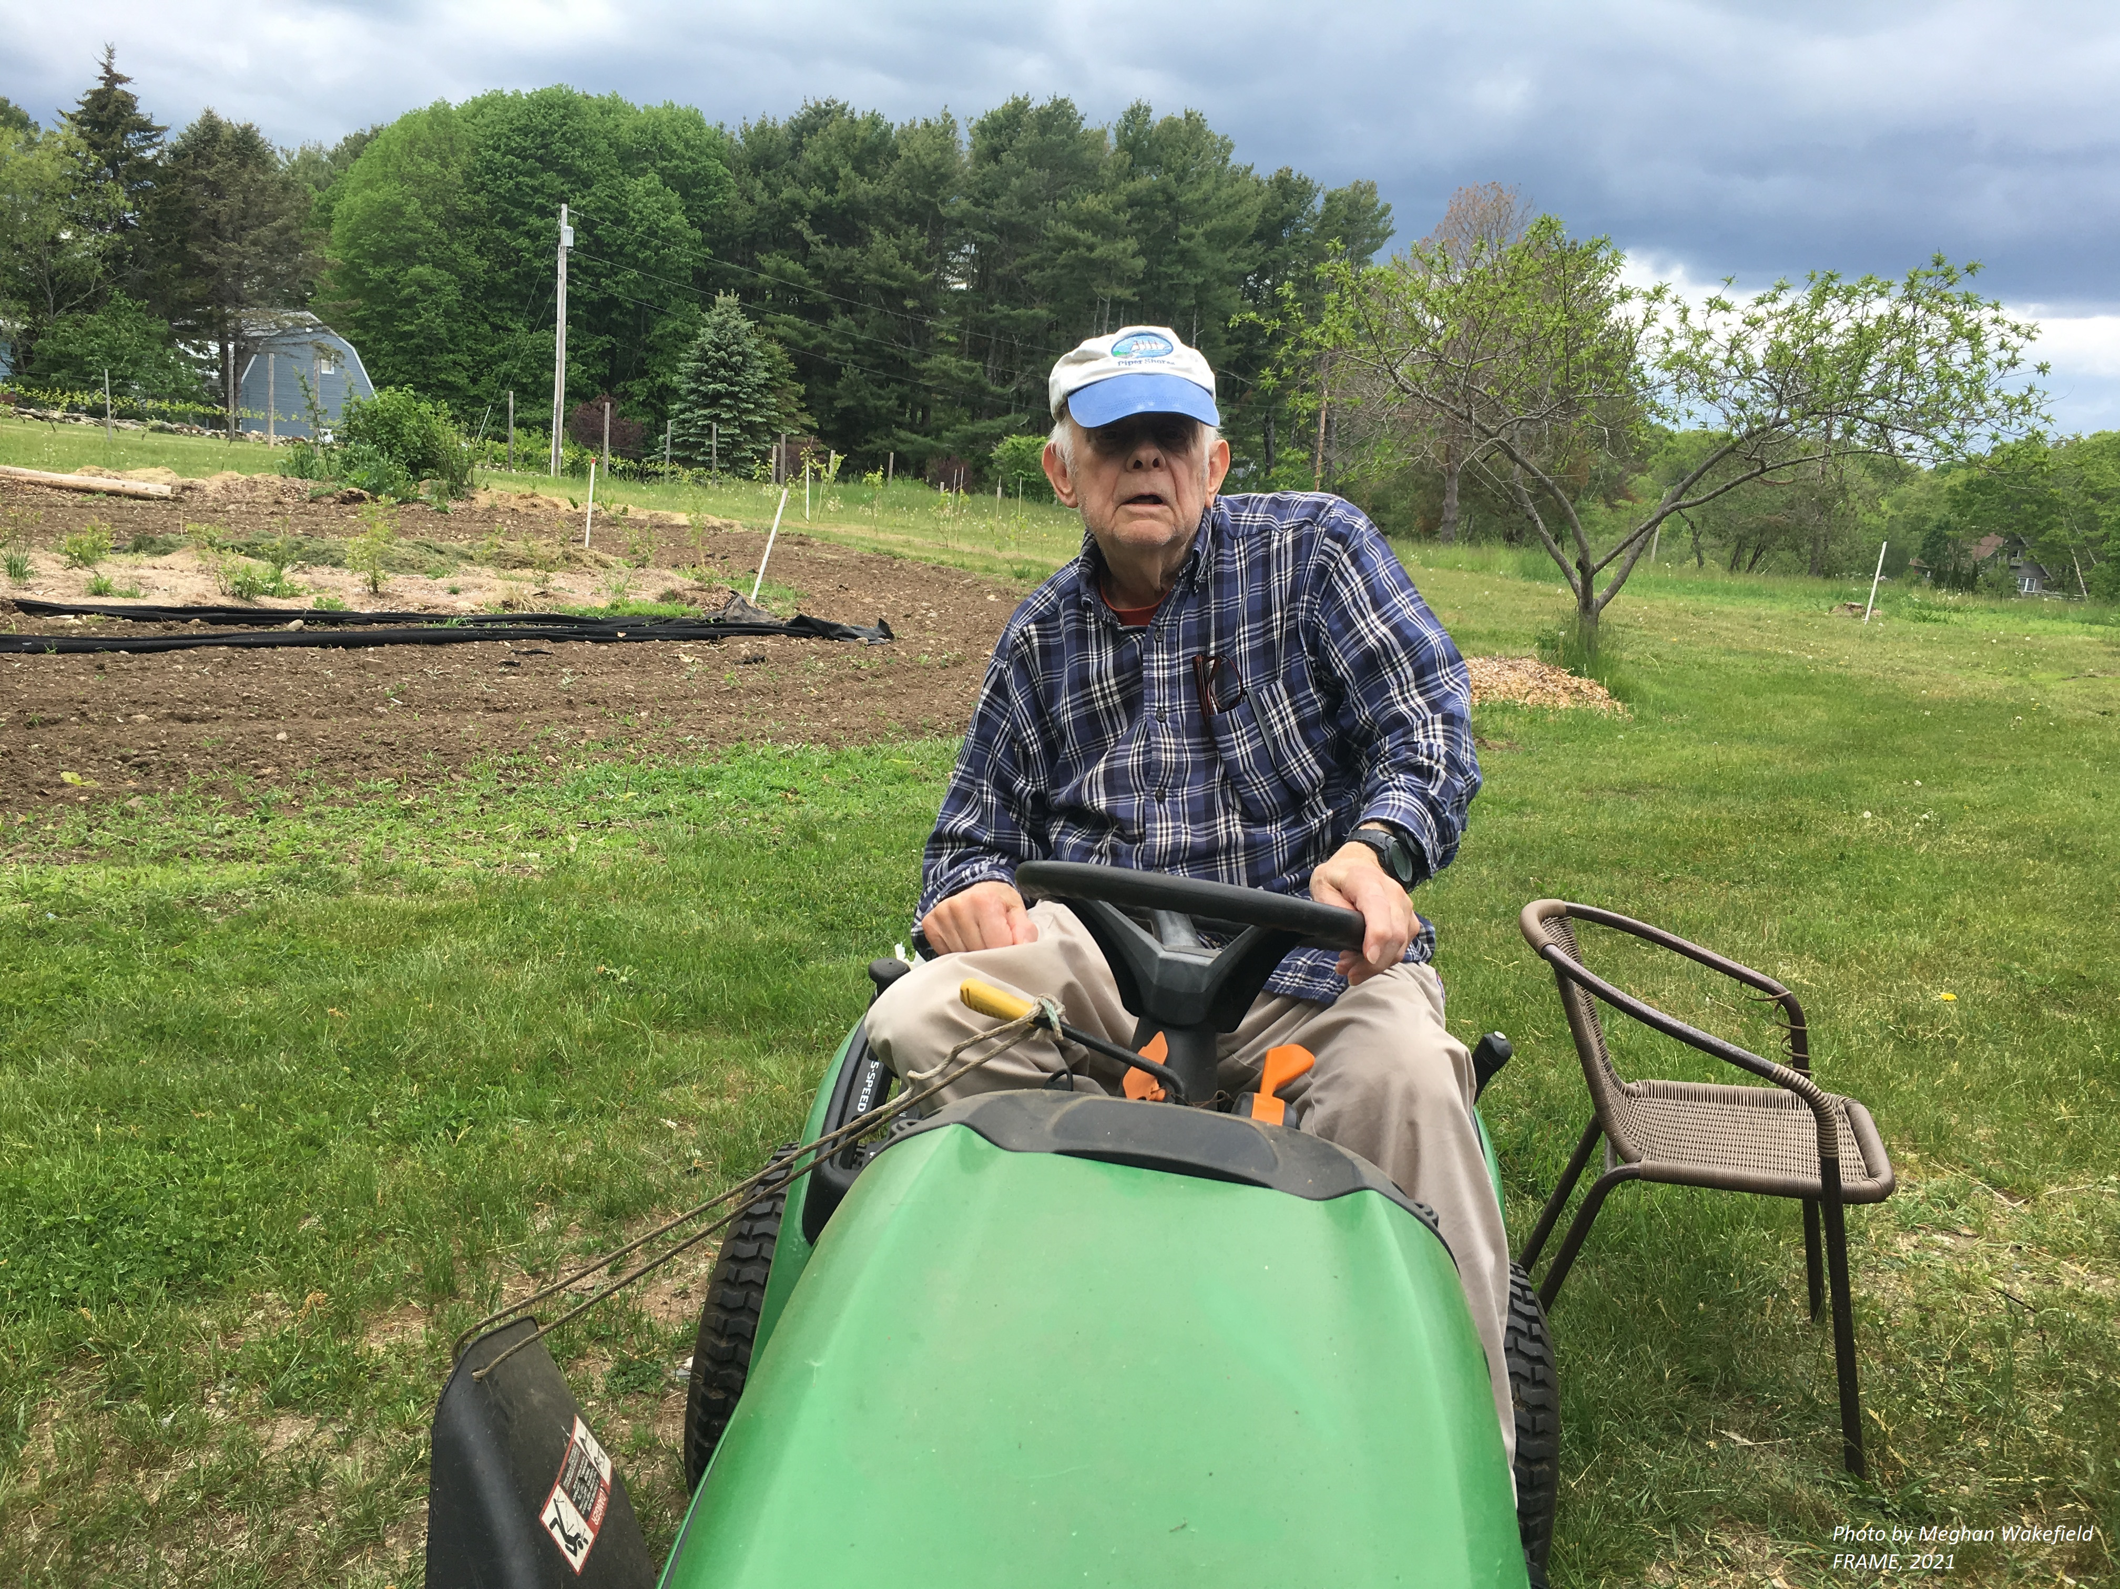
Are we shifting our views to fit this new map of life?
Photos: All images from the Maine Gerontological Society FRAME Photo contest.
Photographers:
Top(L->R): Rosa Fleischer, Elise Klysa, Elise Klysa, Beverly Olson
Bottom: Meghan Wakefield

Slide 16
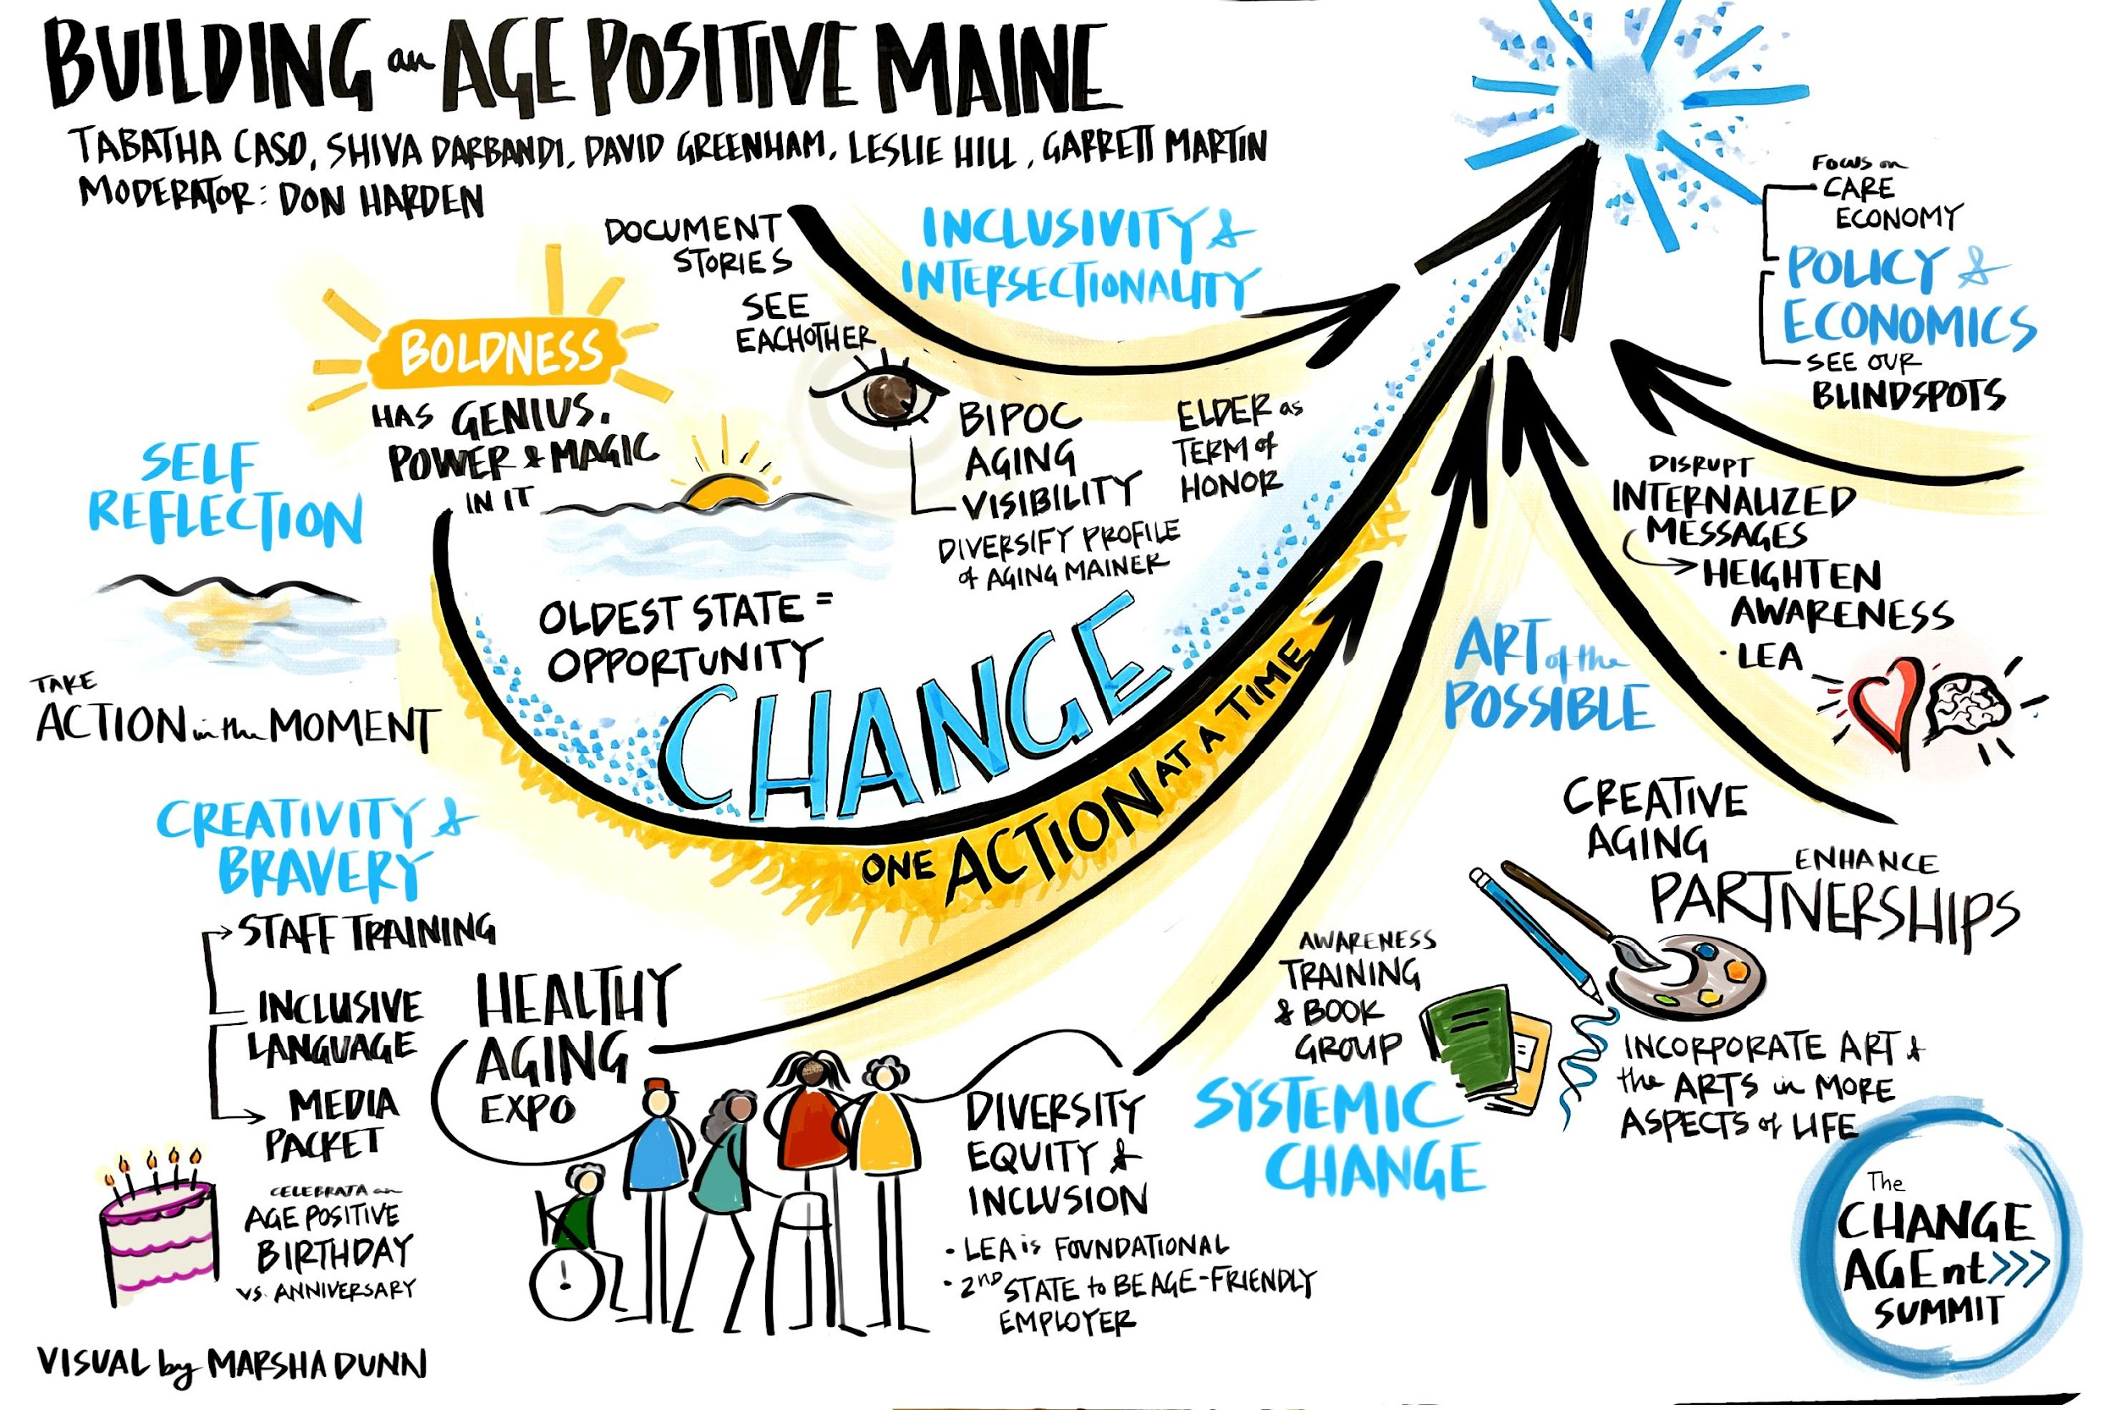
The wave we’re riding

Slide 17
Effects of Age-Positive View/Culture
Older people who embrace positive views about aging and who have purpose:
Live 7.5 years longer than those with less positive perceptions of aging (Levy at al, 2002)
Are 44% more likely to recover after experiencing a new disability (Levy et al, 2012)
Experience less depression and anxiety (Levy et al, 2014)
Have less cardiovascular disease, produce less cortisol over time (Levy et al, 2009)
Have fewer chronic conditions (Levy at al, 2002)

Slide 18
Addressing What Matters Most
Clear priorities that are understood by patients, their family members or caregivers, and their clinicians can drive care that is less burdensome, better integrated, and most importantly, consistent with what matters most to patients

Slide 19
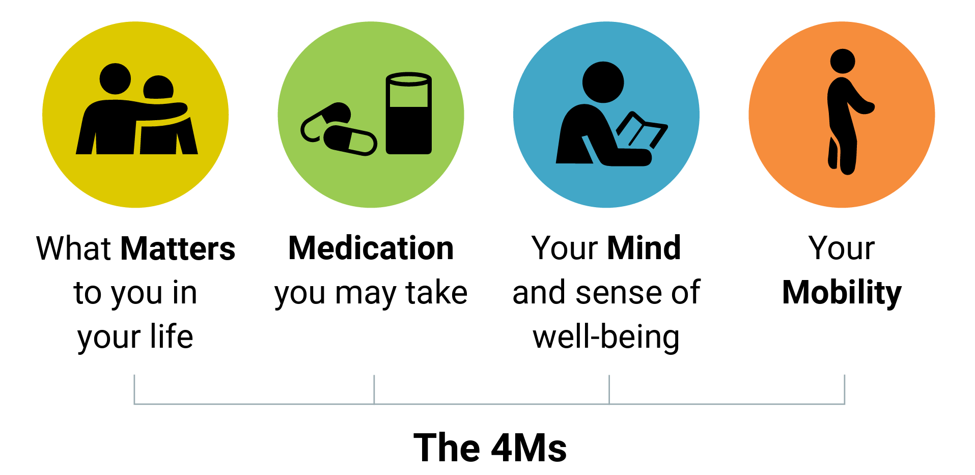
Age-Friendly Healthcare
Foster Belonging
Source: The John A. Hartford Foundation

Slide 20
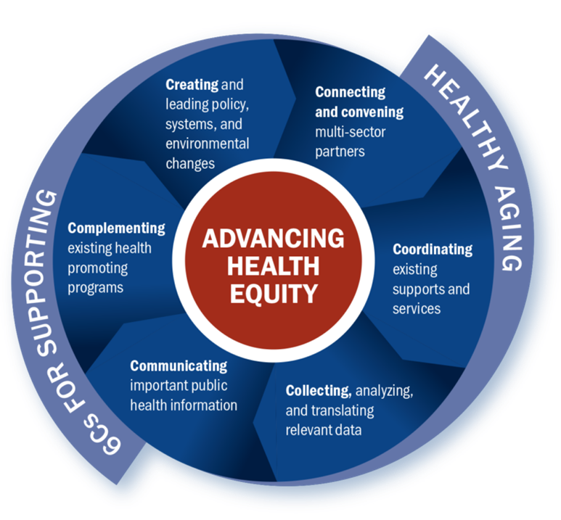
Age-Friendly Public Health System
Florida
Michigan
Mississippi
Washington
Tennessee
Source: https://afphs.org/about/

Slide 21
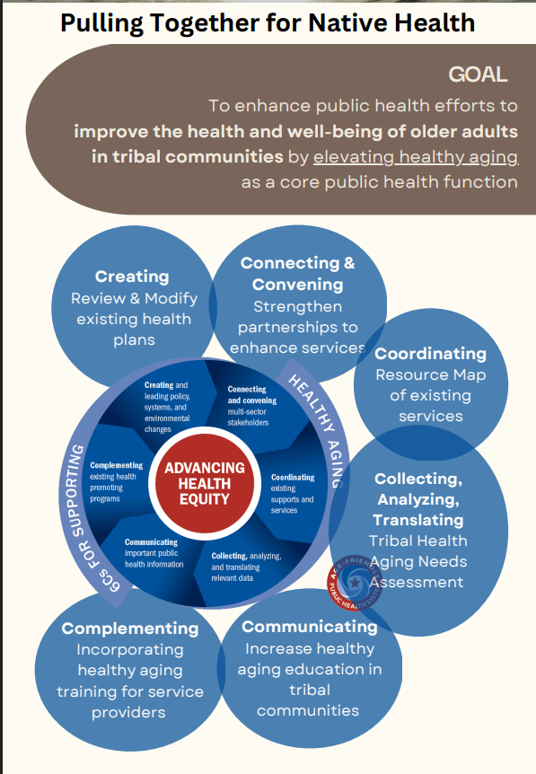
Washington
AIAN have 5.5 fewer years of life expectancy
Higher mortality rates from chronic liver disease, diabetes, and unintentional injuries
Alzheimer's disease and related dementia messaging – Protecting our Wisdom
Source: https://www.indianhealthboard.net/agefriendlypublichealth

Slide 22
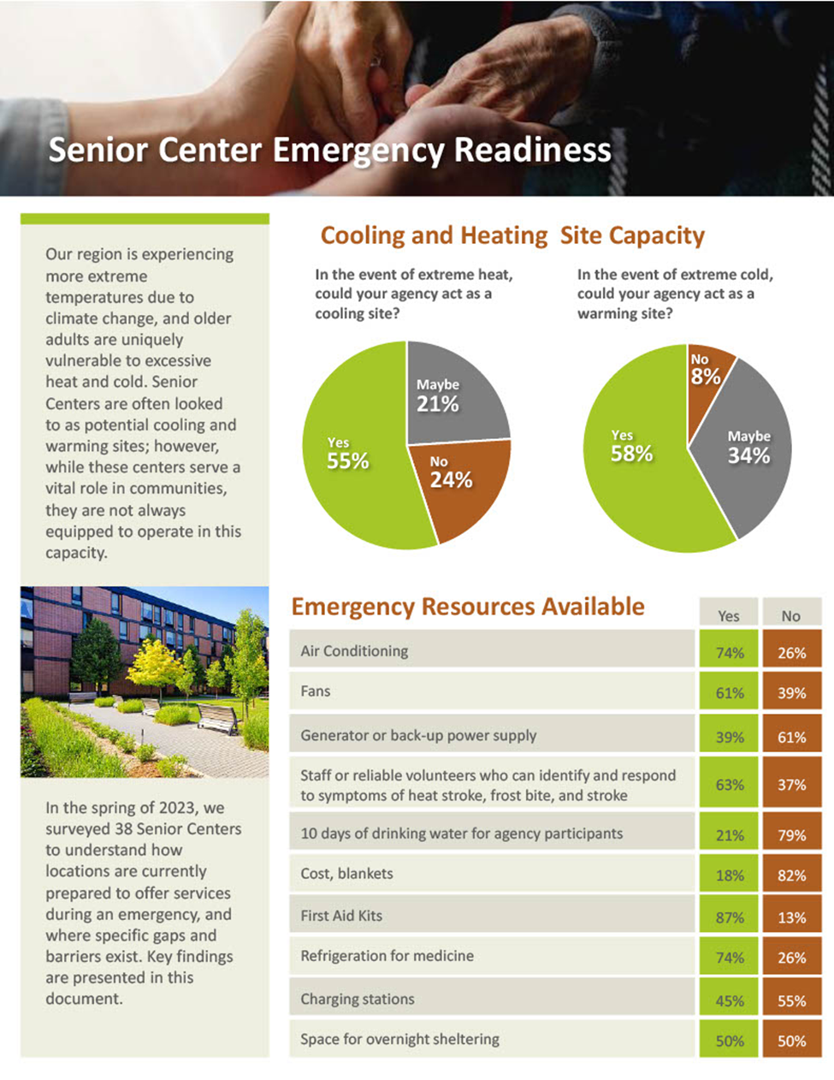
Washington
Half do not have space for overnight sheltering
Over half don't have generators, 10 days of water, cots and blankets, or charging stations.
Source: https://afphs.org/wp-content/uploads/2023/08/Senior-Center-Emergency-Readiness-8.10.23.pdf
Notes:
ement agencies on helping these locations become better ready to meet the needs of older adults in emergencies and disasters.

Slide 23
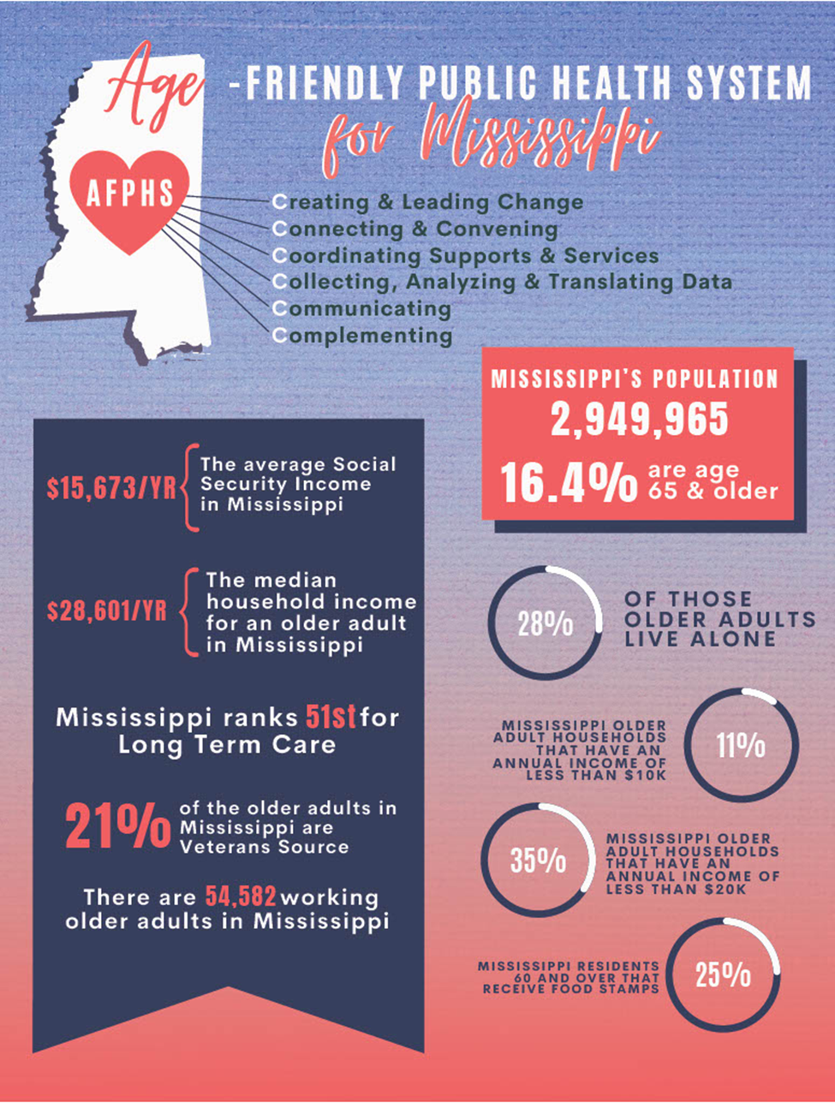
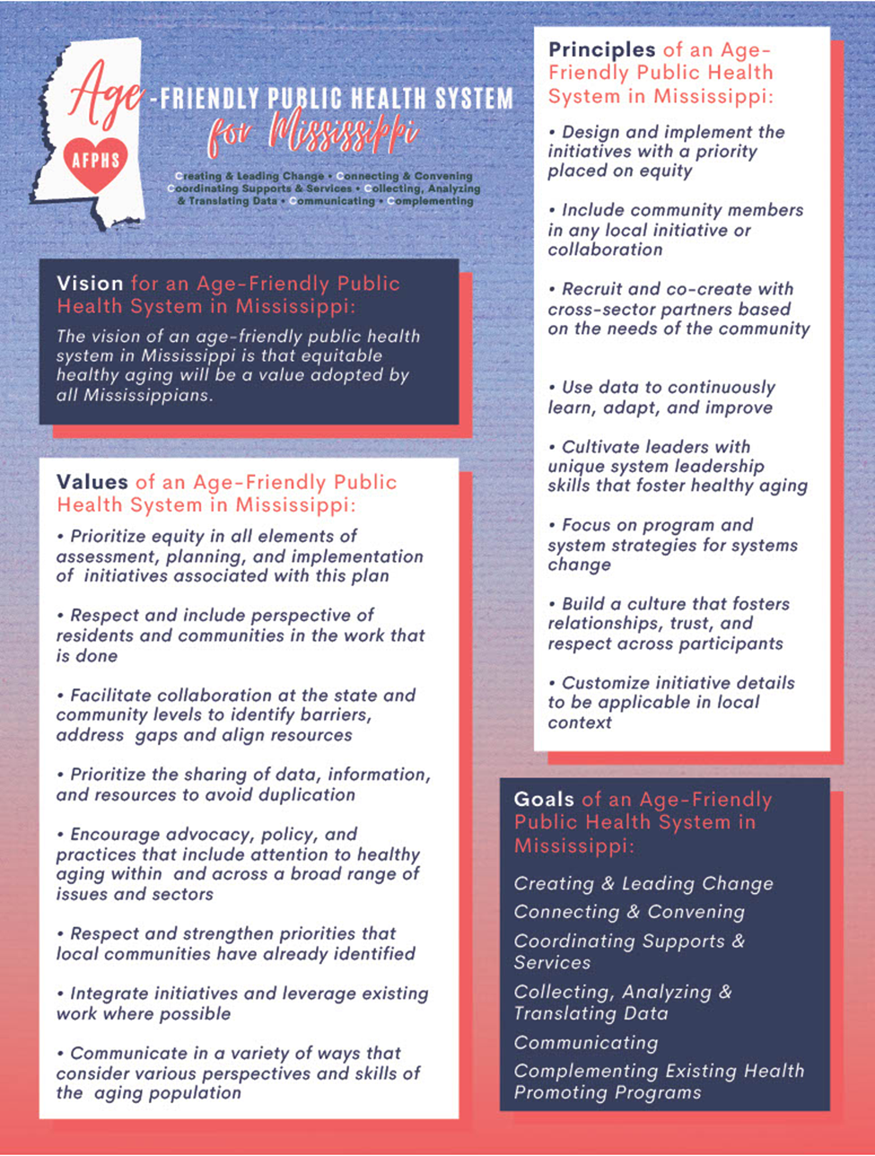
Mississippi
Vision
Values
Principles
Goals
Source: AFPHS-MS

Slide 24
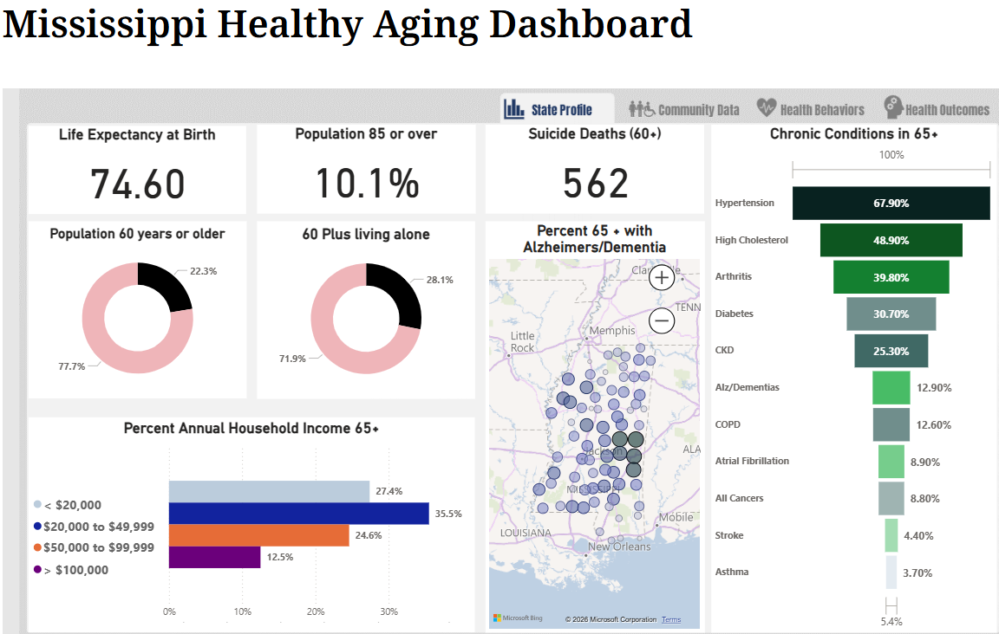
Mississippi
Life expectancy
Population 85+, 60+
60+ living alone
Older adult suicide deaths
Chronic conditions 65+
Percent 65+ with ADRD
Percent annual income 65+
Source: https://msdh.ms.gov/page/43,0,430.html

Slide 25
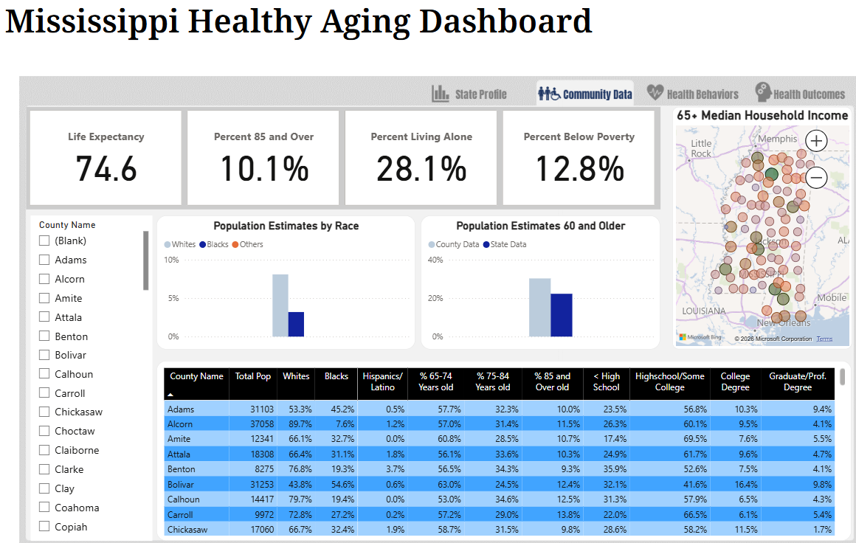
Mississippi
Life expectancy
Population 85+, 60+
Living alone
Race
Below poverty
Median income 65+
Level of education
Source: https://msdh.ms.gov/page/43,0,430.html

Slide 26
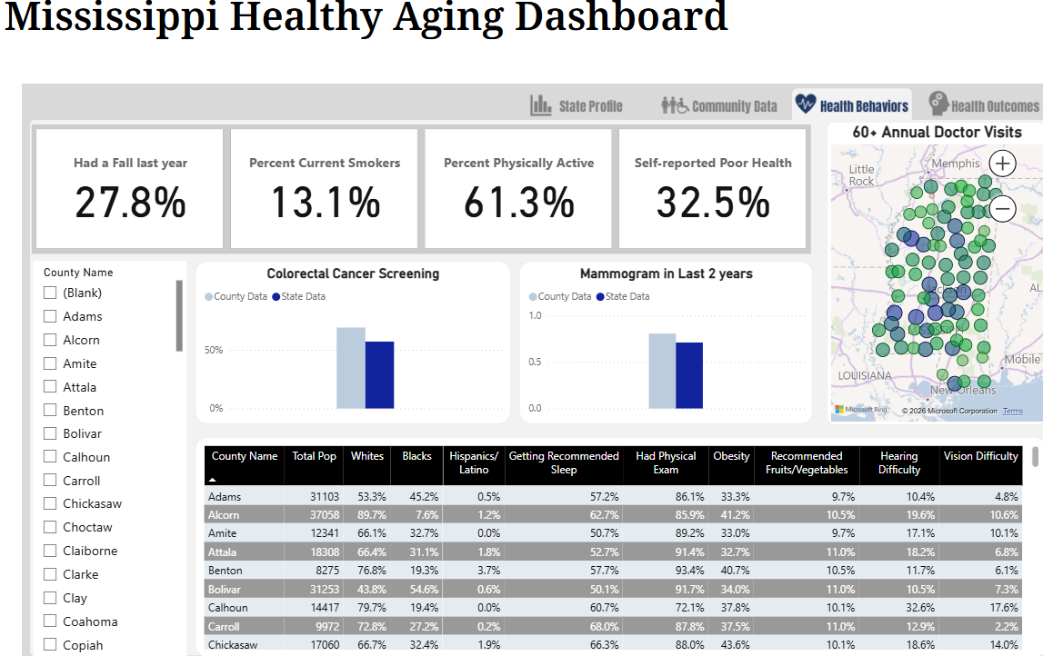
Mississippi
Falls in past year
Smoking
Physical activity
Self-reported poor health
Annual doctor visit
Screenings
Ethnicity, sleep, obesity, eating habits, hearing/vision difficulty
Source: https://msdh.ms.gov/page/43,0,430.html

Slide 27
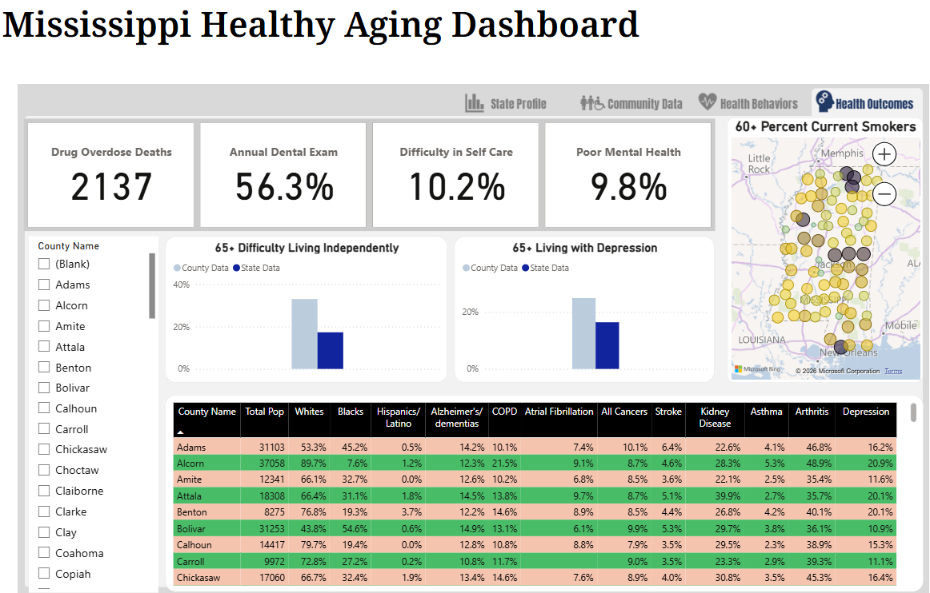
Mississippi
Overdose deaths
Annual dental exam
Difficulty in self-care
Poor mental health
Difficulty in living independently
Depression
Chronic conditions
Source: https://msdh.ms.gov/page/43,0,430.html

Slide 28
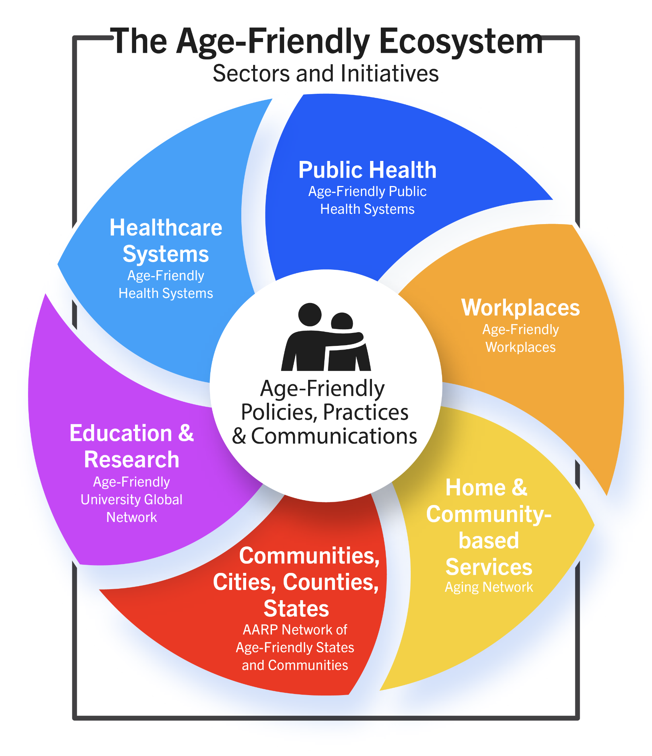
Age-Friendly Ecosystem
Source: JAHF_Age-Friendly Ecosystem

Slide 29
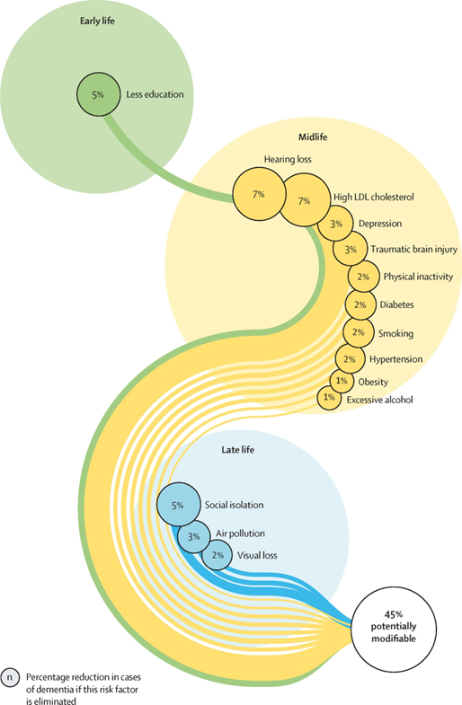
Dementia Risk Factors
Livingston et al, 2024

Slide 30
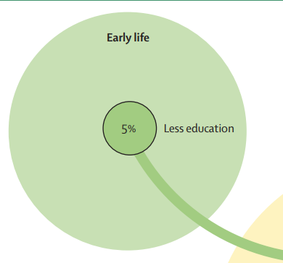
Dementia Risk Factors
Livingston et al, 2024

Slide 31
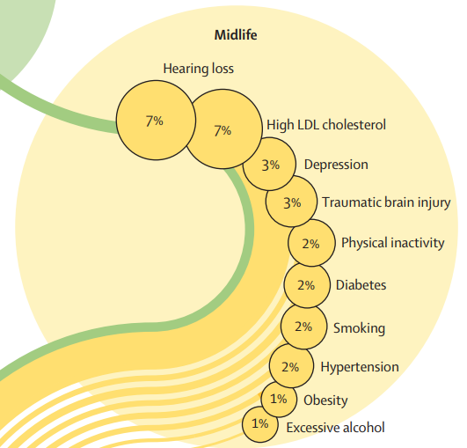
Dementia Risk Factors
Livingston et al, 2024

Slide 32
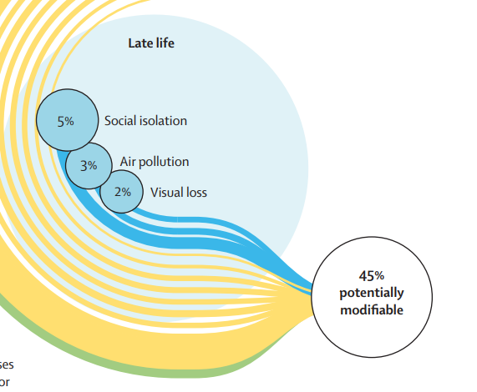
Dementia Risk Factors
Livingston et al, 2024

Slide 33

Group Work
Early Life
1) Less Education
Midlife
2) Hearing Loss
3) High LDL Cholesterol
4) Depression
5) Traumatic Brain Injury
6) Physical Inactivity
7) Diabetes
8) Hypertension
Late life
9) Social Isolation
10) Visual Loss

Slide 34
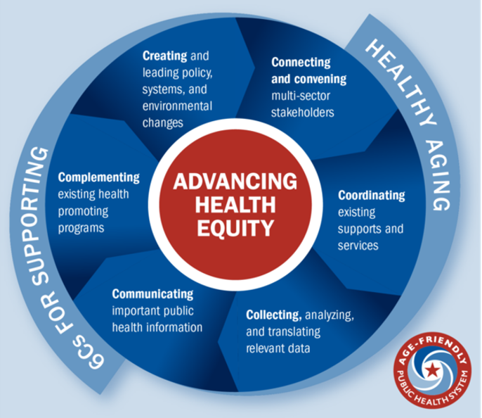
Group Prompts
How would a high functioning age-friendly public health system impact this modifiable risk factor?

Slide 35
Report Out
How would a high functioning age-friendly public health system impact this modifiable risk factor?

Slide 36
Thank you!
Questions?

Slide 37

Age+ ME – How to Join the Movement
Maine is the first state in the country to launch a statewide initiative to end ageism. Join us through one of our programs or bring us into your work.
Leadership Exchange on Ageism
Disrupting Ageism Intensive
Power in Aging Presentations
Reducing Ageism in Employment
Reducing Ageism in Healthcare
Ageism Audits & Technical Assistance available
FMI see: www.Mainecouncilonaging.org/power_in_aging_project/

Slide 38
References
Levy, BE, Pliver, CE, & Pietrzak, RH. (2014) Lower prevalence of psychiatric conditions when negative age stereotypes are resisted. Social Science and Medicine, 228, 170-174.
Levy, BR, Slade MD, Kunkel SR, Kasl, SV. (2002) Longevity increased by positive self-perceptions of aging. Journal of Personality & Social Psychology, 83, 261-270.
Levy, BR, Slade, MD, Murphy, TE, Gill, TM (2012) Association between positive age stereotypes and recovery from disability in older persons. JAMA, 308, 1972-1973.
Levy, BR, Zonderman, AB, Slade, MD, Ferrucci, L. (2009). Age stereotypes held earlier in life predict cardiovascular events in later life. Psychological Science, 20,296-298
Livingston G, Huntley J, Liu K et al. Dementia prevention, intervention, and care: 2024 report of the Lancet standing Commission. The Lancet, 2024; 404, 572-628
Williams, K., Herman, R., Gajewski, B., & Wilson, K. (2009). Elderspeak communication: Impact on dementia care. American Journal of Alzheimer’s Disease and Other Dementias, 24, 11–20. doi:10.1177/1533317508318472
Kristine N. Williams, Yelena Perkhounkova, Ruth Herman, Ann Bossen, A Communication Intervention to Reduce Resistiveness in Dementia Care: A Cluster Randomized Controlled Trial, The Gerontologist, Volume 57, Issue 4, August 2017, Pages 707–718, https://doi.org/10.1093/geront/gnw047

