Slide 1
Aging in Maine: action is key to changing the narrative in the oldest state
Noël Bonam
Betsy Sawyer-Manter
Megan Walton

Slide 2



Who We Are
Noël Bonam, BSc, MPM
  Maine State Director, AARP
Betsy Sawyer-Manter, LMSW
  President & CEO, SeniorsPlus
Megan Walton, MBA
  President & CEO, Southern Maine Agency on Aging (SMAA)

Slide 3
Themes, Takeaways, &Reflections
What did you hear?
What did you learn?
What inspired you?

Slide 4
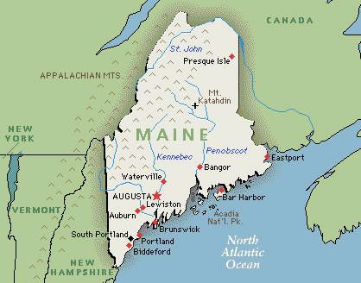
The Maine landscape
What makes Maine a great place to age?
What are the unique resiliencies and protective factors here?
ThePhoto by PhotoAuthor is licensed under CCYYSA.

Slide 5
Taking Action
As an individual
How will I show up as a model aging person / caregiver?
At your workplace
What can we do differently to move the work forward?
In your community
What do I want to bring to my community?

Slide 6
Together we can change the narrative and rewrite the script

