Slide 1

Driving Fitness, Health, and Aging:
The Clinician’s Role in Driver Licensing in Maine
Tom Meuser, phD
Research Analyst (contracted)
Maine Bureau of Motor Vehicles
WELCOME!

Slide 2
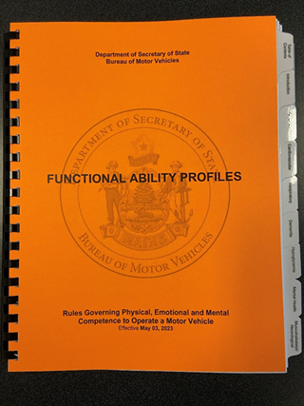
Plan for Presentation
We are audio recording this presentation and discussion for later transcription and review. No personally identifying information will be included.
Introductions
  Chris Ireland, Director, Driver Licensing Services
  Rebeca McCabe, Medical Review Coordinator
Priming Questions
Aims of this Presentation
Overview of the Medical Review Process
Deep Dive into BMV Survey & Medical Data
Audience Input & Feedback
Paper Handouts = FAP Guide, CR-24 Form, Dementia Safety Report, Statewide Survey Slides

Slide 3
Priming Questions
What health and/or functional conditions are of greatest concern for driving capability and safety in older adults?
Where does the primary responsibility lay for the recognition and management of these concerns?
How do you consider and address driving fitness in your professional work, if at all?

Slide 4
Aims of this Presentation
Educate you about the medical review process employed by the Maine BMV with emphasis on application of the Functional Ability Profile (FAP) System.
Share various data points from across 2 years of research projects intended to determine the efficacy of the present approach.
We have a lot to cover today. The survey portion of the slides are provided to you as a paper handout. Above all, we want to hear your reactions to what we present and potential recommendations to enhance our process.

Slide 5
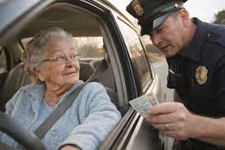
The State Licenses & De-Licenses…
“The Secretary of State is authorized to suspend your license upon receipt of a written adverse report of your driving from a law enforcement officer or other member of the public.”
https://www.maine.gov/sos/bmv/licenses/motoristhandbook.pdf
Maine is a voluntary reporting state. Any citizen can make a good faith report of a potentially unfit driver.

Slide 6


About the Maine BMV Medical Section https://www1.maine.gov/sos/bmv/driver-licenses-and-ids/medical-restriction/medical-review-process
“The Secretary of State shall determine the physical, emotional, and mental competence of a person to operate a motor vehicle with the advice of the Medical Advisory Board and on the basis of the Functional Ability Profiles.”
“Functional ability to operate a vehicle safely may be affected by a wide range of physical, mental or emotional impairments. To simplify reporting and to make possible a comparison of relative risks and limitations, the Medical Advisory Board has developed Functional Ability Profiles for fourteen categories, with multiple levels under each profile.”
Rebecca McCabe
Medical Review Coordinator
207-624-9000, ext. 52124
“Physicians who care for patients with physical, mental, or emotional impairments which may affect their driving safety, whether defined by published guidelines or not, are responsible for making available to their patients without reservation their recommendations and appropriate information related to driving safety and responsibilities.”

Slide 7
BMV Medical Advisory Board (Seat #)
Dr. Evan Savage, Portland
Dr. John A. Taylor, Brunswick (Chair)
Dr. Linda Schumacher-Feero, Augusta
Dr. Isabella A. Askari, Waterville
Dr. Robert J. Lodato, Dexter
Dr. Thomas M. Morrione, Portland
Dr. Patrick Keaney, Brunswick
Dr. Daniel M. Pierce, Scarborough
Dr. Kristen B. Silva, Scarborough
Dr. Daniel Potenza, Bangor
Dr. Jims D. Jean-Jaques, Bangor
Lori M. Towne, Dexter (NP)
Christopher Ireland
Director of Driver Licensing Services
Maine Bureau of Motor Vehicles

Slide 8

Medical Review in Maine
Individual Autonomy Crash & Moving Violation Context Public Safety
Identification of Medically At-Risk Driver
Medical Evaluation & Input to BMV
Short-Term Actions & Outcome2
Long-Term Actions & Outcomes
Self-Report
Health Professional
Family
Neighbor / Friend
Other Informant
Law Enforcement
Relevant Diagnoses
Functional Ability Profile
Required Actions
Active
Active with Restriction(s)
Suspension
Road Testing
Other Testing
No Driving
Non-Driving Transport
Active
Active with Restriction(s)
No Driving
Non-Driving Transport
CR-24 Form
Driver License Services Division - Medical Section
No Action / Restriction / Road Test / No Driving

Slide 9
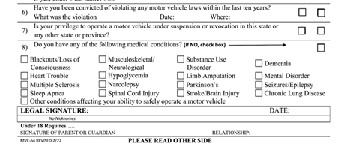

Maine Encourages Self-Reporting
>90% of medical review cases in Maine are from self-report.
~14,000 drivers are medically reviewed in Maine annually.

Slide 10
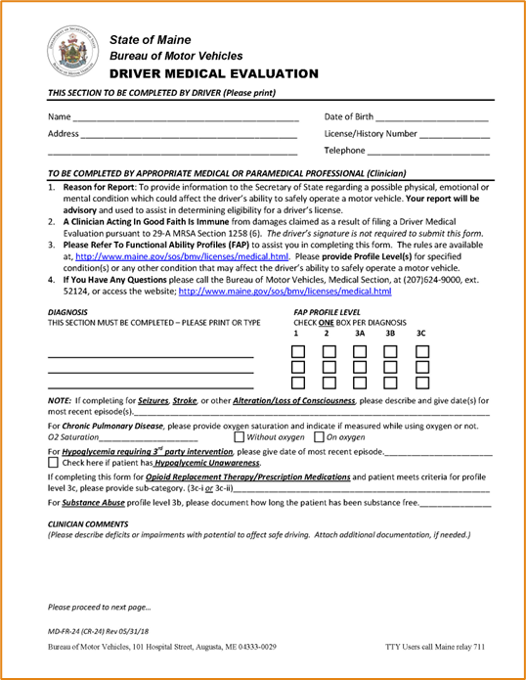
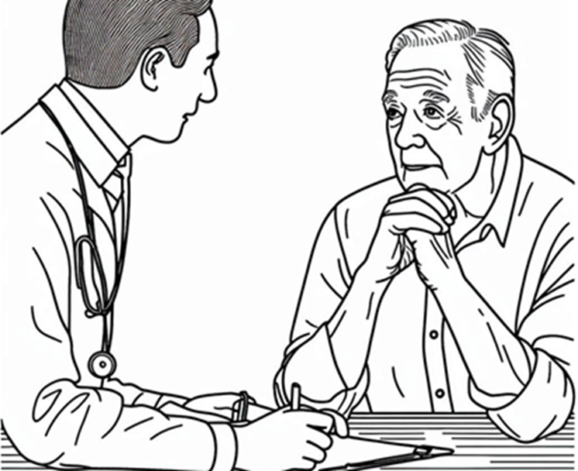
Tell me about your driving…
The Maine BMV relies on “expert” input from physicians and other licensed clinicians.
Form CR-24

Slide 11
Clinicians’ “Expert” Guidance to the BMV
Successful completion of Maine BMV Form CR-24 involves linking (1) your clinical knowledge and experience as a physician or other health professional (e.g., nurse practitioner, physician assistant, OT, PT) with (2) your personal understanding of the driving task. You know from your own driving what it takes to drive competently and safely. The State asks you to apply both knowledge sets here.

Slide 12
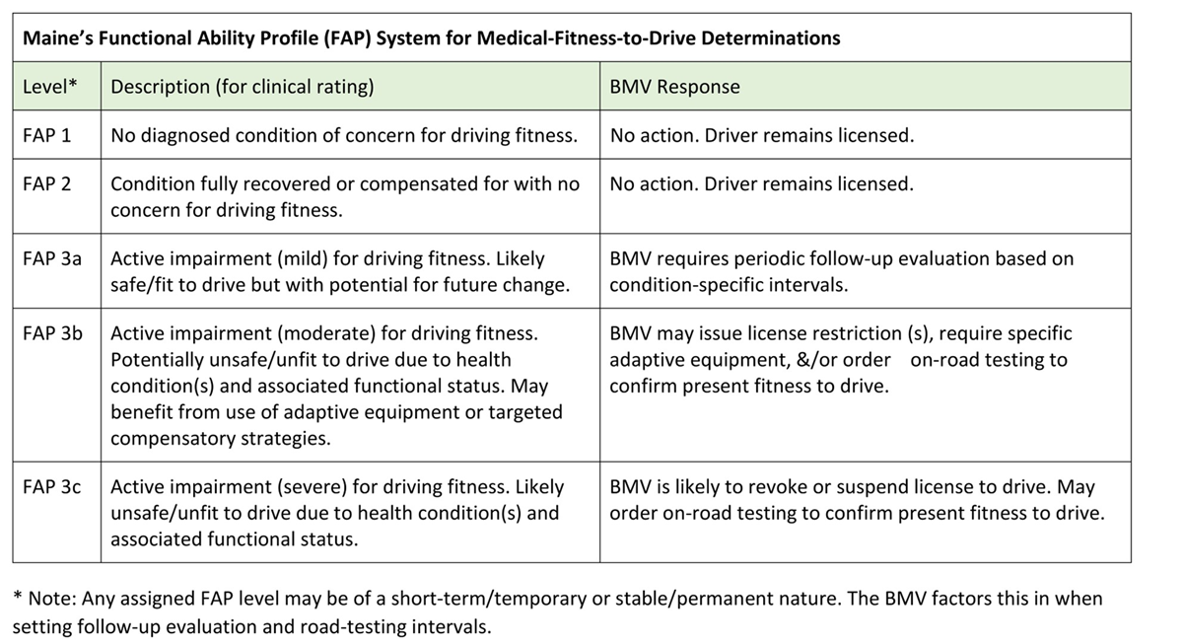
Overview Maine’s FAP System
Look at the condition-specific FAP Tables denoted by the white tabs in your copy of the Orange book.
A FAP rating of “3” is associated with an active medical condition that likely impacts on fitness to operate a motor vehicle safely and responsibly.
BMV will suspend or revoke the driver license at this level.

Slide 13
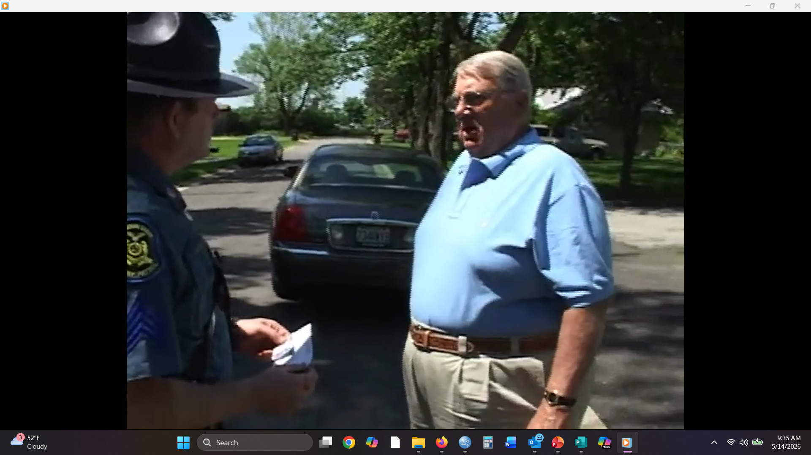
Rating Mr. Green’s Fitness
Howard Green, age 74, retired, widower, 16 years of education, work history in corporate sales, lives with his daughter, clean driving record.
Last evaluated 3 months ago. MoCA = 21.
HTN, Sleep Apnea (compliant with CPAP), Diabetes, & PVD.
Meds = Metformin, Clopidogrel, Atorvastatin, Hydrochlorothiazide, Magnesium Supplement.
Head CT pursuant to fall two years ago showed no acute intracranial process but with diffuse white matter disease and mild atrophy consistent with age.
Officer: “You were weaving and ran a stop sign…”
Mr. Green: “I didn’t know I was doing that, sir. I sure didn’t see a stop sign.

Slide 14
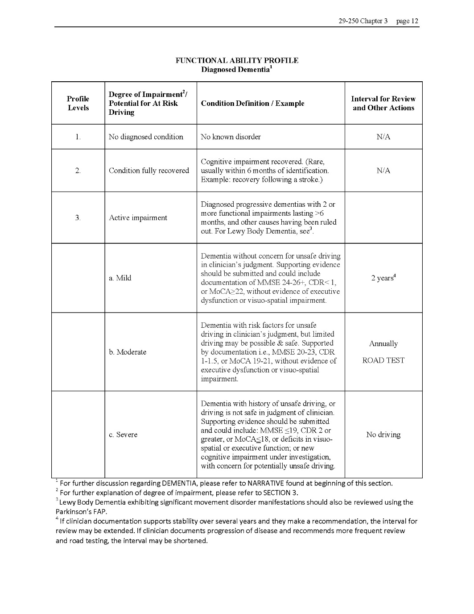

Which FAP level would you apply to Mr. Green based on what you know about his health and driving behavior?

Slide 15
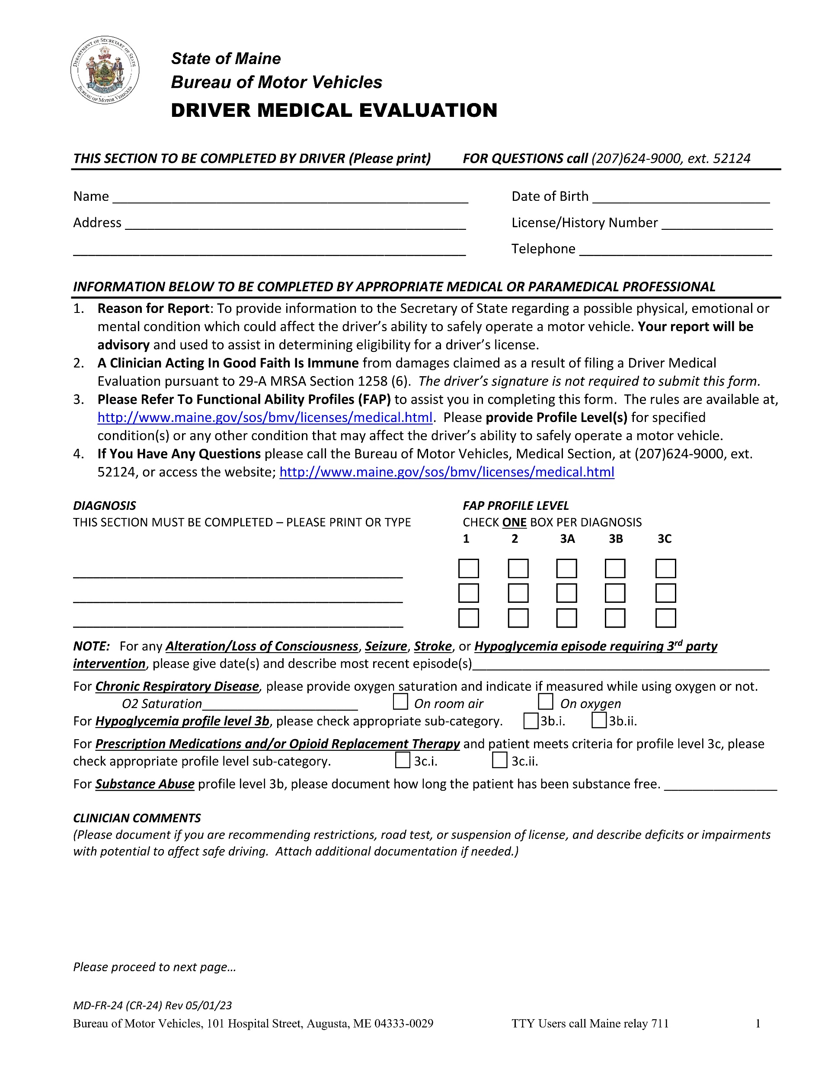
How might Mr. Green’s physician complete Form CR-24?
How can handwritten (or typed) notes support a FAP rating and guide BMV staff to make a reasoned, evidence-based decision on driving?

Slide 16
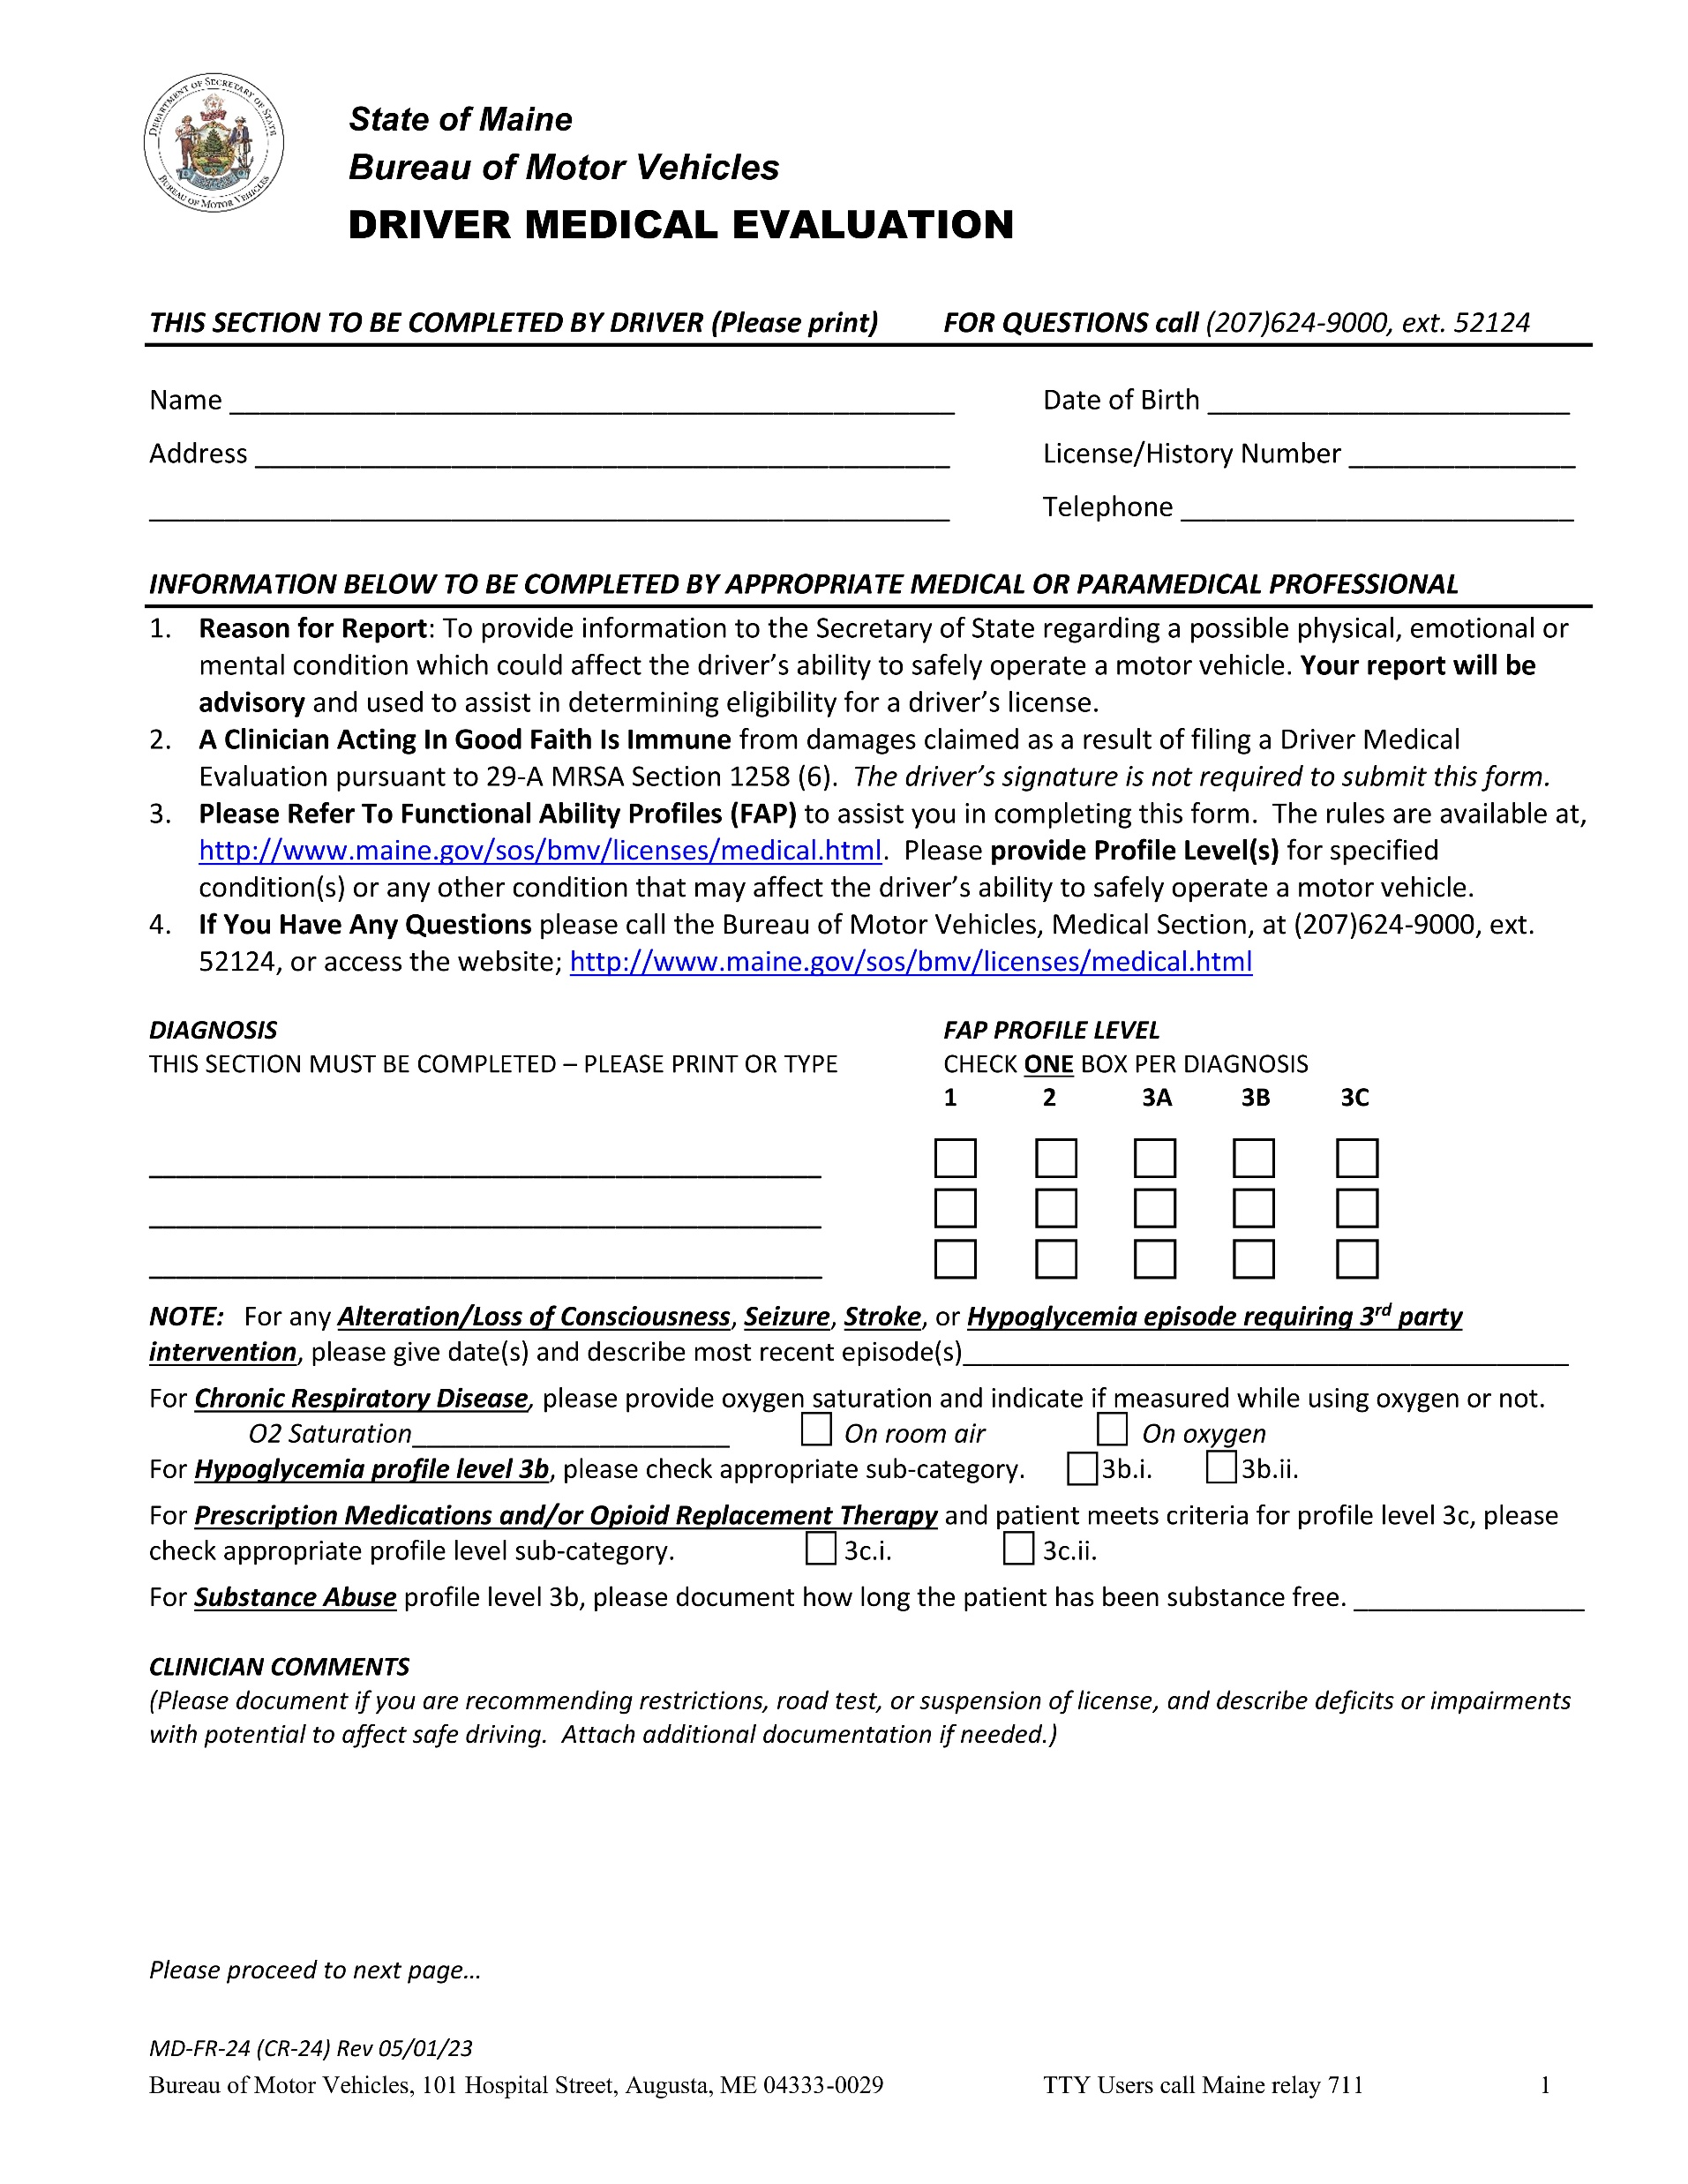

Dementia – Alzheimer’s disease
x
NA
MoCA = 21 of 30 as of today’s evaluation for completion of this form. Short-term memory loss and disorientation to time are most prominent. Mr. Green continues to evidence good social skills and self-care. His daughter reports increasing problems with money management and repetition. I am unaware of any problems in driving, but I believe his moderate dementia warrants caution. I support a road test.

Slide 17
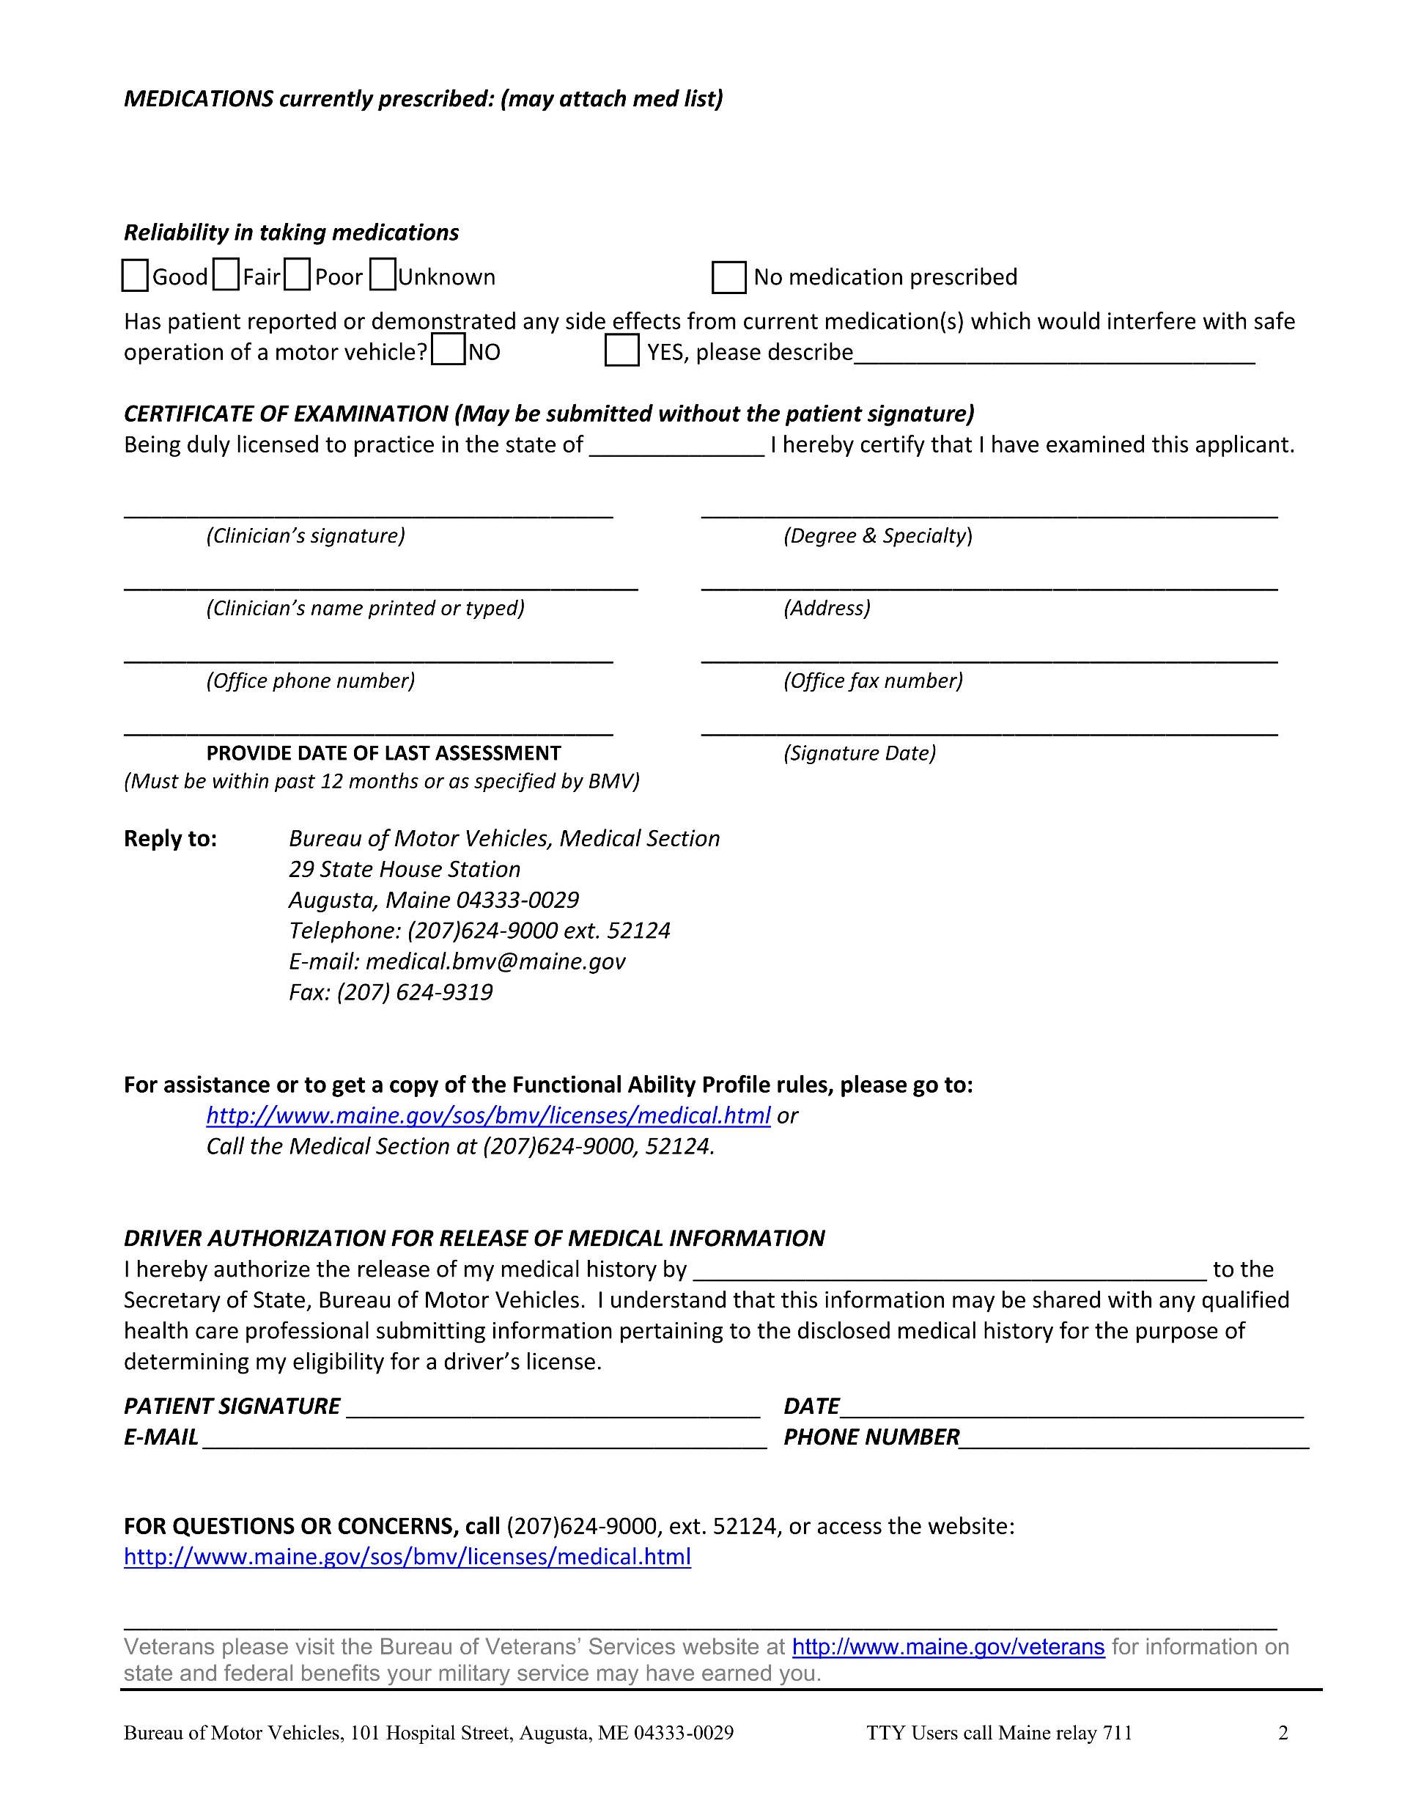


Metformin, Clopidogrel, Atorvastatin, Hydrochlorothiazide, Magnesium Supplement

Slide 18

CR-24 Dementia Cases with Mental Status Score
How does the inclusion of a mental status score support the FAP rating?

Slide 19
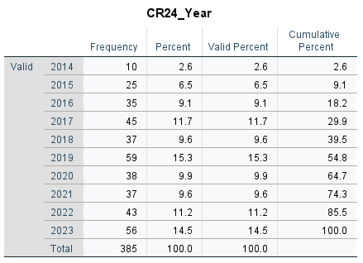
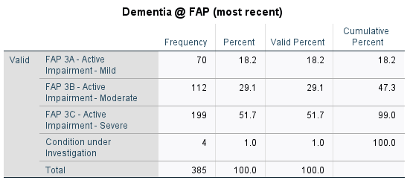
About the Subsample (n = 385)
I generated a random list of Driver ID numbers keyed to the most recent FAP 3a+3b+3c ratings I had. The subsample breakdown above reflects the skew in our raw data for dementia (i.e., favoring 3b-c).
38 2024-25 forms excluded from analysis.
Staff could not locate 67 of 490 (14%) of CR24s that were requested.

Slide 20
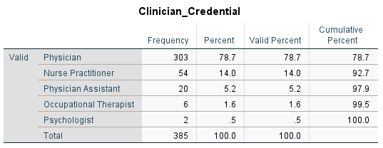
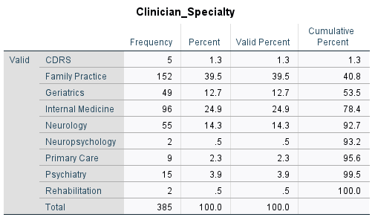

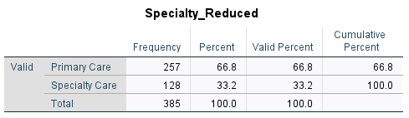
Clinician Respondents

Slide 21
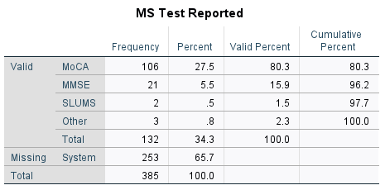
Mental Status Tests in Subsample
Montreal Cognitive Assessment*
Mini Mental State Exam
Saint Louis Mental Status*
All on a 30 point scale, with higher scores associated with better cognitive function.
*Cross validated with MMSE and shown to correlate highly in many studies.
132 of 385 (34%) CR24s included a mental status score.

Slide 22
Sample Notes from CR24
76% of Forms Included Notes, if only MS Score
“Patient has mixed dementia. He has known history of aphasia and developmental delay but he shows worsening dementia with increased incoherence, irregular sleep patterns and MMSE 17/30 in office on 4/3/2023. Given these factors, I recommend patient's license be taken away for both patient and public safety on the road.”
“Pt. w/ dementia. MOCA score: 16/30 on visit 03/10/17. Family reports concerns of worsening memory. Cognitive behavior, missing for hours, concern for drinking alcohol.”
“She was evaluated 5/3/22 and found to have profound deficits this was from her support by MRI concerning dementia. She also had a prior MOCA 8/11/21 SCORE OF 11/30. This is connects with dangerous driving behaviors and police report.”
“Pts dementia has worsened significantly recently. She nearly has an episode where she was driving back from her bank, got lost, and ended up in New Hampshire. She was advised to call 911 to help find her (find her way home) but she refused to do this. She was eventually found by police in NH when out of gas.”

Slide 23
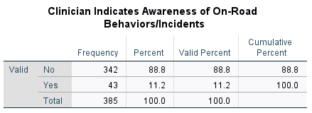
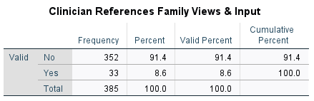
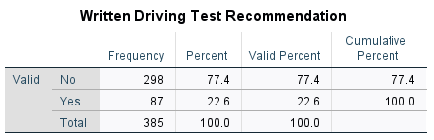
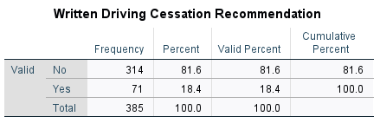
“Written” Clinical Notes on CR24
Are clinicians who provide such written notes more likely to ALSO provide a MS score too?
Yes – Solid trends (p < .065) for Family Input and On-Road Behaviors!

Slide 24
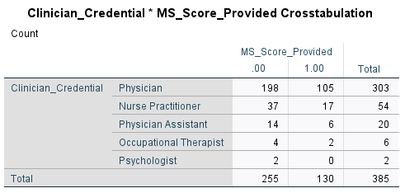
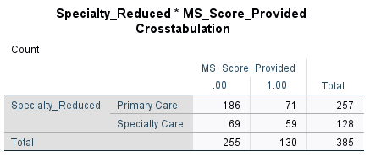
Clinicians & Provided MS Scores
No Significant Differences.
Clinician type is not associated with provision of a MS score.
Chi Square p < .001
Specialist clinicians are more likely to provide a MS score.

Slide 25
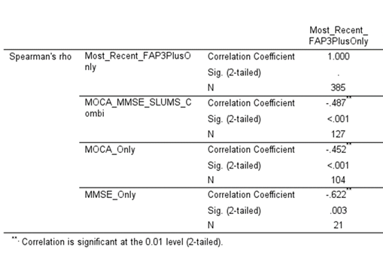
Spearman Correlation (full subsample)
This table shows the correlation between the most recent FAP 3a-c Ratings and associated Mental Status Scores.
FAP 1-2 excluded.
MMSE correlates more strongly than MOCA

Slide 26
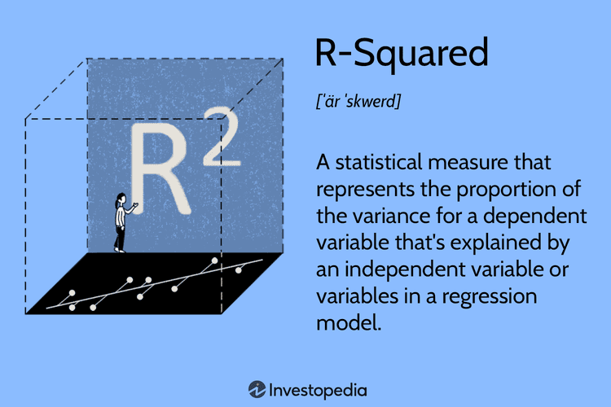
Shared Variance
0.487 x 0.487 = 0.24
That’s 24% of shared variance for the MoCA and FAP rating.
A MoCA score is a very rough approximation of cognitive and functional capacity. More detailed testing is preferable for an accurate picture.
That said, MoCA scores <15 are consistent with high care needs in daily life. Persons with such scores have difficulty with some ADL tasks and most IADL tasks.

Slide 27
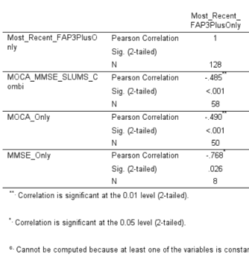
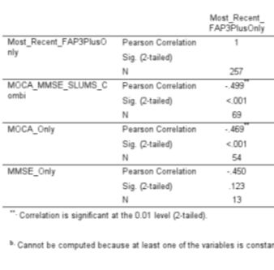
Spearman Correlations
Specialists Only
Primary Care Only

Slide 28
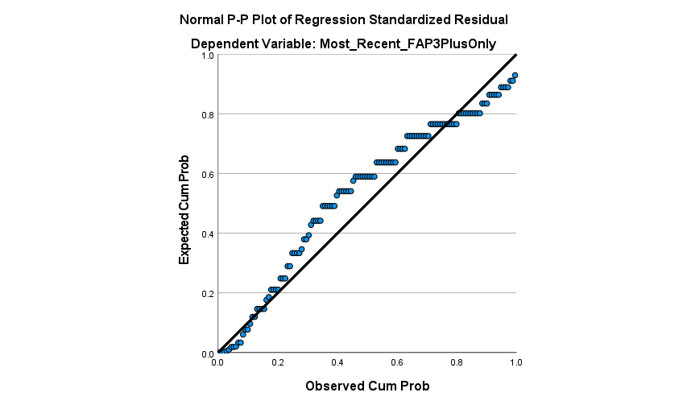
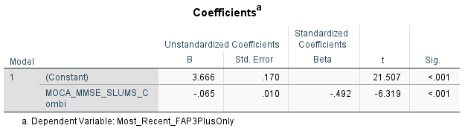
Other Analyses (full subsample)
Do MS scores predict licensing outcomes? – NO (Binary Logistic)
  Most delicensed (or die) regardless of MS score assigned.
Do MS scores predict clinician FAP ratings? – YES (Linear Regression)

Slide 29
Let’s look at some examples of MoCA scores and assigned FAP levels.
What do you notice?
Might clinicians benefit from guidance on MoCA scores and assignment of FAP level?

Slide 30
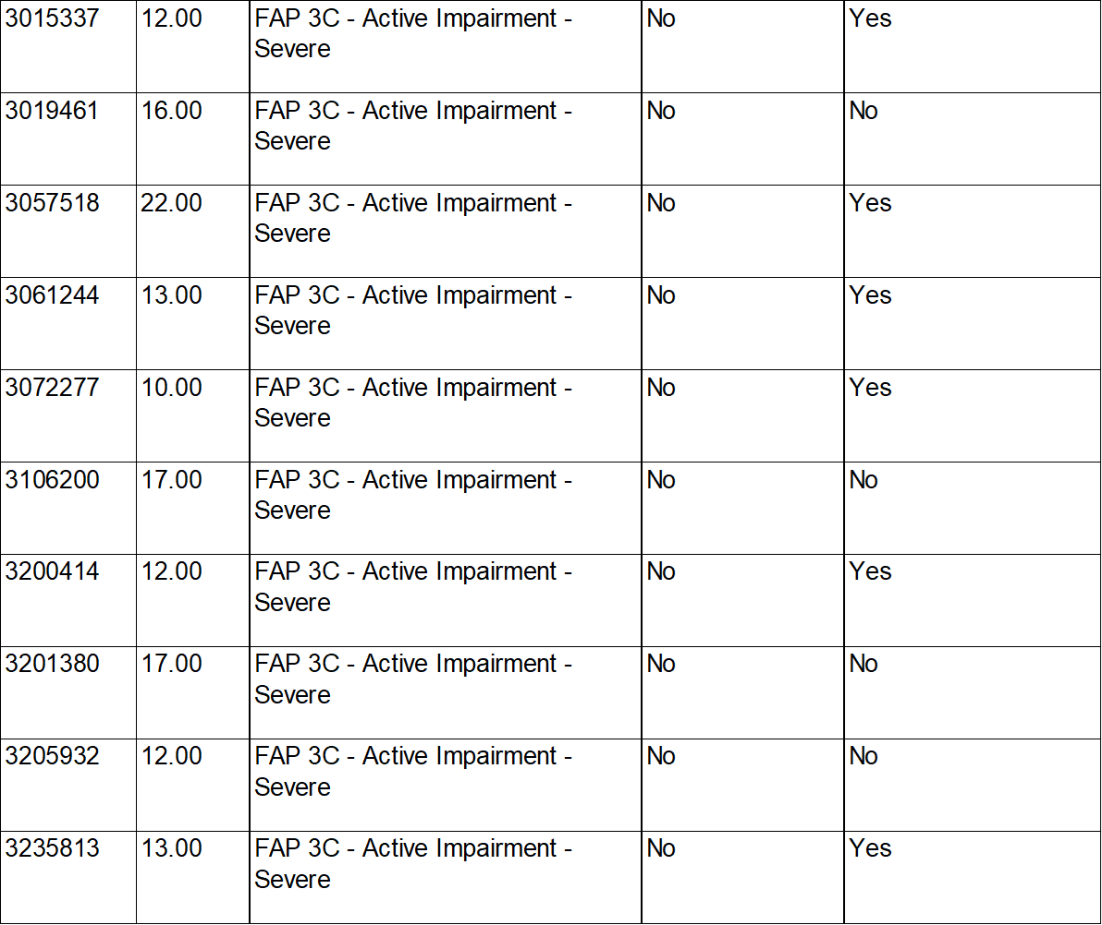

Slide 31
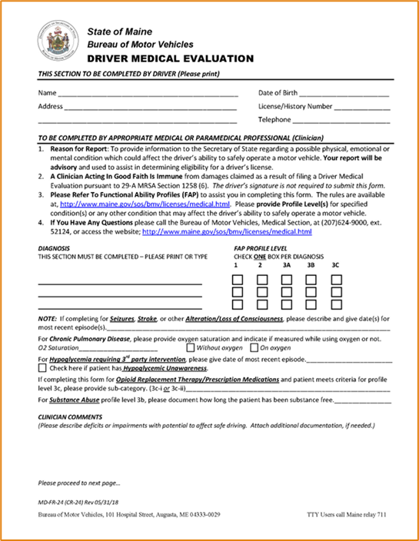
Suggestions for CR-24 Completion
Recognize that the State licenses and de-licenses drivers, not you! Your recommendation offers guidance to the BMV’s Medical Section. They make the final decision – continue driving, driving with restrictions, no driving (temp or permanent).
Consider your own knowledge of the driving task and err on the side of caution in your FAP ratings.
Include a specific diagnosis (e.g., especially in the case of mental disorder and dementia), a mental status score (for dementia), notes about family input, and notes indicating awareness of on-road behaviors and incidents.
Include a medication list.
Other thoughts?

Slide 32
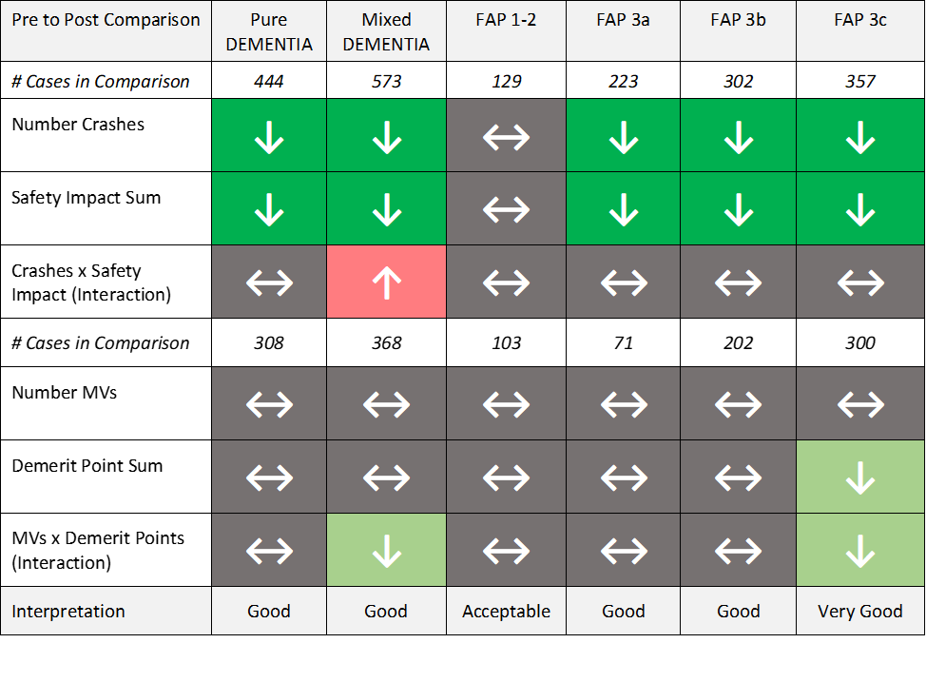
Outcomes Research
Data and Discussion

Slide 33
Outcomes Research Questions
Do current Maine BMV MAB requirements, processes, and procedures result in evidence-based, equitable licensing decisions and safety outcomes whereby:
Medically unfit drivers are identified, evaluated, and remediated to remain safely behind the wheel or adopt another means of transportation; and
Public health and safety are protected without undue burden on the autonomy rights of individual citizens?

Slide 34
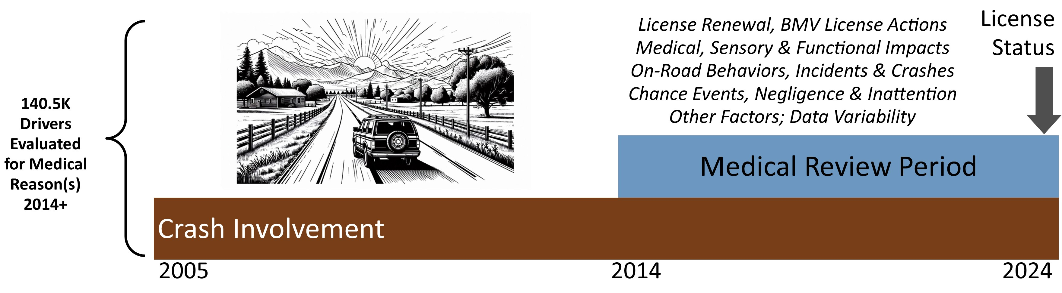

Sample Frame for Maine BMV Research
Medical Data to June 2024
All Other Data to September 2024
Mortality

Slide 35
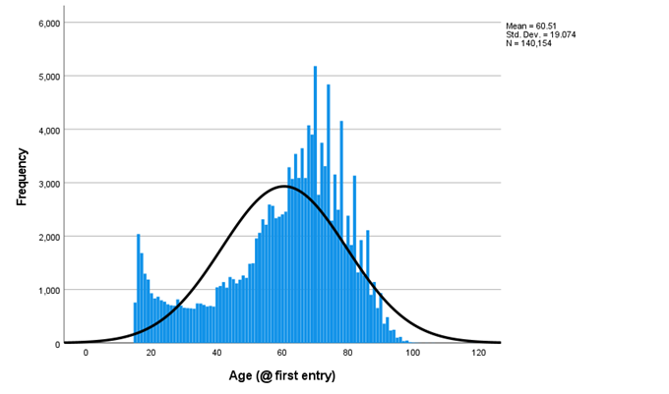

Age & Gender
54% Male
Bimodal distribution for age, with a cluster <20 and another >65.
Mean age at first contact = 60

Slide 36
Diagnoses in Sample (% of 140.5K cases)
Conditions in red may be underreported relatively to likely prevalence in the general population.
  Supraventricular Arrhythmia 5%
  &/or Bradycardia
  Ventricular Tachycardia 1%
  &/or Ventricular Fibrillation
  Other Cardiac Condition 14%
Chronic Respiratory Disease 7%
Dementia 5%
Hypoglycemia 17%
Mental Health Condition 15%
CVA, Stroke, Brain Injury 4%
Multiple Sclerosis 1%
Parkinson Disease 2%
Misc Musculo-Neuro 9%
  Narcolepsy &/or Idiopathic <1%
  Hypersomnia
Other Medical Condition 1%
Prescription Medication &/or Opioid <1%
Replacement Therapy Effect
Seizures &/or Epilepsy 5%
Sleep Apnea Syndrome 15%
Substance Use Disorder 2%
  Unexplained Alteration <1%
  or Loss of Consciousness
  Visual Acuity Condition 21%
  Peripheral Visual Condition 16%
  Visual Condition – Other <1%

Slide 37
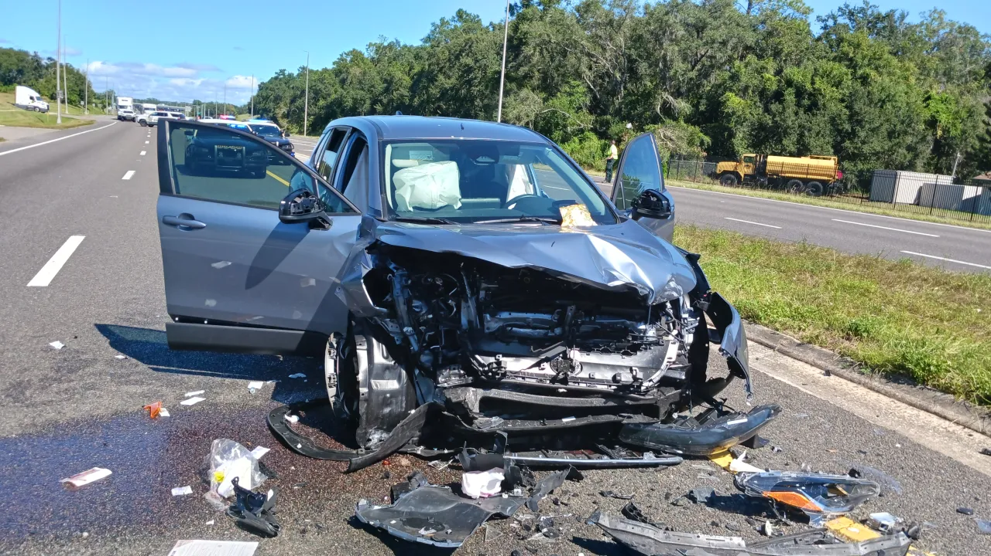
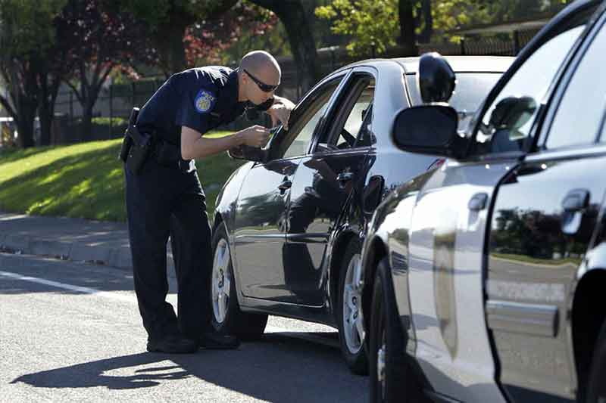
Safety Outcomes
# Crashes as Driver
Crash Severity Rubric
  Fatal (3), Injury (2), Property (1)
# Moving Violations as Driver
Demerit Points

Slide 38
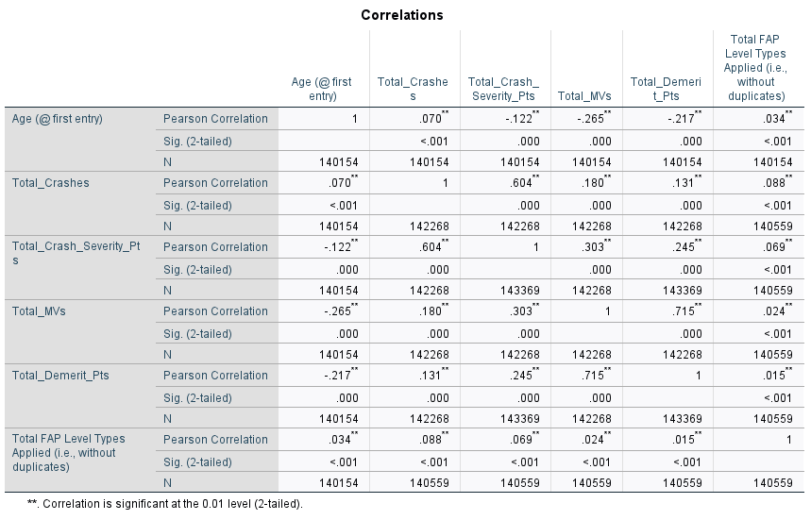
A modest positive correlation was found linking advancing age with number of crashes in our medical review sample.
A stronger negative correlation was found for crash severity and age. Older drivers are involved in less serious crashes.
Older drivers are also involved in fewer moving violations and receive fewer demerit points in comparison to younger drivers.

Slide 39
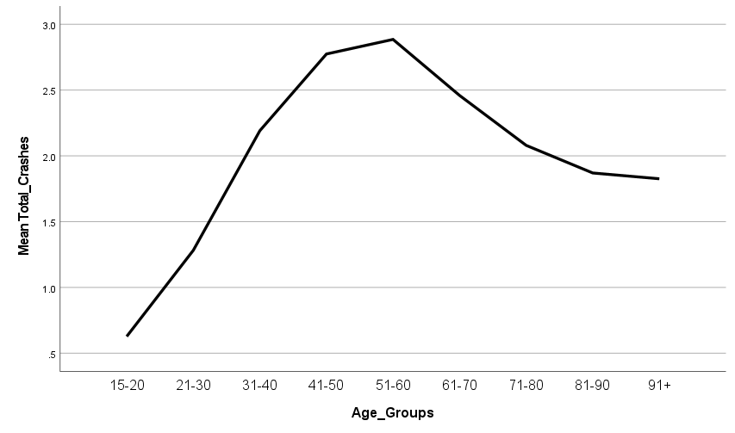
Crashes x Age
This graph depicts mean total crashes in our medical review sample by age.
The largest share of crashes are among middle aged drivers.

Slide 40
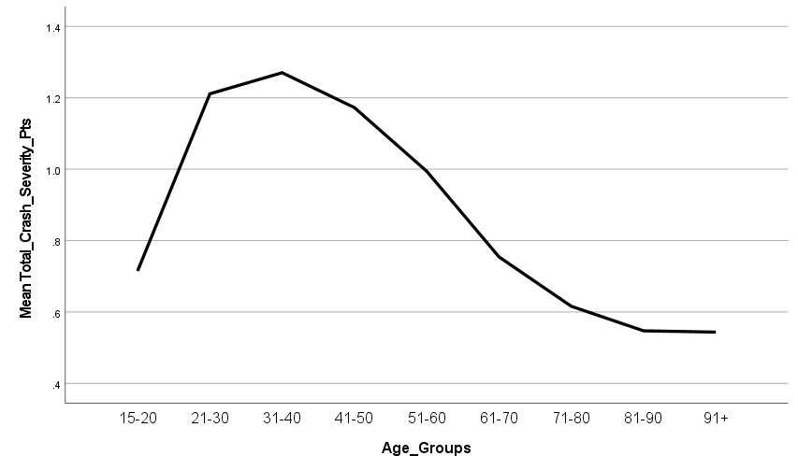
Crash Severity x Age
Higher crash severity is associated with fatalities and disabling injuries (e.g., vs. property damage only).
Crashes which impact public safety the most are among younger drivers in our medical review sample.

Slide 41
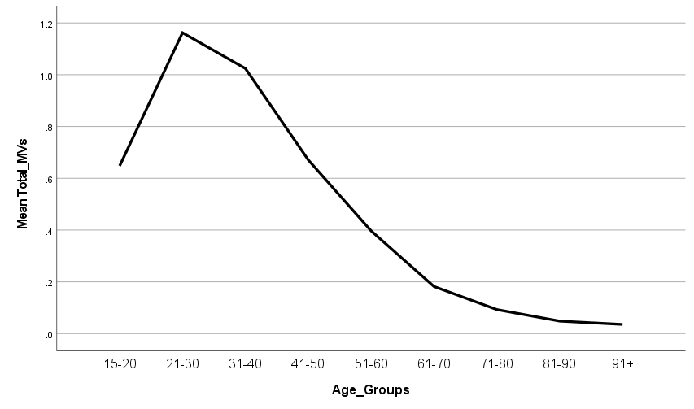
Moving Violations x Age
Moving violations are primarily among younger drivers in our medical review sample.

Slide 42
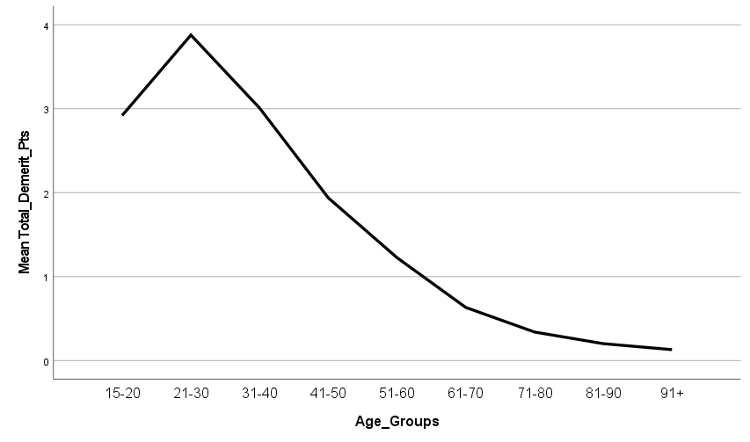
Demerit Points x Age
Demerit points are applied to moving violations based on how egregious and potentially damaging violations may be. Police officers apply a rubric for this.
Again, younger drivers in our medical review sample are the most problematic group.

Slide 43
Drivers Aged 60+ in Sample (n = 85,616)
  Supraventricular Arrhythmia 8%
  &/or Bradycardia
  Ventricular Tachycardia 2%
  &/or Ventricular Fibrillation
  Other Cardiac Condition 18%
Chronic Respiratory Disease 9%
Dementia 8%
Hypoglycemia 21%
Mental Health Condition 6%
CVA, Stroke, Brain Injury 5%
Multiple Sclerosis 1%
Parkinson Disease 3%
Misc Musculo-Neuro 8%
  Narcolepsy &/or Idiopathic <1%
  Hypersomnia
Other Medical Condition 1%
Prescription Medication &/or Opioid <1%
Replacement Therapy Effect
Seizures &/or Epilepsy 3%
Sleep Apnea Syndrome 15%
Substance Use Disorder <1%
  Unexplained Alteration <1%
  or Loss of Consciousness
  Visual Acuity Condition 26%
  Peripheral Visual Condition 20%
  Visual Condition – Other <1%

Slide 44
Conditions x Age
Positive Association (Spearman Correlations)
Negative Association
Dementia 0.25**
Cardiac 0.2**
Vision 0.19**
Respiratory 0.08**
PD 0.08**
Hypoglycemia 0.06**
Stroke 0.04**
Mental Health -0.37**
Seizures -0.15**
Substance Misuse -0.11**
MS -0.06**
Prescription Drugs -0.05**
Sleep Apnea -0.04**
Narcolepsy -0.03**
Other LOC – 0.02**

Slide 45
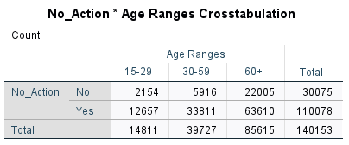
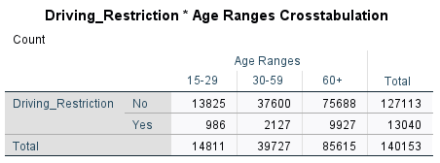
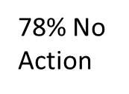

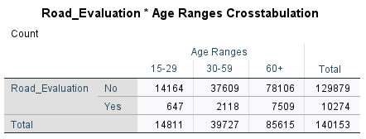
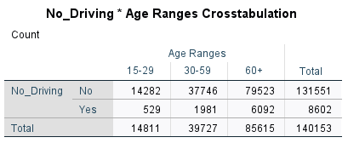
Outcomes – BMV Actions (All Conditions)
9% Restriction
7% Road Test
6% No Driving

Slide 46
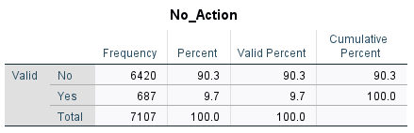
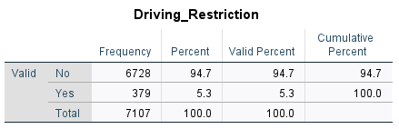

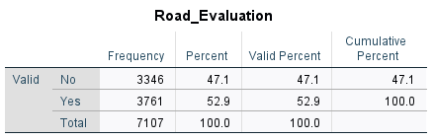
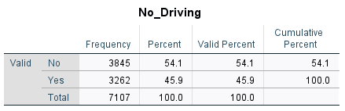

Outcomes – BMV Actions (Dementia)

Slide 47
What diagnoses are associated with higher…?
Total Moving Violations
Total Crashes as driver
Mental Health Condition (0.14***)
Substance Use Disorder (0.14***)
Prescription Medication / Opioid (0.06***)
Seizure / Epilepsy (0.06***)
All others have either tiny positive correlations or negative correlations indicating fewer moving violations or crashes.
Hypoglycemia (0.09***)
Substance Use Disorder (0.05***)
Misc. Musculo-Neurological (0.05***)
Sleep Apnea (0.04***)
Stroke / Brain Injury (0.03***)
Other Cardiac (0.03***)
Dementia (0.02***)

Slide 48
What FAP ratings are associated with higher…?
Total Moving Violations
Total Crashes as driver
FAP 3a (0.04***)
FAP 3b (0.05***)
FAP 3c (0.04***)
This comparison is interesting in what it doesn’t show. The only FAP rating associated with higher number of moving violations is 3a. Might this mean that persons are identified for medical review pursuant to moving violations earlier in their disease course? Possibly.
In contrast, higher severity FAP ratings are associated with number of crashes. Could impairments from the associated medical conditions be contributing to more frequent crashes? We cannot know this for sure in our data, but it is an interesting thought.

Slide 49


Safety Metrics
Crash-Related:
Number of Crashes as a Driver during Pre- vs. Post-Evaluation Periods
Sum of Crash Safety Impact Ratings during Pre- vs. Post-Evaluation Periods
Number Crashes x Safety Impact Sum during Pre- vs. Post-Evaluation Periods
Moving Violation Related (corrected for enforcement differences over time):
Number of MVs during Pre- vs. Post-Evaluation Periods
Sum of Demerit Points from these MVs during Pre- vs. Post-Evaluation Periods
Number of MVs x Demerit Points during Pre- vs. Post-Evaluation Periods

Slide 50
Safety Analytic Ranges (2-Year Pre to Post Comparison)

Slide 51
Dementia. Most recent FAP ratings were distributed across all cases as follows: FAP 1 – unclear diagnosis (3%), FAP 2 – condition resolved (3%), FAP 3a – mild impairment (19%), FAP 3b – moderate impairment (32%), and FAP 3c – severe impairment (41%).
Green = Good
Grey = Neutral
Red = Bad
We see positive public safety impacts for the drivers with dementia that we evaluated during the 2014-2023 period.

Slide 52

Annual Crash Involvement as a Driver

Slide 53

2025 Maine BMV Clinician Survey:
Knowledge, Practice, & Feedback
Tom Meuser, PhD, research analyst (contracted)
Medical section, division of driver licensing, Maine BMV

Slide 54



Professional Designation
Physicians comprise ~half of our sample – a good thing.

Slide 55


Specialization
A third of our sample are primary care providers. We have good representation from geriatrics and mental health, but not from other relevant specialties (e.g., neurology).

Slide 56


We have reasonable statewide coverage and a solid range of experience – little to substantial – across the sample. Most respondents have tangible clinical experience. Our question focused on licensure in Maine, only, and so some may have additional experience from other jurisdictions.

Slide 57

Findings
Familiarity & Confidence
Rank Ordering of Conditions
Primary Questions

Slide 58

Prior Familiarity with the FAP System
One third of respondents knew nothing of the FAP system before completing our survey!
Psychologists and non-physician/nurse clinicians were most likely to know little about the FAP system.
Mental health, hospital-based, and rehab professionals were most likely to know little about the FAP system.

Slide 59
Ranking of FAP Conditions (full sample)
Most Concern for Driving
Least Concern for Driving

Slide 60

Confidence to Evaluate Driving Fitness
These minor differences are not statistically different across clinician groups.

Slide 61


Prior Behavior - Assessment
Many assessed driving. ☺
Physicians and nurse practitioners are more likely to have evaluated driving fitness in the past 3 years.
Primary care, geriatric, and hospital-based clinicians are more likely to have evaluated driving fitness in the past 3 years.

Slide 62


Prior Behavior – OT/CDRS Referral
Few made any referrals. ☹
No difference by profession in referral behavior.
Primary care and geriatric clinicians were more likely to make an OT/CDRS referral.

Slide 63

FAP Ratings for Cases A, B, & C
How do respondents understand the clinical-driving picture and utilize the FAP rating system?

Slide 64

Case B – Marge, 73, Dementia
Marge is a 73-year-old, married, right-handed, woman with a 12th grade education and work history as a postal clerk. She retired at age 65 and lives in Palermo, Maine, off a dirt road. She renewed her driver license recently, and she checked “heart trouble" on the form. Marge’s husband, Bill, expressed concern to their shared PCP, Dr. Brown: “Marge doesn’t seem herself lately. She’s more distracted and a bit forgetful. She hit our mailbox last week and didn’t recall doing it later that day.” Despite Bill’s concern, Marge continues to manage their household, including the preparation of meals, without apparent difficulty.
Marge’s health status is significant for mild obesity, type 2 diabetes, cigarette smoking (50+ yrs @ 0.5-1 pack daily), and periodic migraines. She does NOT carry a heart disease diagnosis. Current medications: metformin, sitagliptin, clopidogrel, simvastatin, propranolol, zoloft, and rizatriptan PRN. Marge saw Dr. Brown for her annual wellness check. She reported feeling “a bit down” and not having the same “energy” as usual, but said she was otherwise fine. Her physical exam was unremarkable. Dr. Brown saw no difference in her physical-functional health from her last exam.
Based on Bill’s report, he administered the Montreal Cognitive Assessment (MoCA). Marge scored 24 of 30 points, with errors in memory and visual tracking. She denied any cognitive change but acknowledged that her mother died with “senility” at age 80.
Marge recently hit her mailbox, scraping it along the rear driver’s side of station wagon when she made an overly tight turn into her driveway. Unbeknownst to Bill, Marge was also stopped by a police officer last month and issued a warning for running through a stop sign (which she claimed not to notice). Her driving record is otherwise clean. Marge and Bill’s home is in a rural area. There is no public transit nearby. They are reliant on their cars for getting to appointments, shopping, etc.

Slide 65



Most Respondents Chose the “Correct” FAP Rating

Slide 66


Proportions & Differences - B
Chi Square (p = .057). Trend.
Nurse practitioners somewhat more likely to rate this case at 3c.
Chi Square (p = .021). Sign.
Geriatrics and hospital-based clinicians more likely to rate at 3c.

Slide 67
Case B – History to FAP (61% chose 3b)
Recent Distractibility & Forgetfulness
Hit Mailbox and Didn’t Recall Doing It
Obesity, Type 2 Diabetes, Migraines
Feeling Down & Low Energy
Normal Physical Exam
24 of 30 on MoCA (mother had “senility”)
Stopped by Police for Running Stop Sign
Live in Rural Area. Car Dependent.
FAP 3b - Active impairment - Moderate risk. Cognitive impairment interferes with everyday activities and there may be geographic disorientation, or deficits in judgment, difficulty problem solving or managing sudden events. Without significant evidence of executive dysfunction or visuo-spatial impairment. Potential concern for driving impairment. Road test required.

Slide 68

Perceptions of Burden
“The variation in what qualifies for A,B,C across the different diagnoses creates a burden - it means that one has to look for the book every time.”

Slide 69

Ratings of Burden in FAP-CR-24 Process
No differences by profession on burden rating.
Hospital-based and ER clinicians rated burden as substantially higher than all other specializations.

Slide 70

Limited Mandatory Reporting?
“Because patients often have symptoms long before a diagnosis, the least we can do is report the impairment to the authority who can take away a license. I've had family members who didn't want to take the keys away and be the bad guy. We have to take responsibility.”
176 of 317 (56%) commented on limited mandatory reporting.

Slide 71

No mean differences based on profession, specialty, # of CR-24s submitted, or perception of burden!
Slight skew in favor of limited mandatory reporting.

Slide 72
Pros of Limited Mandatory Reporting (1)
Improved Public Safety: The most frequently cited benefit is the potential to make roads safer by identifying and evaluating medically at-risk drivers who might otherwise go unreported. Many feel the current system misses people and that they have a duty to protect the public.
Reduces Clinician Burden and "Bad Guy" Role: Many professionals stated that a mandatory system would make difficult conversations with patients and families easier. If reporting is a requirement, it's no longer a personal judgment call by the clinician but a standard procedure, which can help preserve the doctor-patient relationship and shield clinicians from patient anger.
“Nothing is black and white, but I like the idea of mandatory reporting because then it's not a ‘personal attack’ on the patient, but just the ‘rule.’”

Slide 73
Pros of Limited Mandatory Reporting (2)
Creates a Clearer, More Standardized Process: Several commenters expressed that the current system is "wishy-washy" and subjective. A mandatory system with clear, narrowly defined conditions would provide needed guidance, streamline the process, and ensure more consistent reporting across different practices.
Empowers Clinicians and Families: The system would provide a formal mechanism to address concerns when families find it difficult to intervene or when a patient lacks insight into their own impairment. It gives clinicians a way to "force" an evaluation when they have serious concerns.
“It would be helpful to have specific guidelines. At times, completing these forms creates conflict with patients and families. With mandatory reporting, these reporting events may be better understood by families.”

Slide 74
Cons of Limited Mandatory Reporting (1)
Increased Administrative Burden: A major concern is that the system will add more paperwork and administrative tasks to already overburdened clinicians. They worry about keeping track of which conditions to report, figuring out if a report has already been filed, and the time-consuming nature of the process.
Damage to the Doctor-Patient Relationship: Several professionals expressed strong fears that mandatory reporting would erode patient trust. Patients might become hesitant to disclose symptoms or even seek a diagnosis (especially for conditions like dementia) if they fear automatically losing their license, which could do more harm than good to public safety.
“I believe this may increase the paperwork burden rather than decrease it.”

Slide 75
Cons of Limited Mandatory Reporting (2)
Diagnosis Doesn't Equal Impairment: A recurring theme is that a diagnosis alone is not a good indicator of driving ability. Many argued that conditions like dementia present differently in each person and that functional impairment is highly variable. They worry a "black and white" system would unfairly penalize individuals who are still safe to drive, especially in rural areas where driving is a lifeline.
Potential for Poor Compliance and Unintended Consequences: Some professionals are skeptical that the system would be followed, citing poor compliance with other mandatory reporting requirements. There's also concern that clinicians might delay making a formal diagnosis to avoid triggering a report, or that the list of conditions could become too broad and include diagnoses not supported by evidence.
“Could see some potential unintended consequences, of failing to report someone with risky driving for reasons other that the listed conditions or prohibiting driving in someone with a listed condition which is in fact well controlled and does not threaten their driving.”

Slide 76

Big Picture
Preparing for FAP Guide Review & Revision
What do you think of this potential changes to the system based on what you learned today?

Slide 77
Recommendations (based on survey findings)
Either expand outreach and education to engage a full range of health professionals in the FAP process OR restrict approved respondent types to physicians, nurse practitioners and PAs.
Either invest time and effort to explore the creation of a narrow, well-defined set of mandatory reporting standards (i.e., with a goal of reducing ambiguity, “bad guy” syndrome, and burden) OR encourage and empower clinicians to initiate FAP reports directly and based on their own clinical judgments for certain conditions (i.e., separate from patient self-reports).
  Empowering clinicians could increase reports with respect to medication side effects and other conditions of substantial concern that are now under-reported.

Slide 78
Recommendations (based on survey findings)
Eliminate “Mental Disorder” as a FAP category, and replace it with language targeting specific, evidence-based factors (e.g., acute psychosis, delirium).
Revise and simplify the FAP system (i.e., both general and condition-specific components) to encourage physicians to make their best clinical judgments in context of their own experience and common sense as licensed drivers. “Would you feel comfortable as a passenger on a long driving trip with this patient?”
  Case responses and qualitative feedback suggest that some clinicians believe they must apply the “letter of the law” over their own felt impressions. This is cause of consternation, confusion, and burden.

Slide 79
Recommendations (based on all findings)
The Medical Section receives far too many CR-24 forms with ratings of FAP 1 and 2 (~50% of all forms annually). These are a likely driver (pun intended) of perceived burden, especially in those who submit the most CR-24 forms each year). How can these be reduced?
Conduct a detailed, open-minded review of how on-road driving tests are administered for medically-referred drivers.
  Application of the standard on-road test protocol (i.e., which emphasizes success in vehicle operation) misses factors in driver thinking, perception, and decision-making which are relevant to driver and public safety.
  Most drivers who participate in on-road testing pass after 1-2-3 sessions, including those with dementia.

Slide 80
Recommendations (based on all findings)
Maine is overly reliant on self-reporting of medical conditions by potentially at-risk drivers. More than 90% of all reports come from drivers themselves.
  This is very different from other states (e.g., Missouri where 50% of medical reports come from police and license office staff).
  This reliance on self-report likely skews the types of conditions brought to the BMVs attention (e.g., more sleep apnea, less SUD) and risks over-burdening the most “honest” drivers.
  Recommendation. Educate and empower law enforcement, license office staff, clinicians, and family members to initiate reports directly.

Slide 81

Please complete the evaluation form…
https://umaine.qualtrics.com/jfe/form/SV_40IzKlbvTUXoRHo
Thanks for attending!
Tom.Meuser@maine.gov

