Slide 1
Dennis McCullough Memorial Lecture
Advancements in Education on Addiction:
Finding Hope and Healing in Recovery
May 20, 2026
Joseph Skrajewski, MA, MFTI Executive Director, Medical & Professional Education
National Director, Healthcare Solutions

Slide 2
Advancements in Education on Addiction: Finding Hope and Healing in Recovery
Disclosure
Joseph Skrajewski, MA, MFTI is employed by the Hazelden Betty Ford Foundation, a non-profit behavioral health organization.
He has no financial relationships or conflicts to disclose.

Slide 3
Presentation Objectives
At the conclusion of this presentation, the individual will be able to:
1. Define addiction according to the American Society of Addiction Medicine (ASAM) criteria and describe the characteristics that patients with substance use disorder (SUD) display
2. Identify the DSM-V criteria to diagnose substance use disorders
3. Describe evidence illustrating addiction as a disease as opposed to addiction as a choice
4. List ways in which professional education on addiction is improving
5. Explain the importance of screening patients for SUD, in addition to identifying national and local resources to assist patients with SUD

Slide 4
Today
Why addiction education is so important
The skills and competencies required today
Educating medical students, physicians and the healthcare field as a whole

Slide 5
ADDICTION
A primary, chronic disease of brain reward, motivation, memory and related circuitry.
Dysfunction in these circuits leads to characteristic biological, psychological, social and spiritual manifestations. This is reflected in an individual pathologically pursuing reward and/or relief by substance use and other behaviors.

Slide 6
ADDICTION
Addiction is characterized by inability to consistently abstain, impairment in behavioral control, craving, diminished recognition of significant problems with one’s behaviors and interpersonal relationships, and a dysfunctional emotional response. Like other chronic diseases, addiction involves cycles of relapse and remission. Without treatment or engagement in recovery activities, addiction is progressive and can result in disability or premature death.

Slide 7
ALCOHOL USE DISORDER
Alcohol use disorder is a primary, chronic disease with genetic, psychosocial and environmental factors influencing its development and manifestations. The disease is often progressive and fatal. It is characterized by impaired control over drinking, preoccupation with the drug alcohol, use of alcohol despite adverse consequences, and distortions in thinking, most notably denial. Each of these symptoms may be continuous or periodic.

Slide 8
THE TWO MISSING WORDS
Quantity
Frequency

Slide 9
WHO GETS THE DISEASE
AND WHY?
A = P x E
  Addiction = Predisposition x Exposure
Predisposition
  Genetics
  Co-Occurring Disorders
Exposure
  Environment
  Stressors

Slide 10
DSM-V CRITERIA TO DIAGNOSE
SUBSTANCE USE DISORDERS
Purpose of the Criteria:
  These criteria standardize diagnosis across clinicians, guide treatment planning, and inform insurance coverage for services like detoxification, rehabilitation, and counseling.
Severity Levels:
  Mild: 2-3 Criteria Met
  Moderate: 4-5 Criteria Met
  Severe: 6 Or More Criteria Met
Analysis:
  A DSM‑5 SUD diagnosis is made when a person meets 2 or more of the 11 criteria in the past year, with severity determined by how many are met, reflecting a continuum of impairment rather than a binary “abuse” or “dependence” label

Slide 11
DSM-V CRITERIA TO DIAGNOSE
SUBSTANCE USE DISORDERS (Cont.)
The 11 DSM‑5 Criteria
Clinicians assess whether the person has met 2 or more of the following in the past 12 months:
1. Tolerance – Needing more of the substance to get the same effect, or reduced effect from the same amount.
2. Withdrawal – Physical or psychological symptoms when stopping or reducing use.
3. Loss of control – Using more or longer than intended.
4. Time spent – Spending a lot of time getting, using, or recovering from the substance.
5. Craving – Strong desire or urge to use.

Slide 12
DSM-V CRITERIA TO DIAGNOSE
SUBSTANCE USE DISORDERS (Cont.)
6. Failed attempts to cut down – Repeated unsuccessful efforts to reduce or stop use.
7. Abandoning activities – Giving up important activities due to substance use.
8. Continued use despite problems – Using despite social, occupational, or health issues.
9. Risk-taking – Using in physically hazardous situations.
10. Persistent or recurrent social problems – Continuing use despite relationship or social conflict.
11. Use in hazardous situations – Using in dangerous contexts (e.g., unsafe driving, unsafe work).

Slide 13
WHAT IS THE EVIDENCE?
Choice:
  Responsible
    -Fault
  Behaviors
    -Punishment may work
  Cause
    -Parental examples
    -Feeling of deprivation
    -Health/Behavioral issues
  Free will
    -Can Stop
Disease:
  Not responsible
    -Faultless
  Symptoms
    -Punishment doesn’t work
  Cause
    -Genetic predisposition 60%
    -Environmental 40%
    -Nature of the drug
  No free will
    -Can’t Stop

Slide 14
12 STEP GROUPS AND THE IRONY IN HOW THEY WORK
No Facilitator.
No Therapeutic Approach.
Group Attendance Varies.
No Attendance Required.
No Participation Requirements.
No Drug Testing.
Yet They Work And The Only Requirement Is:
“A Desire To Stop Drinking.”

Slide 15
Addiction Focused Interview (6 Key Questions)
Tell me about the things alcohol helps you to accomplish…
Tell me about the things alcohol prevents you from doing…
Tell me why you really came here…

Slide 16
Addiction Focused Interview (6 Key Questions)
Tell me about your first experience with alcohol…
Tell me about your last experience with alcohol…
Have you tried to stop on your own and how did that work out for you?

Slide 17

Ask yourself…
What is the one thing that might cause this patient to die today?

Slide 18
120 seconds

Slide 19
BACKGROUND ON ADVANCEMENTS IN EDUCATION ON ADDICTION
What we know…
  Medical school curricula lacks sufficient SUD training
  Greater stigma is significantly associated with a lesser willingness to provide treatment or refer patients to SUD treatment
  Providers play a central role in identifying and treating individuals with SUD; and have power to ensure those struggling with SUD do not face stigmatizing language, behavior, or needless barriers to care
  SUD is a chronic brain disease
  SUD treatment works
  Meet people where they are at regardless of prescription/recreational use or active use/recovery/return to use

Slide 20
HBFF’s Movement to Educate
Medical Students, Physicians and the Healthcare Field as a Whole
HBFF’S Four Medical & Professional Education Programs
1. Summer Institute for Medical Students (SIMS)
2. Medical Education Partnership (MEP)
3. Course on Addiction & Recovery Education (CARE)
4. ACGME-Accredited Addiction Medicine Fellowship

Slide 21

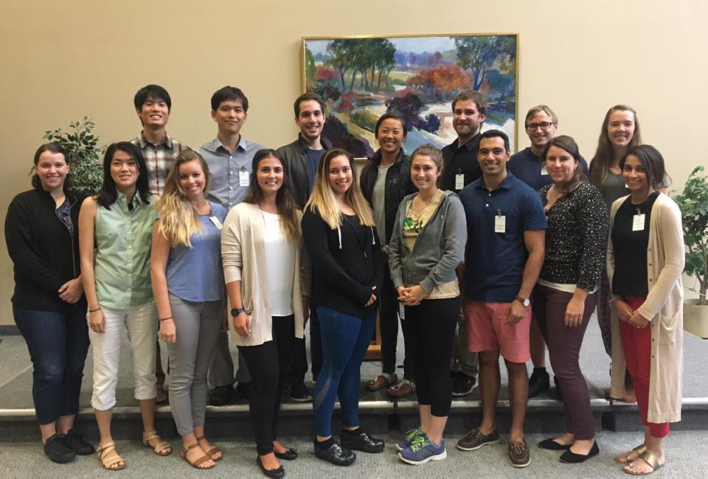
1. Summer Institute for Medical Students (SIMS) Program Description

Slide 22
1. SIMS Program Overview
Addiction is a bio-psycho-social-spiritual disease.
Treatment addresses: the whole person.
How 12 step programs are used in treatment & become part of the lifetime recovery prescription.
This is an immersion program - emotionally charged.
Ideally: Medical education group becomes a safe place to share your experiences.
SIMS participants come to learn about the science of addiction – they leave knowing the spirit of recovery.

Slide 23
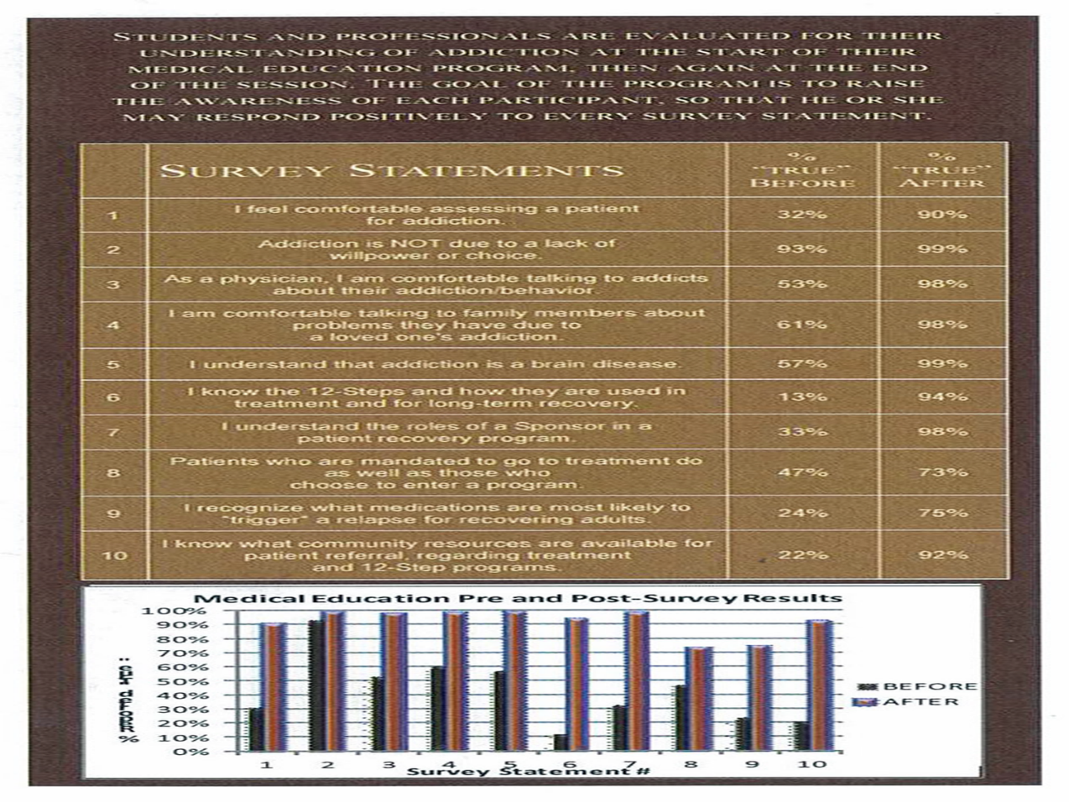
SIMS Output Data

Slide 24
2. Medical Education Partnership (MEP) Program Description
The Medical Education Partnership (MEP) program gives participants the opportunity to learn about addiction, treatment and recovery side-by-side with our expert clinicians and our treatment patients in a five-day program.
MEP provides an insider's view into the process of evidence-based, Twelve Step addiction treatment and recovery.
MEP involves:
  Classroom instruction
  Clinical observation
  Integration into patient life

Slide 25
3. Course on Addiction & Recovery Education (CARE)
Used in medical schools around the world, the CARE online curriculum prepares medical students to identify, intervene and address substance use disorders.
A first-of-its-kind online course for medical students, CARE draws from leading experts and emerging science:
Aquifer/MedU and NYU Grossman SOM platforms support easy access and navigation
Interactive format fosters learning engagement
Flexible modules allow for customization

Slide 26
4. Addiction Medicine Fellowship
With an intense focus on patient care, the Hazelden Betty Ford Eisenhower Health ACGME-Accredited Addiction Medicine Fellowship involves:
Assessing patients from admission through treatment
Administering detoxification protocols
Completing addiction-focused patient histories and physical exams
Determining pathophysiology, medical treatment and relapse indicators, proficiency in medical management, interview skills, patient education and oral presentations

Slide 27
Medical & Professional Education at HBFF
Focus Groups For 2026 And Beyond:
  Medical Students
  Medical Education Partnerships (Individual School Groups – UNECOM, UNTHSC-TCOM, TTUHSC, UNSOM, Stanford Medicine, Mayo Clinic ASOM, Western University of Health Sciences COMP, Touro COM California, PCOM, SLU SOM, Rush Medical, UTCOP, etc)
  Doctors
  Nurses, Nurse Practitioners & Physician Assistants
  Pharmacists
  Public Health
  Social Workers
  Corrections Officers
  Family Law Lawyers & Judges
  And More…

Slide 28
Summary
Addiction education is a must in all settings
Now is the time for action
If we don’t take matters into our own hands, no one will

Slide 29
Finding Hope and Healing in Recovery
Childhood experience with addiction in the family (later leading to Emmy Award winning collaboration with Nickelodeon News and Sesame Street)
Evolution into addiction on Wall Street and navigating the aftermath of the 9/11 tragedy
Recovery into career at Hazelden Betty Ford and working with the White House ONDCP, NIDA, NIAAA, SAMHSA, ASAM and ACAAM.
Lifelong dedication to dispel misconceptions around addiction, reduce stigma, and equip others (like you) with the knowledge and compassion to make a meaningful difference in the lives of those (that includes older adults) affected by addiction.

Slide 30
ADVANCEMENTS IN EDUCATION ON ADDICTION:FINDING HOPE AND
HEALING IN RECOVERY
-Questions?
-Comments?
-Thank you so much for your support!
-For more information, please contact: Joseph Skrajewski
at 760-773-4375 or jskrajewski@hazeldenbettyford.org

Slide 31
References
Brown, R. L., Batty, E., Lofwall, M., Kiviniemi, M., & Kizewski, A. (2023). Opioid use-related stigma and health care decision-making. Psychology of Addictive Behaviors, 37(2), 222–227. https://doi.org/10.1037/adb0000830
Chappel, J., Veach, T., Krug, R., 1985. The substance abuse attitude survey: an instrument for measuring attitudes. J. Stud. Alcohol 46 (1), 48–52.
Jones, C. M., Noonan, R. K., & Compton, W. M. (2020). Prevalence and correlates of ever having a substance use problem and substance use recovery status among adults in the United States, 2018. Drug and alcohol dependence, 214, 108169.
Krendl, A. C., & Perry, B. L. (2022). Addiction onset and offset characteristics and public stigma toward people with common substance dependencies: A large national survey experiment. Drug & Alcohol Dependence, 237, N.PAG. https://doi.org/10.1016/j.drugalcdep.2022.109503
Lin, C., Cousins, S. J., Zhu, Y., Clingan, S. E., Mooney, L. J., Kan, E., Wu, F., & Hser, Y.-I. (2024). A scoping review of social determinants of health’s impact on substance use disorders over the life course. Journal of Substance Use & Addiction Treatment, 166, N.PAG. https://doi.org/10.1016/j.josat.2024.209484
McNeely, J., Kumar, P.C., Rieckmann, T. et al. (2018). Barriers and facilitators affecting the implementation of substance use screening in primary care clinics: a qualitative study of patients, providers, and staff. Addict Sci Clin Pract 13, 8. https://doi.org/10.1186/s13722-018-0110-8
Muzyk, A., Smothers, Z. P. W., Akrobetu, D., Ruiz Veve, J., MacEachern, M., Tetrault, J. M., & Gruppen, L. (2019). Substance Use Disorder Education in Medical Schools: A Scoping Review. Academic medicine : journal of the Association of American Medical Colleges, 94(11), 1825–1834. https://doi.org/10.1097/ACM.0000000000002883

Slide 32
References Continued
Richmond, I. C., & Foster, J. H. (2003). Negative attitudes towards people with co-morbid mental health and substance misuse problems: An investigation of mental health professionals. Journal of Mental Health, 12(4), 393–403. https://doi.org/10.1080/0963823031000153439
Russolillo, A., Guan, M., Dogherty, E. J., Kolar, M., Du, J., Brynjarsdóttir, E., & Carter, M. (2023). Attitudes towards people who use substances: a survey of mental health clinicians from an urban hospital in British Columbia. Harm reduction journal, 20(1), 7. https://doi.org/10.1186/s12954-023-00733-w
Sastre-Rus M, García-Lorenzo A, Lluch-Canut MT, Tomás-Sábado J, Zabaleta-Del-Olmo E. Instruments to assess mental health-related stigma among health professionals and students in health sciences: A systematic psychometric review. J Adv Nurs. 2019 Sep;75(9):1838-1853. doi: 10.1111/jan.13960. Epub 2019 Mar 3. PMID: 30697780.
Shatterproof. (2020). A Movement to End Addiction Stigma: Addressing opioid use disorder stigma: The missing element of our nation’s strategy to confront the opioid epidemic [White Paper]. https://www.shatterproof.org/sites/default/files/2020-07/A-Movement-to-End-Addiction-Stigma.pdf
Substance Abuse and Mental Health Services Administration. (2024). Key substance use and mental health indicators in the United States: Results from the 2023 National Survey on Drug Use and Health (HHS Publication No. PEP24-07-021, NSDUH Series H-59). Center for Behavioral Health Statistics and Quality, Substance Abuse and Mental Health Services Administration. https://www.samhsa.gov/data/report/2023-nsduh-annual-national-report

Slide 33

ADVANCEMENTS IN EDUCATION ON ADDICTION / FINDING HOPE AND HEALING IN RECOVERY
Joseph Skrajewski, MA, MFTI
EXECUTIVE Director, Medical & PROFESSIONAL Education
hazelden betty ford foundation

