Slide 1
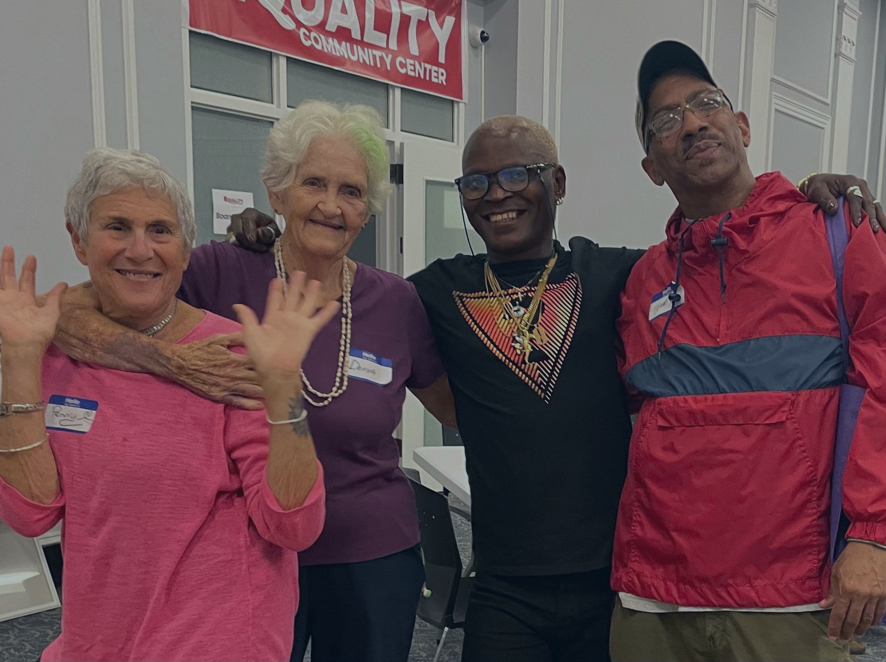
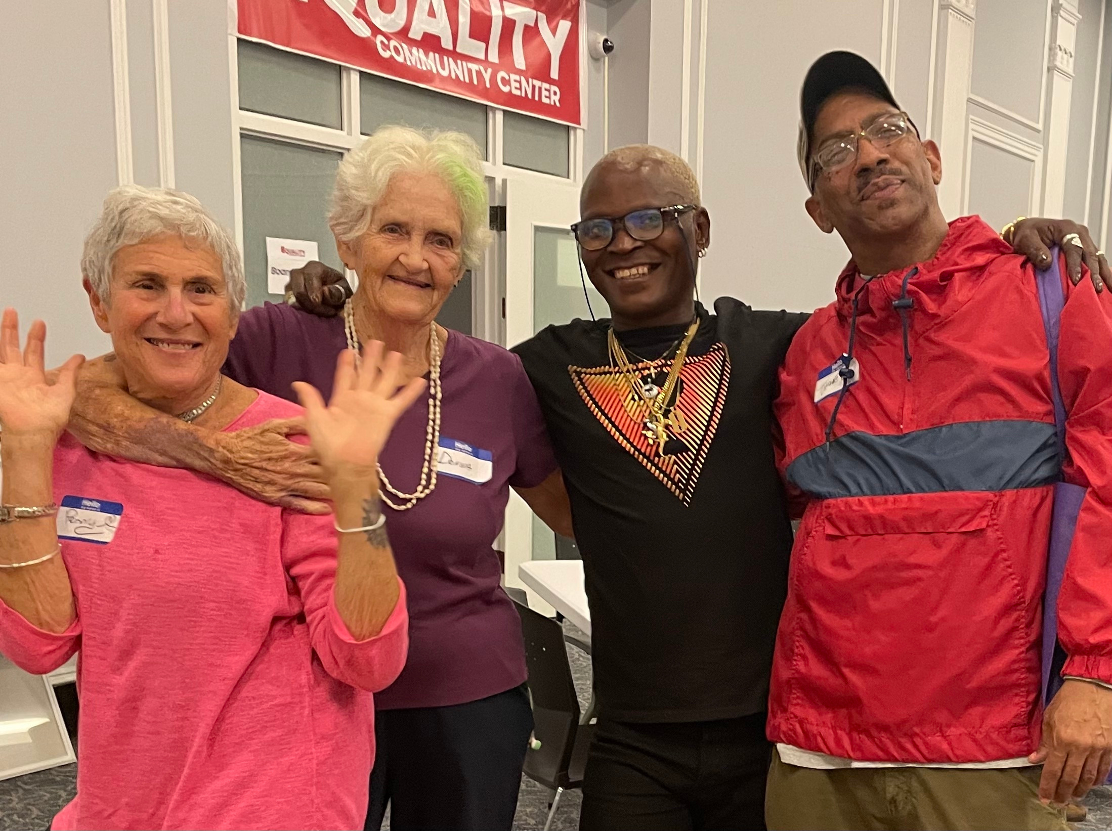


33RD MAINE GERIATRICS CONFERENCE
MAY 20, 2026
IMPROVING HEALTH CARE FOR OLDER LGBTQ+ ADULTS:
A COMMUNITY-INFORMED DISCUSSION

Slide 2

NORM SETTING
  This is a learning opportunity.
  Remain curious, open, and respectful.
  Avoid assumptions.
  Allow for mistakes.
  Share your thoughts, but also give others a chance to speak.
  What’s shared here stays here / What’s learned here leaves here.
  Take care of yourself however feels best (snacks, breaks, etc.).
  We are not here to debate people’s identities and experiences.
  Expect lack of closure.
  Any others?
WAL & JOE GROUP | 2020
Notes:
- Mention how Maine was the first state to pass marriage equality through vote

Slide 3
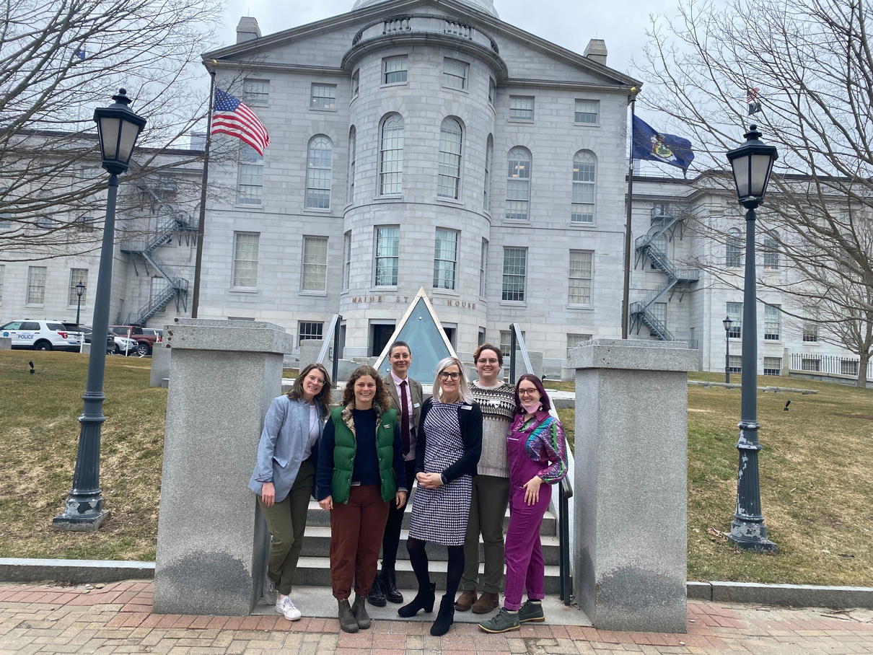
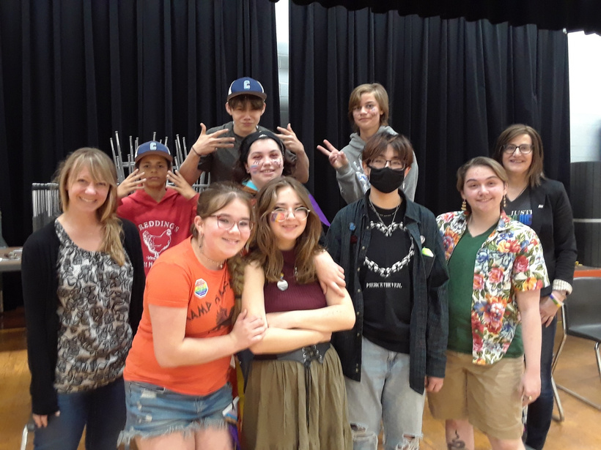
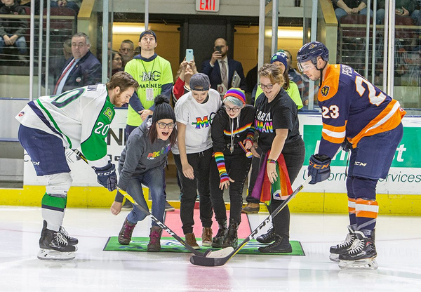
EQUALITYMAINE
Founded in 1984, EqualityMaine, which includes the Network for Older Adults, works to support Maine’s diverse LGBTQ+ population through community building, educational programs, and advocating for inclusive policies and laws.
ADVOCACY
EDUCATION
COMMUNITY
WAL & JOE GROUP | 2020
Notes:
- Mention how Maine was the first state to pass marriage equality through vote

Slide 4
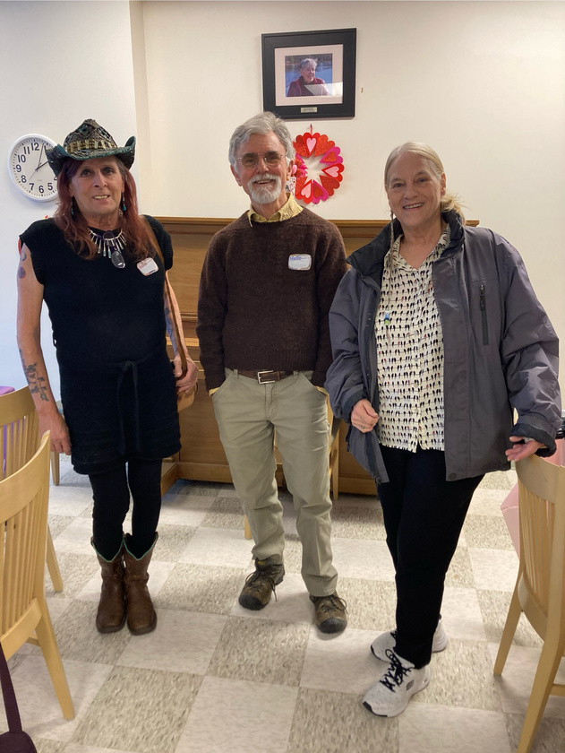
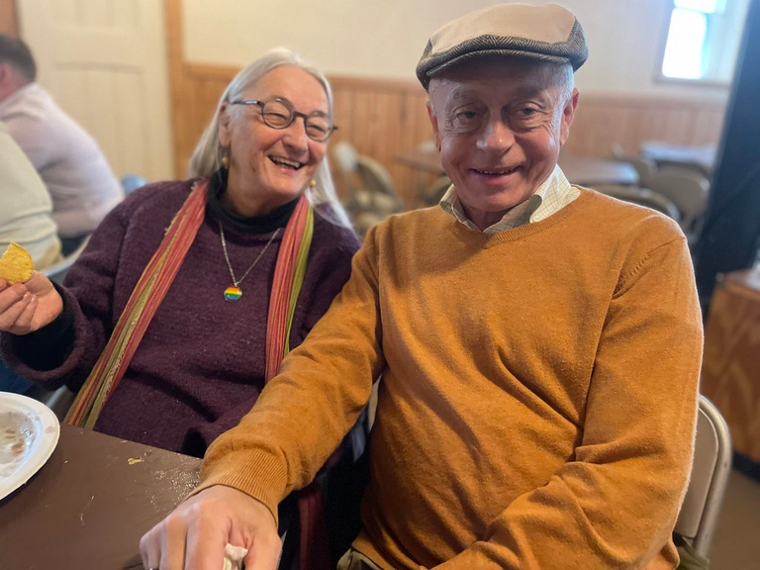
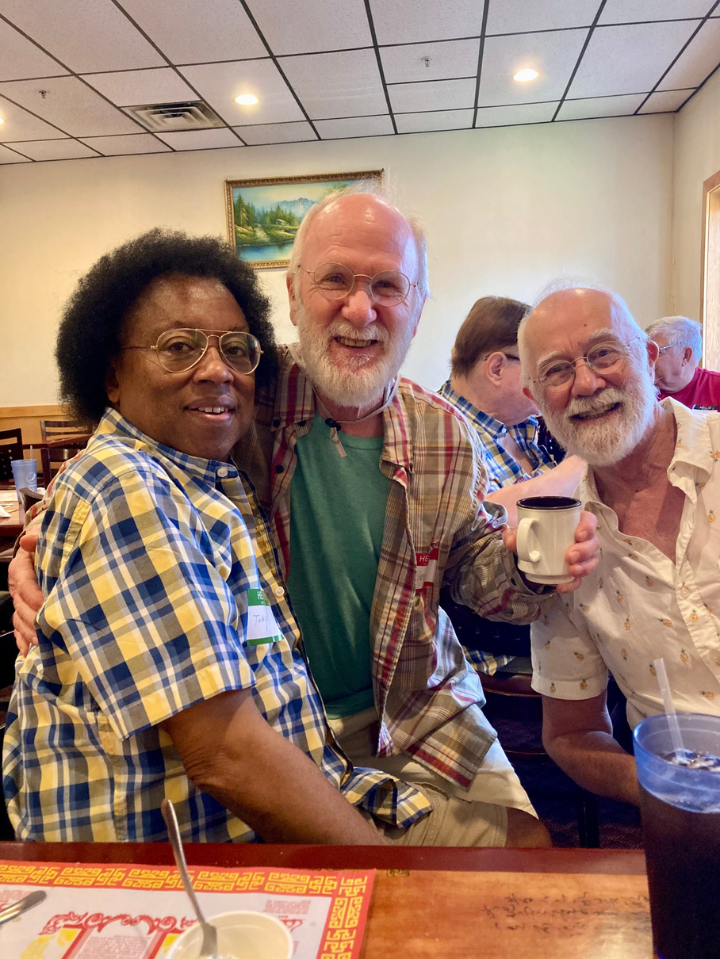
NETWORK FOR OLDER ADULTS
SAGE Maine merged with EqualityMaine in November of 2019. In 2023, the name was changed to the Network for Older Adults, or NOA. NOA is a statewide program that seeks to support, connect, and advocate with LGBTQ+ older adults in Maine.
WAL & JOE GROUP | 2020

Slide 5
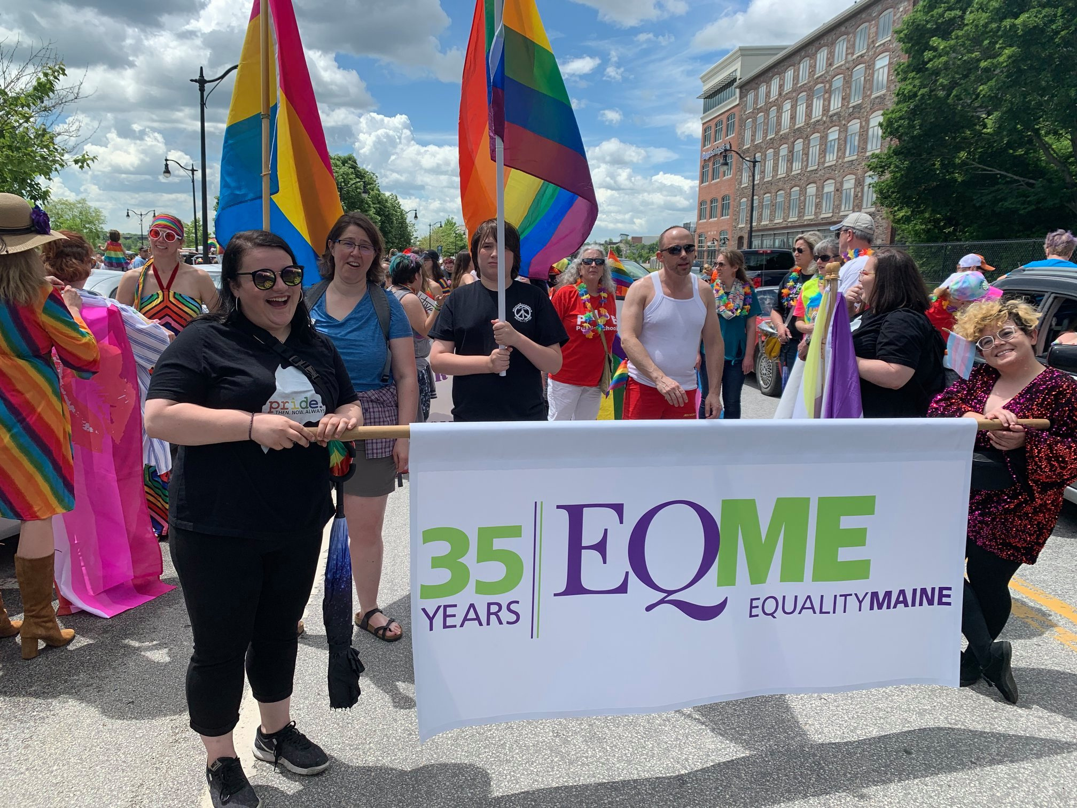
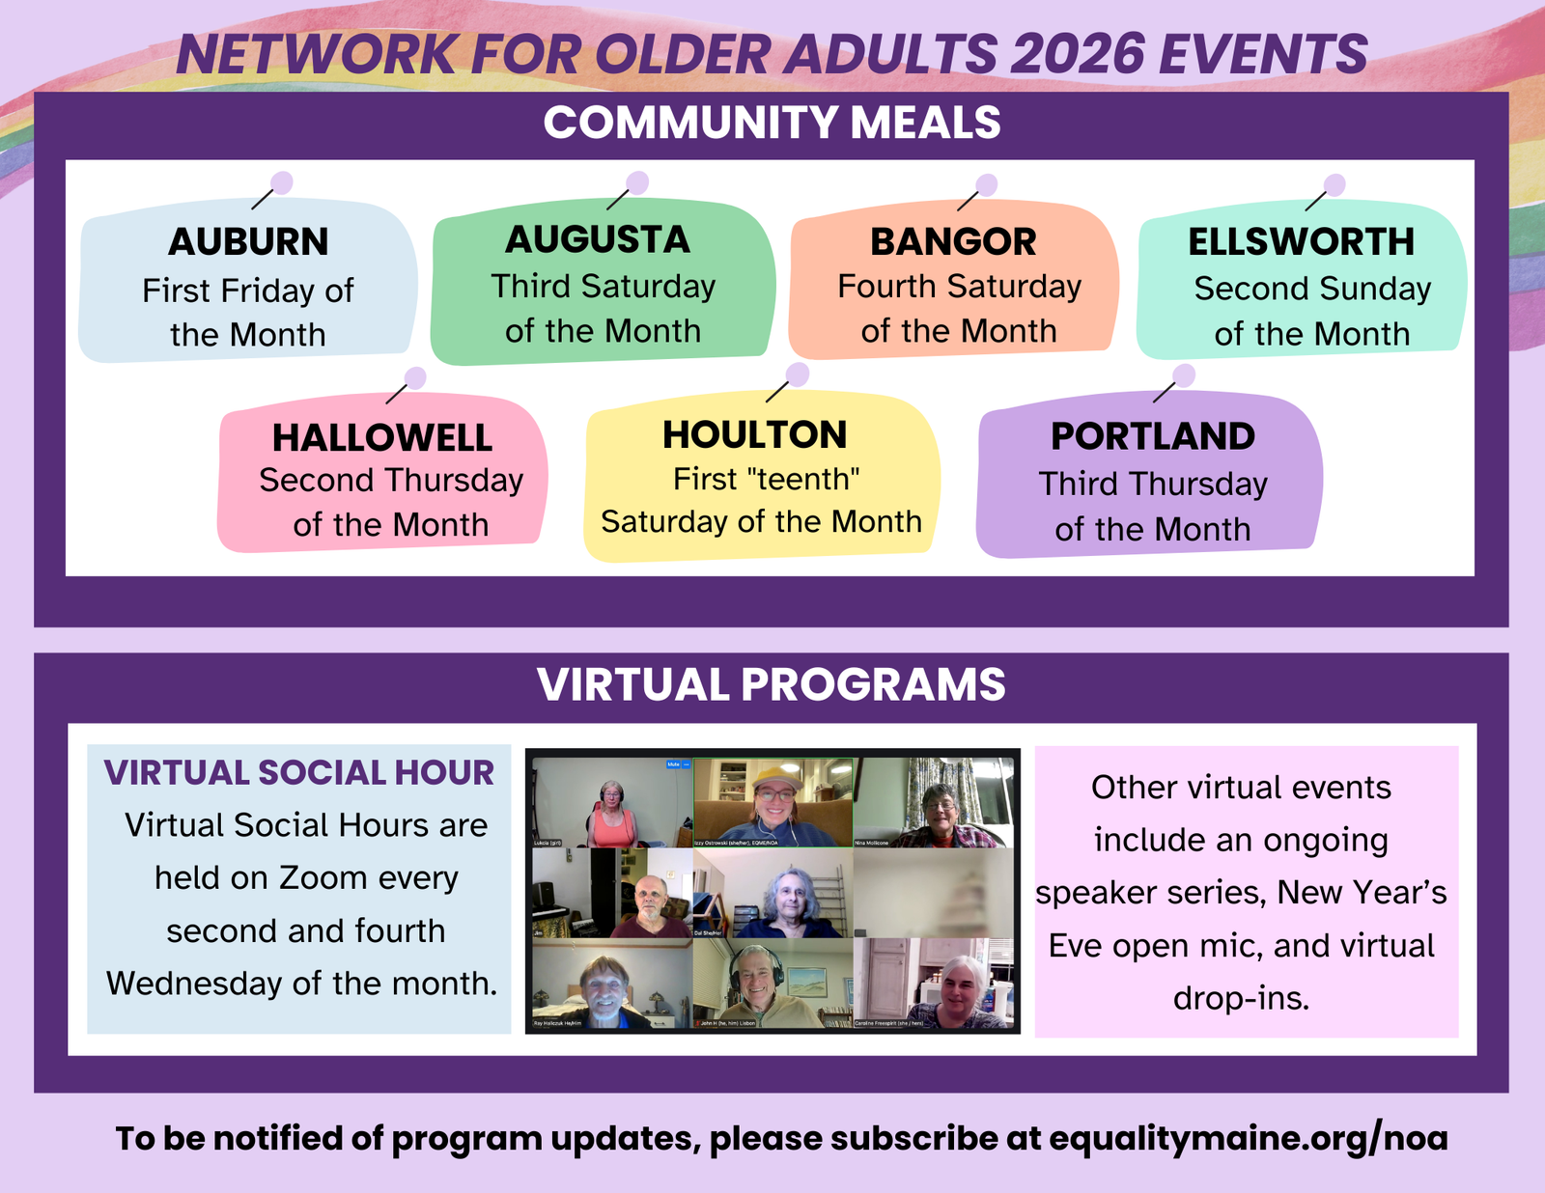
WAL & JOE GROUP | 2020

Slide 6

WAL & JOE GROUP | 2020

Slide 7
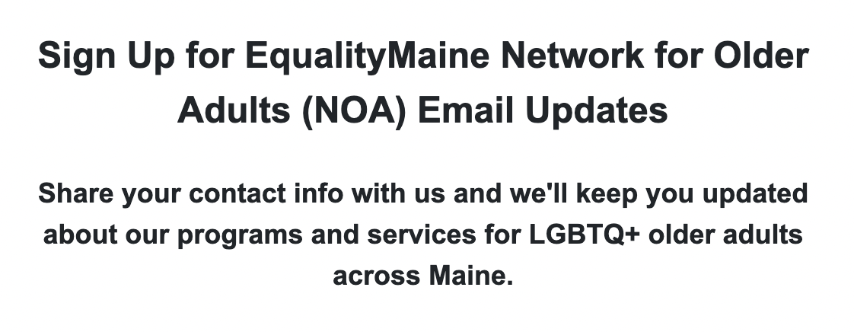


STAYING UP TO DATE WITH NOA
EQUALITYMAINE 2022

Slide 8
HOW MANY LGBTQ+ OLDER ADULTS ARE THERE IN THE UNITED STATES?
EQUALITYMAINE 2022

Slide 9
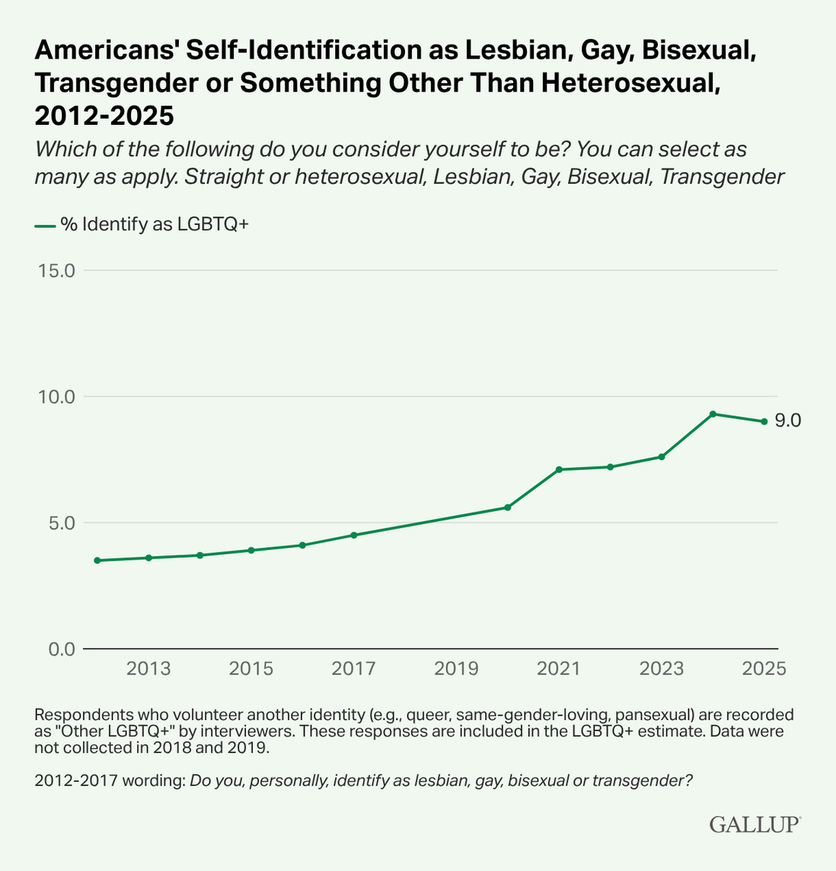
HTTPS://NEWS.GALLUP.COM/POLL/656708/LGBTQ-IDENTIFICATION-RISES.ASPX
EQUALITYMAINE 2022

Slide 10
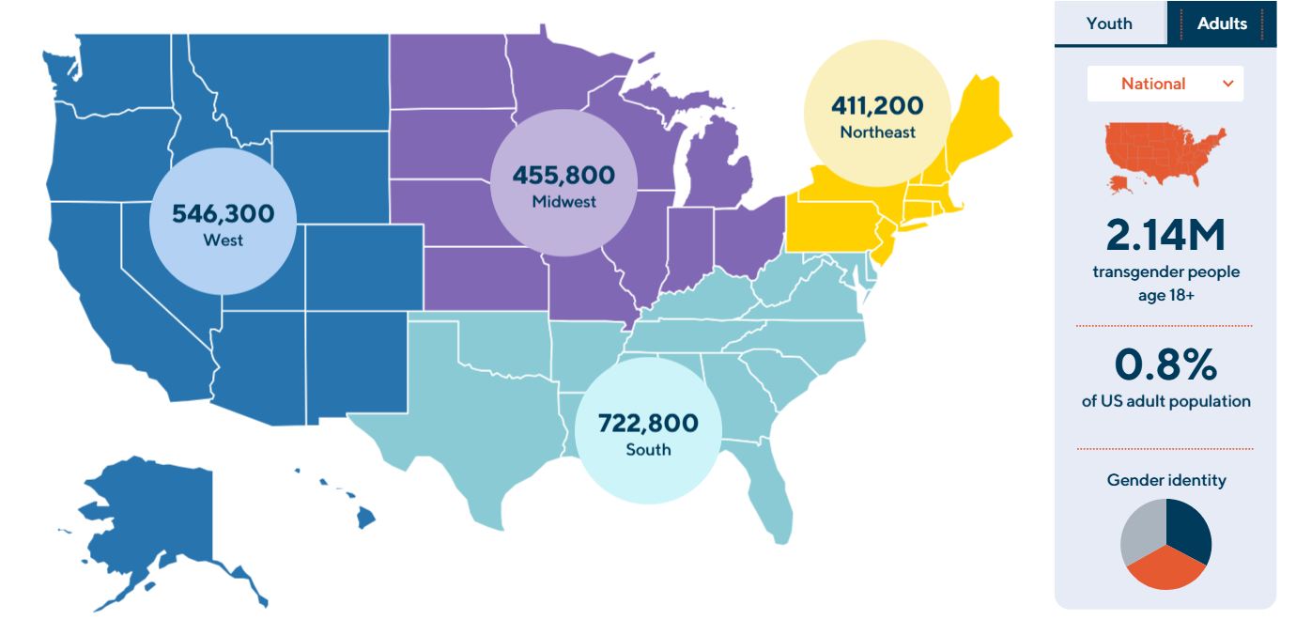
HTTPS://WILLIAMSINSTITUTE.LAW.UCLA.EDU/SUBPOPULATIONS/TRANSGENDER-PEOPLE/
EQUALITYMAINE 2022

Slide 11
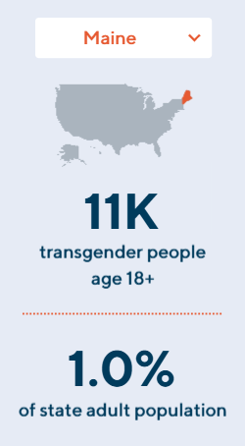
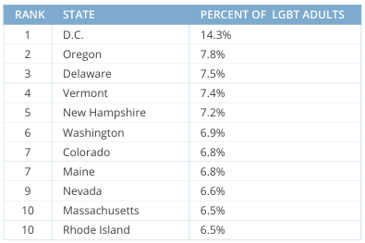
HTTPS://WILLIAMSINSTITUTE.LAW.UCLA.EDU/SUBPOPULATIONS/TRANSGENDER-PEOPLE/
HTTPS://NEWS.GALLUP.COM/POLL/656708/LGBTQ-IDENTIFICATION-RISES.ASPX
EQUALITYMAINE 2022

Slide 12
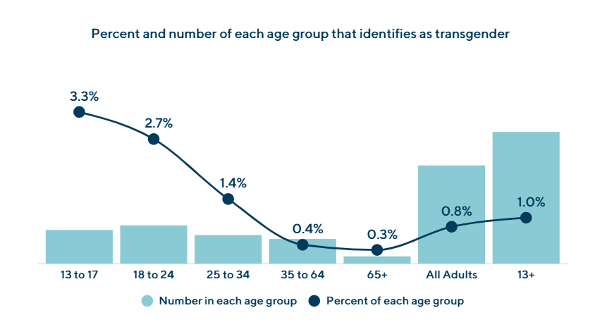
HTTPS://WILLIAMSINSTITUTE.LAW.UCLA.EDU/SUBPOPULATIONS/TRANSGENDER-PEOPLE/
EQUALITYMAINE 2022

Slide 13
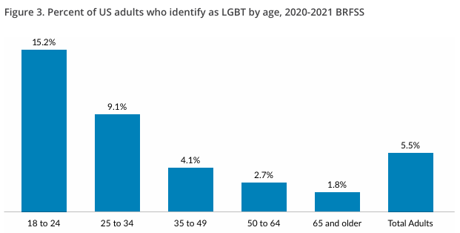
HTTPS://NEWS.GALLUP.COM/POLL/656708/LGBTQ-IDENTIFICATION-RISES.ASPX
EQUALITYMAINE 2022

Slide 14
HEALTH DISPARITIES EXIST FOR LGBTQ+ OLDER ADULTS IN THE UNITED STATES
  MORE LIKELY TO REPORT POOR MENTAL HEALTH​
  More likely to have suicidal ideation, planning, and attempts than cis- and straight-age-matched peers
  LESS LIKELY TO ACCESS PREVENTIVE SERVICES SUCH AS CANCER SCREENING AND VACCINATIONS​
  MORE LIKELY TO HAVE POOR PHYSICAL HEALTH INCLUDING CVD, DIABETES, AMONG OTHER CONDITIONS​
  MORE LIKELY TO BE DIAGNOSED WITH DEMENTIA​
AMERICAN GERIATRICS SOCIETY ETHICS COMMITTEE. AMERICAN GERIATRICS SOCIETY CARE OF LESBIAN, GAY, BISEXUAL, AND TRANSGENDER OLDER ADULTS POSITION STATEMENT: AMERICAN GERIATRICS SOCIETY ETHICS COMMITTEE. J AM GERIATR SOC. 2015;63(3):423-426. DOI:10.1111/JGS.13297​
CAPISTRANT BD, NAKASH O. SUICIDE RISK FOR SEXUAL MINORITIES IN MIDDLE AND OLDER AGE: EVIDENCE FROM THE NATIONAL SURVEY ON DRUG USE AND HEALTH. AM J GERIATR PSYCHIATRY. 2019;27(5):559-563. DOI:10.1016/J.JAGP.2018.12.023​
HOY-ELLIS CP, FREDRIKSEN-GOLDSEN KI, KIM HJ. UTILIZATION OF RECOMMENDED PREVENTIVE HEALTH SCREENINGS BETWEEN TRANSGENDER AND CISGENDER OLDER ADULTS IN SEXUAL AND GENDER MINORITY COMMUNITIES. J AGING HEALTH. 2022;34(6-8):844-857. DOI:10.1177/08982643211068557​
FREDRIKSEN-GOLDSEN KI, COOK-DANIELS L, KIM HJ, ET AL. PHYSICAL AND MENTAL HEALTH OF TRANSGENDER OLDER ADULTS: AN AT-RISK AND UNDERSERVED POPULATION. GERONTOLOGIST. 2014;54(3):488-500. DOI:10.1093/GERONT/GNT021​

Slide 15
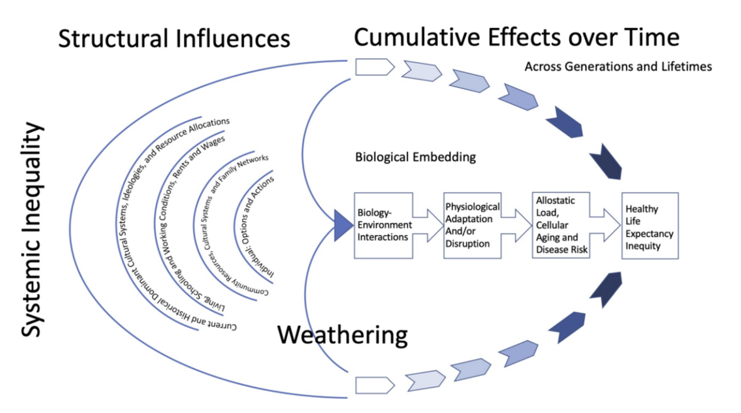
GERONIMUS AT, PEARSON JA, LINNENBRINGER E, ET AL. WEATHERING IN DETROIT: PLACE, RACE, ETHNICITY, AND POVERTY AS CONCEPTUALLY FLUCTUATING SOCIAL CONSTRUCTS SHAPING VARIATION IN ALLOSTATIC LOAD. MILBANK Q. 2020;98(4):1171-1218. DOI:10.1111/1468-0009.12484​
EQUALITYMAINE 2022

Slide 16
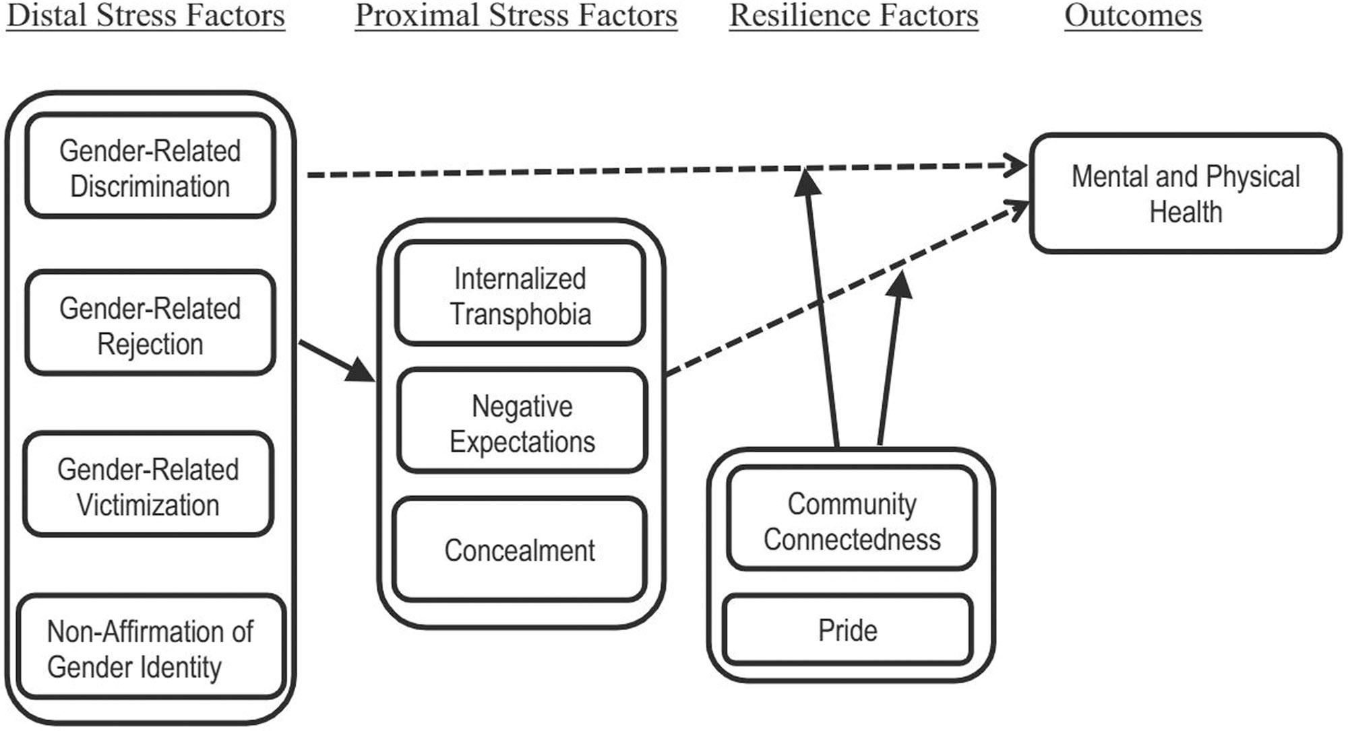
STREED CG JR, BEACH LB, CACERES BA, ET AL. ASSESSING AND ADDRESSING CARDIOVASCULAR HEALTH IN PEOPLE WHO ARE TRANSGENDER AND GENDER DIVERSE: A SCIENTIFIC STATEMENT FROM THE AMERICAN HEART ASSOCIATION. CIRCULATION. 2021;144(6):E136-E148. DOI:10.1161/CIR.0000000000001003
EQUALITYMAINE 2022

Slide 17
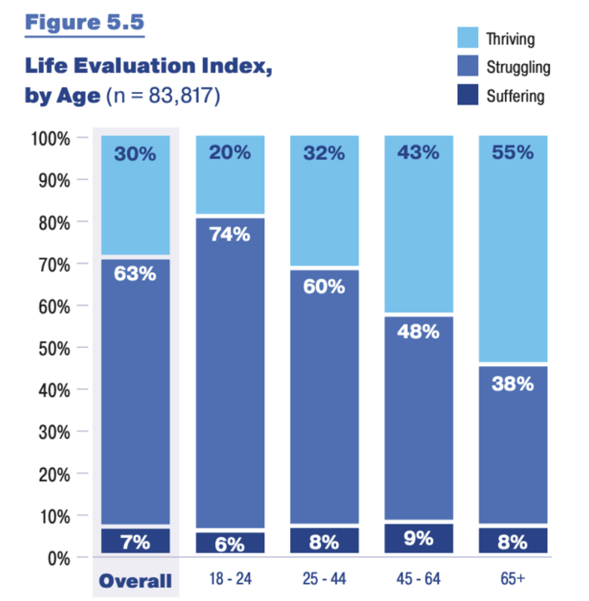
U.S. TRANS SURVEY 2022
HEALTH AND WELLBEING REPORT
HTTPS://TRANSEQUALITY.ORG/SITES/DEFAULT/FILES/2025-06/USTS_2022HEALTH%26WELLBEINGREPORT_WEB.PDF
EQUALITYMAINE 2022

Slide 18
We wanted to better understand how older LGBTQ+ adults were experiencing healthcare in the State of Maine...
EQUALITYMAINE 2022

Slide 19
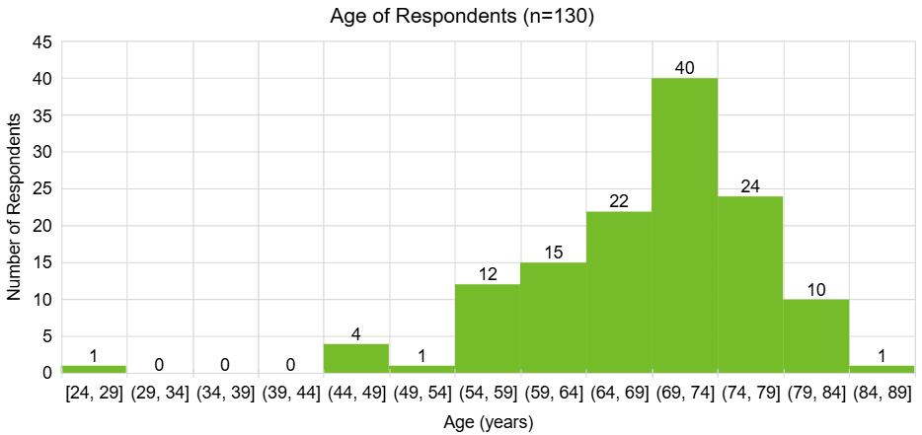
EQUALITYMAINE 2022

Slide 20
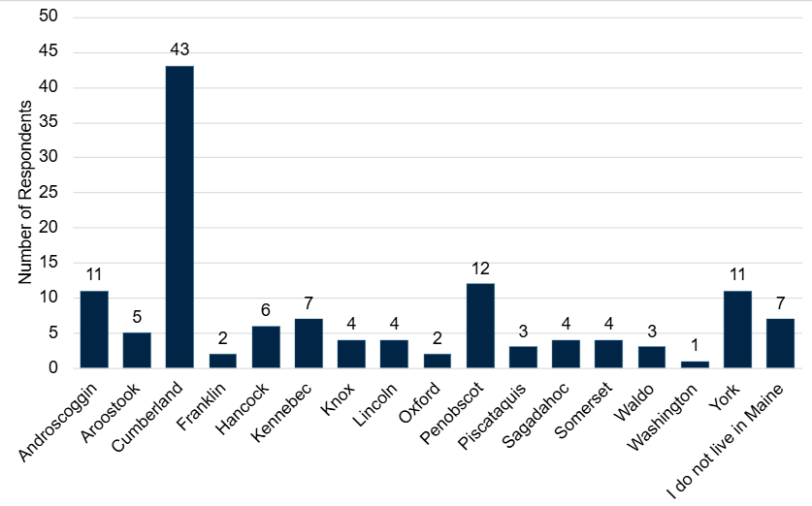
EQUALITYMAINE 2022

Slide 21
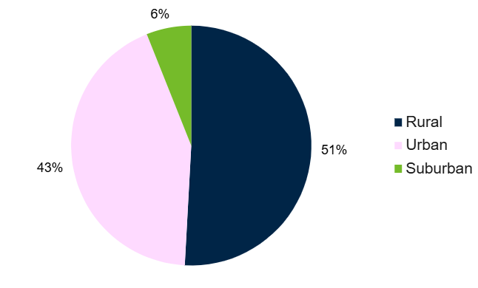
EQUALITYMAINE 2022

Slide 22
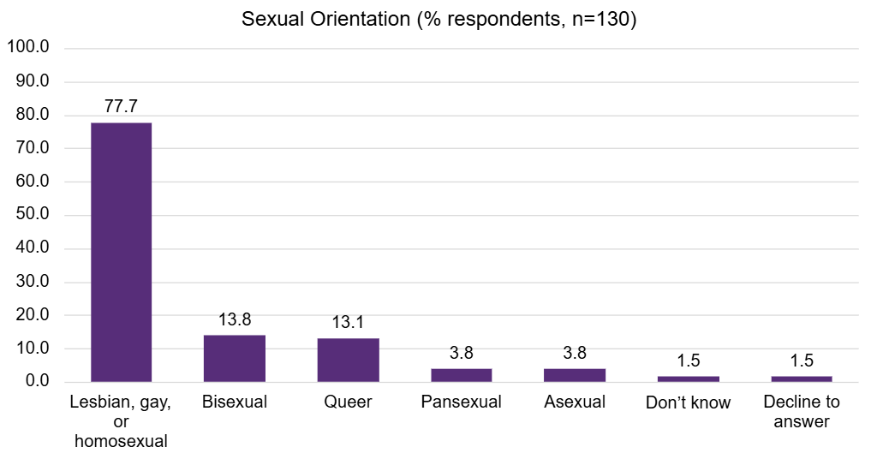
EQUALITYMAINE 2022

Slide 23
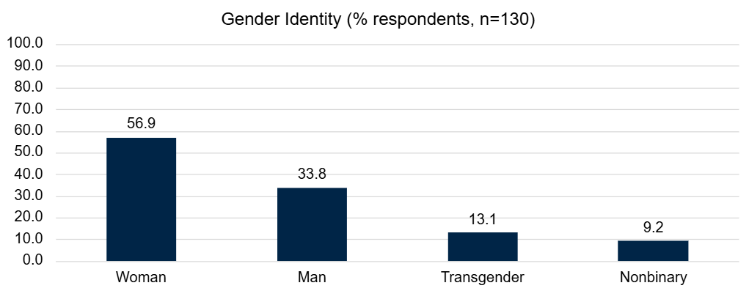
EQUALITYMAINE 2022

Slide 24
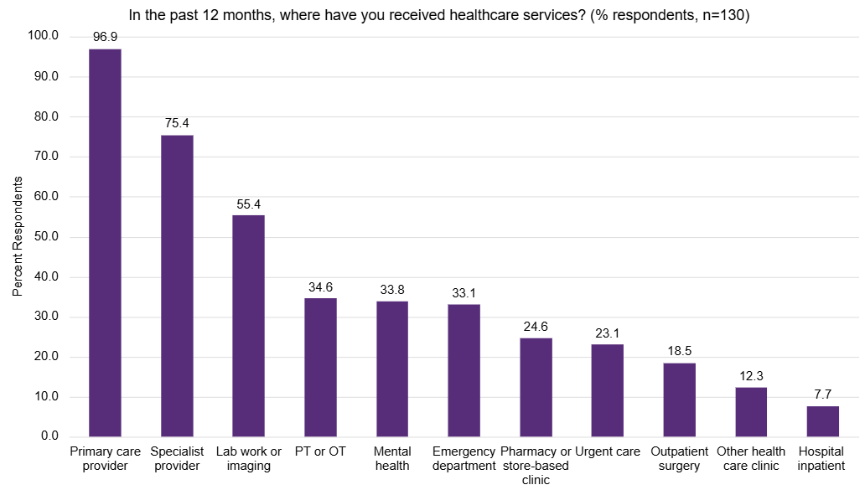
EQUALITYMAINE 2022

Slide 25
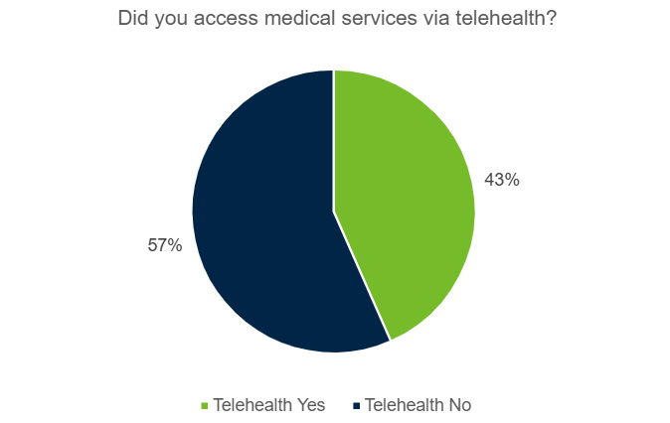
EQUALITYMAINE 2022

Slide 26
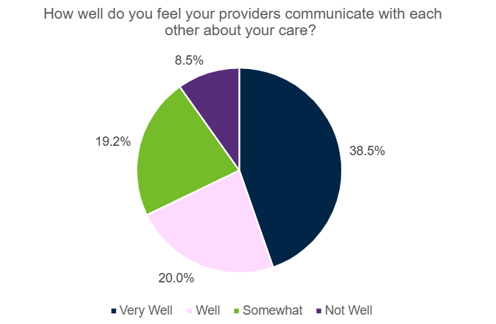
EQUALITYMAINE 2022

Slide 27
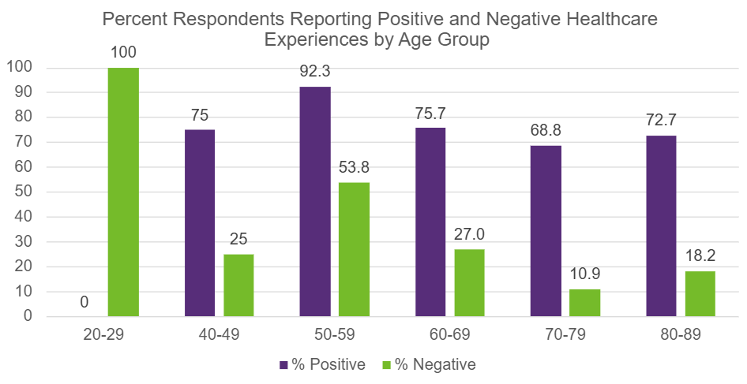
EQUALITYMAINE 2022

Slide 28
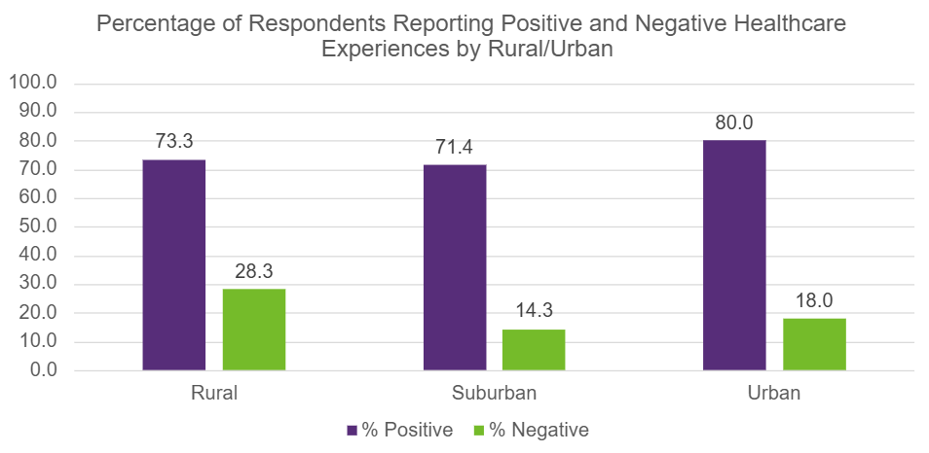
EQUALITYMAINE 2022

Slide 29
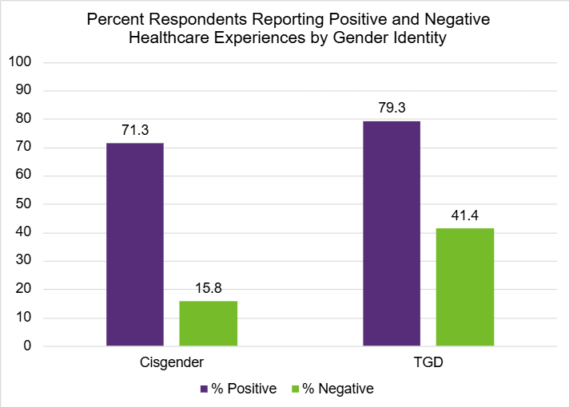
EQUALITYMAINE 2022

Slide 30
LGBTQ+ Older Adult Story Sharing
EQUALITYMAINE 2022

Slide 31
Discussion and Q&A
EQUALITYMAINE 2022

Slide 32
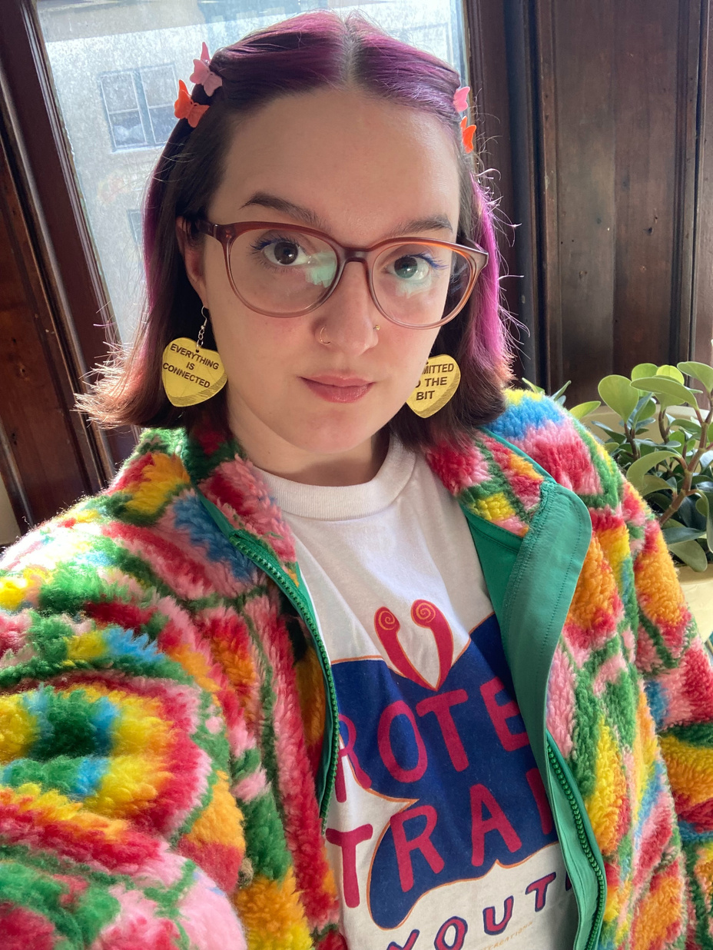

CONTACT INFO
IZZY OSTROWSKI (SHE/HER)
DIRECTOR OF NOA AND COMMUNITY ENGAGEMENT
Mailing address
EqualityMaine
PO Box 1951
Portland, ME 04104
Email address
izzy@equalitymaine.org

Slide 33
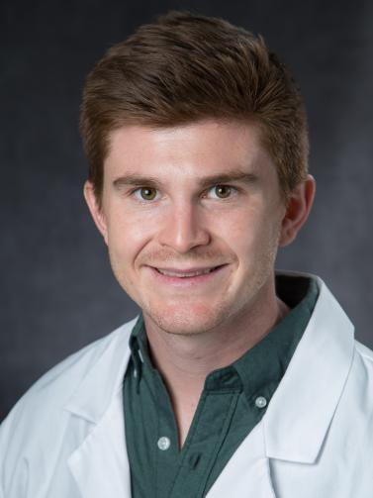
CONTACT INFO
TOBY NICHOLSON, MD, MPH, ScM, AAHIVS (he/him)
Family and Preventive Medicine Physician
Email address
tobias.nicholson@mainehealth.org

