Slide 1
Addressing Ageism in Healthcare
Marilyn R. Gugliucci, MA, PhD AGHEF, GSAF, AGSF, NAOMEF
Professor, Division of Geriatrics
Director, Geriatrics Education & Research
University of New England College of Osteopathic Medicine
Rebecca Spear, DO, FACP
Fellowship Program Director, Maine-Dartmouth
Clinical Assistant Professor, Internal Medicine, UNECOM

Slide 2
Objectives
Define ageism and ageism in healthcare
Raise consciousness of how ageism occurs in healthcare
Address ageism in healthcare and how to impact lasting change

Slide 3
Combat AGEISM ~ WHO
Global Campaign to Combat Ageism - #AWorld4AllAges – YouTube

Slide 4
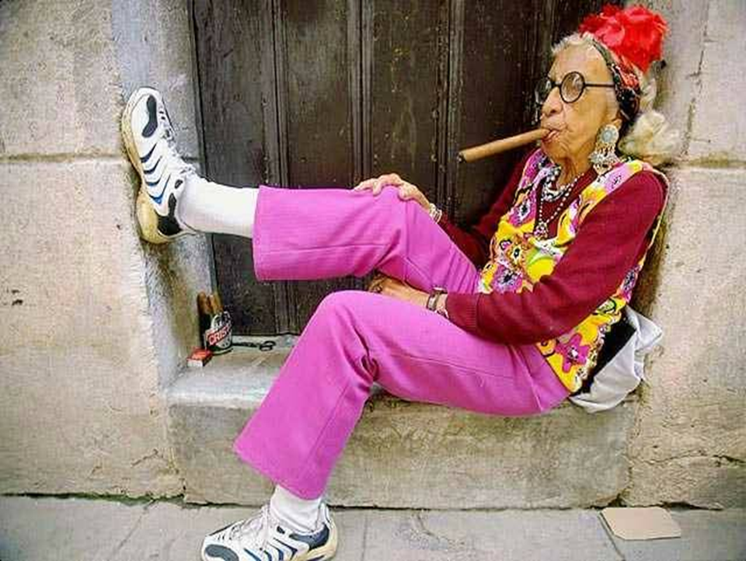
Definitions…
Notes:
My Goal in life is to change the world regarding negative attitudes about aging.
Coach in a former life – so use auditory, kinesthetic and visual modes for learning
Who here is eager to turn 70, 80 or 90?? Eager not Anxious??? What does our society say about older adults and aging? What kind of drivers are they? What about their personality?
How many here work with Geriatric Patients??? Will address this later…

Slide 5
AGEISM Defined ~ WHO
The stereotypes (how we think), prejudice (how we feel) and discrimination (how we act) directed towards people on the basis of their age.
3 Dimensions (Multifaceted social phenomenon)
Institutional/Societal
Interpersonal
Self-directed
World Health Organization (WHO), 2021

Slide 6
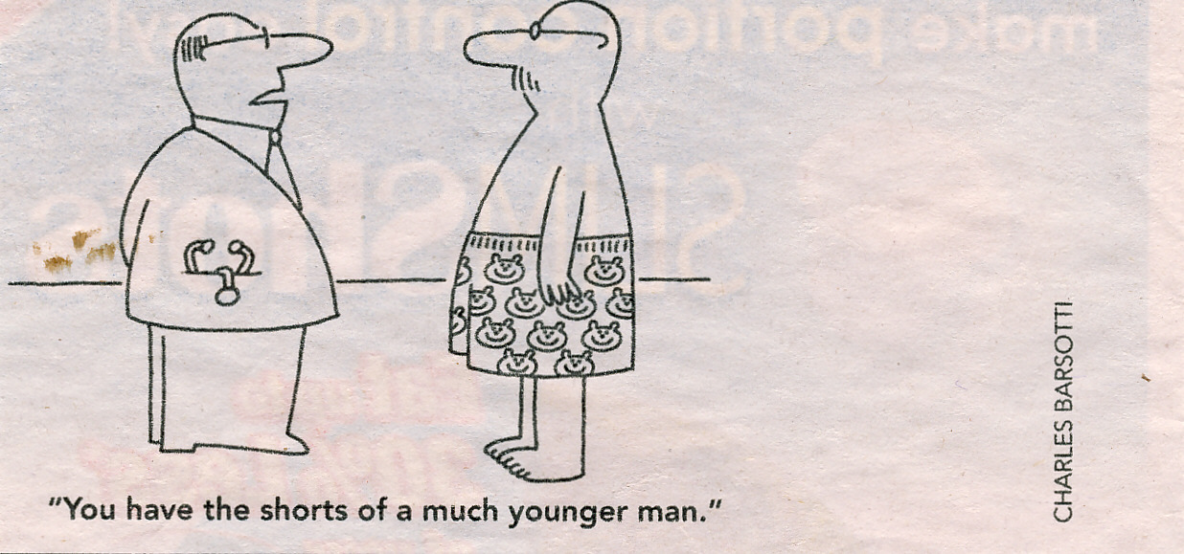
Important Info…
5-7 Avg #...
10-14 ….
65% …. 17%
$63 Billion…
Geriatricians…
Highest Happiness Quotient
Age Categories in the US
Young-Old = 65-74 years of age
Old = 75-84 years of age
Old(est)-Old = 85 years and better (older)
Oldest-Old = 100+

Slide 7
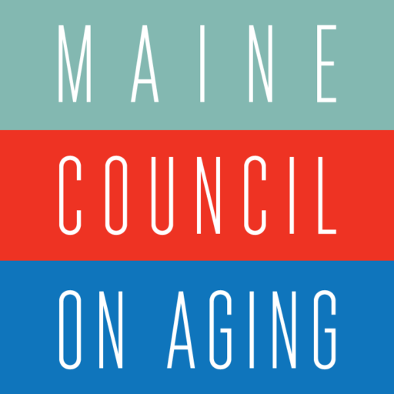
Ageism Experiences
December 2019 University of Michigan National Poll on Healthy Aging

Slide 8
Dimensions of Ageism

Slide 9
Guiding Questions
Where have you seen these domains of ageism in healthcare?
What can you do to impact this and move toward age positivity?

Slide 10
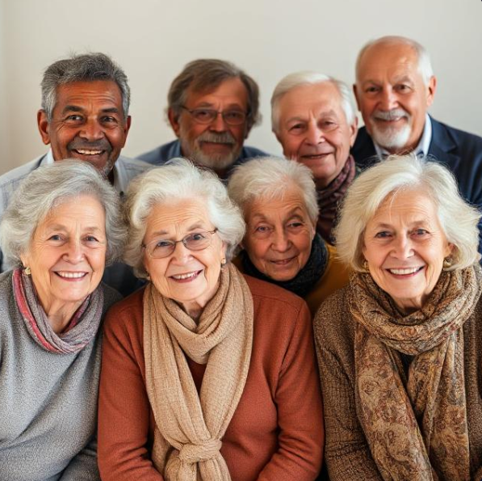

Slide 11
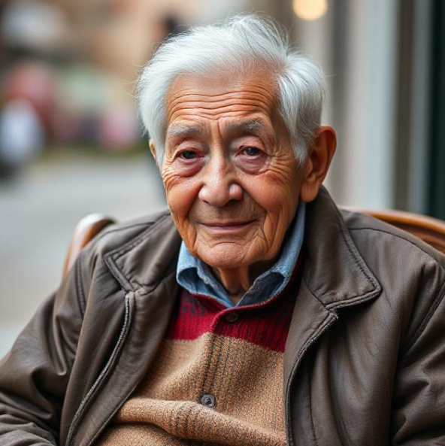
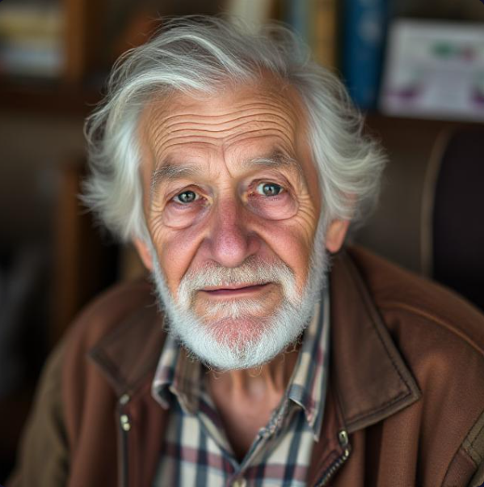
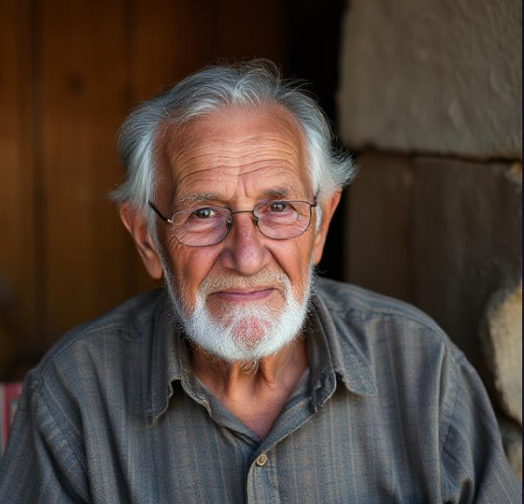
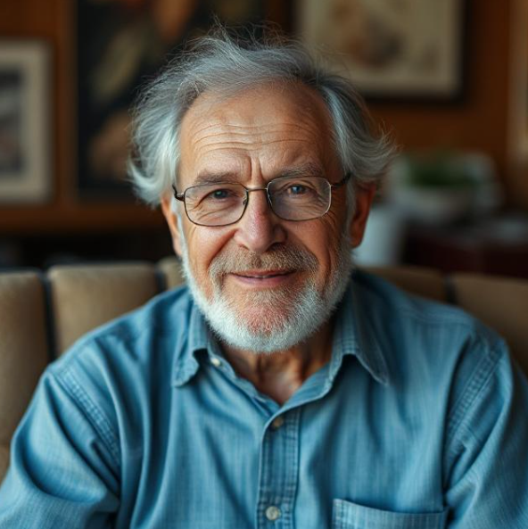
Reframing Aging
Frameworks Institute, 2019
National Center to Reframe Aging
Least
Competent
Most
Competent
Senior Elder Senior Older Older Citizen Person Adult
69 yrs 69 yrs 68 yrs 64 yrs 54 yrs
Age Association

Slide 12
AGE Friendly Health Systems 4 Ms

Slide 13
Avoiding Elderspeak
Voice: loud and slow
Tone: high pitched
Body Language: facing the care partner
Resistiveness to care:
Increased with the use of elderspeak
Williams et al. 2008

Slide 14
Communication Pie Chart
55%
Body
Language
38%
Voice
Tone
“…if words and body language disagree, one tends to believe the body language.”
A. Mehrabian, 1987

Slide 15
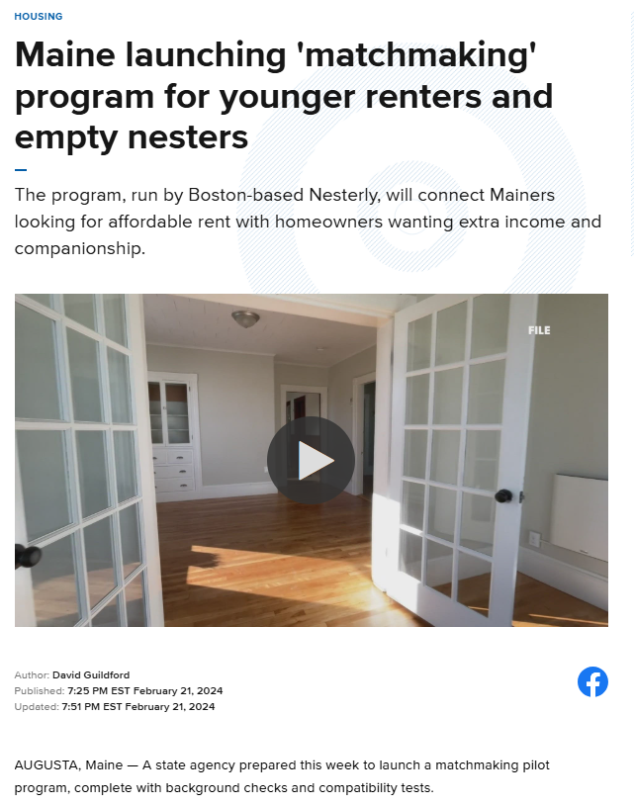
Intergenerational Experiences
Geriatrics Education Mentors (GEMs)
Adult Day
Intergenerational Housing

Slide 16
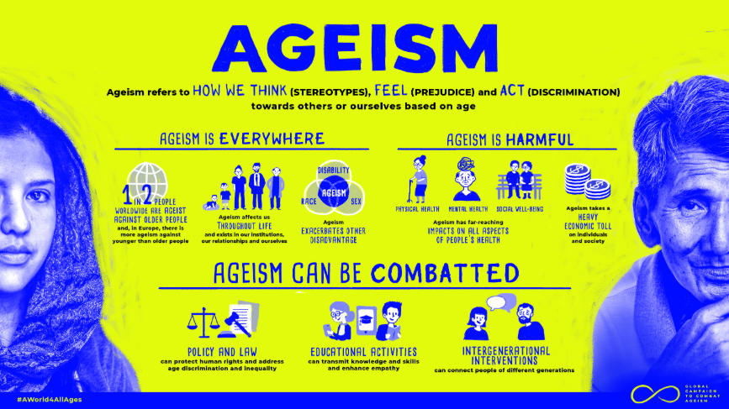
Movements and Initiatives
Age+ ME- MCOA
AARP
World Health Organization

Slide 17
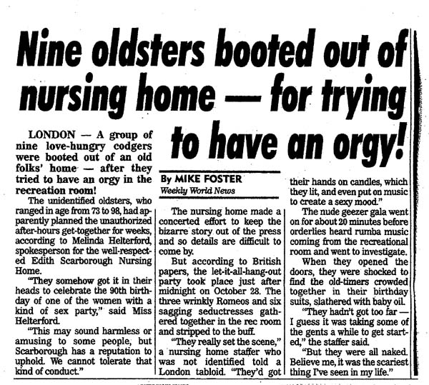
Weekly World News, London, Nov 28, 2000:

Slide 18
References
Age+ME. Maine Council on Aging. https://mainecouncilonaging.org/agepositiveme/
Age Friendly Health Systems. Institute For Healthcare Improvement. https://www.ihi.org/networks/initiatives/age-friendly-health-systems
Global Report on Ageism. World Health Organization. https://www.who.int/teams/social-determinants-of-health/demographic-change-and-healthy-ageing/combatting-ageism/global-report-on-ageism
Living 100. AARP. https://www.aarpinternational.org/living-100/outlook
Maine launching “matchmaking” program for younger renters and empty nesters. News Center Maine. Feb 21, 2024. https://www.newscentermaine.com/article/news/local/housing/maine-launching-matchmaking-program-younger-renters-empty-nesters-housing/97-79da2189-0728-4bed-8a5a-092bb195fdb0
Nine Oldsters booted out of nursing home- for trying to have an orgy!. World Weekly news, London. Nov 28, 2000.
Experiences with Everyday Ageism. University of Michigan National Poll on Healthy Aging. 2019
Williams KN, Herman R, Gajewski B, Wilson K. Elderspeak communication: impact on dementia care. Am J Alzheimers Dis Other Demen. 2009 Feb-Mar;24(1):11-20. doi: 10.1177/1533317508318472. Epub 2008 Jun 30. PMID: 18591210; PMCID: PMC2823803.

