Slide 1

Advancing Policy for Older Mainers
32nd Maine Geriatrics Conference
Karen Mason
Associate Director
Office of Aging & Disability Services
Maine Department of Health and Human Services
May 22, 2025

Slide 2
Outline
  State & Federal Landscape
  Home and Community-Based Supports
  Long-Term Care
  Workforce
  Cabinet on Aging

Slide 3
State Of Maine Landscape
“Part 1” Budget Passed
  Closes MaineCare shortfall in SFY 25’
  Maintains Current Services in SFY 26’-27’ biennium
  Legislature included a 1.95% COLA Increase for Direct Care Workers
“Part 2” Budget
Legislature is now working on new or expanded
programs for SFY 26’-27’
  Not likely to be completed until late in the session (late June)

Slide 4
Federal Landscape
Closely monitoring proposed reductions
  Medicaid
      House: Goal to act by Memorial Day
      Senate: By this summer
  Older Americans Act funded services

Slide 5
Caregiver Supports: Respite for ME Evaluation
  Highlights
  After receiving Respite for ME Grants services for 90 days, the proportion of caregivers participating in Year 2 indicated:
    High Stress scores decreased by 10%
    Low financial strain increased by 6%
    High Depression scores decreased by 14%
    Negative impacts on the ability to work declined by 22%
    Negative impacts on job performance declined by 9%
Notes:
50% of caregivers had lower overall burden scores.
Negative impacts on job performance decreased by 16%.
High financial strain decreased by 13%.

Slide 6
Caregiver Supports: Respite for ME
  Department sponsored LD 709, “An Act to Establish the Respite for ME Program”, to codify lessons learned from the pilot program funded by the Maine Jobs and Recovery Plan.
  Repeals the State Respite Care Program and replaces state statute to build upon the well-documented success of the Respite for ME pilot by establishing family caregiver services that align with the National Family Caregiver Support Program.
  Signed by Governor Mills and will become law later this year.
  OADS has started the process of updating program policies through rulemaking.
Notes:
50% of caregivers had lower overall burden scores.
Negative impacts on job performance decreased by 16%.
High financial strain decreased by 13%.

Slide 7
Home and Community-Based Supports
  Strengthening Home Care - Implemented the Department’s proposal to license personal care agencies to improve quality, person-centeredness, and consistency of care
  Nurse Delegation
  Implementation of new Federal Rules
    Older Americans Act (OAA) Final rule
    Ensuring Access to Medicaid Services Final Rule
  MaineCare Clinical Services Rate Analysis in process

Slide 8
Access Navigator Tool
Funded by Section 9817 of the American Rescue Plan Act (ARPA)
Allows the public to self-assess their needs using a comprehensive questionnaire to make tailored recommendations and referrals.​
User can choose to navigate resources on their own or connect with an Aging and Disability Resource Center (ADRC) Specialist at their local Area Agency on Aging (AAA) via emailed submission of results.
78% of users elected to connect to their local AAA for additional assistance.
85.71% of respondents to satisfaction survey felt the tool was very easy to use.
Exploring opportunities to enhance functionality and expand use in the future.
Maine Access Navigator: Maine Office of Aging and Disability Services

Slide 9
Caregiver Supports: Adult Day
  Initiative for licensed Maine-based Adult Day Centers to improve access to Adult Day Services. The initiative included 2 Parts:
    Part One: Pilot funding aimed at enhancing service delivery, access, and community outreach
    Part Two: Statewide campaign to rebrand and market Adult Day Services to promote the benefits of Adult Day Services for caregivers and eligible individuals

Slide 10
Caregiver Supports: Adult Day
Part One- Pilots
OADS awarded 4 pilot projects- Aroostook Area Agency on Aging, Spectrum Generations, Maine General and Southern Maine Area Agency on Aging
Pilot Highlights included:
  Developing Helping families navigate the paperwork and process of enrolling in Adult Day services
  Explored volunteer and local transportation options to reduce transportation barriers
  Establish training programs to assist persons with dementia to use transportation options effectively
  Explored the efficacy of trial visits to improve enrollment
  Explored the feasibility of expanding service hours
  Implemented local outreach /education / marketing campaigns

Slide 11

Caregiver Supports: Adult Day
Part Two- Statewide Marketing
Through the Request for Proposal (RFP) process, Burgess Advertising and Marketing was selected to assist the Department in developing a comprehensive statewide marketing plan that included the rebranding of adult day services, a multimedia campaign and website development. The marketing campaign launched on September 9, 2024.
https://www.maine.gov/dhhs/oads/get-support/older-adults-disabilities/adult-day-services

Slide 12
Caregiver Supports:
Mental Health First Aid and Family to Family
Contracted with the National Alliance of Mental Illness (NAMI) Maine to deliver two national best-practice education programs: Mental Health First Aid (MHFA) and Family to Family(F2F)
Focuses on providing strategies and tools to family and/or formal caregivers supporting adults living with physical disabilities and mental health challenges
Completed 14 sessions to a total of 150+ caregivers from May 2023 through February 2025
This Pilot also funded the creation of NAMI's Mental Health Wellness Toolkit

Slide 13
Long-Term Care &
Nursing Home Reform
October 2024 - final rate model is released to include:
  3-year Quality Bonus Pool (made possible by the Transition Fund appropriated by the Legislature)
  February 2025 – new rates went live. Specialty Care rate reform work begins for residents with brain injury (BI) or medical-psychiatric (MPU) needs
  QuEST launched to support Nursing Facilities (NF’s)improve quality

Slide 14

What is QuEST?
3 unique and complementary initiatives to support quality improvement in NF's. Monthly webinars (each meets quarterly) with a focus on:
Reducing overuse of antipsychotic medications
Increasing stability in staffing
Understanding each of the measures, how to implement, and how to improve
Each initiative supports a selected quality measure:
Percentage of nursing staff turnover
Patient & family experience of care (CoreQ)
Antipsychotic Use
Urinary tract infections (monitoring only)

Slide 15
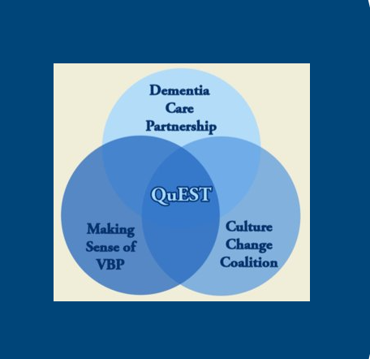
QuEST Supports
Making Sense of Value-Based Purchasing
  Technical support for understanding the "nuts and bolts" of VBP
Dementia Care Partnership
  Support for decreasing the overuse of antipsychotic medications
Culture Change Coalition
  Support for stabilizing staffing to improve nursing staff turnover and decrease the use of temporary agency staff

Slide 16
Assisted Housing Rule
Current rules were adopted back in 2008
Rule is major substantive and is currently in the legislative review process (A hearing was held – Work Session scheduled
  If the Legislature passes the proposed rule, it will go into effect
Represents consolidation of 10 parts into 2 parts: Assisted Living Facilities and Residential Care Facilities
Department plans to have a separate rule for small HCBS settings, which we licensed under the previous Assisted Living Rule

Slide 17
Direct Service Worker (DSW)
Core Curriculum
Streamline Entry to direct care and support across settings and groups of people​
Baseline portable credential for PSS/DSP​
Hybrid learning model- Asynchronous 12 hours online training and 8 hours LIVE
Increased efficiency to obtain certification – decrease in the amount of time​
​
Better Prepared Workforce ​
Stronger, more relevant training for those who work with aging population​
Aging training for those that serve the IDD population
Improves quality of training, offering up-to-date, person-centered practices​
Behavioral health concepts integrated throughout ​
​
Improved Learning Experience​
Highly interactive online learning
Closed captioning and narration on each slide​
Translated into the top 5 new Mainer languages and ASL​
Hands-on skills demonstration​
​
Pilot program has been launched to private pay personal care agencies, as we wait to open MaineCare rule

Slide 18

Direct Care and Support Media Campaign
Building on Caring for ME, a new media campaign titled:
Careers with Purpose
Connecting Lives, Advancing Community
Rolled out in the Summer of 2024
https://mainecareerswithpurpose.org/

Slide 19
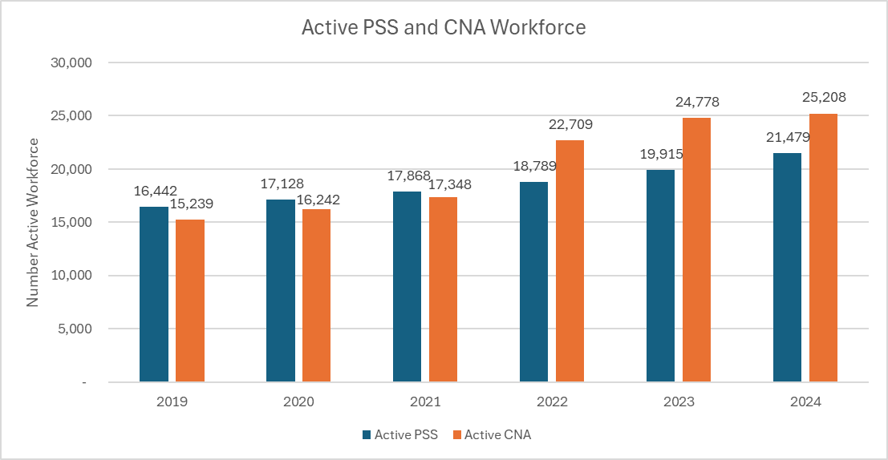
PSS & CRMA
Notes:
Like CNA’s there has been a steady increase in Direct Care workforce staff. Active PSS staff have increased 76% from 2019.
Wile Active CRMA’s has decrease by 8% from 2019 we have seen a 55% increase in new CRMA certifications issued.

Slide 20



Maine’s First Direct Care and Support Professional Advisory Council
Direct Care and Support Advisory Council
Mission: to bring direct care and support professionals together to create positive change.
2024 Annual Conference
"Uplifting the Voices of Maine's Direct Care and Support Professionals"
The council uses a collective voice to shape the future of direct care and ensure that voices are heard and valued, increasing awareness and recognition of direct care workers' roles.
Fosters the exchange of valuable experiences
Nurtures leadership and advocacy skills
Offers expertise and guidance to policymakers on workforce issues and initiatives

Slide 21
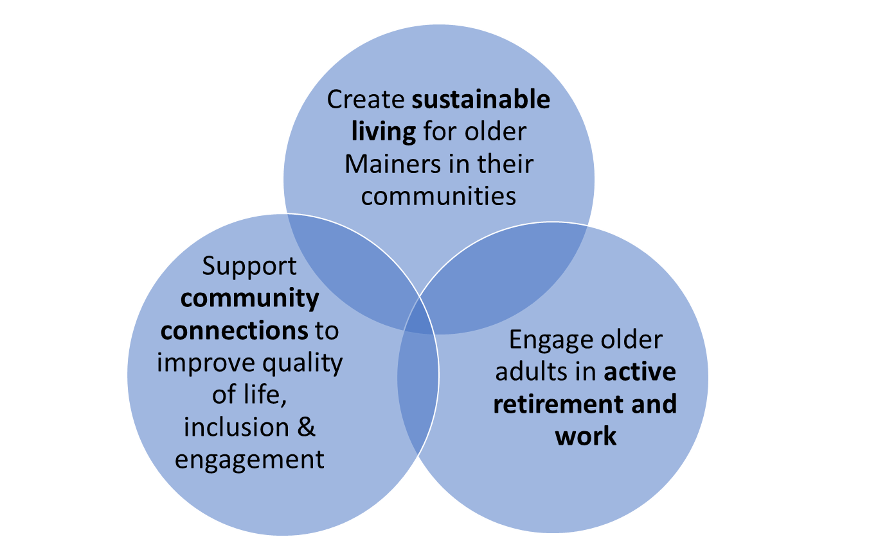
Maine’s Cabinet on Aging
Focus Areas

Slide 22

Cabinet - Community Supports
Community Connections Initiative
Purpose is to align strategies around our shared goals and empower Lifelong communities in their work and knowledge of their communities.
Received federal approval for a $2.5 million initiative from the American Rescue Plan to:
  Support and training for Lifelong communities to develop pilots to help their fellow residents identify and access desired supports and make it more comfortable to accept help or to participate in social opportunities.
  Provide mini-grant funding opportunities for Lifelong communities.
  Increase capacity of Area Agencies on Aging to strengthen community partnerships.
Key partners: University of Maine’s Center on Aging and Maine’s Area Agencies on Aging.

Slide 23
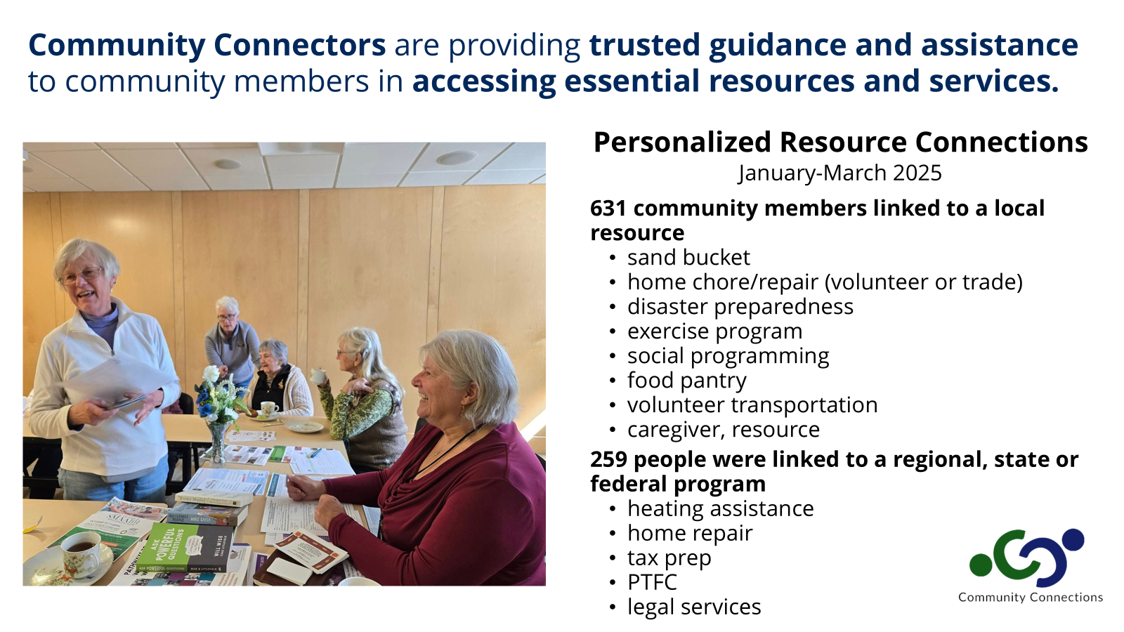
Impacts of Community Connectors
Increased outreach and referrals between communities and Area Agencies on Aging

Slide 24
Strengthening Elder Justice
  Maine’s Elder Justice Roadmap : Charting Progress
Adult Protective Services (APS) positions capacity expanded
National core curriculum for all APS staff
Established Elder Service Connections program
Increased staffing to support civil legal services for older adults
Financial Investigator hired at the criminal division of the Attorney General’s office
Mandated Reporter Training
Adult Protective Services Annual Report

Slide 25


