Slide 1
32nd Maine Geriatrics Conference
“Ageism – Let’s Change the Conversation”
May 22, 2025
Presented by the Maine Council on Aging
Maureen O’Connor, Power in Aging Project Director & Susan Gatti, PIA Co-Presenter
Funded by the Point32Health Foundation, John A. Hartford Foundation, Alpha One
These slides are adapted from the Maine Council on Aging’s Leadership Exchange on Ageism and Power in Aging programs
and include © copyrighted material. Please ask permission to reproduce.

Slide 2
Questions For Today
What is ageism and what are its impacts?
How can we see and change our own age-bias?
Why does what we think and say about aging matter?
How can we live healthier lives as we age, through the benefits of age-positivity?

Slide 3
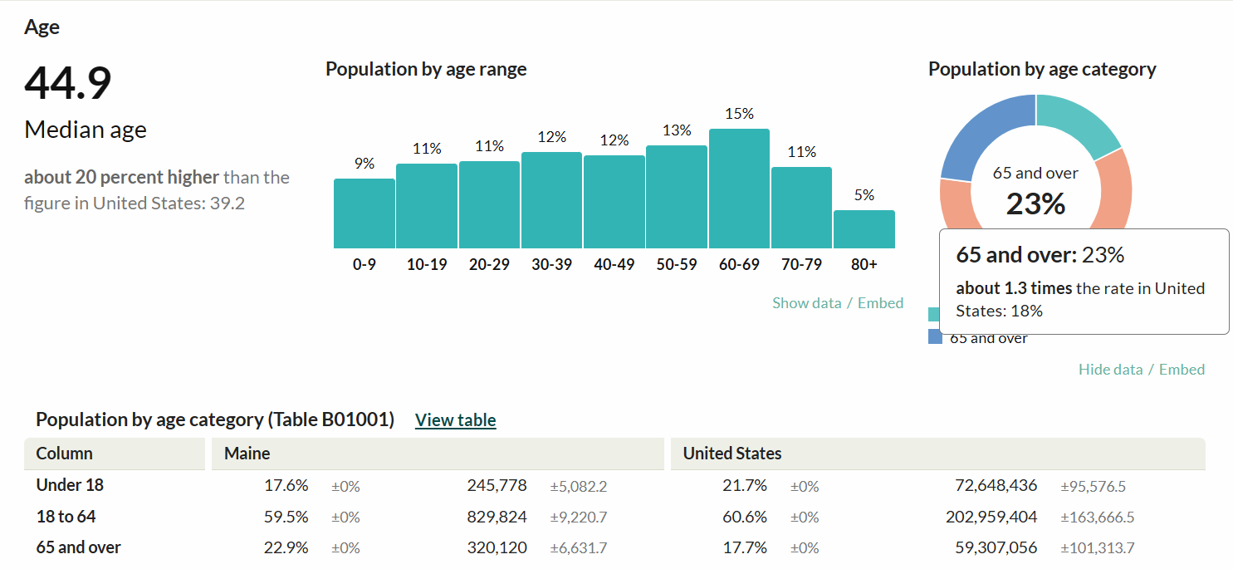
Maine’s Demographics-2023

Slide 4
Worldwide Birthrate shift
Year 1968
Year 2022
Women had 5+ children on average
Women had ≤2 children on average
Source:
Jennifer Sciubba, Ph.D.
“This shift towards fewer babies is permanent and not a problem to be solved…That’s why I always start by putting this in global context. This is not some fluke; this is not an exception; this is a permanent shift the likes of which we’ve never seen before.”

Slide 5
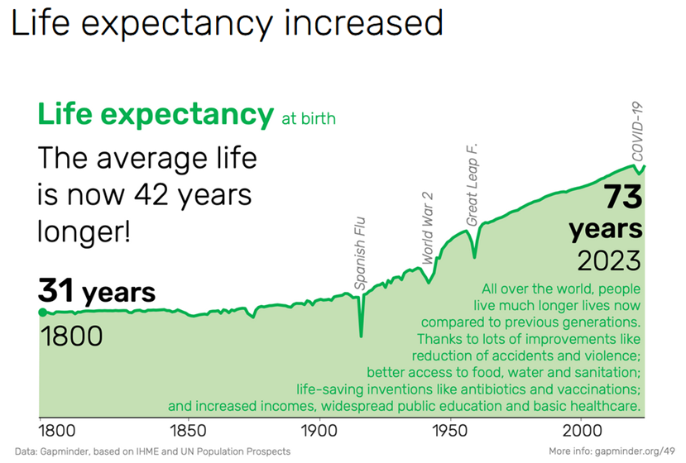
Another shift – and some great news!

Slide 6
Shout Out Loud
What are some of the messages, stereotypes, assumptions, attitudes, or beliefs about aging and older people?

Slide 7
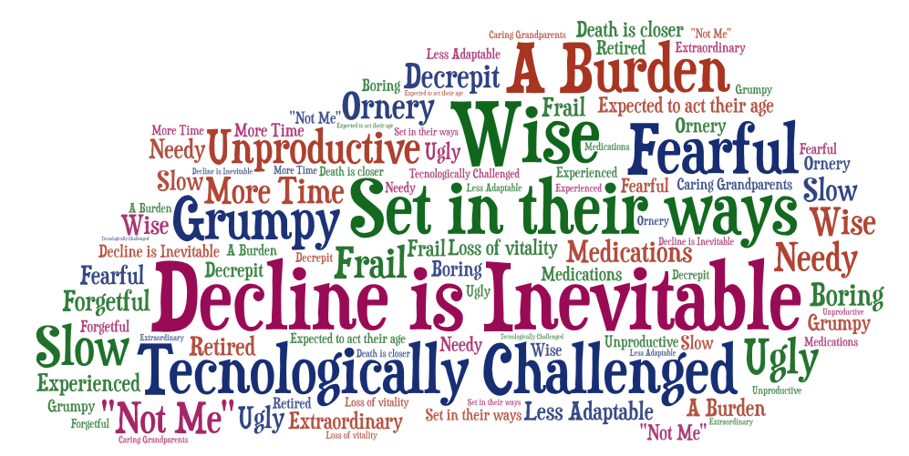
How we think about aging and older people
Word Cloud from a group sharing on messages, stereotypes, assumptions, attitudes, or beliefs about aging and
older people.

Slide 8
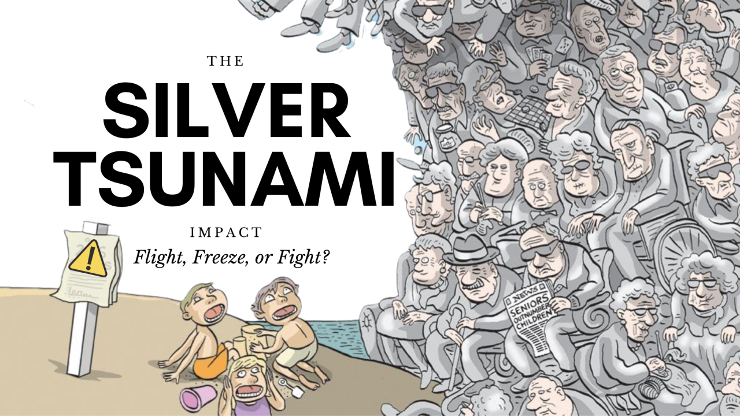
The wave we’ve been sold
Cartoon by Graham Mackay – approved to be shared not printed

Slide 9
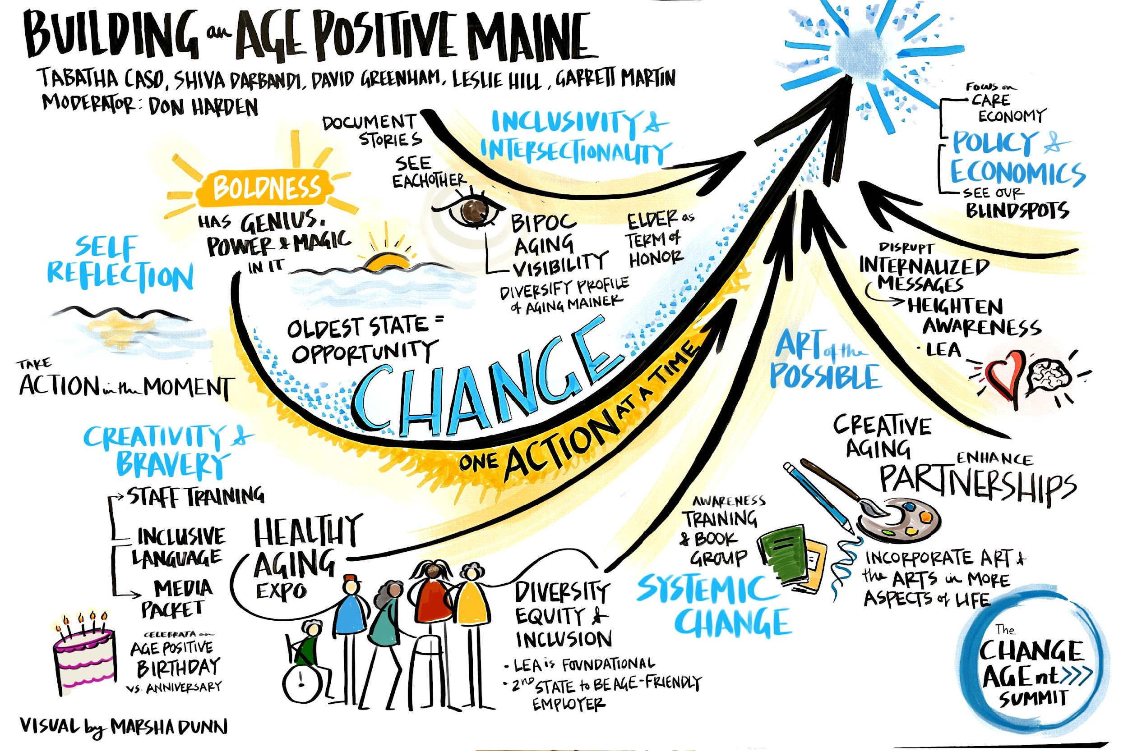
The wave we’re riding

Slide 10
Ending age-bias is simple!
1
Ageism is bad for us and
Bad for systemic change
+
1
Awareness of age bias
Reduces acts of ageism
2
=
Conversations that help people become aware of age-bias will lead to a more age-positive Maine and support for change!

Slide 11
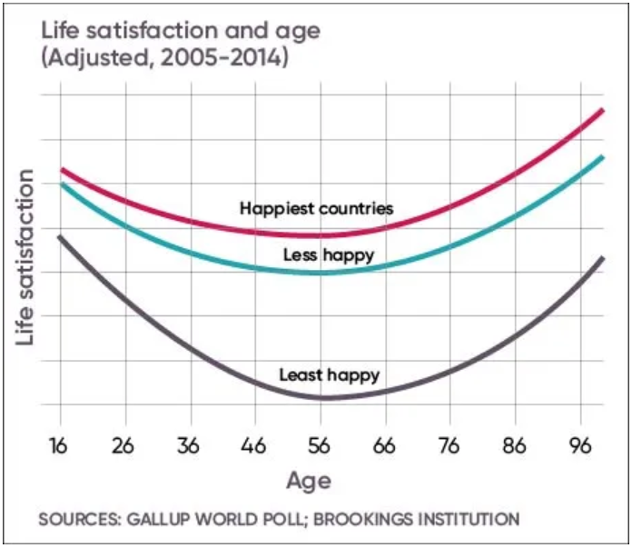
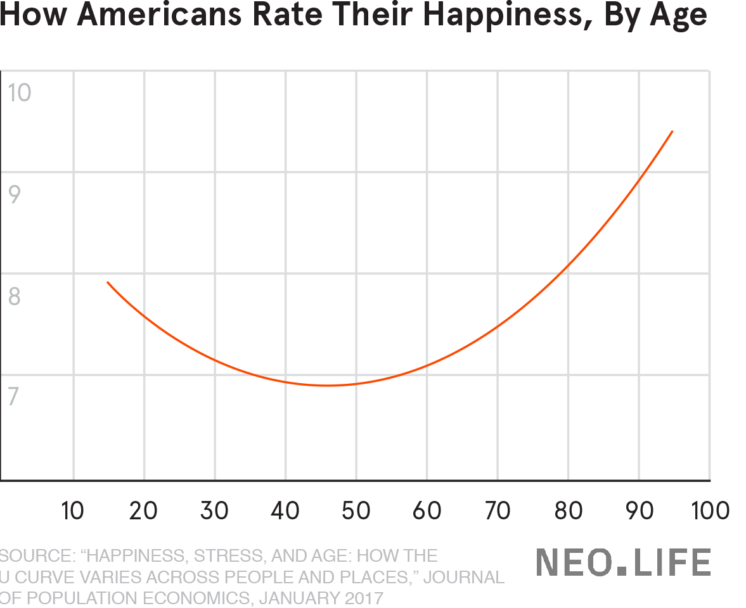
Life gets happier with age
Even joy and gratitude have been proven to reduce stress, increase sleep, and reduce serious health events like strokes.

Slide 12
Health Effects of Age-Positive View/Purpose
Older people who embrace positive views about aging and who have purpose:
Live 7.5 years longer than those with less positive perceptions of aging
Are 44% more likely to recover after experiencing a new disability
Experience less depression and anxiety
Have less cardiovascular disease, produce less cortisol (a stress hormone) over time, and autopsy findings show less dementia
Have fewer chronic conditions

Slide 13
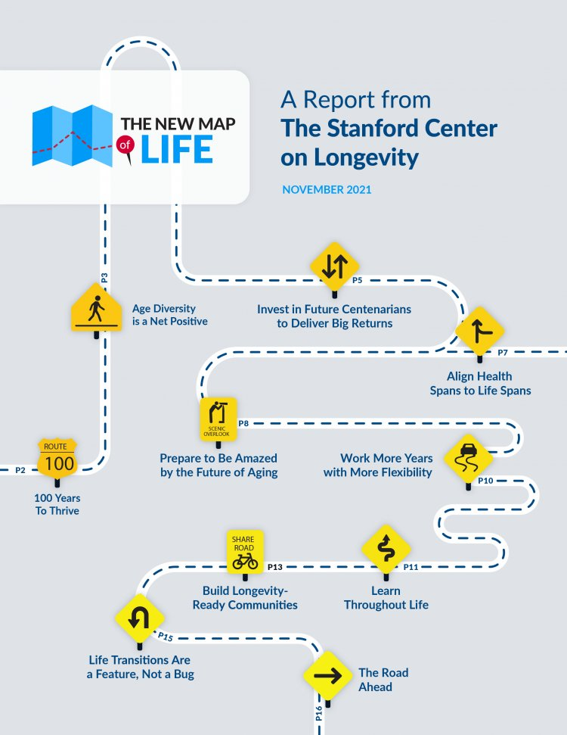
The New Map of Life
Report Recommends:
Align health span with life span
Age-diversity is a net positive
Work more years with more flexibility
Build longevity-ready communities
Ensure lifelong learning
Life transitions an expected feature
100 years to thrive!

Slide 14
What’s holding us back from…
Living our most productive and healthy lives as we age?
Making investments to support our changing needs as we age together – allowing us to stay connected in all ways as we age?

Slide 15
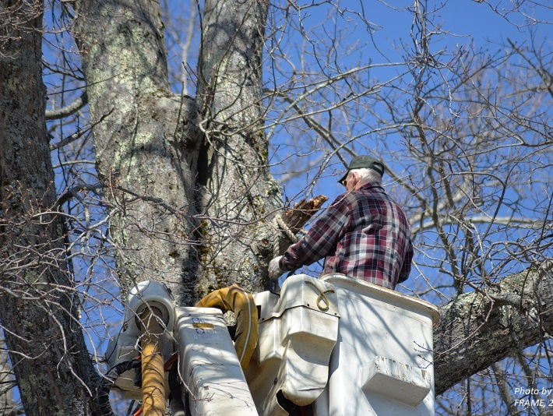
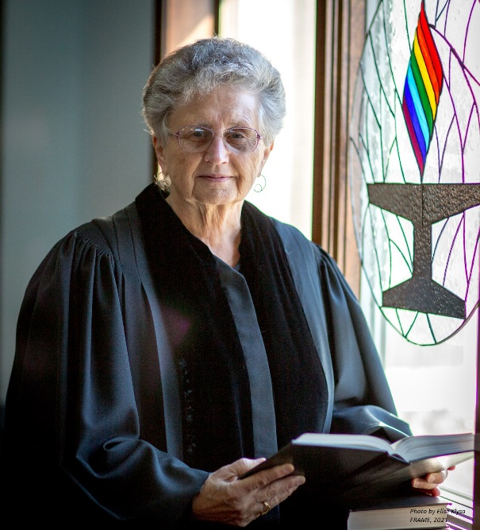
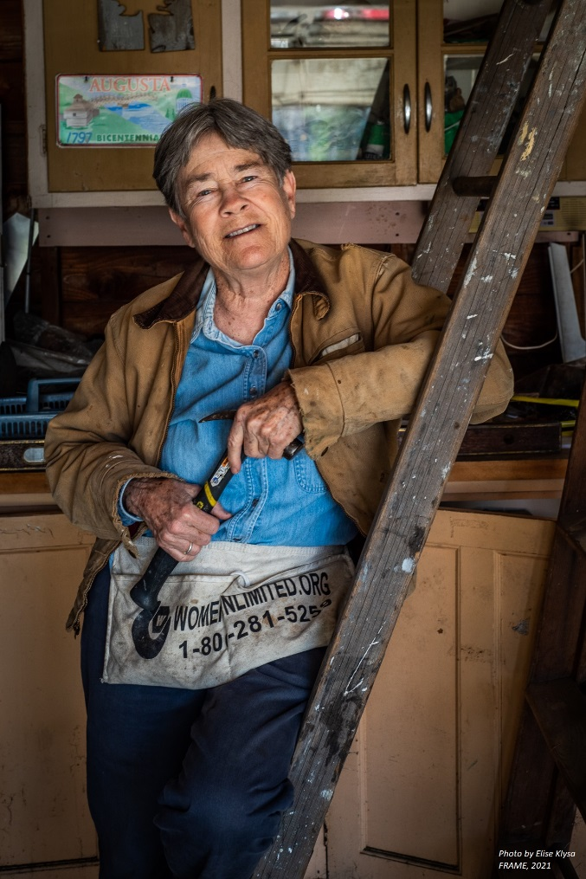
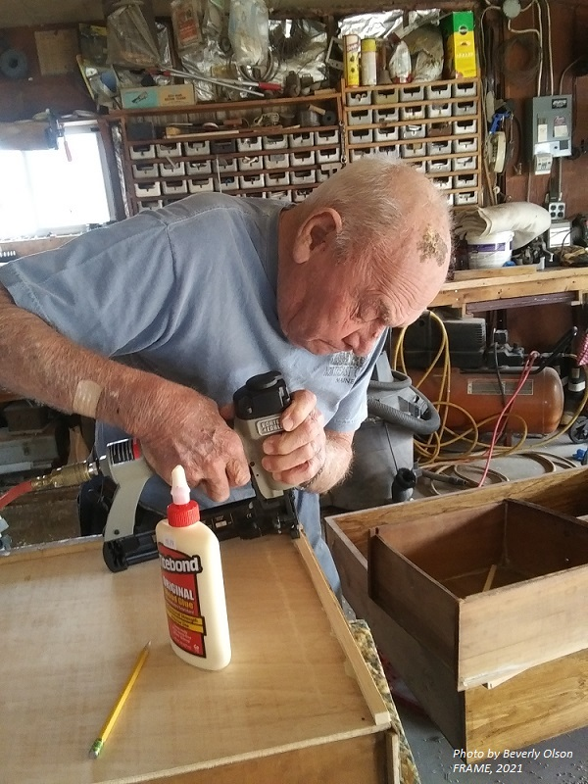
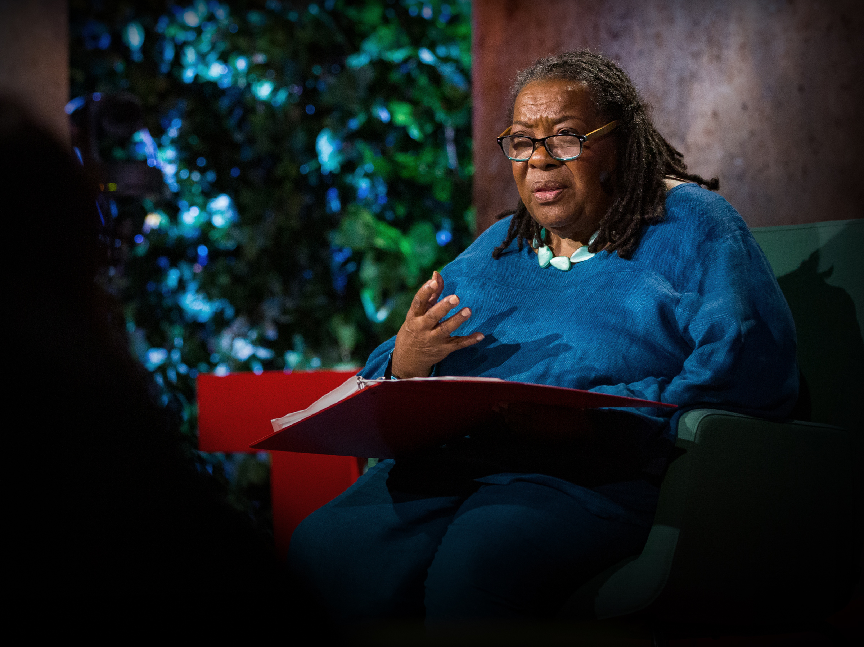
What keeps us from seeing the whole person?

Slide 17
What is Ageism?
Ageism is stereotyping, prejudice, bias or discrimination on the basis of age.
Stereotyping: how we think
Prejudice and bias: how we feel
Discrimination: how we act
Ageism manifests both as:
discrimination against older people (and sometimes younger people),
and as a privileging or idealizing of youth.

Slide 18
A Global View on Ageism
“Ageism pervades many institutions and sectors of society, including those providing health and social care, the workplace, the media and the legal system.”
“Ageism…is associated with a shorter lifespan, poorer physical and mental health, slower recovery from disability and cognitive decline.”
WHO Global Report on Ageism, March 2021

Slide 19
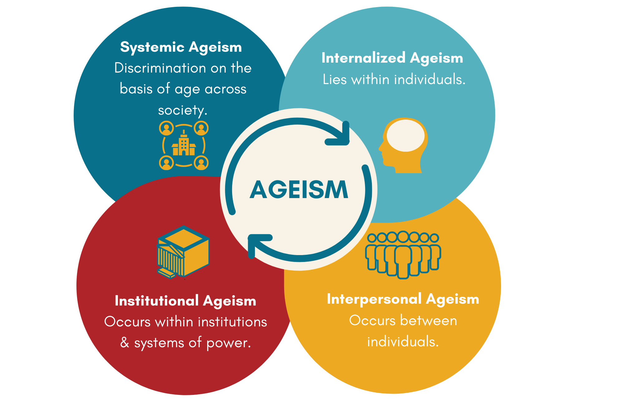
The Many Aspects of Ageism
Notes:
KV

Slide 20
How does ageism work?
1. We’re culturally shaped to value youth and to avoid appearing old – it’s a pervasive narrative we seldom think about.
2. We bring our own internalized attitudes about older people and our own aging with us wherever we go.
3. We reinforce cultural stereotypes with one another – we give ageist cards, have “senior moments,” offer ageist compliments like “you never seem to age.”
4. These attitudes seep into our actions – skewing our perception and helping to build an unconscious culture of exclusion.

Slide 21
Cultural Messaging
“…50, which is basically dead.”

Slide 22
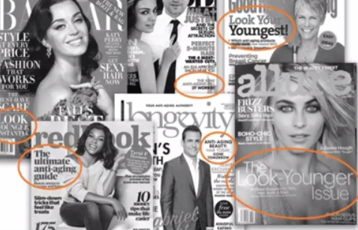

Slide 23
The Invisibility of Ageism

Slide 24
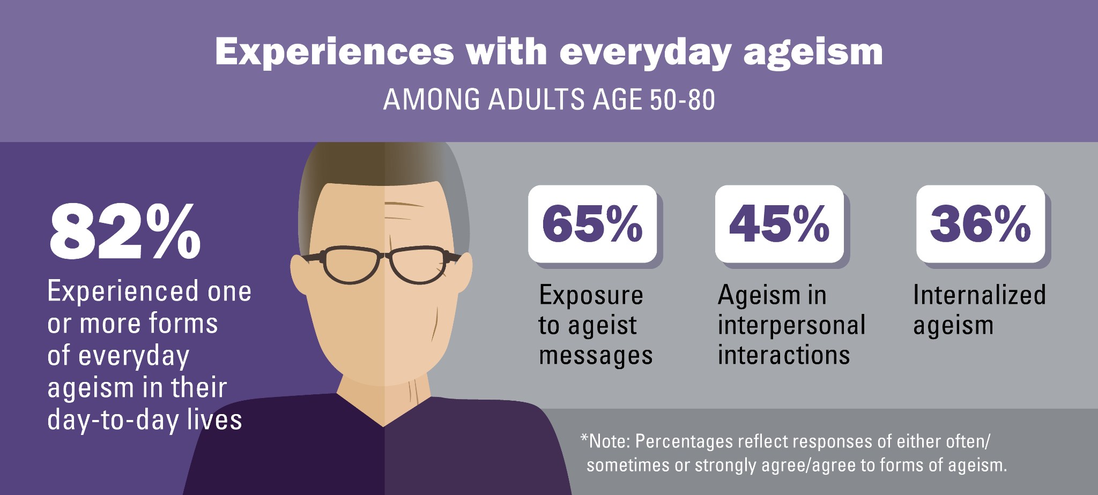
2019 National Poll on Ageism
December 2019, the University of Michigan National Poll on Healthy Aging

Slide 25
Ask Yourself:
Have you ever witnessed or experienced age-bias or age discrimination?

Slide 26
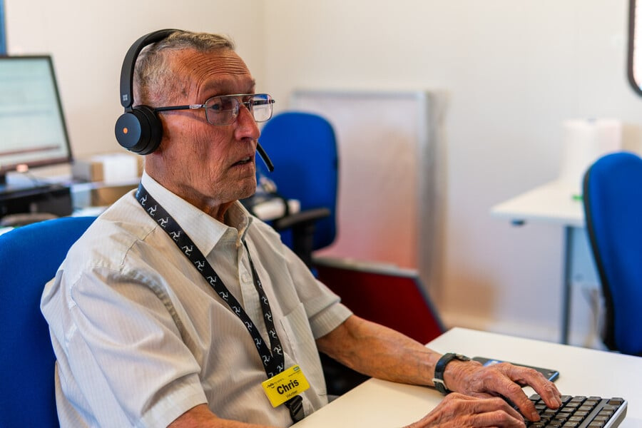
Impacts of Ageism - Workplace
Age discrimination leads to:
personal economic challenges,
social isolation
health challenges.
Systemically, age-bias keeps us from solving our workforce shortages by embracing older workers.
Bias against older workers cost the U.S. economy an estimated $850 billion in gross domestic product in 2018.
Notes:
KV

Slide 27
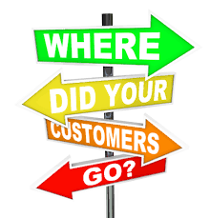
Impacts of Ageism - Business
“There are an estimated “74 million baby boomers in America, and this group controlled 54% of total U.S. household wealth, giving boomers the most spending power of any generation.”
“In a SunLife survey conducted in the UK, 50,000 people over the age of 50 were asked about their perceptions of how the advertising industry portrayed them, and 75% thought they were never represented in mainstream ads. Not even once.”
2020 Forbes: “Ageism in Marketing is Bad Business.”
Ageist comments can also lead to a loss of customers.
Notes:
Baby boomers–do we need to define?

Slide 28
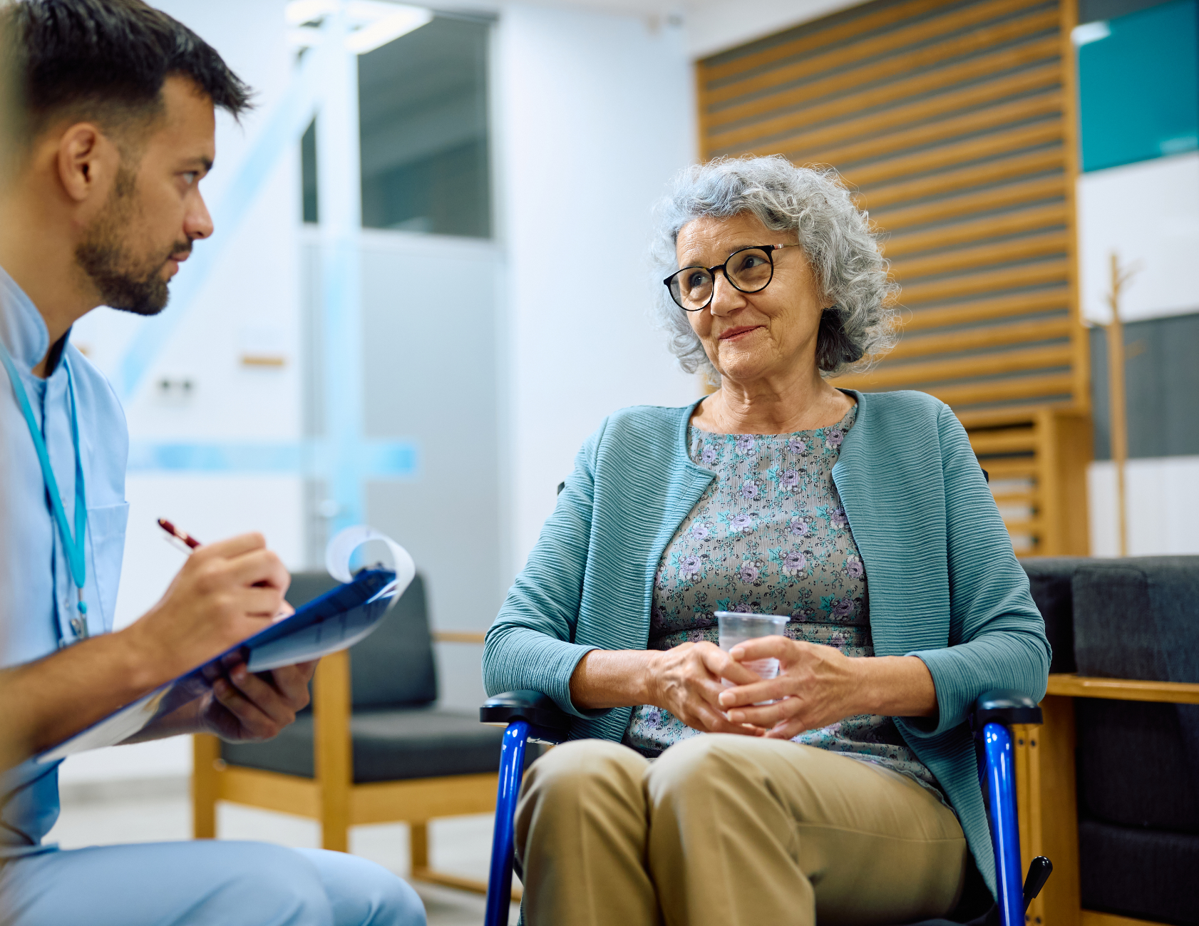
Impacts of Ageism – Health
Ageism in healthcare drives poorer health outcomes for older people AND increased costs to our health system.
$63 billion
1 in every 7 dollars attributed to ageism
Notes:
KV
‘Ageism amplifies Cost & Prevalence of Health Conditions’ Levy BR, Slade MD, Chang ES, Kannoth S, Wang SY. Gerontologist. 2020; 60: 174-181.
In 2020, the first study on the cost of ageism on the US economy was published – it found that annually one in every seven dollars ($63 billion) spent on health care for the eight most expensive conditions was due to ageism.

Slide 29
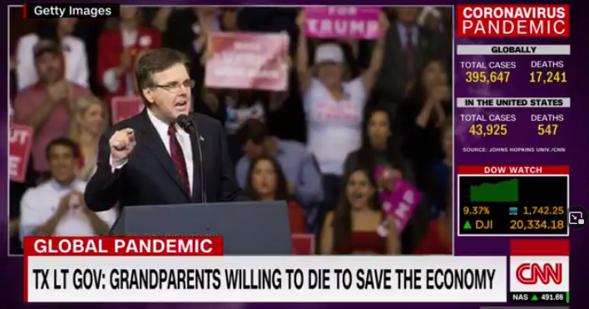
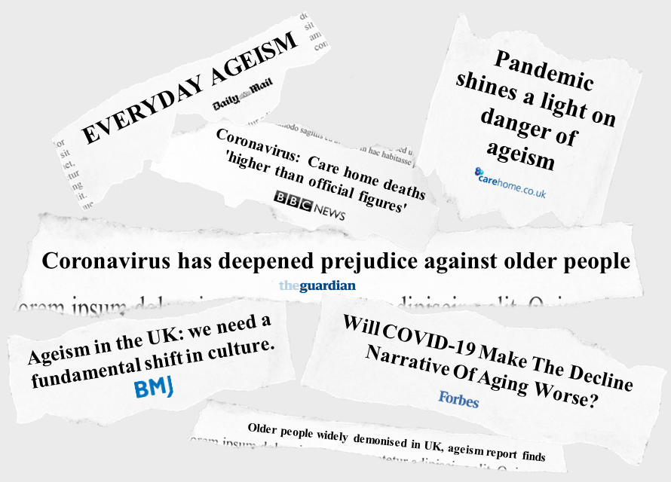
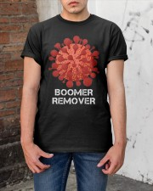
Impacts of Ageism During COVID
1,001,230 deaths of people 50+ 93% of all U.S. Deaths 50+
“‘Systemic Ageism’ To Blame For COVID-19 Deaths In Quebec Care Homes, Inquest Hears” 11.1.21

Slide 31
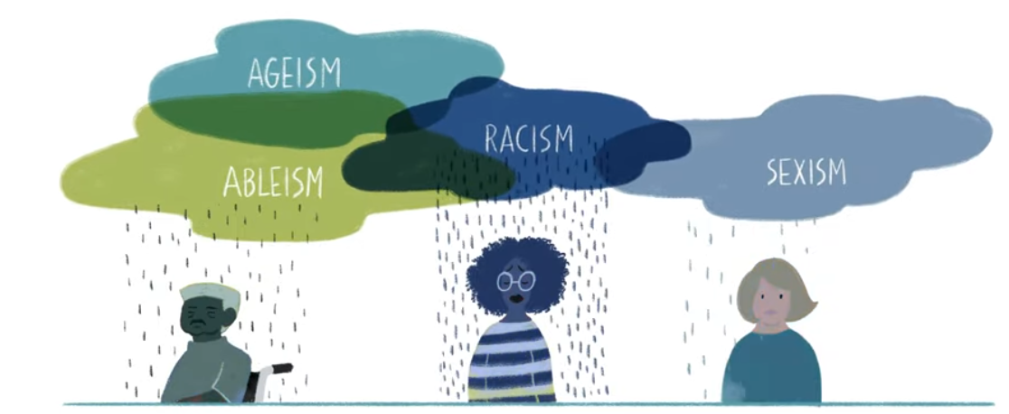
Discrimination Magnified
Disparities from other systems of discrimination (race, gender, rurality, class, sexual orientation, ability, etc.) all get worse as people age.
Other systems of discrimination are ALSO operating at all four levels and ALSO affect messages, resources and rules.

Slide 32
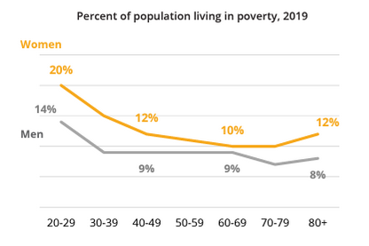
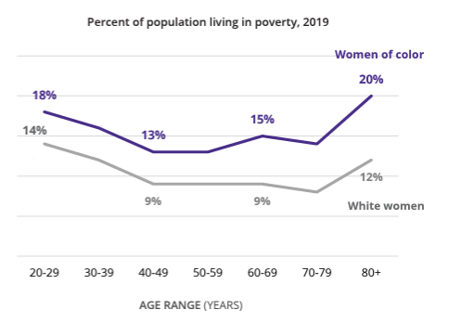
The intersection of age, gender, race and poverty

Slide 33
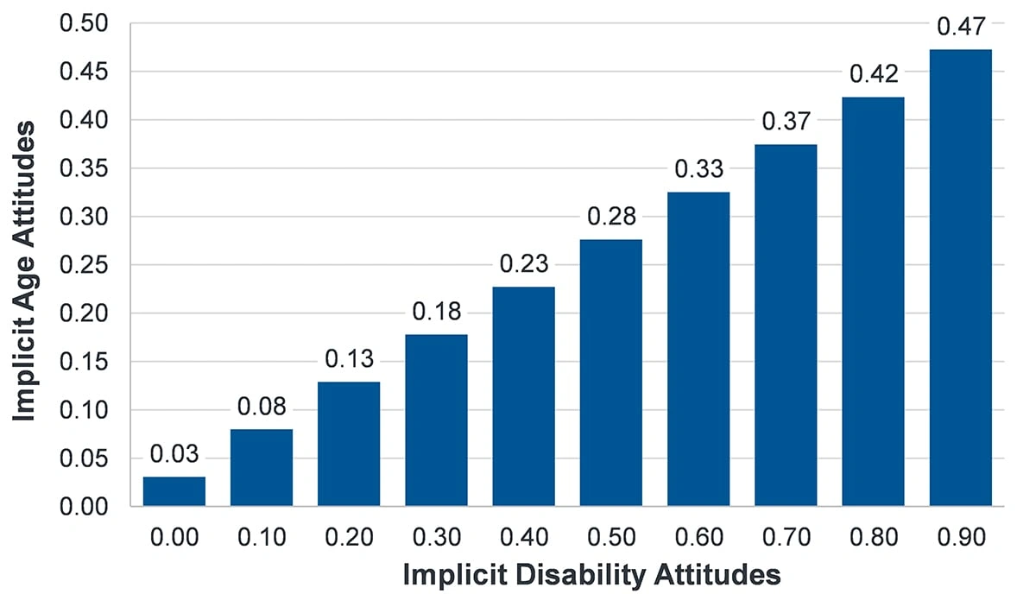
Ageism and Ableism
The more disability prejudice a person has, the more likely they are to be ageist.

Slide 34
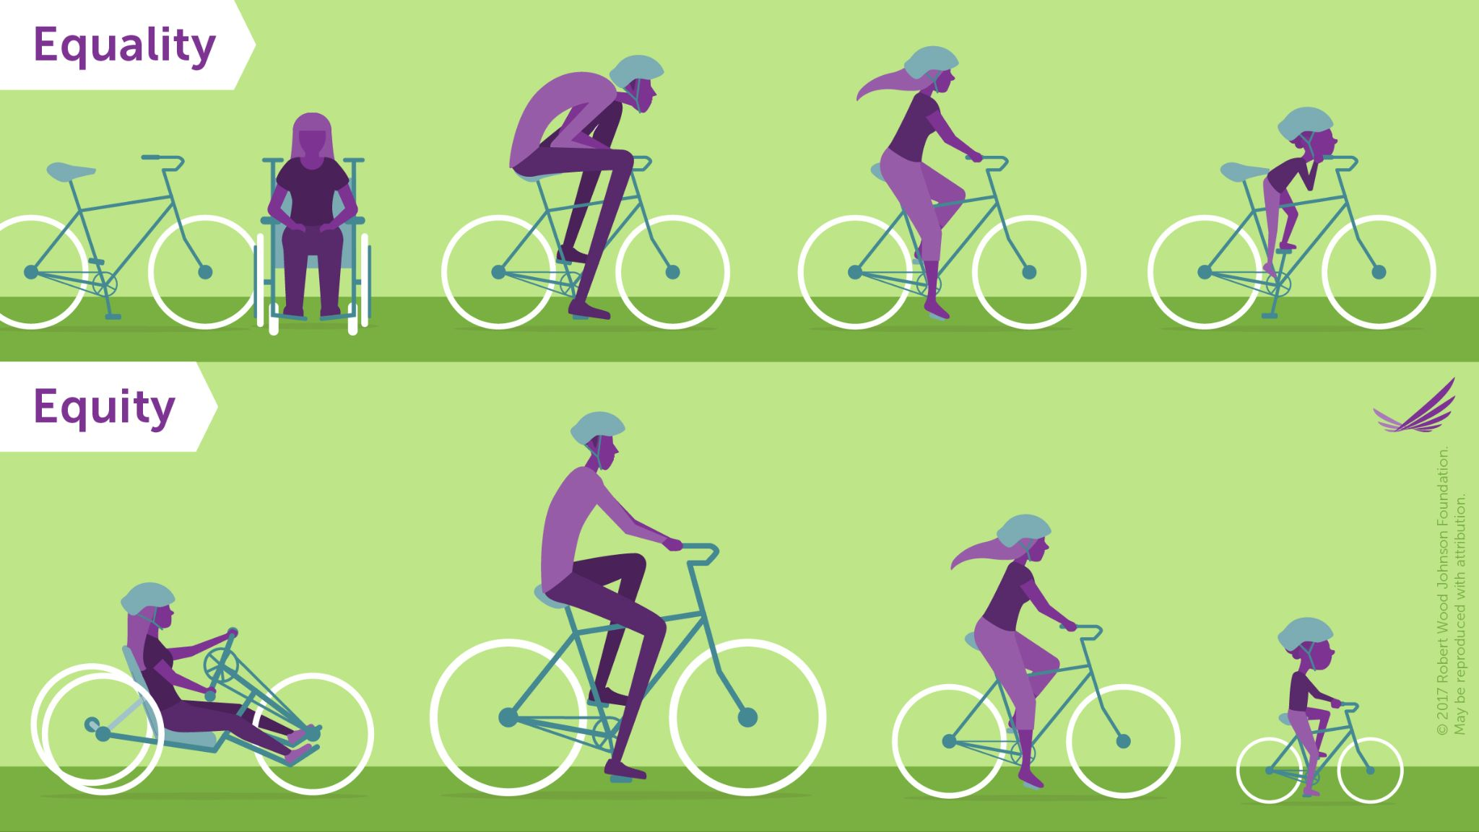
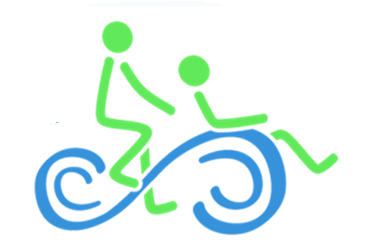
Age Equity

Slide 35
The “Age Equity Lens”
How can we build intentional awareness of the needs of older people into our work to:
Promote and support older adult health and wellbeing
Inform the development of interventions, policies, and programs – and allocation of resources
Target efforts to include older adults
Identify gaps, increase access to services, and coordinate to reduce cost and duplication of efforts
Notes:
Voting Rights - SAVE Act

Slide 36
Why it Matters:
Multigenerational strengths
A multigenerational – or intergenerational – approach can offer:
The different perspectives of different ages and life experiences
Broad range of abilities and knowledge
Multiple perspectives that can combine to make creative solutions
Learning/mentoring/knowledge transfer possibilities
Mastery of current technology plus experience with tech evolution – beware of stereotypes
Greater job & life satisfaction

Slide 37
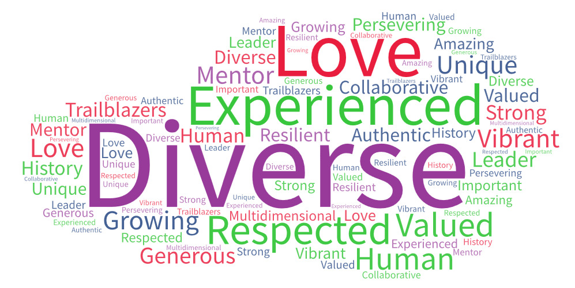
How do we flip the script on ageism?
Word Cloud from a group sharing positive messages about aging and
older people.

Slide 38
Language Matters
How do Americans view words describing older people?
Aging_Research_Report_2017 (frameworksinstitute.org)

Slide 39
Recommendations
Today and always:
Describe the person as the person wants to be described.
Generally, use older people/person as a non-offensive term instead of senior, senior citizen, and elderly.
Be specific when possible, e.g., people over 60.
“Elder” is often used by BIPOC and LGBTQ folks to refer to older community members with respect.
NEVER use “the elderly” to refer to a group - it’s really not cool and older people really do not like this!

Slide 40
Elderspeak
Refers to the way some people speak to older adults:
Automatically speaking slowly and loudly
Using a high-pitched voice
Using terms of endearment such as honey, dear, sweetie
Speaking to an adult as if they were a young child
Speaking to the care partner instead of the older person

Slide 41
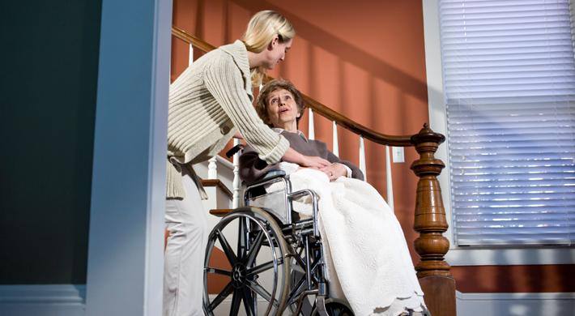
Elderspeak: Why not?
It’s degrading and patronizing
Contributes to depersonalization
Implies power/ powerlessness
Conveys presumed incompetence
Increases challenging behavior
This Photo by Unknown Author is licensed under CC BY-ND

Slide 42
Elderspeak: Avoid it!
Focus on the older person as much as possible, even if they have limited capacity
Individualize – don’t rely on stereotypes
Avoid speech mannerisms of elderspeak
Ensure that people around you know about elderspeak and avoid it, too

Slide 43
Reducing ageism starts with you!
Don’t participate in sharing ageist messages. (Watch those birthday cards!)
Do call people out (gently) for ageist remarks.
Do include yourself – we’re all aging. Shift to “us” instead of “them.”
Do lead by example by embracing your own age and the accumulated skills and knowledge that come with aging.
Do use neutral words to describe older people – avoid “senior” “elderly” “elder” – let’s just say “people” or older people if you have to.
Do avoid painting all older people with the same brush.
Do build defenses against the ageism present in everyday culture.

Slide 44
Self Reflection:
Thinking about all you’ve heard
What is one thing that you will try to do differently to live a more age-positive life?

Slide 45
What if We Shift?
What if… this really starts with us?
What if… we change our perspective about our own aging and embrace the view that an age-positive culture is key to better health, longer life, and better quality of life?
What if… we embrace our new longevity and see older people as valuable to our families, communities and workforce instead of a problem to be solved?
Could we build healthier people and communities, and a stronger workforce and economy? We know we could!

Slide 46
The Maine Council on Aging can help!
Maine is the first state in the country to launch a statewide initiative to end ageism. The Maine Council on Aging can help with learning and action:
Leadership Exchange on Ageism (LEA) – 14-hour intensive peer learning experience – leads people to take rapid action within their spheres of influence – 330+ grads
Disrupting Ageism Intensive – 8-hour in-service for leadership teams with integrated action planning
Power in Aging presentations – like this one – thousands reached
Age-Positive Healthcare and Age-Positive Employment trainings, adapted to different settings and needs
Technical assistance when you want to take action and need expertise
Notes:
Here’s what the Maine Council on Aging is doing – we’re ending ageism by 2032 – through all different kinds of conversation!

Slide 47
Notes:
https://mainecouncilonaging.org/agepositiveme/

Slide 48
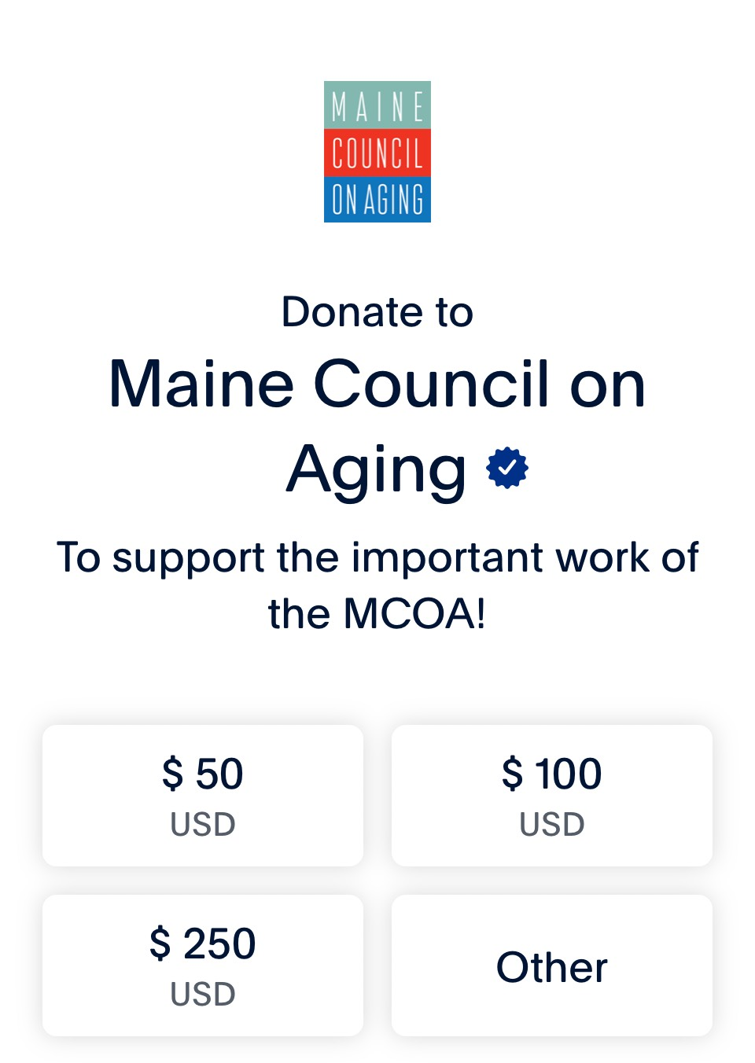
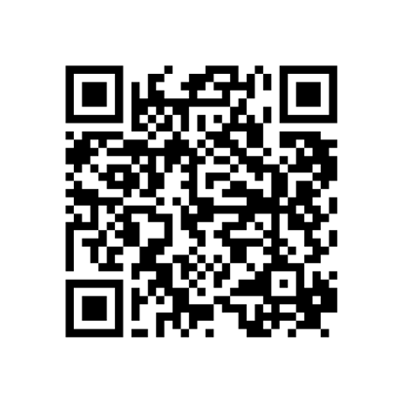
Thank you! Maureen O’Connor moconnor@mainecouncilonaging.org
Questions?
Survey Link

