Slide 1
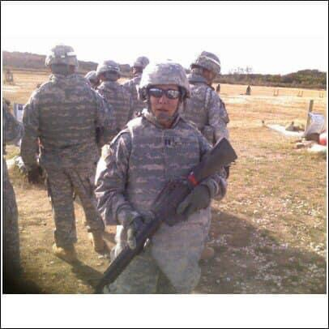
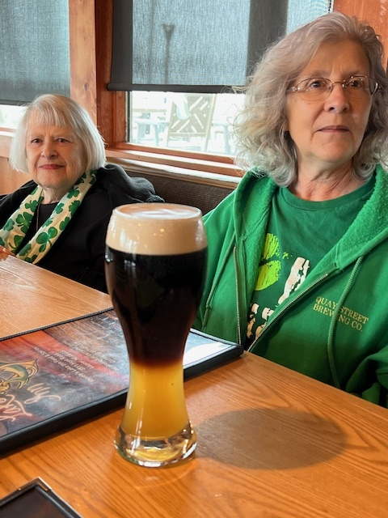
Caring for Caregivers 101
By Kathleen Young, DNP, PMHNP-BC

Slide 2
Accreditation Statement and Disclaimer
RSA Grant GE1HS53336-01-00
This project is funded in full by the Health Resources and Services Administration (HRSA) of the U.S. Department of Health and Human Services (HHS) as part of an award totaling $1.33 million. The contents are those of the author(s) and do not necessarily represent the official views of, nor an endorsement, by HRSA, HHS, or the U.S. Government. For more information, please visit HRSA.gov.
The speaker has no relevant financial relationship with commercial interest to disclose, nor do they have an interest in selling a technology, program, product and/or service to CME Professionals.

Slide 3
Objectives
At the end of this presentation, learners should be able to:
Identify caregiver distress in family members caring for a loved one with dementia.
Identify resources for caregivers within Maine.
Identify technology resources that can assist families and increase the safety net.

Slide 4
Statistics of Caregiving
7 million older adults have Alzheimer’s Dementia in the U.S.
More than 11 million Americans provide care to a family member with dementia.
These hours = $350 billion.
30% of caregivers are age 65 and older.
25% of caregivers are of the “sandwich generation.”
Number 1 problem reported by caregivers was navigating care!
66% of caregivers have difficulty finding resources and support.
70% of the cost of caregiving is borne by families.

Slide 5
Cost of Health Care for this Population
2024 – healthcare and long-term care costs = $360 billion.
Medicare and Medicaid are projected to cover 64%.
Out of pocket spending is expected to be around $91 billion.
Care for one person living with dementia = $400,000
People with dementia are more likely to have other chronic medical conditions.

Slide 6
So why is this a big deal?????
There are limited resources in Maine.
Primary Care Providers are in a state of flux.
Access to healthcare is narrowing.
Medicare doesn’t cover case management services!
May be hard to recognize caregiver distress in a brief office visit.

Slide 7
Identifying Caregiver Distress – 10 Warning Signs!
Mom knows how to get dressed!
Distress
Anger and frustration and denial
Depression and anxiety
Social isolation
Burden and exhaustion
Lack of concentration
Changes in eating habits
Sleeplessness
Health problems
Irritability and mood changes
Emotional reactions
I can’t handle one more thing!
I don’t care about going out.
What will happen if he can’t drive anymore?
Everyone is overreacting, Dad will get better!
OMG I have diabetes???
I can’t keep track of everything!!!
All I do is cry.
I can’t remember the last time I felt good.
What if Mom wanders out of the house at night?

Slide 8
Other Red Flags
Reporting a higher acuity of symptoms than noted during a visit.
Caregiver role reversal!
Feeling hopeless or helpless.
Giving up hobbies they used to enjoy due to the amount of caregiving time.
Caregiving affecting their career.
Placing the person in unsafe situations.
Relational conflicts between the caregiver and patient.

Slide 9
Early Self Care Teaching!
Become educated about the disease.
Learn to be realistic both about the disease and your own capabilities.
Accept and share your feelings with a “safe person.”
Look for humor daily.
Take care of yourself: sleep, diet, healthcare, exercise, hobbies.
Create an early network of people that can help you!
Don’t wait until the last minute to plan ahead.
Fill your spiritual bucket if this is important to you.

Slide 10
Dealing with Caregiver Feelings with Higher Level of Care Placement
Doesn’t make them a “bad” caregiver.
Caregivers will tend to feel guilty.
Need to consider the additional social stimulation.
Safety is a key consideration in placement.
There is a significant transition period when placement occurs for the patient. Their short-term memory now has to “learn the new place.”

Slide 12
The Five “Area Agencies on Aging”
Seniors Plus, serving Androscoggin, Franklin, and Oxford Counties – 800-427-1241 or 207-795-4010; Aroostook Area Agency on Aging, serving Aroostook County – 800-439-1789; Southern Maine Area Agency on Aging, serving Cumberland and York Counties, excluding the towns of Brunswick and Harpswell – 800-427-7411; Eastern Area Agency on Aging, serving Hancock, Penobscot, Piscataquis, and Washington Counties – 800-432-7812; Spectrum Generations, serving Kennebec, Knox, Lincoln, Sagadahoc, Somerset, and Waldo Counties, plus the towns of Brunswick and Harpswell – 800-639-1553.

Slide 13
Seniors Plus
Money Minders program matches volunteers with clients who need monthly reminders to pay bills.
Friendly Caller program connects volunteers with older adults to receive weekly social telephone calls.
Meals on Wheels program and community dining sites.
Specialized Services that include home modifications, assistive technology, emergency response systems and nursing facility respite. You have to be accepted in the care coordination program to receive specialized services.
Acceptance into their services is based upon financial eligibility.

Slide 14
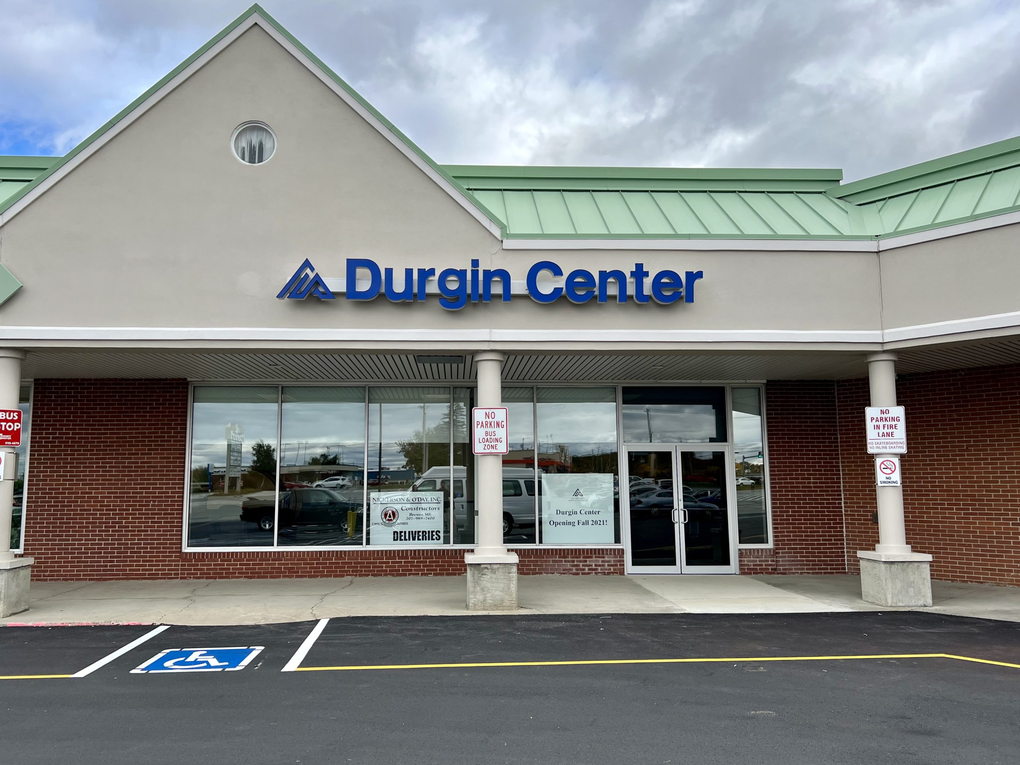
Eastern Area Agency on Aging
Dining in centers in Brewer, Brooksville, Calais, Millinocket and Milo.
Furry Friends Food Bank and the Commodity Supplemental Food Program.
Durgin Center in Brewer has regularly scheduled activities during the week.

Slide 15
Resources available to families/caregivers – Military Service Members
1. For patients that had served in the military for least 24 consecutive months and were honorably discharged, you are eligible for VA care.
www.aarp.org/home-family/voices/veterans
2. If they served during wartime, they may be eligible for Aid and Attendance care.
3. May also be eligible for Adult Day healthcare services, Hospice care, light housekeeping, personal care, respite care, and social worker support.
4. Navigating the VA system requires stamina, patience and determination.
Please see the Veterans Directed Care (VDC) page at:
Veterans Directed Care (VDC) | Eastern Agency on Aging

Slide 16
Guiding an Improved Dementia Experience Model - GUIDE
Launched in July of 2024 by CMS.
Goal is to improve the quality of life for people with dementia and their caregivers
Provides a 24/7 helpline and pairs them with a care navigator for medical care and other services
Provides caregiver education and training
Provides access to respite care services
Current programs include Androscoggin Home Health Services and Maine Health.

Slide 17
Caregiver Coaching – Virtual and Free!
They are in the caregiver burnout prevention business!
Courage to Caregivers Organization provides 1:1 caregiver support and group support with virtual access.
They have a great electronic book on coping with the holidays:
Coping with the Holidays Booklet 2023
Self-care is giving the world the best of you, instead of what’s
Left of you! – Katie Reed

Slide 18
Caregiver Resources for Day Programs or Respite
My Friend’s Place - Bangor
Mondays, Wednesdays, and Fridays from 10 a.m. to 2 p.m.
In the Fireside Room at First United Methodist Church, Essex Street, Bangor.
Friendship Cottage Adult Day Service Center – Blue Hill
Monday thru Friday
Bridges Home Services Adult Day Care Services – Waterville, Hallowell, Skowhegan, and Belfast
Thursdays 7:30am to 6pm and Saturdays 9am to 5pm.
Anatolia Adult Care Center, Portland Adult Day Programs
Southern Maine Agency on Aging – Biddeford and Springvale

Slide 19
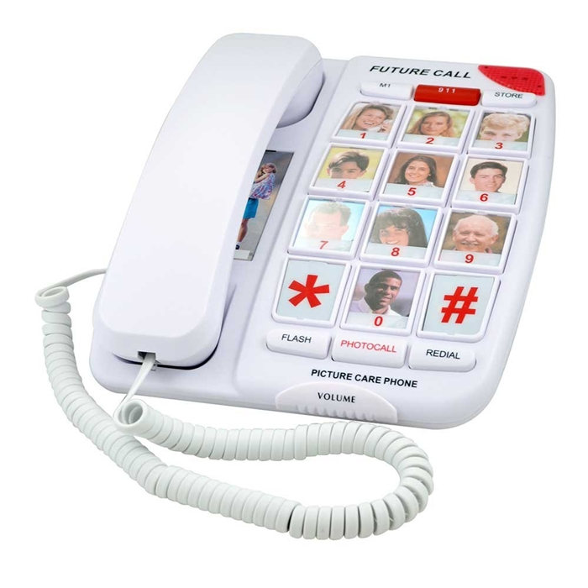
Technology Available for Caregivers
Voice-activated smart speakers to set medication/appointment reminders and prompts for ADLs.
Automated pill dispensers with reminders or bubble packing medications.
GPS tracking devices – Game Warden of Maine Project Lifesaver.
Motion sensors in the home.
Smart door locks.
Cameras – ring system.
Digital photo frames to stimulate memory and conversations.
Personalized music play lists.
Large button phones for easy dialing.

Slide 20
More Ideas
Smart watches that detect falls and alert help.
Buckle Boss for car seatbelts.
Car door assist handles.
Electrical appliance monitoring devices.
Digital clocks.
Night lights with darkness sensors.
Bed alarms pads.

Slide 21
Whew

Slide 22
Our Gang!

Slide 23
References
Alzheimer’s Association. (2025). Caregiving. Caregiving - Alzheimer's & Dementia | Alzheimer's Association.
Alzheimer’s Association. (2025). Alzheimer’s disease facts and figures. Alzheimer's Facts and Figures Report | Alzheimer's Association.
Courage to Caregivers Organization. (2018-19). Education, support, empowerment. Overview — Courage to Caregivers.
Department of Health and Human Services. (2023). Care partner supports. Care Partner Supports | Department of Health and Human Services

