Slide 1
Rebecca Spear, DO, FACP Program Director, Geriatric Medicine Fellowship Maine-Dartmouth Family Medicine Residency Lori M. Towne MSN, FNP-BC HRSA Rural Dementia Training Program Grant Primary Care Faculty and Liaison Northern Light Mayo and C.A. Dean Hospitals Primary Care Service Line Clinical Lead
Clinical Pathway for Dementia in Primary Care
HRSA Grant GE1HS53336-01-00 This project is funded in full by the Health Resources and Services Administration (HRSA) of the U.S. Department of Health and Human Services (HHS) as part of an award totaling $1.33 million. The contents are those of the author(s) and do not necessarily represent the official views of, nor an endorsement, by HRSA, HHS, or the U.S. Government. For more information, please visit HRSA.gov.

Slide 2
Disclosures
Rebecca Spear, DO:
No personnel financial conflict of interest
Lori Towne, FNP-BC:
Currently 40% in HRSA grant-funded role through NLH
No personnel financial conflict of interest

Slide 3
Learning Objectives
Identify
Identify 3 of the most common causes of mild cognitive impairment that can progress to dementia.
Name
Name two validated instruments for screening for cognitive impairment.
Name
Differentiate potential specialist referral options for dementia care and evaluation.

Slide 4
Mild Cognitive Impairment
“ The cognitive deficits do not interfere with capacity for independence in everyday activities (i.e. complex instrumental activities of daily living such as paying bills or managing medications are preserved, but greater effort, compensatory strategies, or accommodations may be required”
Cognitive impairment WITHOUT impact on function
Diagnostic and Statistical Manual of metal Disorders: 5th edition

Slide 5
Function: IADLs
https://www.alz.org/careplanning/downloads/lawton-iadl.pdf

Slide 6
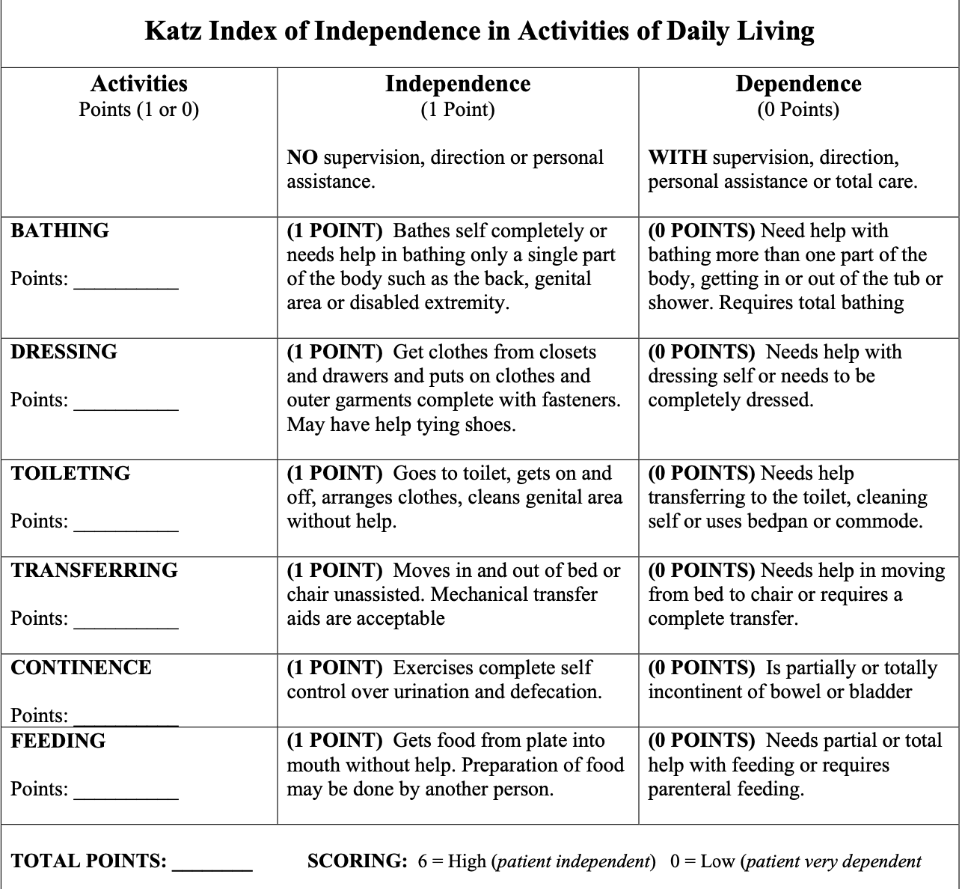
Function: ADLs
https://www.alz.org/careplanning/downloads/katz-adl.pdf

Slide 7
Dementia
A) Evidence of significant cognitive decline from a previous level of performance in one or more cognitive domains (complex attention, executive function, learning and memory, language, perceptual-motor, or social cognition) based on:
1. Concern of the individual, a knowledgeable informant, or the clinician that the has been a significant decline in cognitive function; and
2. A substantial impairment in cognitive performance, preferably documented by a standardized neuropsychological testing or, in its absence, another quantified clinical assessment
B. Cognitive deficits interfere with independence in everyday activities (i.e. at a minimum, requiring assistance with complex instrumental activities of daily living such as paying bills or managing medications)
C. The cognitive deficits do not occur exclusively in the context of delirium
Diagnostic and Statistical Manual of Mental Disorders: 5th edition

Slide 8
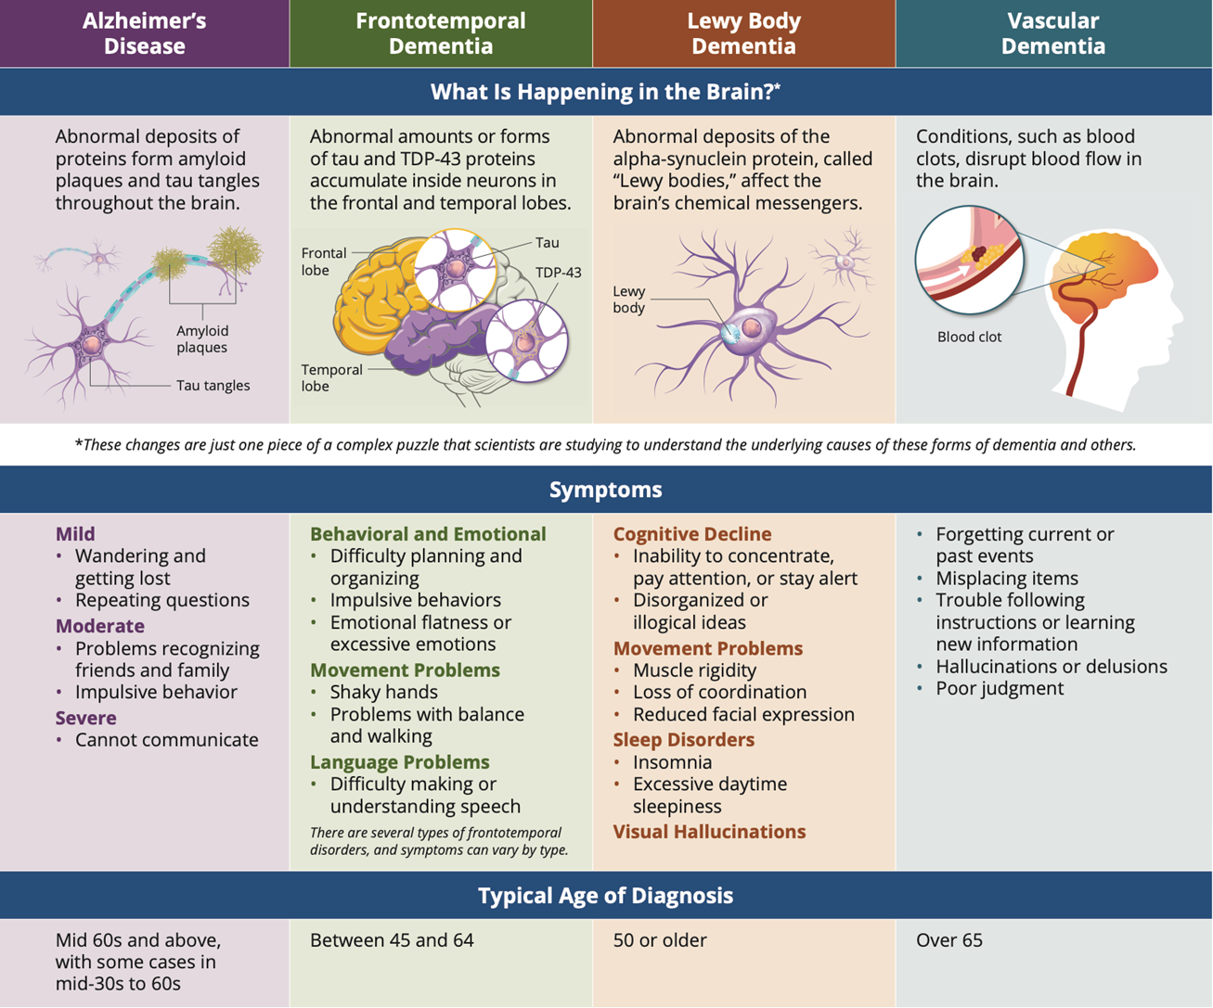
Types of Dementia

Slide 9
Who Needs to be Screened?
Patients at Medicare Annual Wellness Visits
Clinical suspicion of a problem
Reported cognitive problem
Notes:
Who needs to be screened?
This is always a tricky question with varying recommendations depending on your source.
For the purposes of the clinical pathway, we recommend screening:
Patients during their medicare annual wellness visit
If you have a clinical suspicion of a cognitive problem
Or a reported cognitive problem which usually comes from family or friends.

Slide 10
Dementia Progression
Mild: impact on IADLs
Moderate: Impact on ADLs
Severe: full dependence in IADLs and ADLs

Slide 11
Screening Tools
There are multiple screening tools available
Clinical Pathway focuses on:
Mini-Cog
MoCA (Montreal Cognitive Assessment of Cognition)
AD8 (The Washington University Dementia Screening Test)
Other Screening Tools:
SLUMS
MMSE
Notes:
AD8 = The eight item informant interview to differentiate aging and dementia
SLUMS – Saint Lous University Mental Status Examination
MMSE = Mini Mental State Examination

Slide 12
Initial Screening
Mini-Cog
AD8
MoCA
Notes:
For the purposes of our presentation today, we will highlight the Mini-Cog, the AD8, and the MoCA as part of our clinical pathway

Slide 13
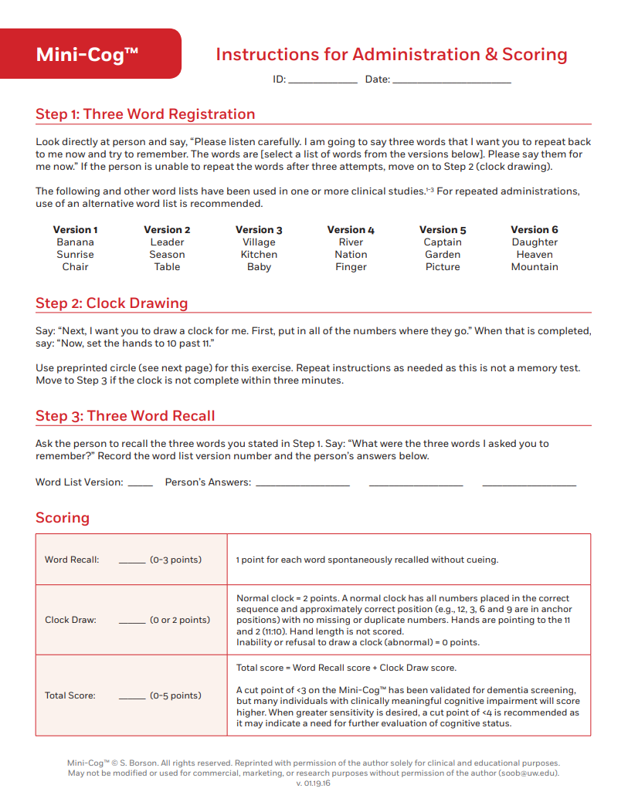
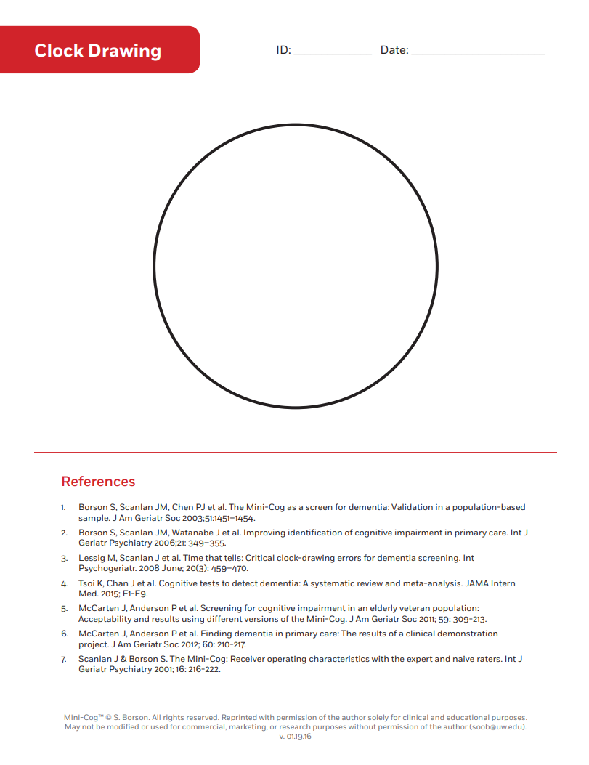
Mini-Cog
A total score of 0, 1, or 2 indicates higher likelihood of clinically important cognitive impairment.
A total score of 3, 4, or 5 indicates lower likelihood of dementia but does not rule out some degree of cognitive impairment.
https://mini-cog.com/how-to-use-it/
Notes:
Dr. Soo Borson and her team at the University of Washington’s Memory Disorders Clinic and Dementia Health Services Research Group created and systematically validated the Mini-Cog© as a simple tool to more easily identify people who might have clinically important, but unrecognized, cognitive impairment.
The Mini‐Cog is a brief, cognitive screening test that is frequently used to evaluate cognition in older adults in various settings.
It consists of two components:
a three‐word recall task that assesses memory
and the clock drawing test that assesses cognitive domains such as cognitive function, language, visual‐motor skills and executive function.
The standard scoring system involves assigning a score of 0 to 3 points on the word recall task for the correct recall of 0, 1, 2, or 3 words, respectively.
The clock drawing test is scored as being either 'normal' or 'abnormal’.
A positive test on the Mini‐Cog (i.e. indicating a possible diagnosis of dementia) is assigned if the delayed word recall score is 0 out of 3, or if their delayed recall score is either 1 or 2 and their clock drawing test is abnormal.
A score of 3 on the delayed word recall or 1 to 2 on the word recall with a normal clock drawing is considered a negative test (i.e. no dementia is present)

Slide 14
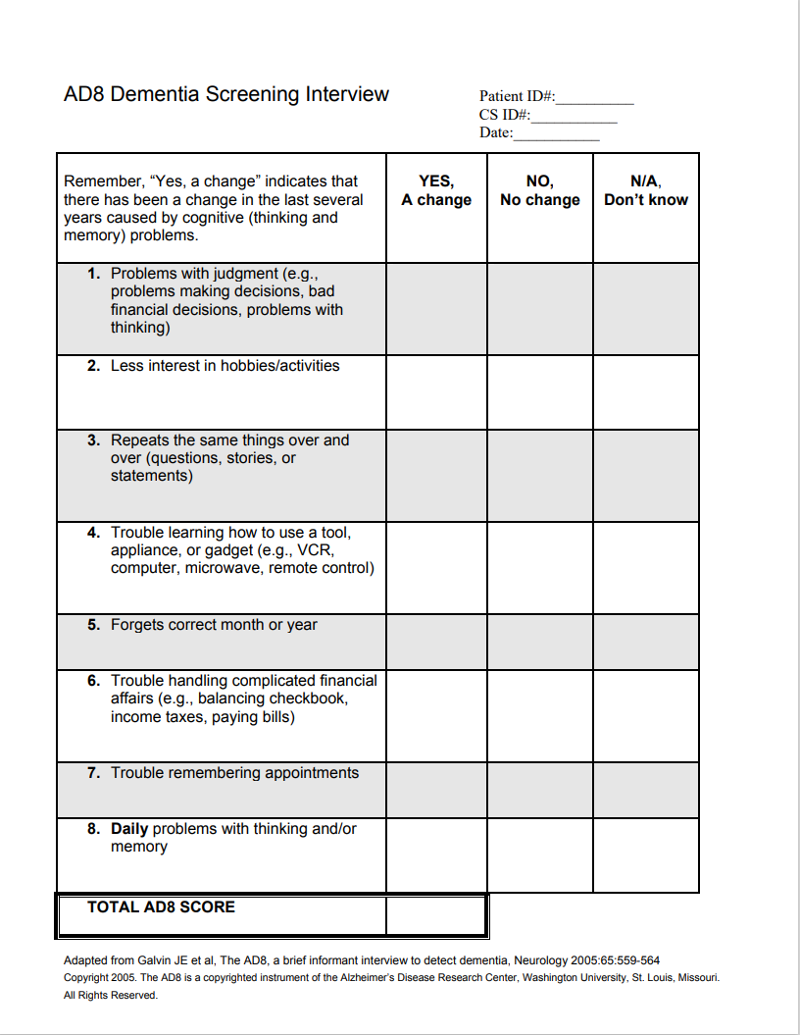
AD8
0 – 1: Normal cognition
2 or greater: Cognitive impairment is likely to be present
https://www.alz.org/getmedia/6e7291bf-4ac8-40ed-a148-824d4591ed7e/ad8-dementia-screening.pdf
Notes:
The AD‐8 is a short questionnaire, completed by a suitable 'informant' who knows the person well.
AD‐8 is designed to assess change in functional performance secondary to cognitive change.
The questionnaire includes eight ‘yes or no’ questions, to be answered by someone who knows the person under investigation
a relative, carer or close friend (sometimes described as an informant).
The questions ask about whether the informant has noticed a change in the individual’s memory and thinking abilities over the past years.
A point is given for every item where they think the person’s abilities have changed.
Higher scores occur when more changes are noted by the informant.
The AD-8 would not usually be used to make a final diagnosis of dementia, but it may help identify those who require further assessment.

Slide 15
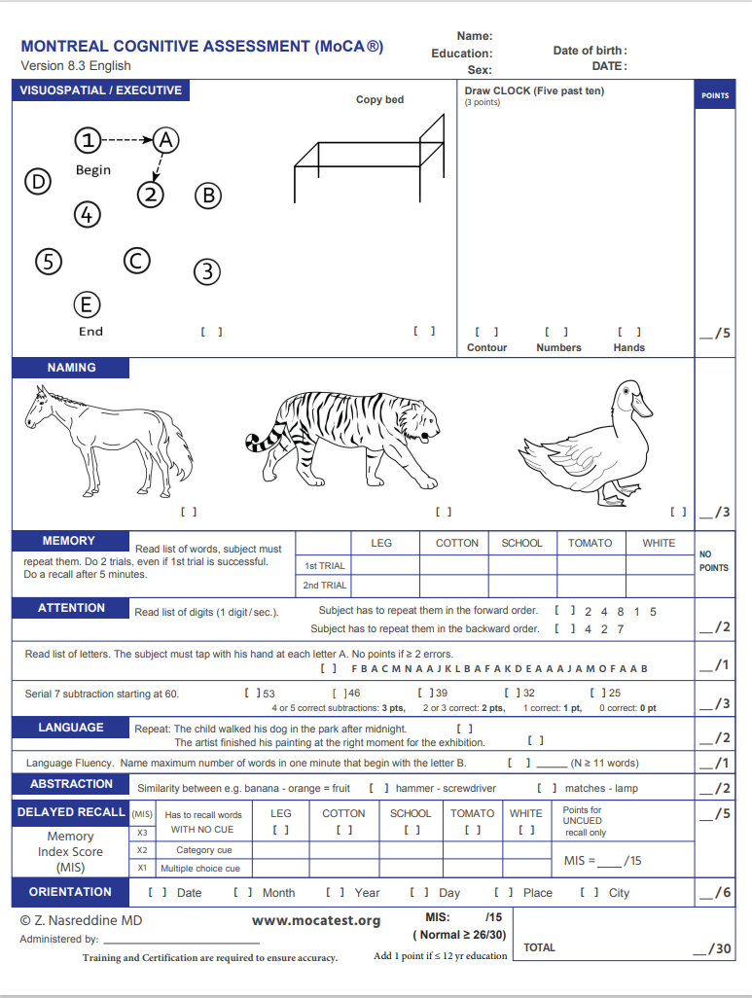
MoCA
Normal Cognitive performance 26 and above
Mild impairment 18-25
Moderate impairment 10-17
Severe impairment 0-9
https://mocacognition.com/
Notes:
The Montreal Cognitive Assessment (MoCA) is a popular and simple-to-administer screening instrument to detect cognitive impairment.
The MoCA generates a total score and six domain-specific index scores:
(1) Memory,
(2) Executive Functioning,
(3) Attention,
(4) Language,
(5) Visuospatial,
(6) Orientation.
There is utility of MoCA Index scores in clinical practice to assist in the early detection of domain-specific cognitive impairment.
Still, careful clinical characterization of dementia phenotypes and diagnosis requires a more systematic and thorough neuropsychological examination by a trained professional.
Limitations of the MoCA are found with people of high education levels as well as low education levels

Slide 16
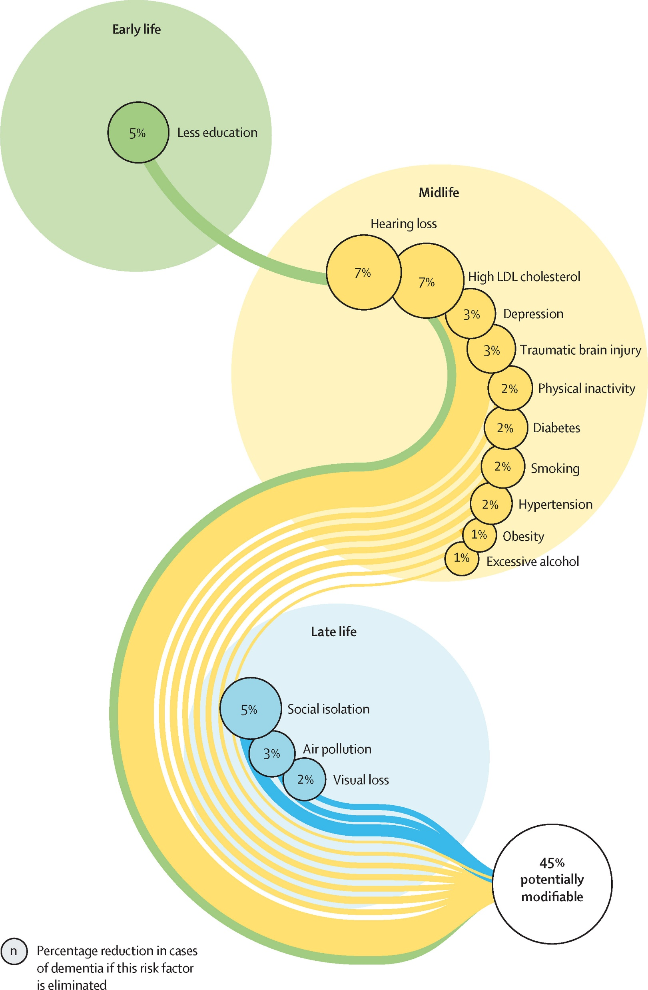
Common risk factors that can progress to dementia
Less Education
Hearing Loss
High LDL Cholesterol
Depression
Traumatic Brain Injury
Physical Inactivity
Smoking
Diabetes
Hypertension
Obesity
Excessive Alcohol Consumption
Social Isolation
Air Pollution
Untreated Vision Loss
Livingston, Gill et al. “Dementia Prevention, Intervention, and Care: 2024 Report of the Lancet Standing Commission.” The Lancet (British edition) 404.10452 (2024): 572–628. Web.
Notes:
This diagrams is from the Dementia Prevention, intervention, and care: the 2024 reports of the Lancet standing Commission
Two new modifiable risk factors for dementia
New evidence supports adding vision loss and high cholesterol as potentially modifiable risk factors for dementia to the 12 risk factors identified in the 2020 Lancet Commission
The 2024 Report broke the risk factors up by
Early Life
Midlife
Late Life
45% potentially modifiable risk factors!

Slide 17
Early Life
Livingston, Gill et al. “Dementia Prevention, Intervention, and Care: 2024 Report of the Lancet Standing Commission.” The Lancet (British edition) 404.10452 (2024): 572–628. Web.
Notes:
Higher childhood education levels and lifelong higher educational attainment reduce dementia risk
Studies suggests overall cognitive ability increases, with education, before reaching a plateau in late adolescence, when brain reaches greatest plasticity with relatively few further gains with education after age 20 years.
This suggests cognitive stimulation is more important in early life;
Much of the apparent later effect might be due to people of higher cognitive function seeking out cognitively stimulating activities and education.
It is difficult to separate out the specific impact of education from the effect of overall cognitive ability and the specific impact of later-life cognitive activity from lifelong cognitive function and activity.

Slide 18
Midlife
Livingston, Gill et al. “Dementia Prevention, Intervention, and Care: 2024 Report of the Lancet Standing Commission.” The Lancet (British edition) 404.10452 (2024): 572–628. Web.
Notes:
Midlife tends to be the time where lifestyle diseases and compression morbidity takes place
This includes high cholesterol, diabetes, hypertension, obesity
These conditions contribute to increased vascular damage and dementia neuropathology
Physical inactivity
Longitudinal studies have shown evidence for physical activity protecting against clinically diagnosed Alzheimer’s Disease.
People might stop exercising due to prodromal dementia so inactivity might be either a consequence or a cause or both in dementia and might be more of a risk in those with cardiovascular morbidity.
As with other outcomes, exercise might be required to be sustained and continue nearer the time of risk
Smoking
New evidence now shows that midlife smoking appears to be a stronger risk factor for dementia than is smoking in late life, possibly because of improvements in treating cardiovascular disease and smoking-related cancers, leading to an increased chance of smokers living long enough to develop dementia.
Excessive Alcohol
Heavy alcohol use (12 drinks/week or more) has been associated with an increased risk of all-cause dementia and reduced grey matter volume in imaging studies.
Depression
In the 2020 Lancet Commission, it was concluded based on published studies that the link between depression and dementia was probably bidirectional and that, in the years before dementia presentation, depression can be a symptom of evolving dementia; a reaction to cognitive impairment; or a cause of cognitive impairment.
Traumatic Brain Injury
Meta-analysis studies have identified that younger age at TBI (<65 years) and male at birth sex were associated with higher risk of dementia
TBI can cause or exacerbate dementia through direct trauma.
Plausible pathological mechanisms for long-term neurodegeneration following TBI include axonal injury promoting early generation of proteinopathies
Hearing Loss:
As severity of hearing loss increases, dementia risk increases
Several mechanisms have been hypothesized to explain how hearing loss might increase dementia risk:
Psychosocial factors such as loneliness, depression, and social isolation
Reduced cognitive reserve from decreased environmental stimuli
Increased cognitive resources needed for listening
And the interaction of the risks with brain pathology
A causal link between hearing loss and dementia is supported by longer exposure to hearing loss being associated with higher dementia risk, with maximum risk in people who were diagnosed with hearing loss for more than 25 years

Slide 19
Late Life
Livingston, Gill et al. “Dementia Prevention, Intervention, and Care: 2024 Report of the Lancet Standing Commission.” The Lancet (British edition) 404.10452 (2024): 572–628. Web.
Notes:
Social Isolation
There is a growing body of evidence that social isolation in and of itself is its own condition increasing risk of morbidity and mortality
It has been found that less frequent social contact was associated with higher risk of dementia
Loneliness is linked to, but differs from, social isolation because it is about people’s feelings that their social contact is inadequate
Loneliness was also associated with increased dementia risk
Social contact in any form has a potentially beneficial effect on dementia risk by building cognitive reserve, promoting healthy behaviours, and reducing stress and inflammation
Social isolation has been linked to lower grey matter volume in the temporal, frontal, and other brain regions than for people who were not socially isolated.
Air Pollution
Exposure to particulates in domestic and external environments is now of intense concern and interest.
Exposure is lifelong and is a potential contributor to many long-term conditions across the life course.
Particulate matter air pollution have been identified as risk factors for dementia and cognitive impairment
This includes residential wood and coal burning stoves as a source of indoor air pollution
Animal models suggest airborne particulate pollutants accelerate neurodegenerative processes through:
cerebrovascular and cardiovascular disease
amyloid-beta deposition (a protein fragment that's a key component of senile plaques, which are a hallmark of Alzheimer's disease)
and amyloid precursor protein processing (a protein found in the brain and other tissues. It's known for its role in Alzheimer's disease, where it's processed in a way that leads to the formation of amyloid plaques)
Visual Loss
Increasing evidence supports an association between untreated vision loss and dementia risk and potential modification by treatment
The mechanisms behind these associations might be related to underlying illness, such as diabetes, which is a risk factor for dementia; vision loss itself, as might be suggested by a possible effect of cataract surgery; or shared neuropathological processes in both the retina and the brain.

Slide 20
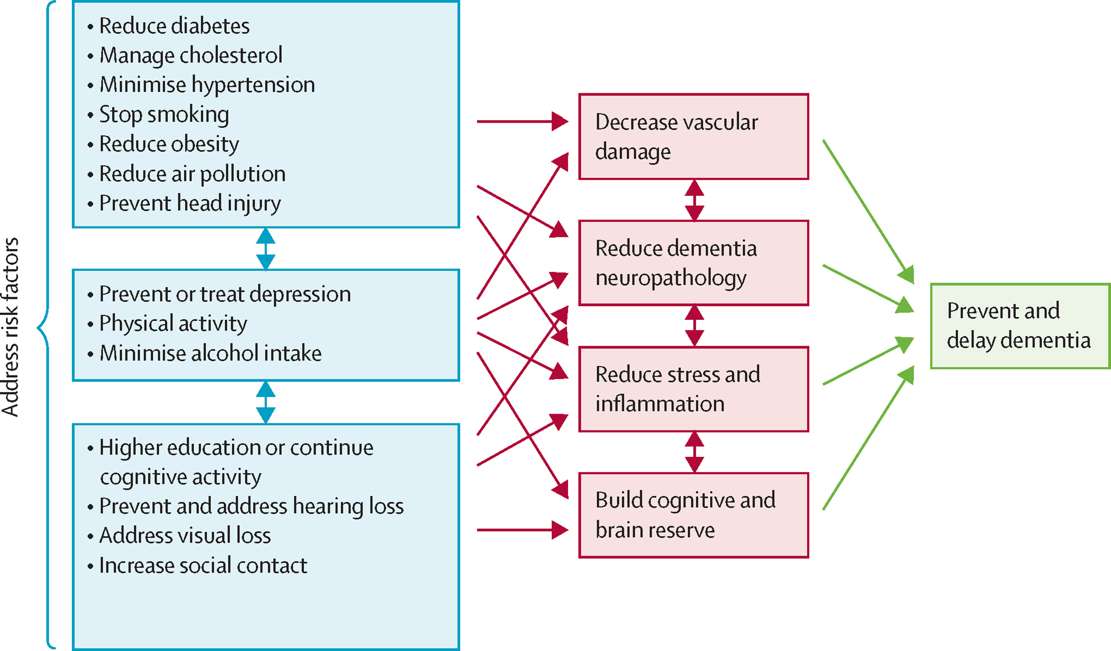
Livingston, Gill et al. “Dementia Prevention, Intervention, and Care: 2024 Report of the Lancet Standing Commission.” The Lancet (British edition) 404.10452 (2024): 572–628. Web.
Notes:
This is another diagram from the 2024 Lancet report
I found this helpful to break down the risk factors and how addressing these factors potentially prevent dementia
Decrease Vascular Damage
Reduce dementia neuropathology
Reduce stress and inflammation
Build cognitive and brain reserve
You will see from the diagram the cross over benefit of addressing these risk factors
This is another great teaching tool for patients and has personally helped me have richer conversations with my patients about lifestyle and behavioral modification
There are also factors here that need community involvement and change in policy such as
Reducing air pollution
Prevention of head injuries
Addressing social isolation and loneliness

Slide 21
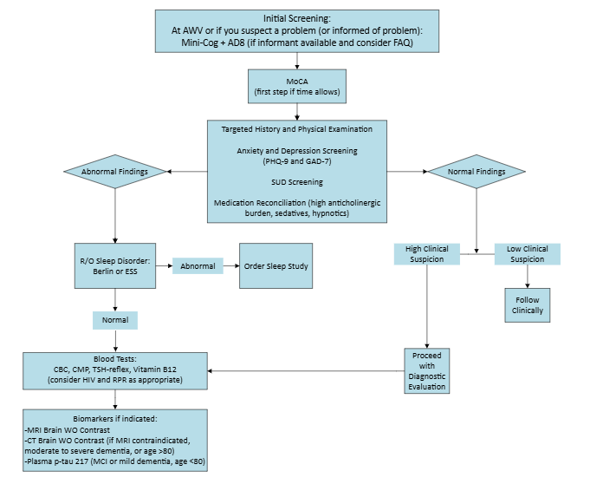
Northern Light Health
Dementia Care Pathway
Notes:
This is the team’s current dementia and cognitive impairment pathway in algorithmic form.
The clinical pathway is a product of collaboration within the grant team, NLH neurologists, as well as geriatricians and primary care providers from around the state including Dr. Amy Madden at Health Reach and Dr. Rebecca Spear at Maine General
It represents components from evidence-based practice and current algorithms in use.
The goal of developing a clinical pathway to:
Achieve consistent screening, evaluation, and assessments among primary care providers
Support primary care providers in the management of patients with dementia and MCI
Provide a decision algorithm for case consultations and appropriate referrals
And lastly, embed the clinical pathway within the EHR
Neuropsychiatry, neuropsychology, and neurology at NLH have reached consensus on the clinical pathway as well as referral recommendations for each specialty

Slide 22
History
History Element | Examples
Time course and pattern of decline | Acute, sub-acute, gradual, progressive, step-wise, fluctuating
Safety concerns and assessment of daily functioning | Driving, finances, medications, wandering, aggression
Social history | Living situation, family support, occupation, education, substance use
Cognitive symptoms | Memory, attention, word-finding, getting lost, organization, judgment
Neuropsychiatric symptoms | Depression, anxiety, irritability, delusions, hallucinations, sundowning
Motor symptoms | Gait impairment, postural instability, tremor, rigidity
Sensory and autonomic symptoms | Hearing, vision, anosmia, orthostasis, incontinence, constipation, temperature
Sleep-related symptoms | Insomnia, sleep apnea, REM behavioral disorder, confusional arousals

Slide 23
Physical Exam
Examination Element | Examples
Observation | Appearance, hygiene, posture, station
Mental Status | Affect, speech, insight, judgment
Ocular Examination | Saccades, convergence, nystagmus
Cranial Nerve Examination | Olfaction, visual fields, ptosis, facial droop
Reflexes | Hyperreflexia, frontal release signs, Babinski
Strength | Weakness, fasciculations, atrophy
Sensory | Romberg, limb proprioception, temperature
Movement | TUG, tremor, rigidity, postural stability, gait

Slide 24
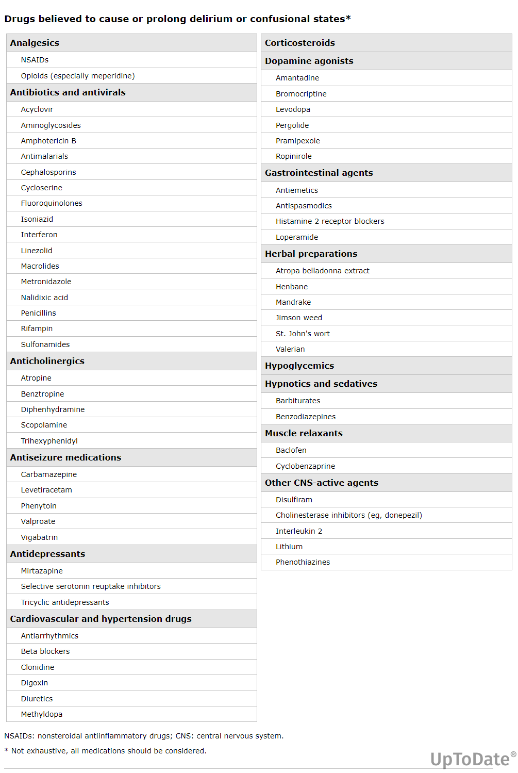
High Risk Medications
High anticholinergic burden
Sedatives
Hypnotics
Consider clinical pharmacist consult/deprescribing
Notes:
Older patients taking at least five medications are at increased risk of mild cognitive impairment and dementia.
Polypharmacy and mild cognitive decline are associated with morbidity and high healthcare cost.
Every attempt should be made to minimize polypharmacy in older adults.
Multiple drug-drug and drug-disease interactions are associated with polypharmacy in older adults
Over a long time, the continued use of polypharmacy can also create new comorbidities, requiring more medications.
This vicious cycle makes older adults weaker, resulting in decreased strength, falls, increased dependence on others, increased morbidity, and mortality
The beers criteria(initially developed by Mark H. Beers in 1991) for potentially inappropriate medication use in older adults from the American Geriatric Society list problematic medications for elderly patients.
It also gives recommendations regarding drug interactions to avoid. The list of medicines keeps changing. The most recent 2019 update uses the five criteria from 2015. They are:
The medications should typically be avoided by older adults.
Medications should be avoided in the older adults with certain conditions.
Medications with caution because of benefits that may offset risks.
Medication interactions.
Changes in dosing based on kidney function.

Slide 25
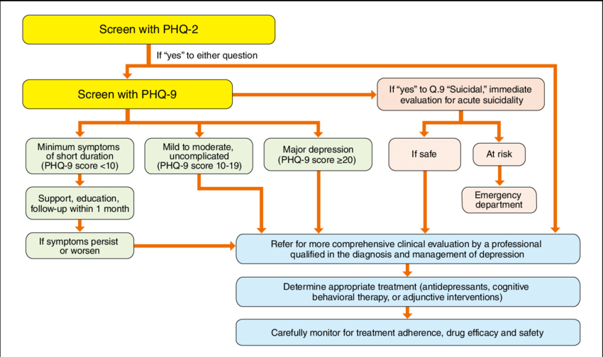
Depression Screening
Depression screening using PHQ-2 and PHQ-9. PHQ, Patient Health Questionnaire. (Source: Prepared based on Lichtman JH, et al. 2008. 122 )
Notes:
We talked about depression when reviewing risk factors
In the primary care setting, we typically use the PUBLIC HEALTH QUESTIONNAIRE
PHQ-2 and the longer PHQ-9 if the first 2 questions from the PHQ-2 are positive
The PHQ-2, comprising the first 2 items of the PHQ-9, inquires about the degree to which an individual has experienced depressed mood and anhedonia over the past two weeks.
Its purpose is not to establish final diagnosis or to monitor depression severity, but rather to screen for depression.
Patients who screen positive should be further evaluated with the PHQ-9 to determine whether they meet criteria for a depressive disorder.

Slide 26
Rule Out Sleep Disorder
Sleep-related breathing disorder
REM sleep disorder
Sleep deprivation
Insomnia
Notes:
Evidence has shown that sleep disorders could contribute to cognitive decline or dementia (cognitive disorders) and might serve as a promising target for dementia prevention.
Evidence suggested sleep could influence core biomarkers of Alzheimer’s disease (AD).
Difficulty in falling asleep, poor sleep quality, sleep loss, excessive daytime sleepiness and sleep disordered breathing has been suggested to increase cerebral Aβ deposition in non-demented older adults.
Apnea or obstructive sleep apnea syndrome has been found to be related to higher levels of AD-related neuronal injury biomarkers (ie, P-Tau and T-Tau).
Sleep quality could even modulate the protective effects of other environmental factors such as physical exercise on brain Aβ deposition.
Furthermore, prospective cohort studies have found that various sleep conditions or parameters, such as insomnia, obstructive sleep apnea, sleep-related behaviors disorder, and changed sleep duration, could significantly elevate the risk of cognitive disorders among non-demented adults.
REM sleep disorder can be a sign of dementia particularly dementia with Lewy bodies and Parkinson’s disease
Acting out dreams during REM sleep is a potential symptom of these neurodegenerative diseases

Slide 27
Blood Testing
Recommended Laboratory Studies:
Complete Blood Count (CBC)
Complete Metabolic Panel (CMP)
Thyroid Stimulation Hormone (TSH) with reflex T4
Vitamin B12 with reflex Methylmalonic Acid (MMA)
If Risk Factors Present:
HIV and RPR
ESR and CRP
Whole blood thiamine
Plasma p-tau 217?
Notes:
Part of the evaluation is ruling out secondary causes of cognitive impairment
Ruling out hematologic, renal, liver, and metabolic conditions that can contribute to cognitive impairment with obtaining a CBC and CMP
Ruling out a thyroid disorder and B12 deficiency which may be potentially reversible with treatment
Ruling out thiamine deficiency, HIV, and syphilis
ESR and CRP are nonspecific inflammatory markers which may help develop a differential diagnosis
I am not including any extensive overview of additional biomarkers such as the Plasma p-tau 217 as this is a separate talk best delivered by a specialist
this may be indicated in the primary care setting in younger patients with mild cognitive impairment
AND
Typical Alzheimer’s Disease syndrome – gradual progressive deficits in short-term memory, orientation, semantic fluency, visual-spatial and executive function, prodromal anxiety and depression symptoms, impaired insight and judgment

Slide 28
Neuroimaging
Always indicated in the setting of:
Acute onset of cognitive impairment
Focal neurologic deficits
Rapidly progressive symptoms
When the differential includes:
Stroke
Subdural hematoma
Intracranial hemorrhage
Structural lesion or malignancy
Normal pressure hydrocephalus (NPH)
Routine Dementia Workup
MRI brain without contrast
CT brain without contrast if MRI is contraindication, patient is > 85, or patient has severe dementia
Notes:
Neuroimaging helps to rule out structural abnormalities

Slide 29
Primary Care Dementia Management
Cases that may be appropriate for primary care management include:
Late onset Alzheimer’s or vascular dementia in older patients with adequate support
Late onset Alzheimer’s or vascular dementia in older patients without significant neurological or psychiatric symptoms
Multi-factorial dementia with multiple medical comorbidities (cirrhosis, CKD, etc)

Slide 30
Possible Referral Disciplines
Geriatric Medicine: MD/DO, 4-year family medicine or internal medicine residency + 1 year Geriatric Medicine Fellowship
Geriatric Psychiatry: MD/DO, 4-year psychiatry residency + 1 year Geriatric Psychiatry Fellowship
Neurology: MD/DO, 4-year Neurology residency
Neuropsychology: Masters then PhD or PsyD, internship and fellowship work following

Slide 31
When to Refer to Neuropsychology
New onset of progressive cognitive decline in any cognitive domain
Multiple causes of cognitive impairment are suspected
History of learning or intellectual disability
High or low level of educational or occupational achievement (i.e. screening tools may not be accurate)
Cognitive assessment is needed to guide recommendations on functioning (ex: employment, driving, decision-making capacity, guardianship, etc)
Family or caregivers need a more thorough evaluation to guide supportive care

Slide 32
When to Refer to Neurology
Sudden onset deficits or focal examination findings
Rapidly progressive dementia (normal to dementia in < 6 months, please contact Neuropsychiatry or Neurology directly at the time of referral)
Cognitive impairment with epilepsy
Cognitive impairment with a gait or movement disorder
Cognitive impairment with motor neuron disease
Cognitive impairment with new or not previously diagnosed strokes

Slide 33
When to Refer to Neuropsychiatry
Early-onset dementia (age < 65)
Atypical pattern of cognitive decline (ex: visual-spatial, language, executive function)
Cognitive decline with behavioral symptoms (personality change, impulsivity, agitation, psychosis)
Dementia with suspected genetic cause (multiple relatives)
Mild cognitive impairment or mild dementia, confirmed Alzheimer’s Disease, patient and/or family is interested in anti-amyloid therapy
Patient and family are interested in clinical trials for cognitive impairment
Notes:
Northern Light Memory and Aging

Slide 34
Patient and Caregiver
Neuro-Radiology
Speech Pathology
Physical Therapy
Vestibular Therapy
Neuro-Optometry
Neurology
Sleep Medicine
Neuro-Psychology
Psychiatry
Geriatric Medicine
Social Services
Primary Care
Notes:
Most importantly, caring for patients with cognitive impairment and dementia is a team-based approach
The diagram lists several potential disciplines who can support the patient and the caregiver
It is vitally important to include:
Shared decision-making
Individualized care plans
Patient and Family education
Good communication
Enhanced caregiver support
Ongoing adaptation to the patient and caregiver needs

Slide 35
References
Borson, S., Scanlan, J., Brush, M., Vitaliano, P., & Dokmak, A. (2000). The mini-cog: a cognitive 'vital signs' measure for dementia screening in multi-lingual elderly. International journal of geriatric psychiatry, 15(11), 1021–1027. https://doi.org/10.1002/1099-1166(200011)15:11<1021::aid-gps234>3.0.co;2-6
Chippa, V., & Roy, K. (2023). Geriatric Cognitive Decline and Polypharmacy. In StatPearls. StatPearls Publishing. https://pubmed.ncbi.nlm.nih.gov/34662089/
Dombrowski W, Mims A, Kremer I, Cano Desandes P, Rodrigo-Herrero S, Epps F, Snow T, Gutierrez M, Nasta A, Epperly MB, Manaloto K, Hansen JC. Dementia Ideal Care: Ecosystem Map of Best Practices and Care Pathways Enhanced by Technology and Community. J Alzheimers Dis. 2024;100(1):87-117. doi: 10.3233/JAD-231491. PMID: 38848182; PMCID: PMC11307099.
Falk N, Cole A, Meredith TJ. Evaluation of Suspected Dementia. Am Fam Physician. 2018 Mar 15;97(6):398-405. PMID: 29671539.
Gallegos M, Morgan ML, Cervigni M, Martino P, Murray J, Calandra M, Razumovskiy A, Caycho-Rodríguez T, Gallegos WLA. 45 Years of the mini-mental state examination (MMSE): A perspective from ibero-america. Dement Neuropsychol. 2022 Jul 29;16(4):384-387. doi: 10.1590/1980-5764-DN-2021-0097. PMID: 36530763; PMCID: PMC9745978.
Hendry, K., Green, C., McShane, R., Noel-Storr, A. H., Stott, D. J., Anwer, S., Sutton, A. J., Burton, J. K., & Quinn, T. J. (2019). AD-8 for detection of dementia across a variety of healthcare settings. The Cochrane database of systematic reviews, 3(3), CD011121. https://doi.org/10.1002/14651858.CD011121.pub2
James, Charlotte et al. “Performance of Machine Learning Algorithms for Predicting Progression to Dementia in Memory Clinic Patients.” JAMA network open 4.12 (2021): e2136553–e2136553. Web.

Slide 36
References continued
Kroenke, K., Spitzer, R. L., & Williams, J. B. W. (1999). Patient Health Questionnaire-9 (PHQ-9) [Database record]. APA PsycTests. https://doi.org/10.1037/t06165-000
Lichtman, J. H., Bigger, J. T., Jr, Blumenthal, J. A., Frasure-Smith, N., Kaufmann, P. G., Lespérance, F., Mark, D. B., Sheps, D. S., Taylor, C. B., Froelicher, E. S., American Heart Association Prevention Committee of the Council on Cardiovascular Nursing, American Heart Association Council on Clinical Cardiology, American Heart Association Council on Epidemiology and Prevention, American Heart Association Interdisciplinary Council on Quality of Care and Outcomes Research, & American Psychiatric Association (2008). Depression and coronary heart disease: recommendations for screening, referral, and treatment: a science advisory from the American Heart Association Prevention Committee of the Council on Cardiovascular Nursing, Council on Clinical Cardiology, Council on Epidemiology and Prevention, and Interdisciplinary Council on Quality of Care and Outcomes Research: endorsed by the American Psychiatric Association. Circulation, 118(17), 1768–1775. https://doi.org/10.1161/CIRCULATIONAHA.108.19076
Livingston, G., Huntley, J., Sommerlad, A., Ames, D., Ballard, C., Banerjee, S., Brayne, C., Burns, A., Cohen-Mansfield, J., Cooper, C., Costafreda, S. G., Dias, A., Fox, N., Gitlin, L. N., Howard, R., Kales, H. C., Kivimäki, M., Larson, E. B., Ogunniyi, A., Orgeta, V., … Mukadam, N. (2020). Dementia prevention, intervention, and care: 2020 report of the Lancet Commission. Lancet (London, England), 396(10248), 413–446. https://doi.org/10.1016/S0140-6736(20)30367-6
Livingston, Gill et al. “Dementia Prevention, Intervention, and Care: 2024 Report of the Lancet Standing Commission.” The Lancet (British edition) 404.10452 (2024): 572–628. Web.
Esther S. Oh. Dementia. Ann Intern Med. [Epub 12 November 2024]. doi:10.7326/ANNALS-24-02207
Seitz, D. P., Chan, C. C., Newton, H. T., Gill, S. S., Herrmann, N., Smailagic, N., Nikolaou, V., & Fage, B. A. (2018). Mini-Cog for the diagnosis of Alzheimer's disease dementia and other dementias within a primary care setting. The Cochrane database of systematic reviews, 2(2), CD011415. https://doi.org/10.1002/14651858.CD011415.pub2

Slide 37
References continued
Tung EE, Walston V, Bartley M. Approach to the Older Adult With New Cognitive Symptoms. Mayo Clin Proc. 2020 Jun;95(6):1281-1292. doi: 10.1016/j.mayocp.2019.10.013. PMID: 32498781.
Wood, J. L., Weintraub, S., Coventry, C., Xu, J., Zhang, H., Rogalski, E., Mesulam, M. M., & Gefen, T. (2020). Montreal Cognitive Assessment (MoCA) Performance and Domain-Specific Index Scores in Amnestic Versus Aphasic Dementia. Journal of the International Neuropsychological Society : JINS, 26(9), 927–931. https://doi.org/10.1017/S135561772000048X
Xu W., Tan C., Zou J, Xi-Peng, C., and Tan, L. Sleep problems and risk of all-cause cognitive decline or dementia: an updated systematic review and meta-analysis. Journal of Neurology, Neurosurgery & Psychiatry 2020;91:236-244.
https://jnnp.bmj.com/content/91/3/236
https://www.alz.org/professionals/health-systems-medical-professionals
https://www.alz.org/media/documents/ad8-dementia-screening.pdf
https://mini-cog.com/how-to-use-it/
https://mocacognition.com/
https://www.uptodate.com/contents/evaluation-of-cognitive-impairment-and-dementia?search=dementia%20evaluation&source=search_result&selectedTitle=1%7E150&usage_type=default&display_rank=1#H547044219

Slide 38
Questions?

