Slide 1
Dementia and Long Term Care
Ari Berman

Slide 2
Why work in long term care?
Benefits of working with older adults
Focus on quality of life and what matters most
Consistent warm interactions with patients and their families
Interest in dementia
Leadership opportunities

Slide 3
Leadership opportunities
Interdisciplinary work
Modeling
Inspiring a shared vison
Promoting continuous improvement
Mentorship and education
Opportunity to uplift and nurture

Slide 4
What is most important to nursing home residents and their families?
Staffing
Staff attitude
Communication
Continuity
Routine and predictability
Control of decision-making process
Dignity
Activities
Culture

Slide 5
Challenges in long-term care
Staffing
Recruitment
Retention
Competition
Staffing mandates
Stress/burn out/frequent death
Issues with dignity
Working conditions
Expectations

Slide 6
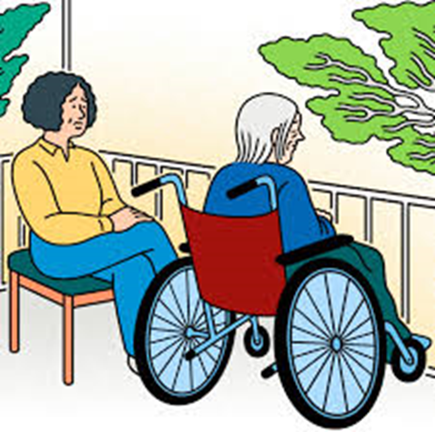
Challenges in long-term care continued, cont’d
Lack of access to specialty care, lack of phlebotomy
Higher acuity patients
Lack of funding, financial pressures
Polypharmacy and acute care management
Challenging needs of residents
Multidrug resistant infections
Heavily regulated
Quality metrics
Disparate electronic medical records

Slide 8
Common issues seen in long-term care
Functional decline
Cognitive decline
Weight loss
Incontinence
Falls
Depression
Polypharmacy
Skin BREAKDOWN

Slide 9
Monitoring dementia patients
Behaviors
Elimination
Food intake
Functional status
Pain
Weight

Slide 10
Managing patients with Dementia in LTC
Optimize function and QOL
Manage medical and behavioral risks and complications related to their dementia
Manage functional deficits
Address pertinent psychosocial issues
Address spiritual issues
Consider palliative care
Engage staff

Slide 11
Dementia Care Considerations
Person centered care: Recognizing the individual behind the disease
Communication: validation and reminiscence
Safety: Clear signs and uncluttered spaces
Caregiver support: education, respite and emotional support

Slide 12
Challenges to care interactions
Dementia: memory loss, aphasia, apraxia, agnosia, behavioral symptoms, depression, apathy, aggression, sensory impairment, pain, delirium
Staff barriers: lack of education and training, focus on task completion, multiple time commitments
Facility barriers: noise, lack of personal space, rooms, poor lighting, lack of home like environment, lack of consistent staffing

Slide 13
Non pharmacologic management of dementia behaviors
Are there unmet needs? spiritual, emotional, or physical?
Assessment: what, why, where, who
Environment: noise, confusing stimuli, temperature, light
Physical symptoms: pain, elimination, sleep
Consideration for: aroma therapy, music therapy, pet therapy, therapeutic touch, exercise, light therapy, activities and engagement, family support, personal space

Slide 14
Why non pharmacologic approaches may fail
They are reactive rather than proactive
Prescribed like medicine
Not always person centered
Superimposed on living environment

Slide 15
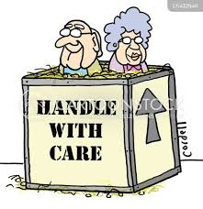
Tools and metrics used to assess quality
MDS – information about functional, cognitive, psychosocial status of residents as well as health conditions, meds and special needs
Short term measures
Long term measures
CHAPS – patient/family experience

Slide 16
Nursing home quality of care metrics
Rehospitalizations
Pressure ulcers
Catheters
Weight loss
Infections
Psychotropic Use
Falls
Vaccinations

Slide 17
Nursing home regulations
Quality of care metrics
Infection control and prevention
Antibiotic stewardship
Interdisciplinary team

Slide 18
QAPI - Quality Assurance Process Improvement
Interdisciplinary approach to proactively prevent complications
Identify, communicate and evaluate changes in status
Establish processes

Slide 19
Future
Staffing solutions
Financial payment models
mindful care approach for patients and staff
Cutting edge technology to optimize care and delivery

