Slide 1
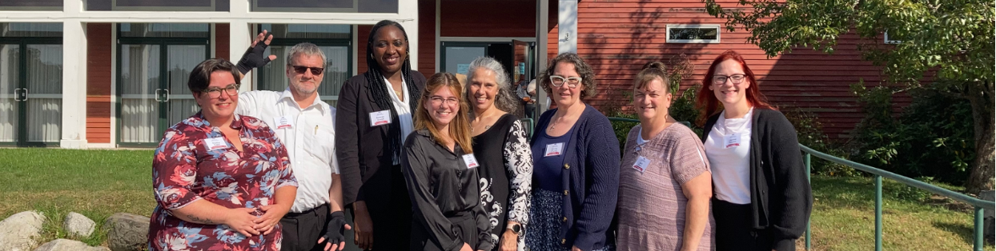
Maine’s Direct Care and Support Professionals Advisory Council:
Uplifting Worker Voices
Mary Lou Ciolfi, JD, MS University of Maine Center on Aging
Geriatrics conference May 22, 2025

Slide 2
The Council Story
The idea
Steering committee
PHI consulting
Recruitment
Meetings & training
2024 conference
The future

Slide 3
The September 2024 Conference
87
Direct care & support professionals
35
Policymakers (OADS, Legislators, advocates)
10
LTCOP staff & volunteers, researchers

Slide 4
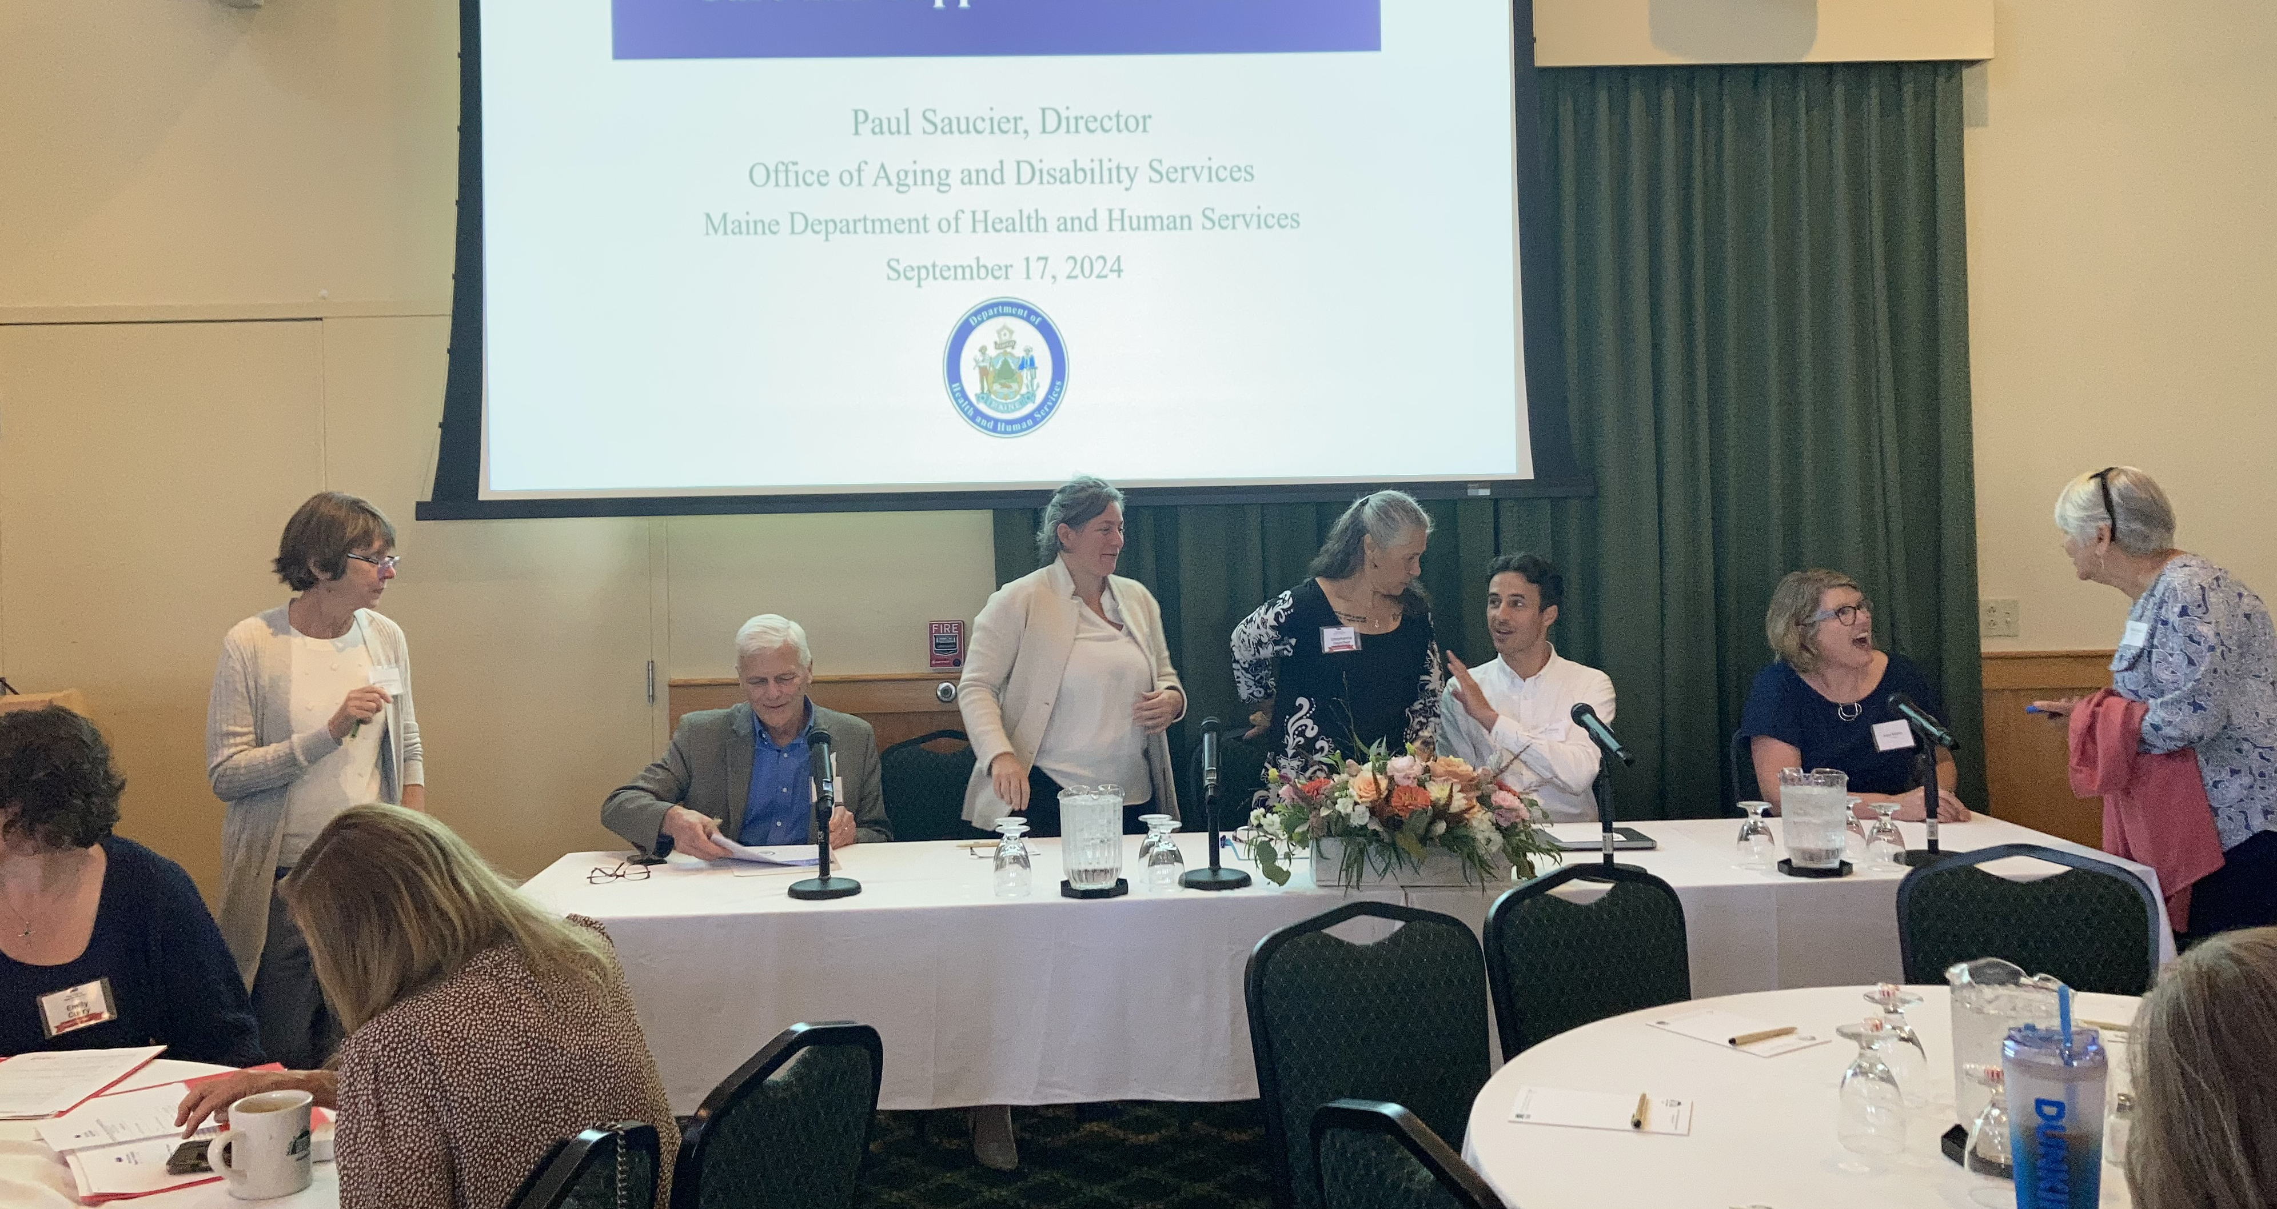
The September 2024 Conference
What did we learn?

Slide 5
The September 2024 Conference
Keynote speaker - Susan Wehry, MD
Panel presentation
AC Members: perspectives from the field
Roundtable discussions & report out – 20 tables

Slide 6
The September 2024 Conference
Retention is so important for both quality and access to care. What and/or who supports you staying in your job?
What can be done to attract new Direct Care and Support Professionals to this role?
What can policymakers do to better support Direct Care and Support Professionals as they undertake their challenges?

Slide 7
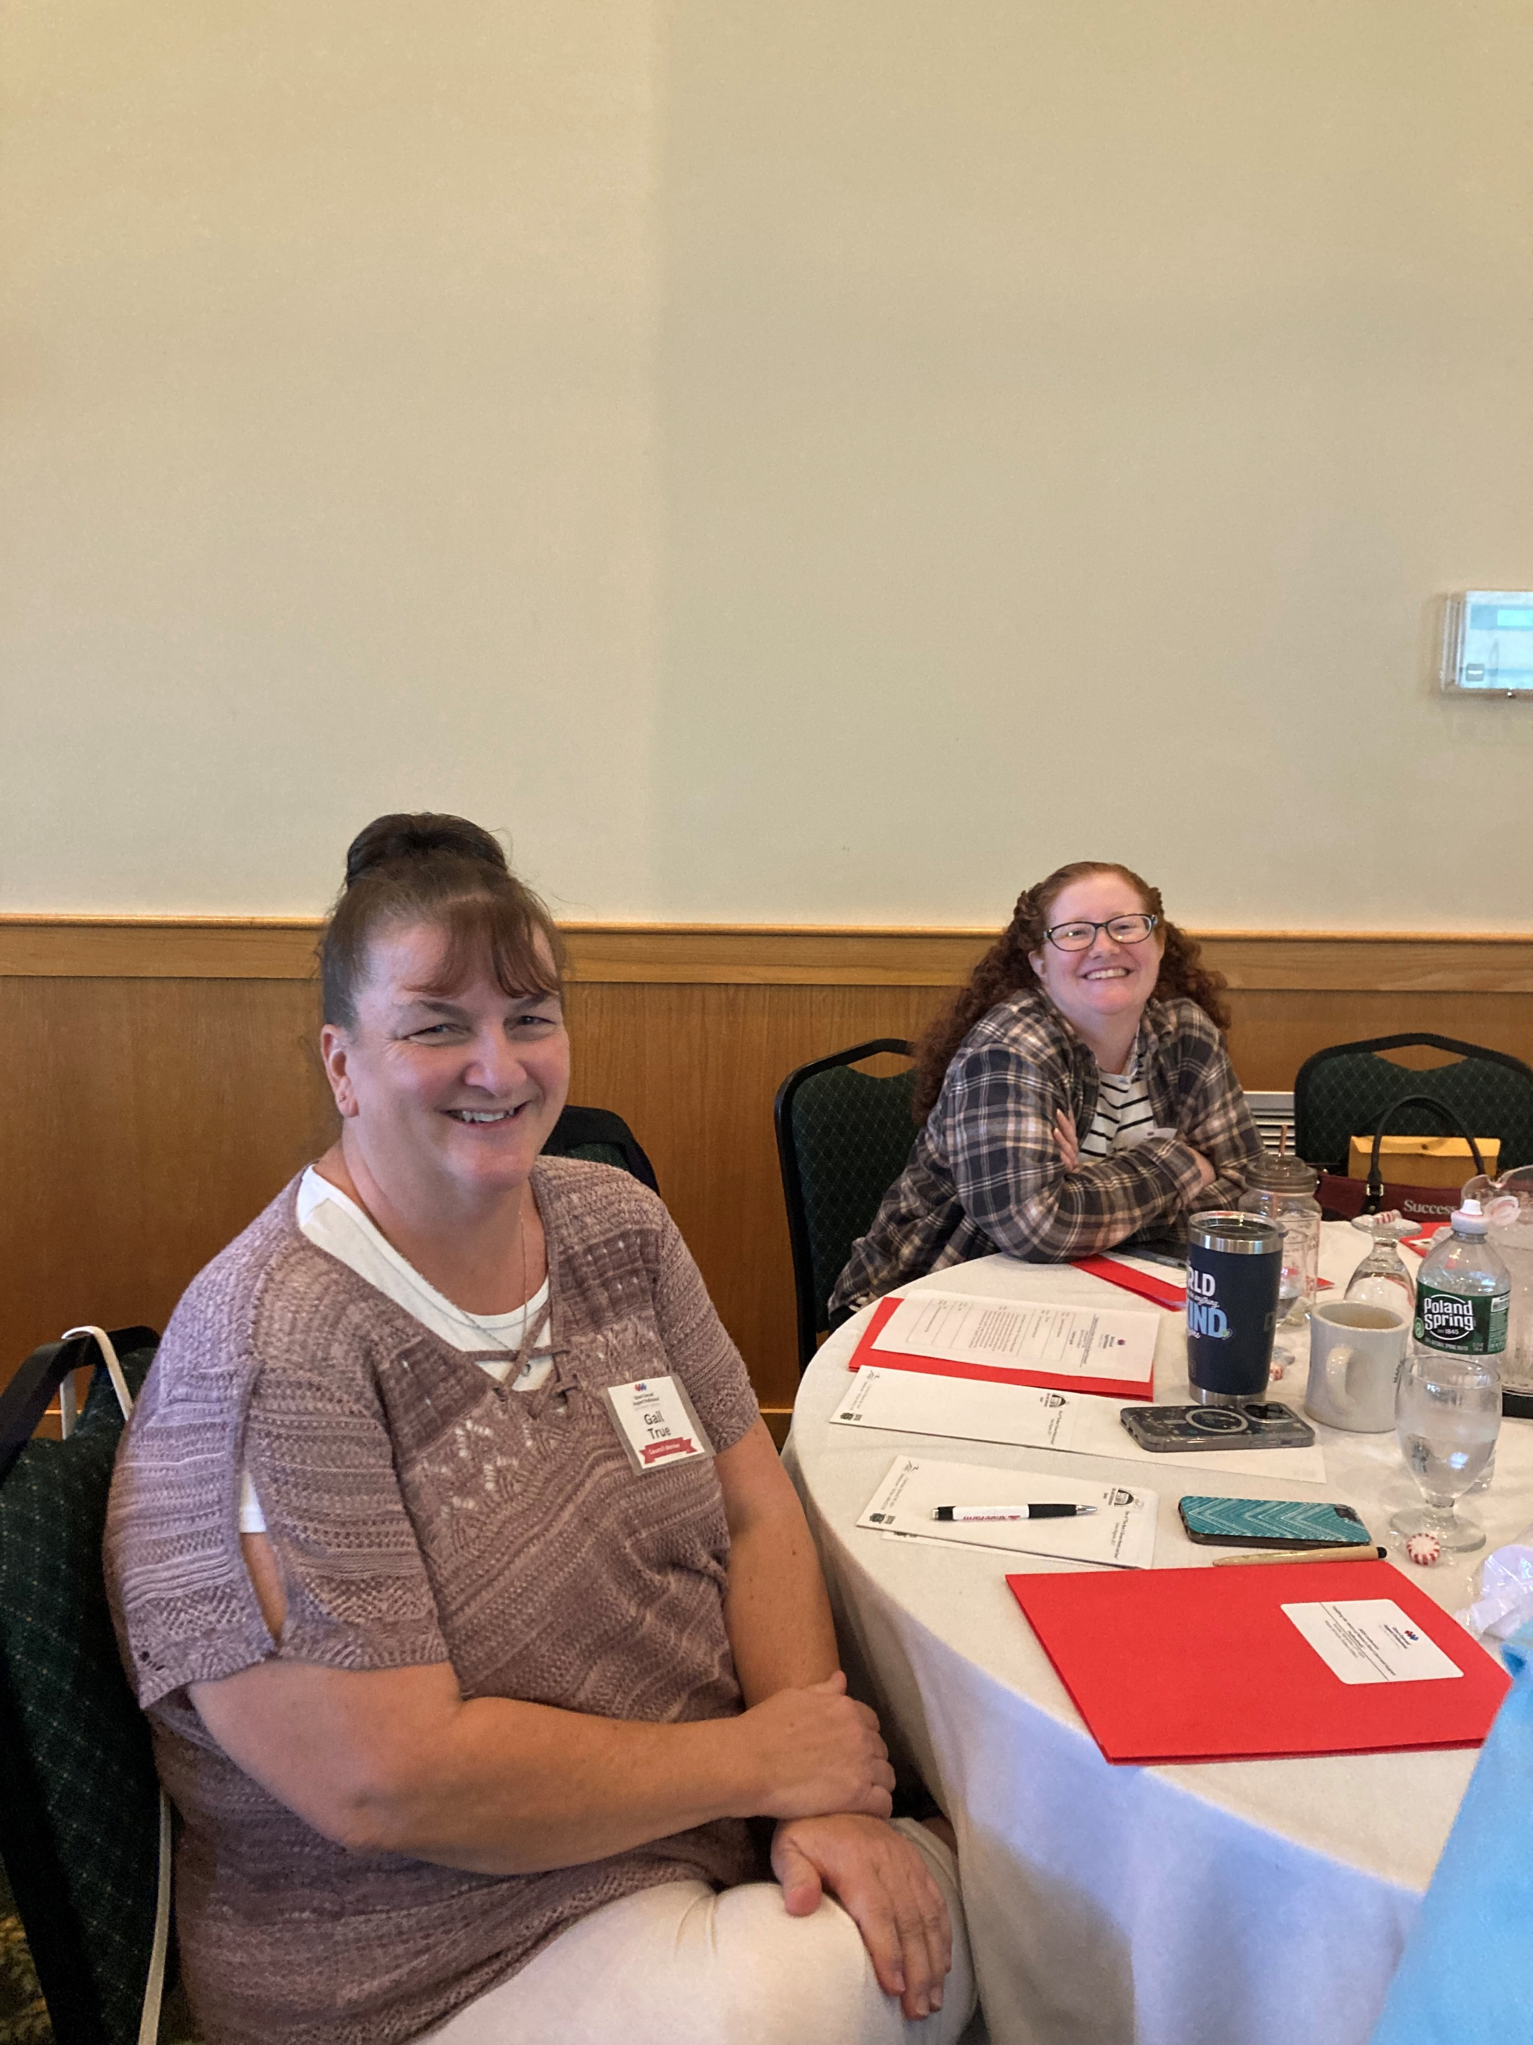
Roundtable Discussions
Hertzberg’s Two Factor Theory
Factors that DECREASE worker dissatisfaction
Factors that INCREASE worker satisfaction
Notes:
MLC
And we thought, hmmmm, Hertzberg’s Two Factor Theory could be very instructive here.
What Hertzberg’s theory says is that there are essentially two groupd of factors that operate on worker satisfaction attitudes: there are factors that [slide] increase worker satisfaction and factors that [slide] decrease dissatisfaction. And what is very interesting – but also something that makes dealing with workers all the more complex – is that the two groups operate independently of one another. As an employer, you can tie yourself in knots trying to increase worker satisfaction, but if you are not also addressing issues that make workers dissatisfied, you are not going to get the results you want.

Slide 8
Roundtable Discussions
Hertzberg’s Two Factor Theory
Factors that DECREASE worker dissatisfaction
Factors that INCREASE worker satisfaction
Notes:
MLC
And we thought, hmmmm, Hertzberg’s Two Factor Theory could be very instructive here.
What Hertzberg’s theory says is that there are essentially two groupd of factors that operate on worker satisfaction attitudes: there are factors that [slide] increase worker satisfaction and factors that [slide] decrease dissatisfaction. And what is very interesting – but also something that makes dealing with workers all the more complex – is that the two groups operate independently of one another. As an employer, you can tie yourself in knots trying to increase worker satisfaction, but if you are not also addressing issues that make workers dissatisfied, you are not going to get the results you want.

Slide 9
Roundtable Discussions
Hertzberg’s Two Factor Theory
Factors that DECREASE worker dissatisfaction
Factors that INCREASE worker satisfaction
Notes:
MLC
And we thought, hmmmm, Hertzberg’s Two Factor Theory could be very instructive here.
What Hertzberg’s theory says is that there are essentially two groupd of factors that operate on worker satisfaction attitudes: there are factors that increase worker satisfaction and factors that decrease dissatisfaction. And what is very interesting – but also something that makes dealing with workers all the more complex – is that the two groups operate independently of one another. As an employer, you can tie yourself in knots trying to increase worker satisfaction, but if you are not also addressing issues that make workers dissatisfied, you are not going to get the results you want.

Slide 10
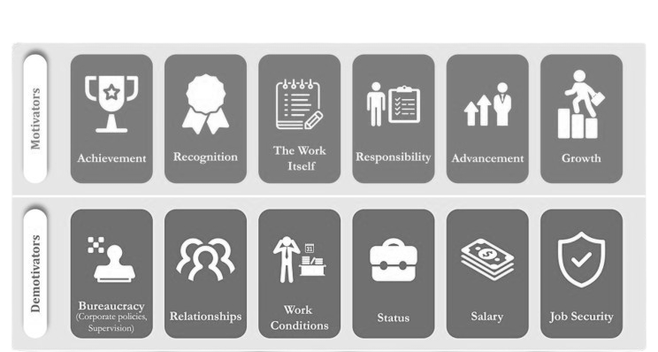
Roundtable Discussions
Hertzberg’s Two Factor Theory
https://www.simplypsychology.org/herzbergs-two-factor-theory.html
Notes:
MLC
To give you some sense of how this works:
Motivators – the things that make workers feel satisfied – tend to be about [read]
And the things that workers tend to feel dissatisfied about are things like: [read]
I offer this information because we tested out organizing the most mentioned themes according to these two domains

Slide 11
The September 2024 Conference
Topic | Mentioned (# of tables) | Increases Satisfaction | Decreases Dissatisfaction
Relationship w/ residents & families | 10 | X
Teamwork, coworkers | 9 |  | X
Management support | 7 |  | X
Training | 7 |  | X
Pay | 6 |  | X
Other support* | 5 |  | X
Meaningful work | 4 | X
Benefits (e.g., health ins) | 3 |  | X
Advancement | 3 | X
Feeling of being valued / appreciated | 2 | X
Good staffing | 2 |  | X
Listening to DCW | 2 |  | X
Lower stress | 1 |  | X
Opps to provide input | 1 | X
Passion &/or dedication for the work | 1 | X
No other jobs available | 1
Notes:
Q#1 Retention is so important for both quality and access to care. What and/or who supports you staying in your job?
The top-mentioned theme in response to this question – it was mentioned at 10 of the 20 tables -- was the “relationships with residents and families --- which is a motivator, right? Something that increases satisfaction.
But look at the next five themes: they are all in the decreases dissatisfaction category: teamwork & coworker relationships, management support, pay, and other support (which were general references like “we need more support than just a paycheck”

Slide 12
The September 2024 Conference
Topic | Mentioned (# of tables)
Raise visibility in community | 8
Recruit at high schools and colleges (e.g., career day) | 5
Job fairs | 5
↑ wages & benefits | 4
Value caregiving in society | 4
Mentoring & job shadowing | 4
Better prep including emotional prep | 4
Tuition reimbursement &/or loan forgiveness &/or college credit | 4
Discounted childcare or offer childcare | 4
Offer training & standardize training | 3
Word of mouth | 3
Positive environment | 2
Referrals &/or referral bonus | 2
Grief counseling | 1
Streamline hiring (e.g., background √s) | 1
Flex schedules | 1
Notes:
Question #2 What can be done to attract new Direct Care and Support Professionals to this role?
The themes that came up for this question do not work so well for the satisfaction/dissatisfaction categories, so I did not group them that way.
The three top-mentioned activities were all about getting the word out about care work opportunities. After that, we start to see a repeat of the themes that might keep someone on the job: better pay and benefits, greater value on the role of care work, better preparation for the job, etc

Slide 13
The September 2024 Conference
Topic | Mentioned (# of tables)
Pay & benefits | 11
Spend time doing the job | 9
Childcare | 5
Meet with residents | 4
Ensure staffing | 4
Better training | 4
Reciprocity of credentials in other states | 4
Streamline certifications | 3
Housing benefit | 3
Equipment for the job | 3
Don't tax OT pay | 2
Anonymous reporting of abuse | 1
Involve DCWs in training curricula | 1
Mental health services | 1
More oversight | 1
Notes:
Q#3 What can policymakers do to better support Direct Care and Support Professionals as they undertake their challenges?
And in the top spot here, mentioned at over half of the tables, was again pay and benefits.
But the next most frequently mentioned theme – mentioned at almost half the tables – was the importance of policymakers and organizational leaders “spending time doing the job”. We saw this over and over – “do my job for a day or a week” so you can see how challenging it is.
The couple of ideas that were only mentioned once or twice are worthy of ongoing discussion. For instance, the mental health of care workers was mentioned here and again on the evaluation forms and maybe it was the same person, but it is tied to what we know of the emotional challenges of the job and being around a lot of death and dying without much emotional support and processing.

Slide 14
The September 2024 Conference
Conference Themes | Suggestions from conference attendees
Pay and benefits | Increase pay and create structure for equity among new and long term workers
Recruit at high schools and colleges | Work w/ schools and communities to offer these events, attend existing events,
Relationship with residents and families | Allow opportunities for staff to build relationships with residents and families
Discounted childcare or offer childcare | Advocate for childcare subsidies so it is affordable for LTC providers to offer
Spend time doing the job | Senior leadership and external policy makers spend time working w/ an experienced aide
Teamwork co-workers | Encourage and support teamwork
Raise visibility in community | Make community leaders aware of staffing needs in LTC
Management support | Offer appreciation, express concern for quality care, offer promotions, offer staff activities outside of work, staff appreciation week, listen well, help on the floor when needed, provide equip needed to do the job well, ongoing training
Training | Improve training experience re content, access, topics
Notes:
There were many suggestions and ideas in each of the mentioned themes, and the good news is that the AC has something to work with in terms of thinking about public policy change and private organizational policy change.
There are several suggestions that are feasible and could be readily translated into organizational or public policy action.

Slide 15
The September 2024 Conference
Next Steps for the Advisory Council
Refine suggestions and assess the feasibility, effectiveness, and the policy implications of the most popular ideas
Engage in strategic planning to address the most pressing worker concerns, focusing on strategies and tactics to both increase satisfaction and decrease dissatisfaction
Secure reliable funding to sustain the work of the AC and grow its visibility and engagement with care workers around the state
Identify legislative champions for the AC and for the care work sector and create communication pathways

Slide 16
The September 2024 Conference
Visit
www.mainedirectcarepros.org

