Slide 1
by Kayla McMullen, RN Kathleen Young , DNP, PMHNP-BC
Addressing Behaviors with Peace and Joy through
Non-pharmacologic Approaches to Behavioral Symptoms

Slide 2
Accreditation Statement and Disclaimer
RSA Grant GE1HS53336-01-00
This project is funded in full by the Health Resources and Services Administration (HRSA) of the U.S. Department of Health and Human Services (HHS) as part of an award totaling $1.33 million. The contents are those of the author(s) and do not necessarily represent the official views of, nor an endorsement, by HRSA, HHS, or the U.S. Government. For more information, please visit HRSA.gov.

Slide 3
Learning Objectives At the end of this presentation, learners should be able to: 1. Identify mistakes caregivers can make that worsen behaviors. 2. Understand why behaviors occur and how to manage them. 3. Understand how to manage holidays.

Slide 4
Behaviors Come in Many Different Forms
Aggression/Agitation
Anxiety, Depression, Apathy
Wandering
Delusions, Hallucinations, Paranoia
Disinhibition
Motor Disturbances ( fidgeting, pacing, repeatedly doing things)
Changes in sleep patterns
Refusing care ( bathing, medications, etc.)

Slide 5
Why can behaviors occur?
Underlying medical conditions/acute infection.
Evaluate medications and any recent changes in them.
Are they in pain? Do they need to use the restroom?
Loss of control, feelings of insecurity.
Lack of structure, overstimulation or not enough stimulation.
Caregiver is overwhelmed or impatient.
Poor lighting.
Can you think of any others?

Slide 6
Caregivers Response is Critical
Individuals with Dementia will respond based upon the caregiver’s response.
Gentle touch. Pressure on the palm is calming. Hand over hand technique.
Approach on their dominant side and down on their eye level but remember eye
sight changes as the disease progresses. You may need to approach from the side.
Calming voice. Don’t scream from across the room.
Simplifying the environment to reduce confusion.
Scheduling activities around natural routines.
Don’t give too many choices.
ALWAYS SAFETY FIRST!

Slide 7
Join Their World
Do not use the word No or “push” them into doing something.
Allow enough time for them to answer.
Use more questions.
Avoid any negative approach.
Do be kind.
Create a place of joy.

Slide 8
Approaches that don’t work!
Correcting the individual when they say or do something wrong.
Arguing with them – instead value peace and calmness.
Reasoning with them as this leads to extreme frustration.
Testing their memory- causes embarrassment, defensiveness and disengagement. “ What’s my name?” “Who is this?”

Slide 9
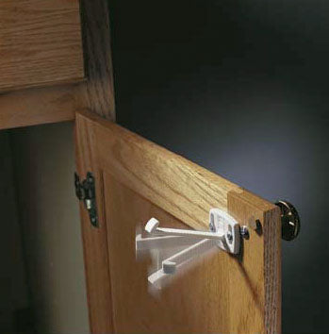
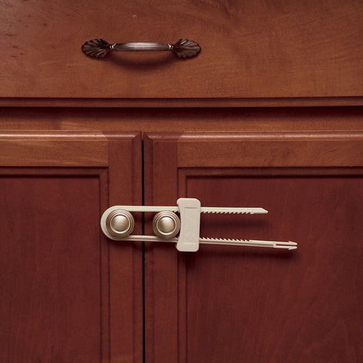
Home Safety
Lock up knives in cabinets with safety locks.
Check for expired food items.
Shut off systems for stoves.
Keep items they can eat already prepped and within reach.
Lock or remove weapons.
Label drawers/cupboards

Slide 10
Delusions and Hallucinations
Delusions are false beliefs that the individual believes is real. Can have themes of someone stealing their belongings, spouse cheating on them, etc.
Hallucinations can involve any of the senses and the individual believes the experience is real.
For acute onset, call the provider as it may be due to a medical condition or medication.
Provide comfort to the individual.
Do not argue with them about what they are seeing, hearing or believe is happening.
Distraction helps.
Create a safe environment.

Slide 11
Disinhibition
Takes a multifaceted approach that includes a calming environment, recognizing and minimizing triggers.
Create a calm and supportive environment.
Use calm and gentle tones of voice and simple sentences. Avoid arguing.
Provide sensory stimulation.
Distract if possible.
Maintain routines and increase daytime activities.
Encourage physical contact.
Explore the reason for the behavior – are they getting over heated, etc.

Slide 12
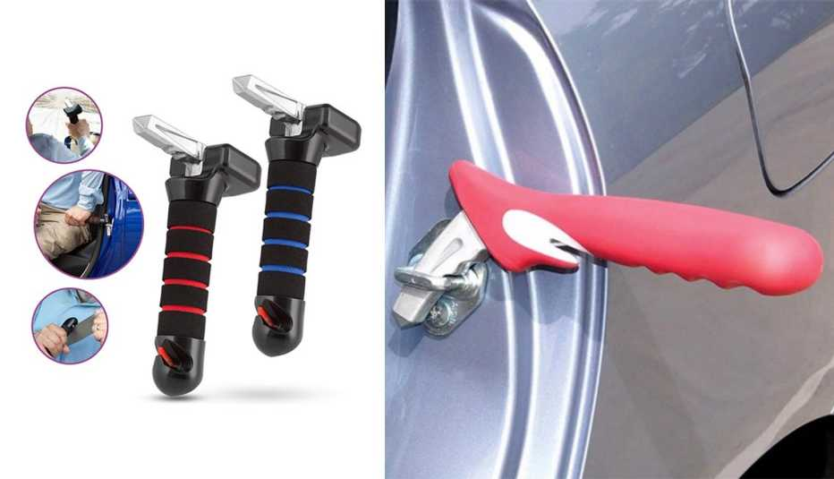
Car Safety – The Battle can get Real!
Consider safety devices in the car such as the Buckle Boss Seatbelt Guard.
Consider having them ride in the back seat that has a child safety door and window locks.
Consider GPS tracking devices if they are still driving.
Consider grab bars to help getting in and out of the car.

Slide 13
Surviving Short Term Memory Challenges
Every day can be groundhog day. Sometimes the file cabinet is locked and bungee corded.
Using calendars to write down important dates and crossing off the day helps for orientation.
Repetitive questions and stories happen frequently and require patience and understanding.
Helping them with devices and directions while driving.
Create specific spaces for frequently lost items like glasses, keys, etc.
Simply the environment.

Slide 14
Wandering
Typically triggered by old memories and not recognizing where they are, or a feeling of distress.
Reduced ability to communicate.
Can be triggered by seeing keys, purses, jackets and the front door.

Slide 15
Addressing Wandering Behaviors
Create a safe environment-
Use door alarms or motion sensors
Install childproof locks or camouflage exits
Establish a Routine-
Keep daily schedule consistent
Plan regular activities and exercise
Provide Supervision-
Don’t leave unattended in unfamiliar setting
Use ID bracelets or GPS trackers for safety
Address Underlying Causes-
Check for pain, discomfort, toileting needs
Ensure they aren’t bored or anxious
Use Visual Cues-
Signs with symbols or colors for important rooms
Cover doors with curtains or murals to discourage exit. Post a “keep out” sign on the door.
Ensure good lighting.

Slide 16
Sundowning
This is a group of symptoms that occur at a specific time of day.
Can include confusion, agitation, anxiety, ignoring directions, pacing or wandering.
As dementia progresses, it can damage the internal clock and the sleep wake cycle.
Change environment by increasing lighting and reduce shadows.
Close drapes and blinds.
Create a calm environment.
Be patient and provide distractions.
Provide physical activity during the day in moderation.
Limit daytime napping to a few hours.

Slide 17
Repetitive Behaviors – Not all are Bad!
They are not able to remember recent actions/events.
They tend to fixate and repeat words as it is soothing to them.
Can be a way to communicate unmet need(s), anxiety, or unspent energy, physical pain or toileting needs.
Identify the underlying cause.
Don’t be aggressive in stopping the behavior.
Provide reassurance and include in daily routine.

Slide 18
Hygiene and Clothing
Create a kind, gentle, warm environment.
Telling them they stink typically doesn’t work!
Don’t deny their favorite things if they don’t shower.
Wrap up clothing as a “present” to get them to try them on and get out of soiled clothing.
Remove soiled clothing when they are in the shower and lay out clean clothing.

Slide 19
Hygiene Helpful Tips
Create a spa environment in the bathroom, flame free candles.
Remember, showering/bathing is a personal thing. Let them do what they can do. Offer a towel to maintain modesty.
Use a shower chair, and handheld shower heads.
Explain each step as you go. Start at their feet.
Use their favorite soap/shampoo.
Goal is to shower at least twice a week with sponge baths in between.
Dry them with a warm towel from the dryer.
Find out what their hygiene habits were before the impairment.

Slide 20
Diet and Hydration
There is a tendency to crave sweets for several reasons: taste, mood, sleep pattern or medications.
They also tend to not want to drink water.
Offer small, frequent meals. Include soft, easy to chew foods. Fluids throughout the day.
Encourage finger foods if utensils are difficult.
Consider increasing fruit to stop the sweet tooth, like watermelon or oranges (also high in water).
Smoothies are another way of getting veggies and water into their diet and settle down the carb cravings.
Offer a variety of fluids, especially fruit-infused water or diluted fruit juice. Use cups with straws and lids if needed.

Slide 21
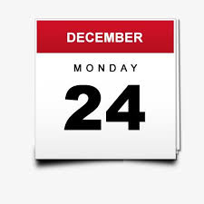
Holidays are Just Dates on the Calendar!
Now is not then:
It is not the past – focusing on the past doesn’t help.
Some but not all:
Using the situation as the reason that you can’t enjoy the holiday season.
Decide what you want to keep and continue the joy.
Resist our emotions by distraction eating and drinking:
This allows the feeling to persist.

Slide 22
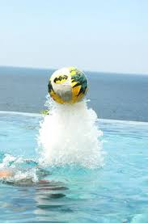
Imagine yourself holding a beach ball under water…….
You try to desperately hold that ball down………..
But what happens?
Eventually your body becomes tired …..
And that ball goes flying into the air.
The same thing occurs when we suppress our emotions. It is better to feel the emotions and let them pass.
Holidays will be different, but it doesn’t make them bad.

Slide 23
Holiday Suggestions
Keep it simple- choose calm, familiar traditions. Avoid overwhelming decorations and loud environments.
Plan Ahead- Schedule activities during their best time of the day. Prepare guests for any changes in behaviors.
Maintain routine- Stick to regular meal and sleep schedules. Avoid disruptions to medications.
Involve them meaningfully- Give simple tasks like folding napkins or decorating cookies. Share familiar music, photos or holiday stories.
Focus on connection over perfection- Be flexible with expectations. Prioritize comfort, joy and togetherness.

Slide 24
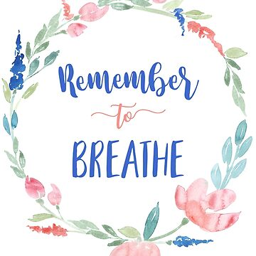

Slide 25
Questions?

