Slide 1
Palliative & Hospice approach to supporting people with advanced dementia
Zoë Tenney, MSN, APRN, FNP-C Certified Hospice & Palliative Nurse Practitioner Northern Light Home Care & Hospice
Cliff Singer, MD, DLFAPA, AGSF
Director, Northern Light Memory and Aging

Slide 2
Disclosures
No personal disclosures for the speakers.
Bother speakers receive partial salary support from HRSA Grant GE1HS53336-01-00.
This project is funded in full by the Health Resources and Services Administration (HRSA) of the U.S. Department of Health and Human Services (HHS) as part of an award totaling $1.33 million. The contents are those of the author(s) and do not necessarily represent the official views of, nor an endorsement, by HRSA, HHS, or the U.S. Government. For more information, please visit HRSA.gov.

Slide 3
Palliative & Hospice Approach: today’s goals
Increase familiarity with the key principles & practices of Palliative & Hospice care as they apply to supporting people with advanced dementia and their loved ones.
Improve understanding of prognostic challenges and Hospice eligibility for people with dementia.
Share clinical pearls re: dementia end-of-life care & bereavement care.

Slide 4
Principles of Palliative Care & Hospice
Provide relief from the symptoms and stress of the illness, including physical, emotional and spiritual distress.
Improve quality of life for both the patient and the family based on their goals & priorities.
Note:
Palliative Care can be utilized at any point in a serious illness regardless of life-expectancy or treatment approach, while Hospice is designed to provide support during the last 6 months of life for people no longer pursuing curative treatments.
UNE Annual Geriatrics Conference, 05/22/202

Slide 5
Why Palliative Care & Hospice?
High quality advance care planning
Decrease admissions/readmissions/ER
Less “crisis driven” care
Improvement in quality of life
Person is more likely to be in setting of choice at time of death
Hospice also offers:
Provision of DME and valuable services like frequent nursing visits, aides, social work, expert spiritual support, 24/7 access by phone and off-hours visits when needed, funeral planning, postmortem care, and volunteers.
Bereavement support for loved ones for 13 months after the patient’s death.
Notes:
AMM

Slide 6
Asking the right question…..
…instead of “What can we do?”
“What should we do?”
This Photo by Unknown Author is licensed under CC BY-SA
UNE Annual Geriatrics Conference, 05/22/202
Notes:
ZT

Slide 7
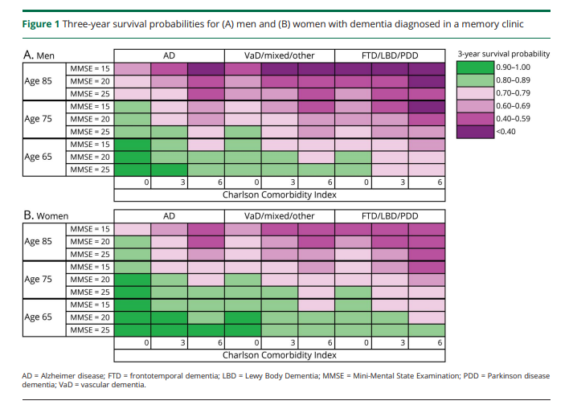
Prognostic Variables in Dementia Patients Haaksma ML et al. Neurology 2020; 94:1-11

Slide 8
Prognosis matters for Hospice
Prognosis/estimating life expectancy can be challenging in advanced dementia.
People with dementia may have very advanced cognitive changes and profound functional limitations well prior to the last 6 months of life.
Comorbidities can be important in assessing life expectancy and trajectory of declines.
Anticipatory guidance for families is needed when there is prognostic uncertainty.

Slide 9
Discussing life expectancy in uncertain times…
© 2015–2023 Ariadne Labs: A Joint Center for Health Systems Innovation (www.ariadnelabs.org) between Brigham and Women’s Hospital and the Harvard T.H. Chan School of Public Health, in collaboration with Dana-Farber Cancer Institute. Licensed under the Creative Commons Attribution-NonCommercial-ShareAlike 4.0 International License, http://creativecommons.org/licenses/by-nc-sa/4.0
UNE Annual Geriatrics Conference, 05/22/202

Slide 10
General Hospice eligibility guidelines from CMS
Patients with Alzheimer’s dementia should show all the following characteristics
Unable to ambulate without assistance
Unable to dress without assistance
Unable to bathe without assistance
Urinary and fecal incontinence, intermittent or constant
No consistently meaningful verbal communication: stereotypical phrases only or the ability to speak is limited to six or fewer intelligible words
CMS Hospice eligibility criteria for dementia due to Alzheimer’s and related conditions generally require the following elements (LCD - Hospice - Determining Terminal Status (L33393)), which suggest a prognosis of 6 months or less.
UNE Annual Geriatrics Conference, 05/22/202

Slide 11
Patients should have had one of the following within the past 12 months:
;
Pyelonephritis
Aspiration pneumonia
Septicemia
Decubitus ulcers, multiple, stage 3-4
Fever, recurrent after antibiotics
Inability to maintain sufficient fluid and calorie intake with 10% weight loss during the previous six months or serum albumin < 2.5 gm/dl
CMS Hospice eligibility criteria for dementia due to Alzheimer’s and related conditions generally require the following elements (LCD - Hospice - Determining Terminal Status (L33393)), which suggest a prognosis of 6 months or less.

Slide 12
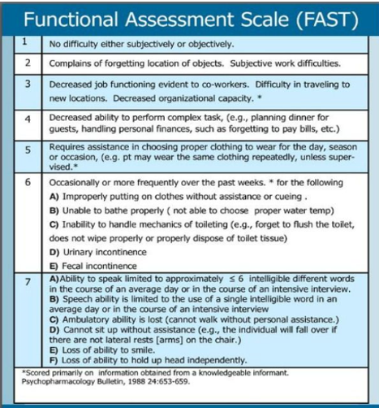
Recertification in Hospice
Starting when a patient has been under Hospice care for 6 months (at the end of their second 90 day benefit period):
Patient must be seen “face to face” by an NP or physician employed by the Hospice every 8 weeks.
Evidence of clinical of decline and continued Hospice appropriateness must be meticulously documented for the patient to be recertified.

Slide 13
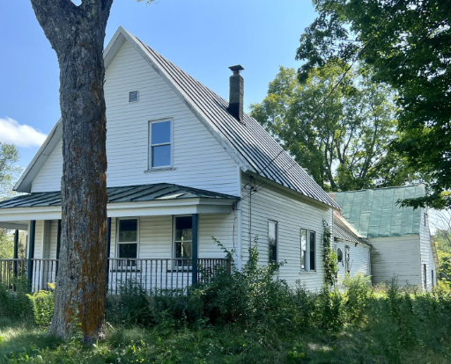
A few thoughts-
Go to the home
Involve social work
Offer anticipatory guidance
Affirm the caregivers
Don’t recommend percutaneous feeding tubes, offer assisted oral feeding instead (Am. Geriatrics Society and AAHPM)
Educate yourself on spiritual practices as needed “How to be a Perfect Stranger” (Matlins & Magida)
Call or send a card after death
Care for your own physical, mental and spiritual health

Slide 14
Pearls from a Hospice team with 273 years combined experience
Patience & presence.
Don’t reorient, “allow them their reality.”
Be curious, learn about them as an individual, their past, what they care about, “always stay open to possibilities, they are still themselves, still full of surprises.”
Unconditional positive regard: Warmth, love, compassion, laughter, dignity, respect.
Sing.

Slide 15
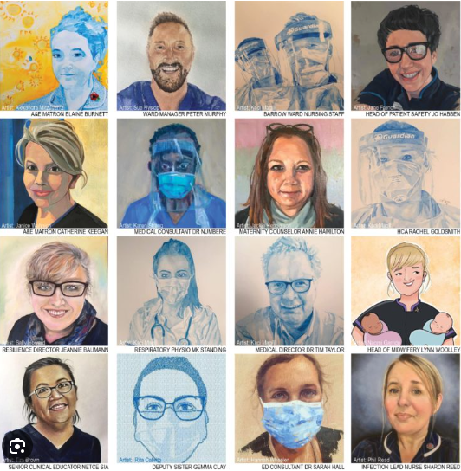
Communication
55% facial expression
38% tone
7% words
Mehrabian A.
Silent messages: a wealth of information about nonverbal communication (body language) 2016 http://www.kaaj.com/psych/smorder.html
UK National Health Service, University Hospitals Sussex “Portraits for heroes - Our Covid Story”

Slide 16
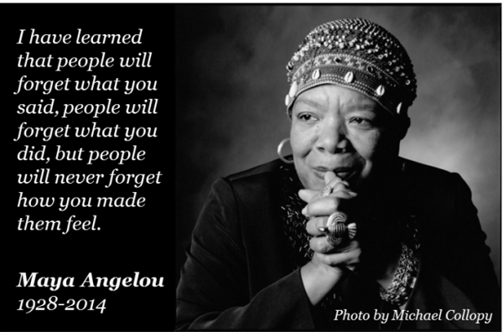

Slide 17
“Forget Me Not”
I feel guilty that I am thinking about myself.
I just worry that I am not strong enough
To enter this whiteout blizzard with you
And see you through with kindness and
protection.

Slide 18
UNE Annual Geriatrics Conference, 05/22/202
Notes:
ZT

