Slide 1

32nd Maine Geriatrics Conference
May 20-21, 2025
Paul Linet, Founder & CEO
3i Housing of Maine
Copyright 2025: 3i Housing of Maine. All rights reserved.

Slide 2
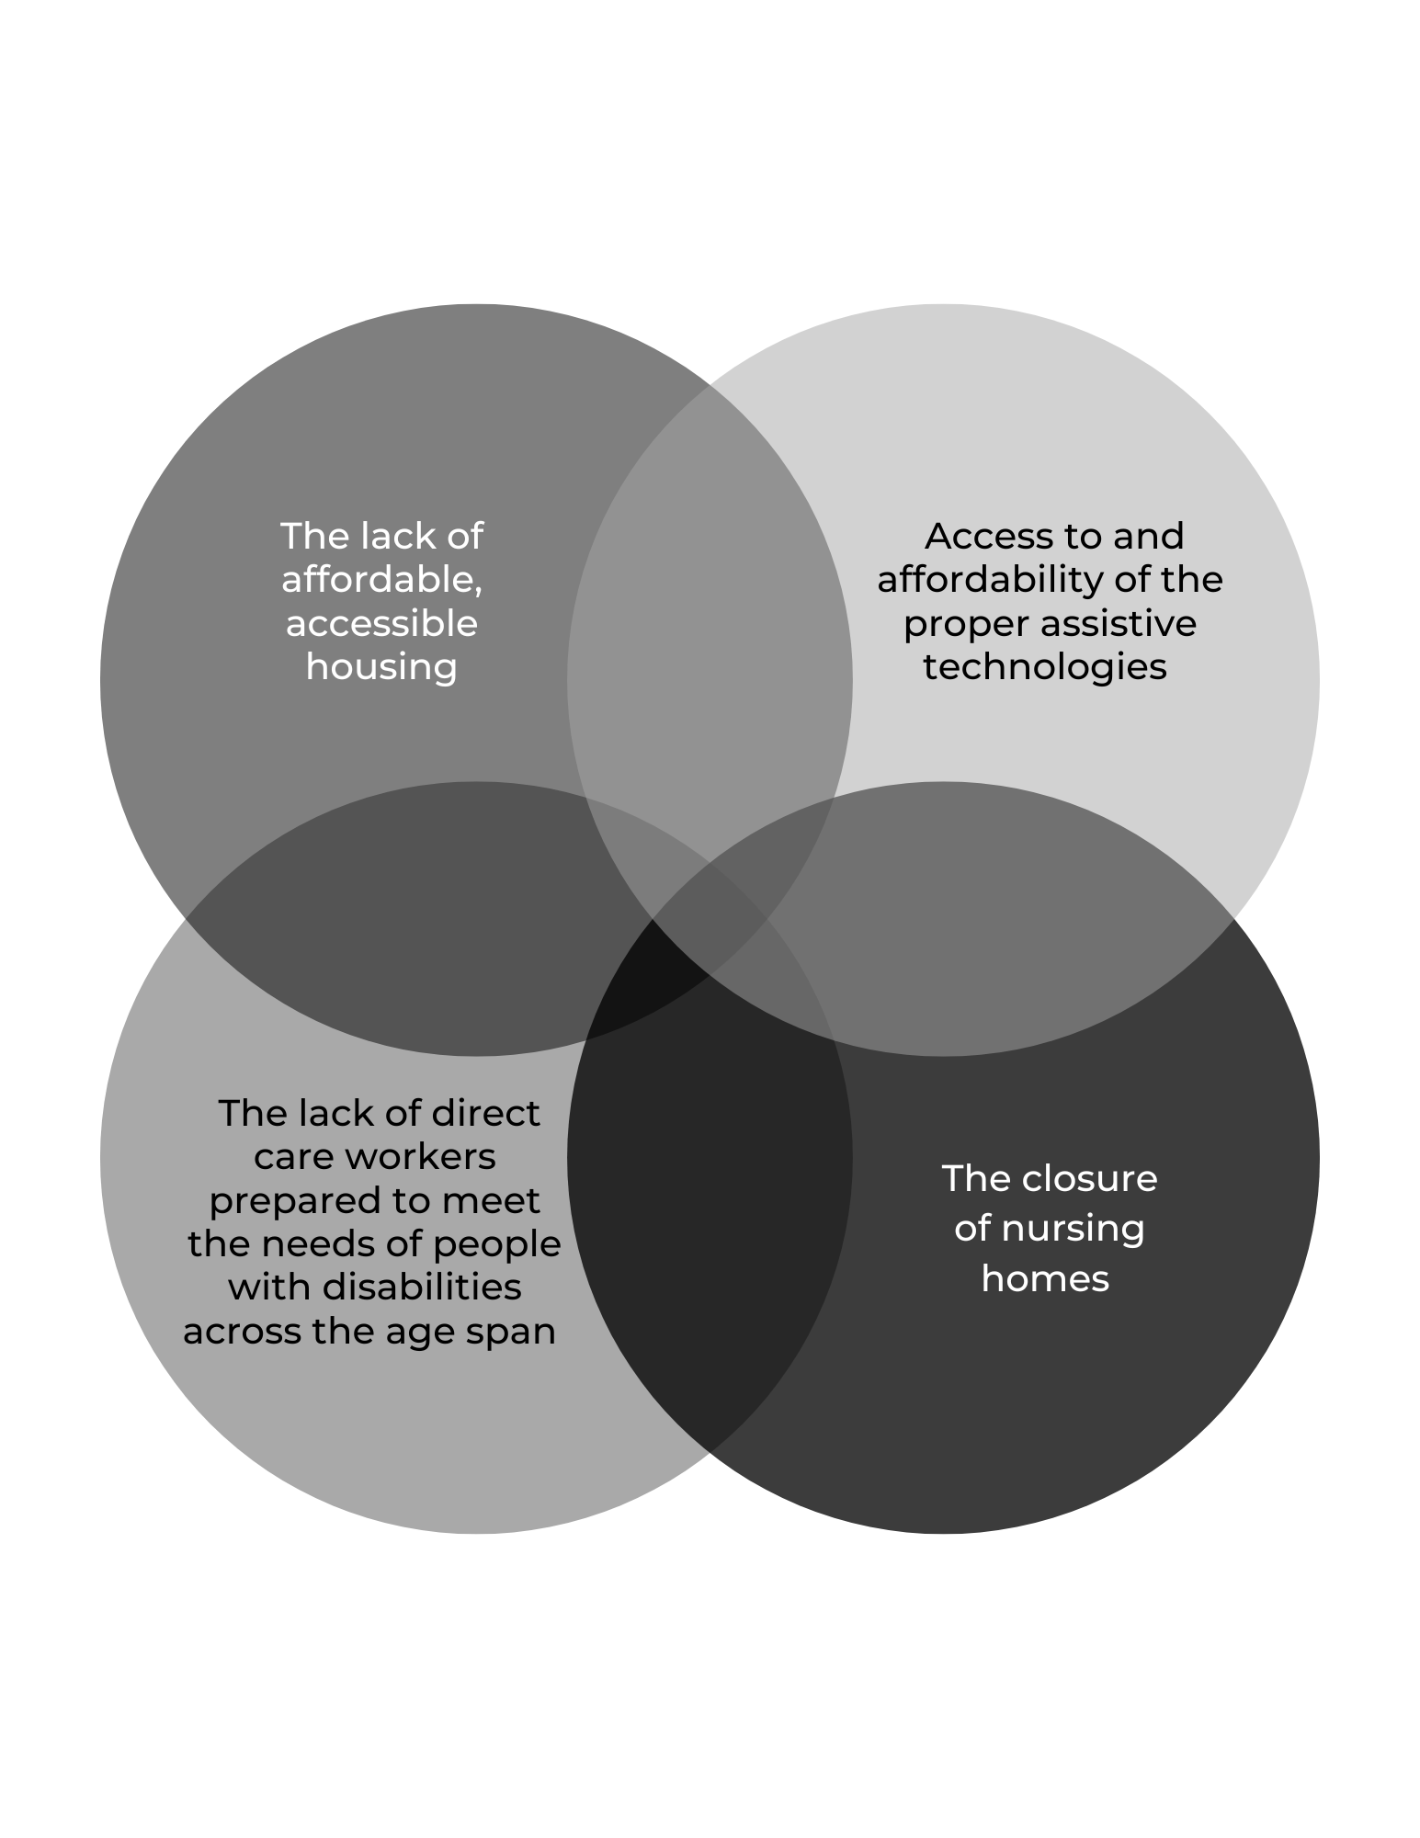
THE
PROBLEMS
™
Copyright 2025: 3i Housing of Maine. All rights reserved.

Slide 3
Accessible Housing Need
8.2%
<5%
of Americans have a physical disability
of the national housing supply is accessible
28.6%
<1%
of older Americans have a physical disability
of housing is wheelchair-accessible
™
Stats from the Fair Housing Center for Rights & Research, 2024
Copyright 2025: 3i Housing of Maine. All rights reserved.

Slide 4
Accessible Housing Need
6.8M
Households experience accessibility challenges in their homes
3M-6M
Is the number of houses the United States is short to fill the accessible housing need.
™
Stats from the Fair Housing Center for Rights & Research, 2024
Copyright 2025: 3i Housing of Maine. All rights reserved.

Slide 5
The 3i HoME Solution
Fully accessible homes and apartments, built with universal design principles equipped with smart assistive technologies and HCBS
Housing options affordable at all economic levels
Housing options suitable for urban or rural settings
Copyright 2025: 3i Housing of Maine. All rights reserved.

Slide 6
The 3i HoME Solution
Mobility Assistive Technology Hub (MATH) providing spaces to partner with innovative assistive technology companies, academic institutions and community residents
Assistive Technology Enhancement Center (ATEC) is available to provide fixes and enhancements to assistive technologies.
Copyright 2025: 3i Housing of Maine. All rights reserved.

Slide 7
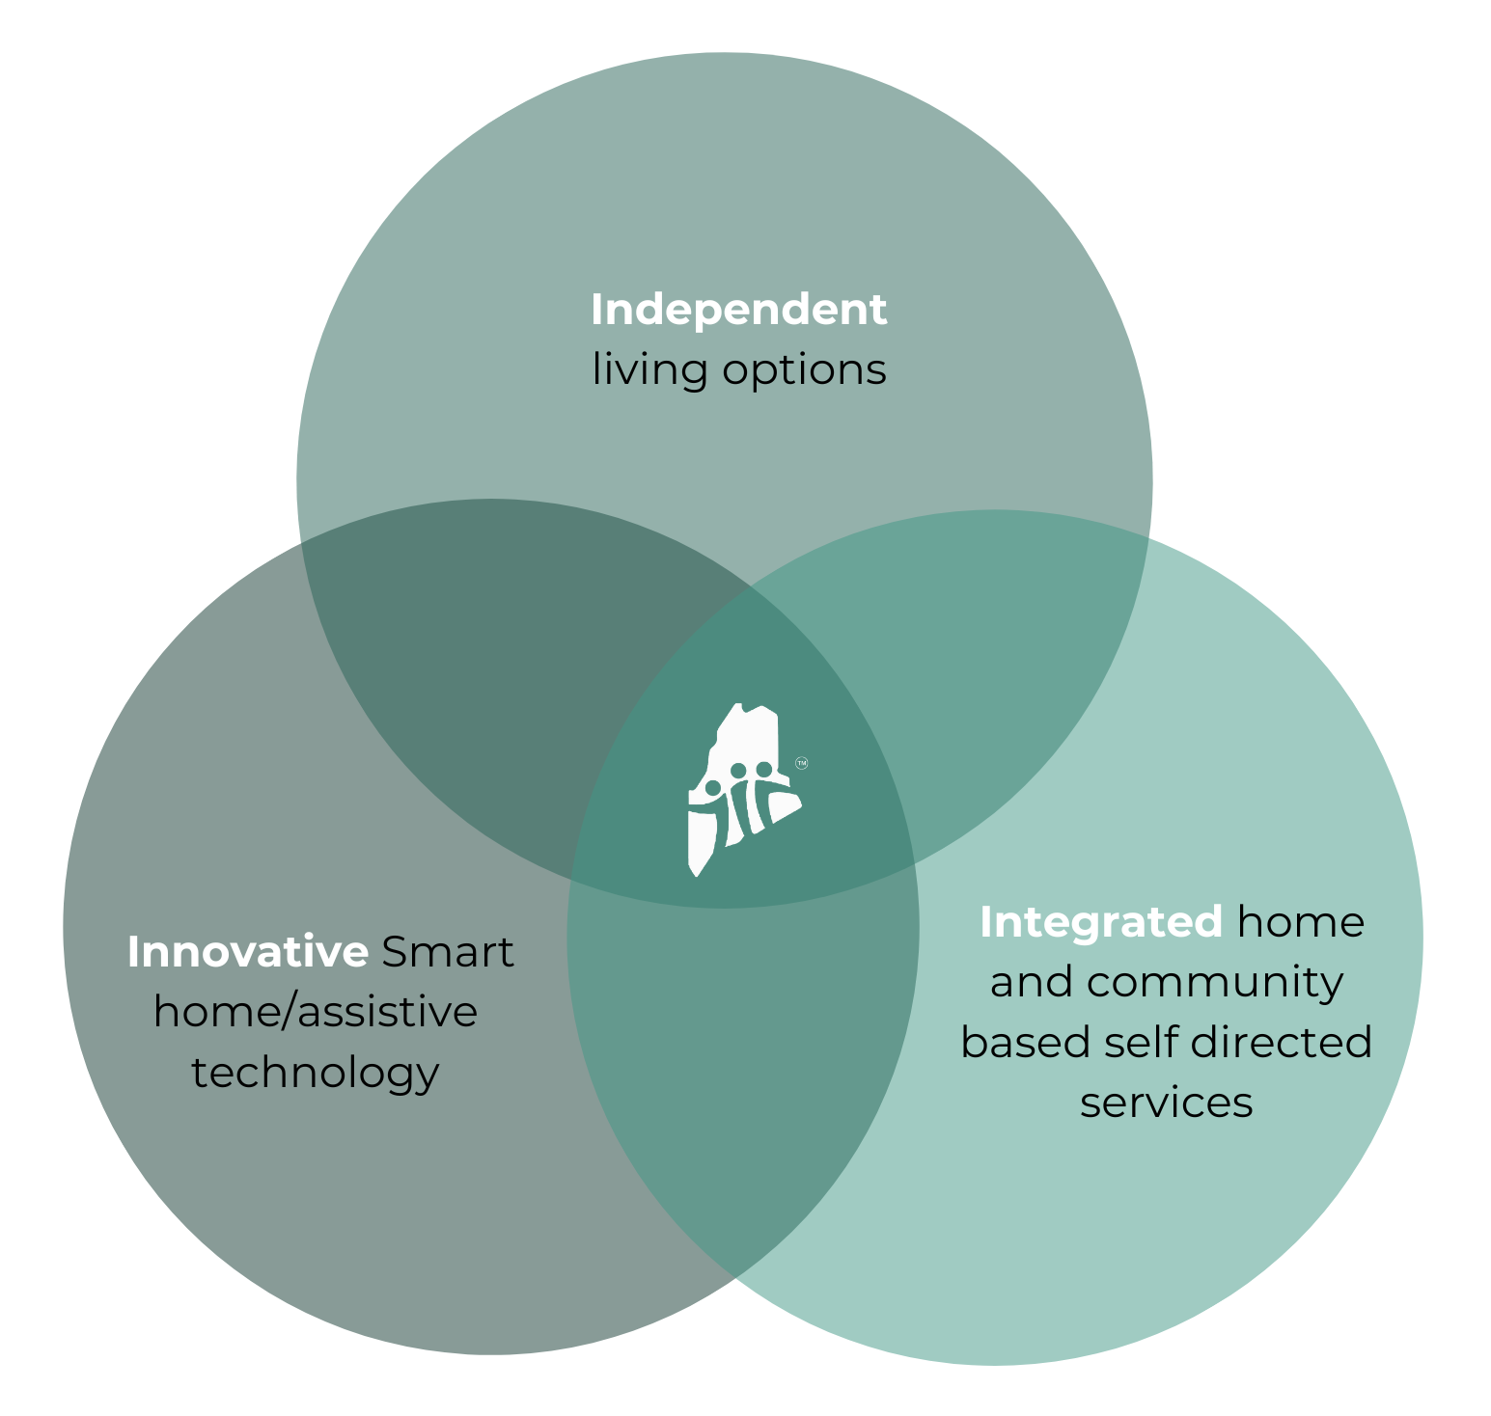
The 3i HoME
Solution
Copyright 2025: 3i Housing of Maine. All rights reserved.

Slide 8
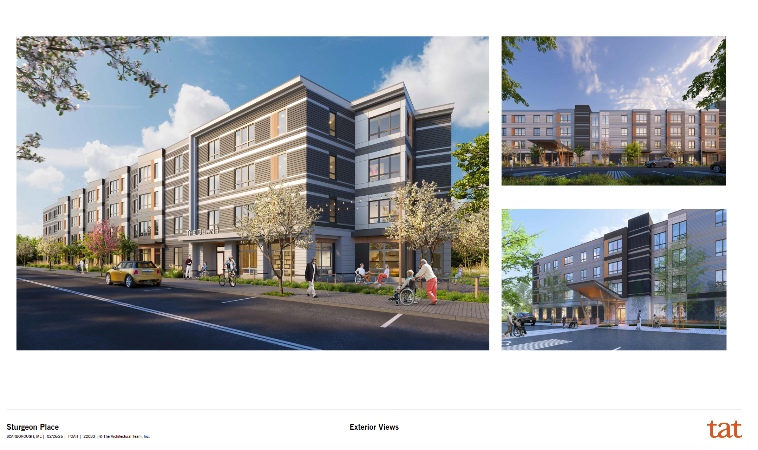
™
Copyright 2025: 3i Housing of Maine. All rights reserved.

Slide 9
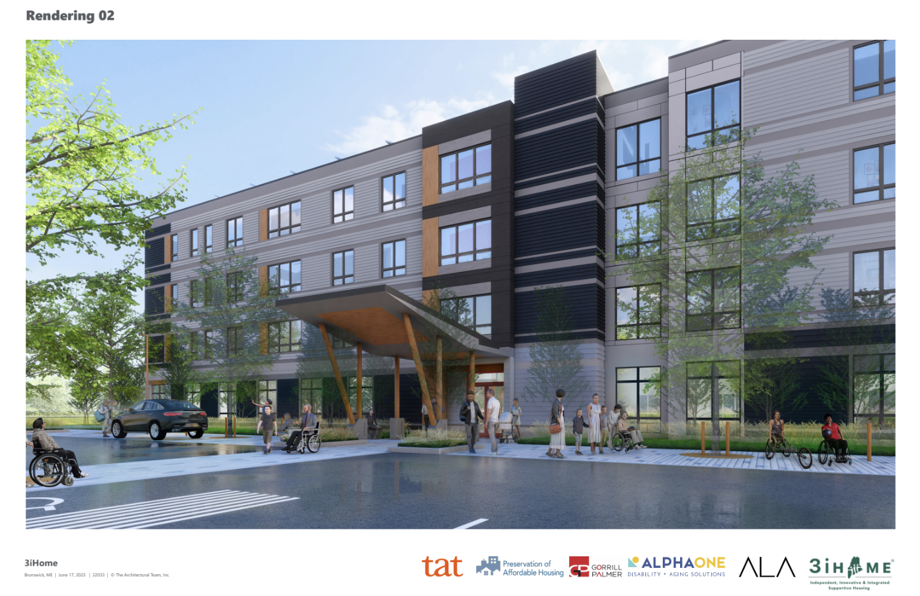
How 3i HoME Works
Sturgeon Place at The Downs
Affordable housing with universal design, adaptive technology and supportive services and an innovation hub (MATH/ATEC)
Copyright 2025: 3i Housing of Maine. All rights reserved.

Slide 10
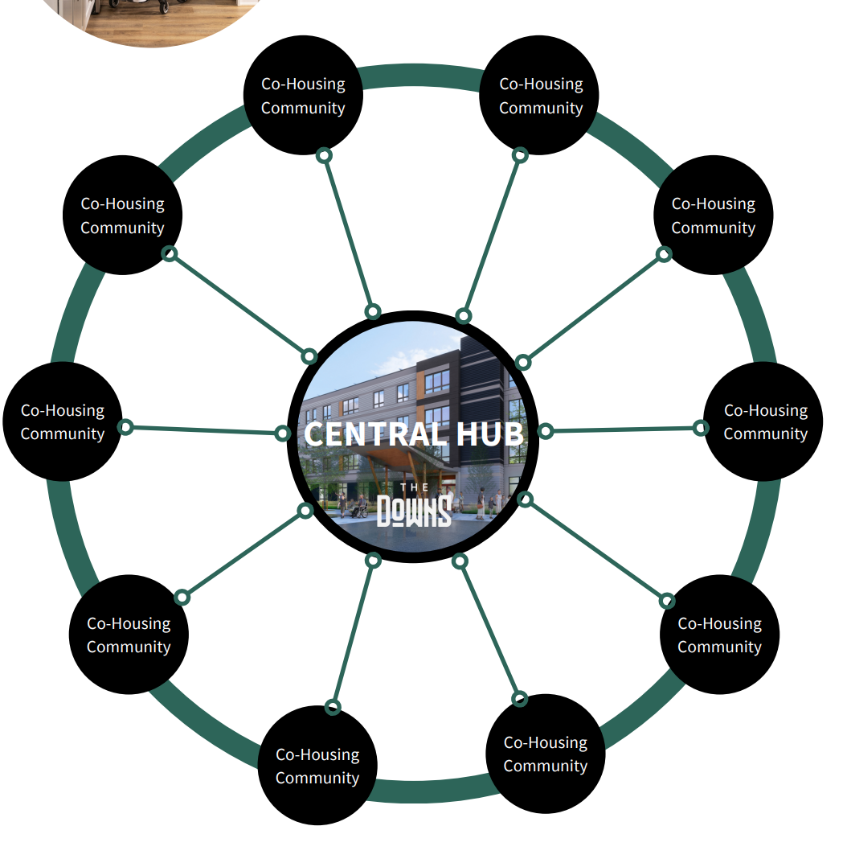
How 3i HoME Works
3i HoME Caring Communities™
Mixed-income housing, AI/adaptive tech, workforce preference, diverse geographies; hub-and-spoke to Sturgeon Place
Copyright 2025: 3i Housing of Maine. All rights reserved.

Slide 11

How 3i HoME Works
AI/Adaptive Tech/Invention
R&D with academia and industry testing adaptive technologies for supportive and person-centered solutions for individuals with disabilities
Copyright 2025: 3i Housing of Maine. All rights reserved.

Slide 12
Sturgeon Place
3i HoME Flagship Project with 51-unit Affordable Housing
in Scarborough, ME
Copyright 2025: 3i Housing of Maine. All rights reserved.

Slide 13
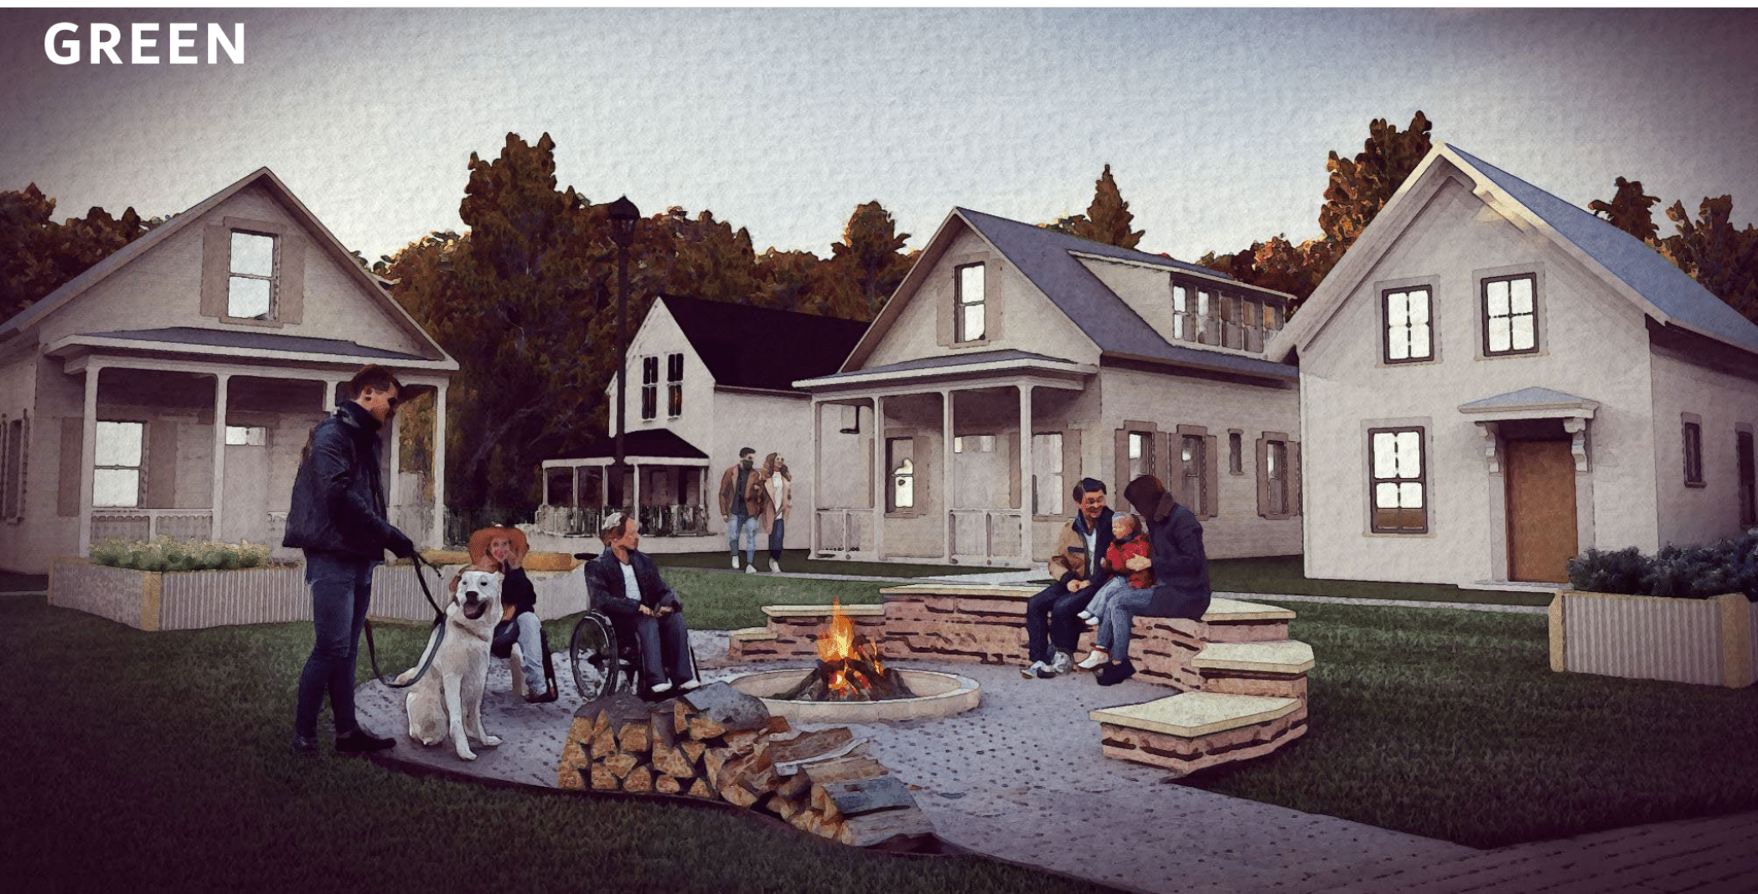
3i HoME Caring Communities™
Single Family Homes and Apartments
Copyright 2025: 3i Housing of Maine. All rights reserved.

Slide 14
The Next Phase –
3i HoME Caring Communities
™
Phase II -3i HoME Caring Communities™ is our new mixed-income, person-center neighborhood model that will utilize enhanced care coordination and other important services (such as shared amenities including transportation, telehealth portals and more) to create an integrated community of smart, green-engineered homes – some with ADU’s for caregivers.
™
Copyright 2025: 3i Housing of Maine. All rights reserved.

Slide 15
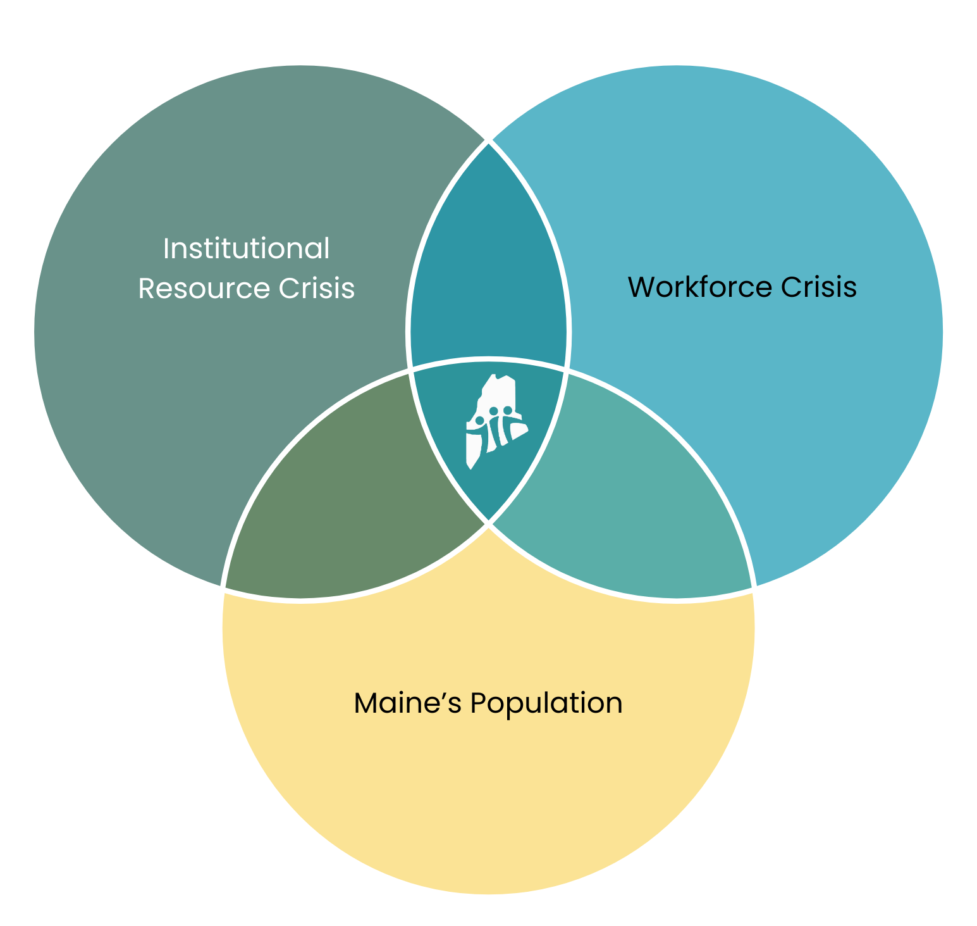
The Next Phase –
3i HoME Caring Communities
™
3i HoME is developing solutions to address to following:
    Institutional Resource Crisis
    Workforce Crisis
    Maine’s Population
™
Copyright 2025: 3i Housing of Maine. All rights reserved.

Slide 16
Why 3i HoME Caring Communities™ Are Needed Now?
WORKFORCE CRISIS
PHI’s Workforce Data Center shows Maine’s direct care workforce faces serious economic instability:
On average, workers are paid almost $2 less per hour than similar skilled workers in other fields, with median personal earnings less than $25,000 a year;
24% lack affordable housing;
39% are in or near poverty; and
37% rely on some form of public assistance.
™
Copyright 2025: 3i Housing of Maine. All rights reserved.

Slide 17
Why 3i HoME Caring Communities™ Are Needed Now?
Long term care leaders urge more funding to prevent more closures of nursing homes, Rose Lundy, January 3, 2024 (https://themainemonitor.org/nursing-home-leaders-seek-more-funding/)
To keep up with staffing minimums, nursing homes have turned to temporary agency staffing, but the “cost of temporary staff has just exploded and reimbursement doesn’t keep pace with that,” Westhoff said.
™
Copyright 2025: 3i Housing of Maine. All rights reserved.

Slide 18
Why 3i HoME Caring Communities™ Are Needed Now?
Mary Jane Richards, CEO of North Country Associates, which operates 23 nursing homes across Maine and Massachusetts, said their costs related to agency staff increased from about $7 million in 2019 to $39 million in 2022. “We simply can’t sustain that,” she said.
™
Copyright 2025: 3i Housing of Maine. All rights reserved.

Slide 19
“Maine DHHS has prioritized efforts to strength the [long-term services and supports] system and the workforce at its heart to improve the health of older Maine people and those with disabilities.”
-DHHS Spokesperson PPH on line 2/26/24
™
Copyright 2025: 3i Housing of Maine. All rights reserved.

Slide 20
80 YEARS LATER….
Imagine a future where people with disabilities can access affordable housing built with principles of universal design; and the direct care (support) workforce is paid a living wage.
™
Copyright 2025: 3i Housing of Maine. All rights reserved.

Slide 21
80 YEARS LATER….
“We cannot be content if some fraction of our people ... is ill-fed, ill-clothed, ill-housed and insecure,” declared Franklin Delano Roosevelt in his 1944 State of the Union address. In 1944, it was declared on the most public platform that, in our country, adequate housing should be a basic human right, yet today, 80 years later, a home remains a privilege.
™
Copyright 2025: 3i Housing of Maine. All rights reserved.

Slide 22
80 YEARS LATER….
The accessible housing, direct care worker and healthcare crises require bold, barrier breaking solutions! 3i Housing of Maine is committed to creating innovative supportive housing solutions that create a future of independent living options for people of all ages and income levels currently living with a disability and seeking to live in a neighborhood designed for access and engagement.
JOIN US IN THIS EFFORT!!!
™
Copyright 2025: 3i Housing of Maine. All rights reserved.

Slide 23
THANK YOU!
FOR MORE INFORMATION AND QUESTIONS, PLEASE CONTACT:
Paul Linet, Founder and CEO
3i Housing of Maine
paul@3ihome.org | 207-489-4663
™
Copyright 2025: 3i Housing of Maine. All rights reserved.

