Slide 1
Memory Bridge exists to end the emotional isolation of people with dementia. We aspire to heal with companionship what medicine cannot cure.

Slide 2
The Caregiver’s Library
Inspiring Insights for Caring Minds
Dementia Without Loneliness

Slide 3
Personalized Care
1
2
3
4
5
6
7
Attention to Control
VALLEY OF AWKWARD
Person-Centered Care
Attention to Encounter

Slide 4
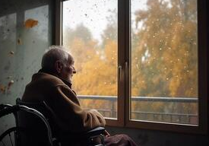

Slide 5
