Slide 1

Empowering Older Adults
Reducing Isolation Through Accessible Community Services Chris Street, Nutrition Director – Eastern Area Agency on Aging Megan Walton, CEO – Southern Maine Agency on Aging Betsy Sawyer-Manter, CEO – Seniors Plus

Slide 2
AGENDA
01 Identify the barriers Understand the primary factors contributing to social isolation and lack of access to services among older adults
02 Explore the solutions Present effective strategies and technologies that enhance service accessibility and promote social engagement for older adults.
03 Promote implementation Discuss actionable steps for community organizations to create inclusive, accessible services that reduce isolation and improve the well-being of older adults.

Slide 3
AGENDA
01 Identify the barriers Understand the primary factors contributing to social isolation and lack of access to services among older adults
02 Explore the solutions Present effective strategies and technologies that enhance service accessibility and promote social engagement for older adults.
03 Promote implementation Discuss actionable steps for community organizations to create inclusive, accessible services that reduce isolation and improve the well-being of older adults.

Slide 4
AGENDA
01 Identify the barriers Understand the primary factors contributing to social isolation and lack of access to services among older adults
02 Explore the solutions Present effective strategies and technologies that enhance service accessibility and promote social engagement for older adults.
03 Promote implementation Discuss actionable steps for community organizations to create inclusive, accessible services that reduce isolation and improve the well-being of older adults.

Slide 5
01 Identify the barriers Understand the primary factors contributing to social isolation and lack of access to services among older adults
1. Defining Terms
2. Statistics
3. National Themes

Slide 6
01 Identify the barriers Understand the primary factors contributing to social isolation and lack of access to services among older adults
1. Defining Terms
2. Statistics
3. National Themes

Slide 7
01 Identify the barriers Understand the primary factors contributing to social isolation and lack of access to services among older adults
1. Defining Terms
2. Statistics
3. National Themes

Slide 8
Loneliness & Isolation
Loneliness
Social Isolation
A subjective emotional experience. It’s about the quality of relationships, not quantity.
An objective condition. It measures the quantity of social connections.

Slide 9
Loneliness & Isolation
Loneliness
Social Isolation
A subjective emotional experience. It’s about the quality of relationships, not quantity.
An objective condition. It measures the quantity of social connections.

Slide 10
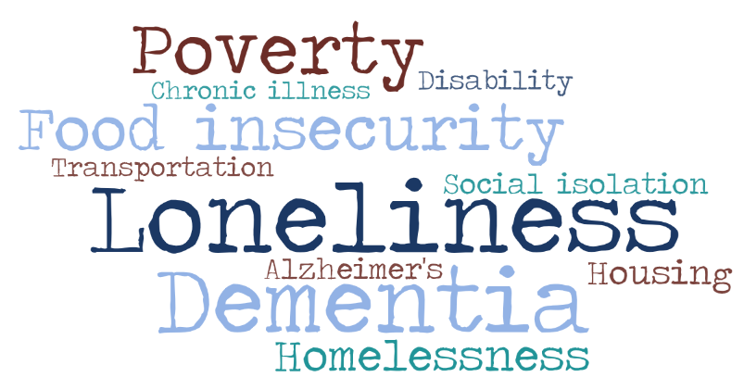

Challenges Impacting Older Mainers
30% of Maine’s population is age 60+
52% of single older Mainers and 22% of older couples lack income to pay for basic needs
26% live alone
29% have a disability
10% experience a fall with injury in any given year
10% live in a household without access to a vehicle
Sources: Meals on Wheels of America 2024 Maine Fact Sheet; Maine Department of Health and Human Services
Notes:
10:17-10:18
Tabby
I'm sure you hear about challenges that impact older mainers through your work. This slide shares a few statistics specifics across the state.
I'll first quickly highlight the ones more specific to EAAA
In our 4 counties - 32% of our population is age 60+ that is higher than overall state.
60% of our Meals on Wheels consumers live alone
As a state in general, this highlights over half of our older maines lack income to pay for basic needs.
Almost 30% have a disability in addition to being older.
Then 10% report falls with injury and 10% don't have access to a vehicle.

Slide 11
02 Explore the solutions Present effective strategies and technologies that enhance service accessibility and promote social engagement for older adults.
1. SMAA
2. Seniors Plus
3. EAAA

Slide 12
02 Explore the solutions Present effective strategies and technologies that enhance service accessibility and promote social engagement for older adults.
1. SMAA
2. Seniors Plus
3. EAAA

Slide 13
02 Explore the solutions Present effective strategies and technologies that enhance service accessibility and promote social engagement for older adults.
1. SMAA
2. Seniors Plus
3. EAAA

Slide 14
Southern Maine Agency on Aging: A Case Study on Integrating Social Connection
Megan Walton, CEO, Southern Maine Agency on Aging

Slide 15
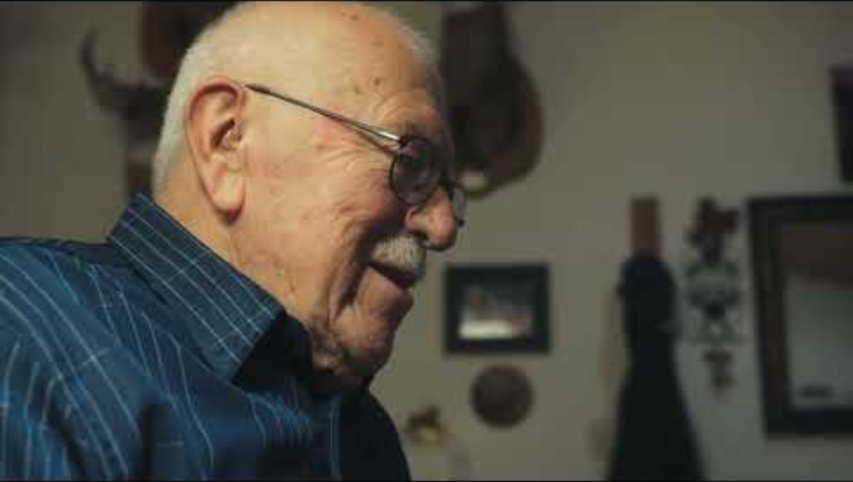
Hank's Story
https://www.youtube.com/watch?v=B463mSygodk

Slide 16
Shifting Landscape

Slide 17
National themes impacting AAAs
Sheer numbers | From 2022-2050, 47% increase in Americans 65+ to 82 million From 1980-2022, median age has increased from 30 to 38.9 1/3 of states have a median age >40 Maine’s median age of 44.8 is highest in the U.S.
Social isolation | From 1980-2023, divorced women 65+ grew from 3% to 15%, and men 4% to 12% More women live alone: 27% (65-74), 39% (75-84), 50% (85+)
Caregiving gap | Caregiver shortage, especially for those with low incomes and dementia Americans with Alzheimer’s will more than double from 6M in 2023 to 13M by 2050
Obesity prevalence | In a single generation, Adults 65+ with obesity nearly doubled from 1988-94 (22%) to 2015-18 (40%)
Economic disparities across population groups | 65+ poverty rates are more than double for Latino (17% ) and black (18%) than non-Hispanic white (8%)
Diversity gap | From 2022-2050, non-Hispanic white population share will drop from 75% to 60% In 2022, 51% of children identified as other than non-Hispanic white

Slide 18
Policy reactions: Increased focus on social care
Implement tools into the healthcare ecosystem to address health inequities that plague older adults
CMS | ICD-10: since 2016, added SDOH codes Z55-65 (only one reimbursable) Quality reporting: since 2024, hospitals must screen inpatients 18+ for SDOH Physician reimbursement: since 2024, health equity billing codes and reimbursement for health equity services
Medicare | Hospital Readmissions Reduction Program (HHRP) imposes up to 3% financial penalties for excessive rehospitalizations within 30 days of discharge SDOH has a significant impact on readmissions, encouraging providers to screen for SDOH and navigate to resources
Medicaid | Since 2022, added Section 1115 waiver framework to expand tools available for states to address HRSN 25 states with HRSN waiver’s approved or pending HRSN matched funding capped at 3% of state’s Medicaid spending Maine’s pending waiver with HRSN elements is focused on SUD
Accreditation: Joint Commission | Since 2023, added requirements to address health care disparities Elevated to National Patient Safety Goal since July 2023 Applies to hospital, primary care, ambulatory health & behavioral health
Business | VC and PE investment focus UniteUs and FindHelp national directories for social care navigation Get Well and TrueLite digital outreach and SDOH assessment
Post-COVID funding ends in 2024 | ARP $1.4B for older adults; Maine received $7.0M CARES $955M; Maine received $5.0M

Slide 19
Social Isolation in Maine & Why It Matters

Slide 20
Older adults face significant social isolation with high impact on health outcomes
Adverse health effects of social isolation | Risk increase
Premature death | Rivals smoking, obesity & physical inactivity
Dementia | 50%
Heart disease | 29%
Stroke | 32%
Mental health | More depression, anxiety & suicide
Heart failure | 57% increased risk of ED visit 68% increased risk of hospitalization 4x increased risk of death
Source: 2024 Census Bureau Household Pulse Survey
Socially Isolated Mainers 65+ | 78,000 - 131,000
Cumberland & York Counties | 28,000 - 47,000
Annual income <$25,000 | 50%
LGBTQ+ | 49%
Extrapolated from AARP national figures

Slide 21
We believe we can do better…
…so we are focusing our long-term directional North Star on reducing social isolation
“In ten years, all older adults in Maine will have a source of social connection.”
Improves health outcomes
Centers SMAA as a cornerstone source for connection among older adults
Informs SMAA’s strategic direction to emphasize social connection
Community hubs
Sustaining connectivity in care transitions
Guiding older adults to the services they need
Directly providing services that open moments of human touch

Slide 22
SMAA's Response

Slide 23
2025-2028 Strategic Plan KPIs North Star: Building Social Connection – Broad Indicators
Vision: In ten years, all older adults in Maine will have a source of social connection.
Population Level Indicator |  | Baseline |  | Comparison |  | Maine Trend | Source | Source
 |  | Year | US / ME | Year | US / ME
Social Isolation Risk Index in 65+ Adults (1-100)¹ |  | 2020 | NA / 43 | 2022 | NA / 46 | Ý | United Health Foundation, America's Health Rankings, Senior Report. | United Health Foundation, America's Health Rankings, Senior Report.
Community Support Expenditures ($ per 60+ Adult) |  | 2019 | $57 / $28 | 2021 | $62 / $39 | Ý | Administration for Community Living, State Program Reports | Administration for Community Living, State Program Reports
Frequent Mental Distress (% 65+ Adults)² |  | 2021 | 8.5% / 7.6% | 2022 | 9.4% / 8.9% | Ý | CDC, Behavioral Risk Factor Surveillance System | CDC, Behavioral Risk Factor Surveillance System
Physical Inactivity (% 65+ Adults)³ |  | 2021 | 31.2% / 35.1% | 2022 | 30.9% / 29.8% | Þ | CDC, Behavioral Risk Factor Surveillance System | CDC, Behavioral Risk Factor Surveillance System
Suicide (Deaths per 100k 65+ adults) |  | 2021 | 16.9 / 20.1 | 2022 | 17.3 / 20.5 | Ý | CDC WONDER, Multiple Cause of Death Files | CDC WONDER, Multiple Cause of Death Files
Volunteerism (% 65+ Adults)⁴ |  | 2019 | 31.6 / 40.9 | 2021 | 22.1% / 29.9% | Þ | US Census, Current Population Survey, Volunteering & Civic Life Supplement | US Census, Current Population Survey, Volunteering & Civic Life Supplement
Primary Caregivers in Fair or Poor Health (% caregivers) ⁵ |  | 2020 | 27% / 15% | 2024 | TBD / 15% |  | US numbers: AARP, “Caregiving in the U.S” reports ME numbers: ME State Plan on Aging Needs Assessments
Caregivers who feel alone or lonely (% caregivers)⁶ |  | 2020 | 21% / 14% | 2024 | TBD / 9% | Þ | US numbers: AARP, “Caregiving in the U.S” reports ME numbers: ME State Plan on Aging Needs Assessments
¹Index of social isolation risk factors (living in poverty; living alone; being divorced, separated or widowed; having never married; having a disability; and having an independent living difficulty) among adults age 65 and older; normalized values are 1 to 100, with a higher value indicating greater risk.
²Percentage of adults age 65 and older who reported their mental health was not good 14 or more days in the past 30 days.
³Percentage of adults age 65 and older in fair or better health who reported doing no physical activity or exercise other than their regular job in the past 30 days.
⁴Percentage of adults age 65 and older who reported volunteering in the past 12 months. ⁵Percentage of family caregivers who are the primary care provider and self-reported fair to poor health. Note: Lower income caregivers and caregivers from diverse communities more often reported worse health. ⁶US: Percentage of caregivers who agreed or strongly agreed with the statement “I feel/felt alone.” ME: Percentage of caregivers who stated they often or always felt lonely and/or disconnected from other people due to caregiving.

Slide 24
Three Pillars to Inclusive Social Care Programming
North Star: Building Social Connection
By FY28, 85% of clients who enroll in a SMAA program report feeling more socially connected as a result.
FY24 Baseline: 79.7% FY25 Target: 81% Yearly analysis to include program break-out and length of stay on services.
Expand community hubs as mission focal point
Front door to aging services
Increased accessibility in local communities and regional areas
Multiple programs and services offered in one location
Addresses cognitive health shortfall
Community centers for older adults and family caregivers
Emphasize social care coordination
AAAs are the social care experts – we have been in that space for 52+ years, "at the kitchen table"
Leverage what we do well - especially with marginalized populations (BIPOC, rural, LGBTQ+, low-income)
Navigation of services, programs, benefits available can be just as critical as the programs themselves
Innovate with & for volunteers
Volunteers are the lifeblood of AAAs, age-friendly communities and older adult services
Volunteers have so many skills to offer and gifts to give – leverage them fully
Volunteers find social connection, belonging, and a "village" through volunteering
Allow volunteers to offer seminars, programs and classes directly to clients

Slide 25

SeniorsPlus is the designated Agency on Aging and Disability Resource Center serving Franklin, Oxford and Androscoggin Counties.
Our mission is to enrich the lives of seniors and adults with disabilities.
SeniorsPlus believes in supporting the independence, dignity, and quality of life of those we serve.

Slide 26
Combating Loneliness and Isolation
What can we do?

Slide 27

Friendly caller
Older adults connect with trained volunteers to receive weekly social telephone calls. This program provides friendly conversation, socialization, connection with others, and an opportunity to meet new people. Participants will be paired with a volunteer and receive weekly calls at an agreed upon time.

Slide 28

Meals on wheels
WE HAVE 3 PARTS TO EACH MEAL DELIVERY:
The first part is a tasty, well balanced meal prepared by our own chefs in our own kitchen. Each meal meets one third of the daily requirements of the Dietary Reference Intake. This meal can be delivered to the homes of the people who are homebound, unable to prepare meals, and have no help to prepare the meals.
The second part is a wellness check. Our drivers get to know each client individually and are able to tell if anything is out of the ordinary.
The third part is socialization. Our driver may be the only person the consumer sees all day or even all week. The consumers really look forward to a few minutes of conversation with the drivers.
It is difficult for older people who are ill or have a disability to get good nutrition. Our monthly menus are varied, appealing, nutritious and are updated monthly with new items.

Slide 29
Zoom and Hybrid Offerings
Evidenced Based Workshops
Writing Workshops
Yoga Classes
Caregiver Support
Discussion and listening sessions
Remove barriers.
Build pathways.

Slide 30
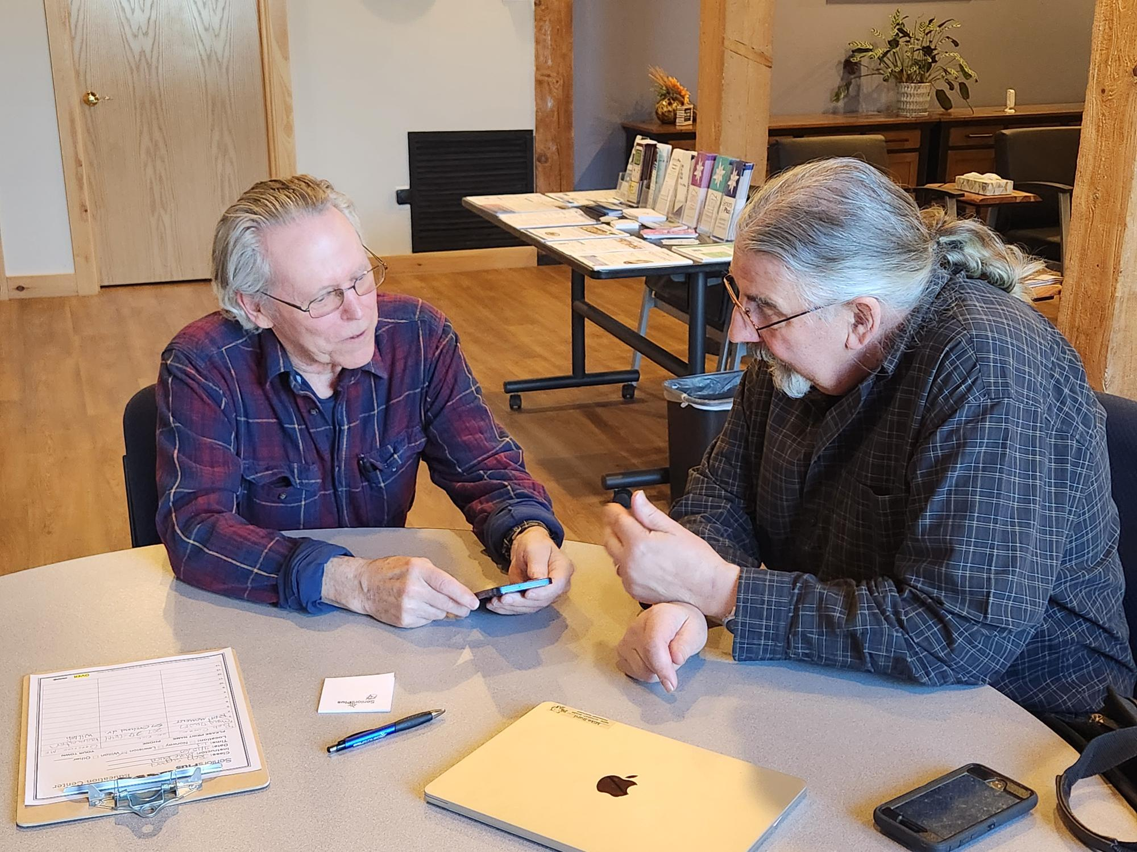
Technology Training
National Digital Equity Center (NDEC) Education
Devices
Safety
Apps and programs
Walk-in Tech support
Thank you to our NDEC Digital Navigators and Franklin County Adult Education
Mike Byrd from Franklin County Adult Ed assists client in Wilton

Slide 31
SeniorsPlus Education Center Offerings and Topics
Exercise
Arts & Crafts
Medical and Health Education
Love of traveling
Social Dining
Many more!
Bring people together.

Slide 32
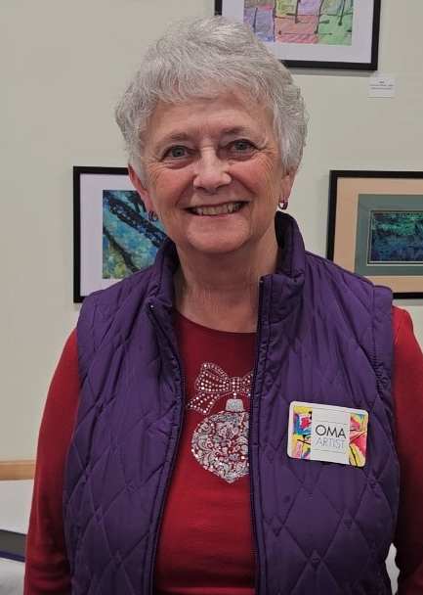
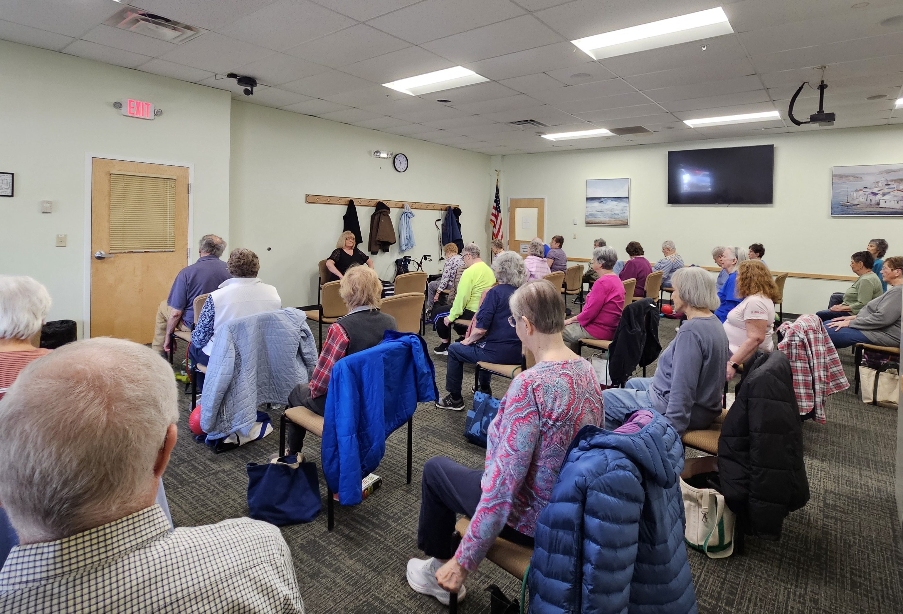
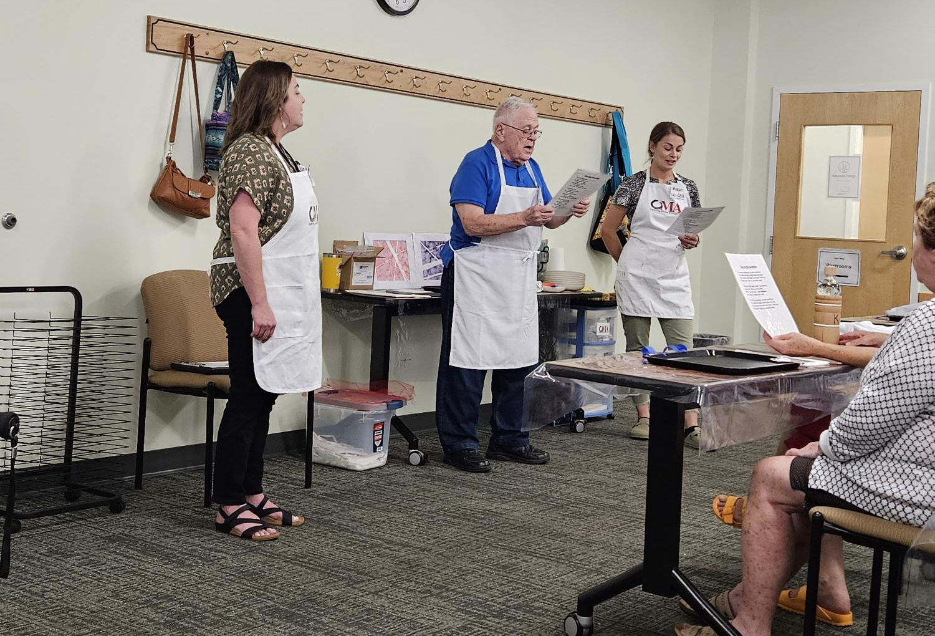
Success!

Slide 33
Lessons Learned
Have Dedicated Staff
Offer Technology Training
Be Consistent
Be Accessible and Flexible

Slide 34
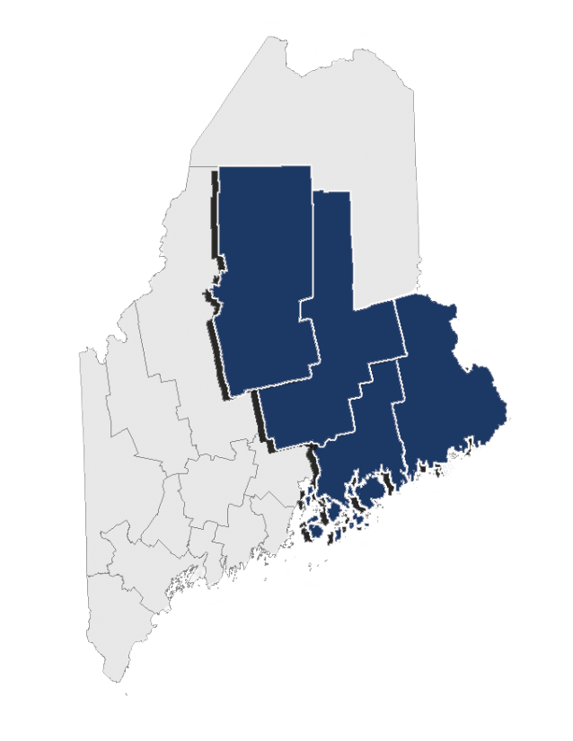
About EAAA
Mission
Our mission is to provide older adults, caregivers, and adults with disabilities in Hancock, Penobscot, Piscataquis, and Washington counties with the information and access to resources they need to be healthy, engaged, and supported in their communities.
By the Numbers
4 counties
50+ years of service
46 staff members
500 volunteers
9,800 people served annually
Notes:
10:08-10:09
Tabby
In our mission, it highlights our 3 populations
1-Older adults
2-Adults with disabilities
3-Caregivers to both of those population
We cover 4 counties Hancock, Penobscot, Piscataquis, and Washington
Our mission is to provide these population in our coverage area with the information and access to resources they need to be healthy, engaged, and supported in their communities.
I want to highlight few numbers to share a little more about us.
-As I mentioned we cover 4 counties
-We have been in service for over 50 years
-We have just under 50 staff members and around 500 volunteers - we could not provide the level of services we do without the volunteers
-And almost 10,000 people served annually
Now I'll transition it to Chris to do a brief overview of the services we provide.

Slide 35
EAAA Access Centers
Regional Access Centers – Building Connections
Regional Access
Socialization
Partnerships
Strategically located throughout service area to provide regional access to vital programs and services.
Opportunities to connect with others in a meaningful way.
Strengthen partnerships with community organizations.
Notes:
Chris
10:12 -10:13
One Minute
ADRC are some of our most vital members – as they truly connect consumers to internal and external resources:
Need we have in community: 13,500 inquiries for services/information were fielded in FY24
Volunteers are the most vital aspect to the work we do. We have mobilized a volunteer base of 500 volunteers who logged 24,000 hours of service to this community.
Meals on Wheels: Last Year We distributed last year 215,000, helping to keep older adults fed and healthy.

Slide 36


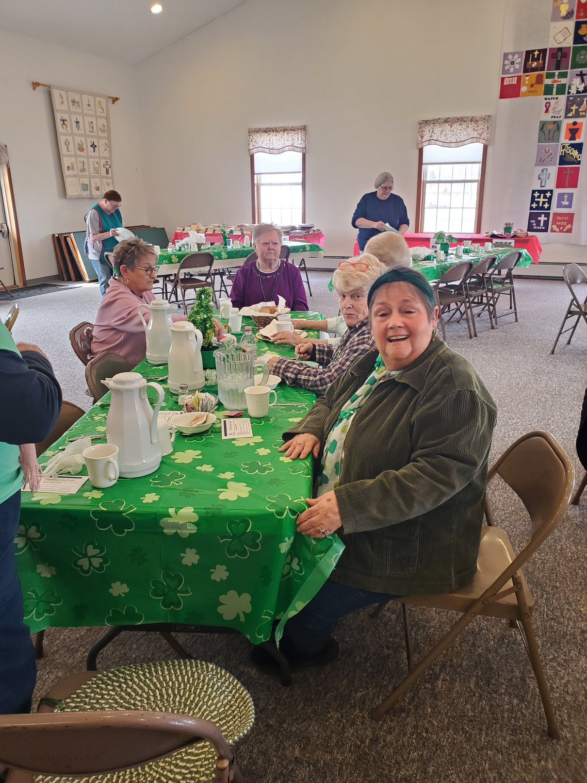
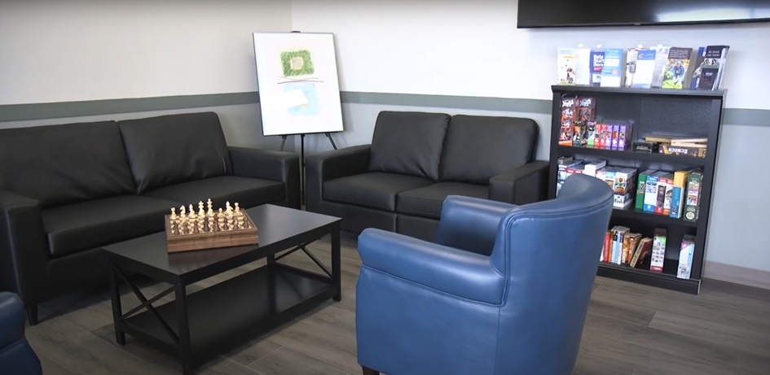
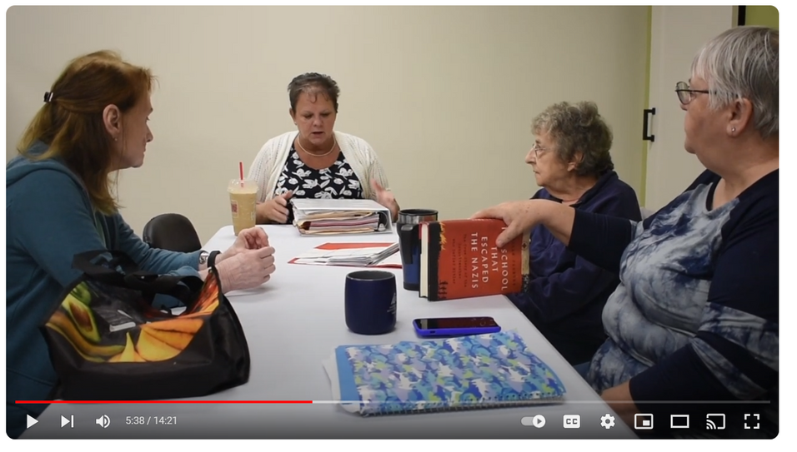
Access Centers - A Home Away From Home
Exercise Classes
Community
Cafe
Arts &
Crafts
Activities
Games &
Other Activities
Walk-In
Resource
Hours
Partner Presentations
Notes:
Chris
10:12 -10:13
One Minute
ADRC are some of our most vital members – as they truly connect consumers to internal and external resources:
Need we have in community: 13,500 inquiries for services/information were fielded in FY24
Volunteers are the most vital aspect to the work we do. We have mobilized a volunteer base of 500 volunteers who logged 24,000 hours of service to this community.
Meals on Wheels: Last Year We distributed last year 215,000, helping to keep older adults fed and healthy.

Slide 37
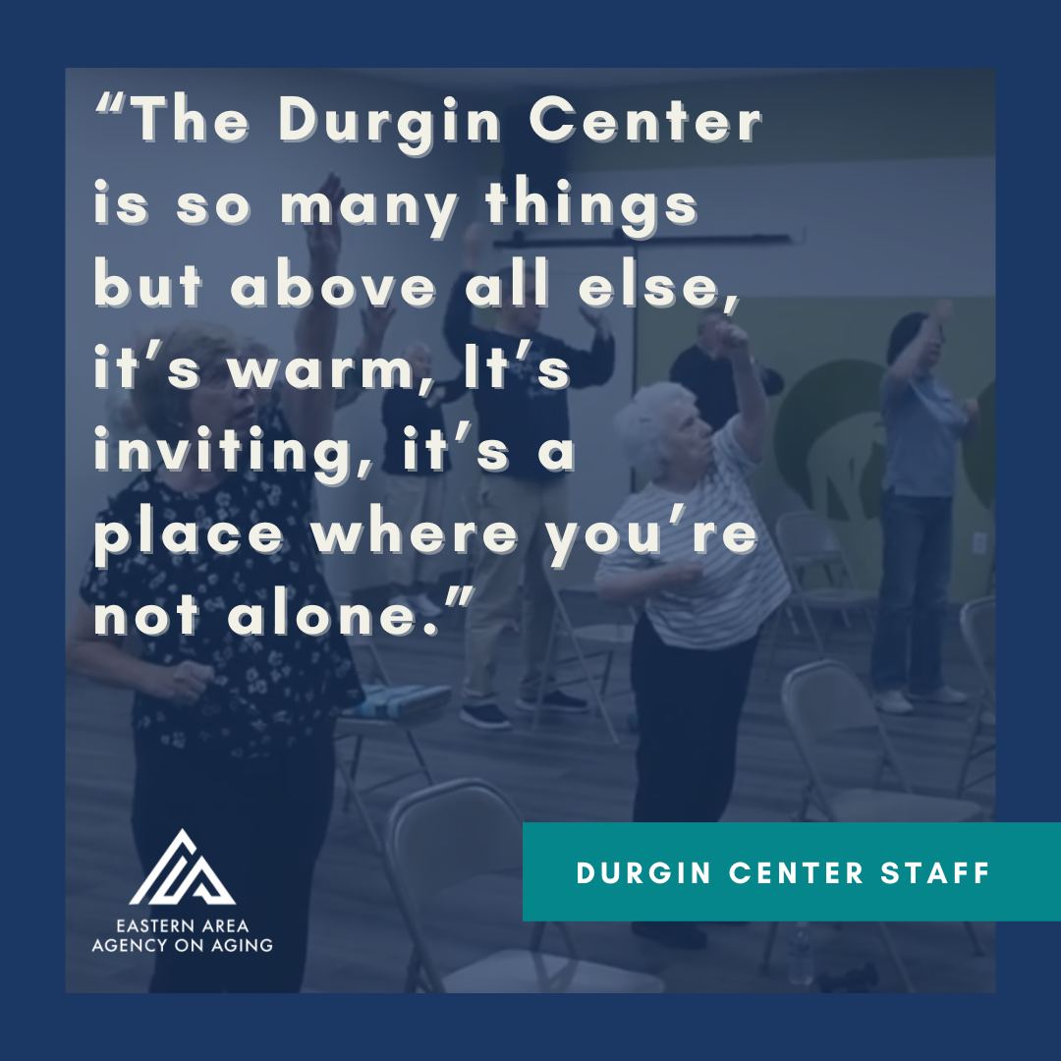
EAAA Access Centers
Locations
Brewer
Calais
Coming Soon…
Ellsworth
Piscataquis County
Millinocket
Machias
Notes:
Chris
10:12 -10:13
One Minute
ADRC are some of our most vital members – as they truly connect consumers to internal and external resources:
Need we have in community: 13,500 inquiries for services/information were fielded in FY24
Volunteers are the most vital aspect to the work we do. We have mobilized a volunteer base of 500 volunteers who logged 24,000 hours of service to this community.
Meals on Wheels: Last Year We distributed last year 215,000, helping to keep older adults fed and healthy.

Slide 38
Discussion
03 Promote implementation Discuss actionable steps for community organizations to create inclusive, accessible services that reduce isolation and improve the well-being of older adults.
1. How can we intentionally build intergenerational opportunities that not only engage older adults but also foster mutual learning and reduce stereotypes between age groups?
2. What partnerships – across health services, faith groups, libraries, or local organizations and businesses – can we form to extend our reach and embed social connection into the everyday lives of older adults?

Slide 39
Questions?

Slide 40

Thank you!
Megan Walton, CEO
Southern Maine Agency on Aging
207.396.6501
mwalton@smaaa.org
Chris Street, Nutrition Director
Eastern Area Agency on Aging
207.941.2865
cstreet@eaaa.org
Betsy Sawyer-Manter, CEO
Seniors Plus
207.795.4010
bsawyer-manter@seniorsplus.org

