Slide 1

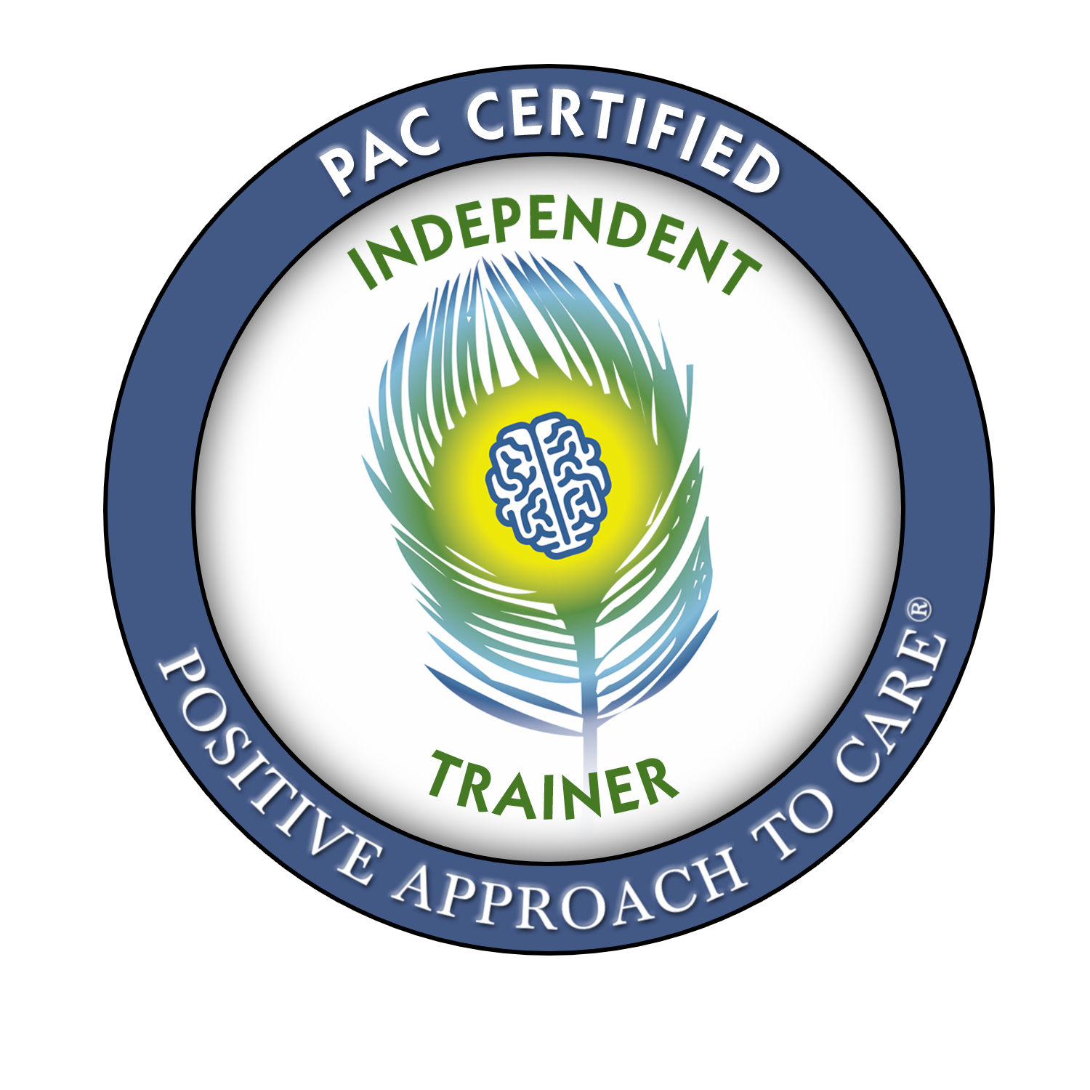
Dementia Recognition & Care
By Jordan Servetas, BSN, RN
Notes:
Intros
Ask why people are taking workshop?
Give rundown of what the format will be (lecture, PPT, videos, images, handouts, role play)
Class is meant to be very interactive and engaging for various learning styles - asking for participation through group discussion and interaction, role playing, body/hand movements as memory devices (mnemonics)

Slide 2
Disclosures
I have no relevant financial relationships with Positive Approach to Care, LLC
Video and Training Materials developed by:
Teepa L. Snow, MS, OTR/L, FAOTA
Dementia Care and Training Specialist -Positive Approach, LLC Consulting Associate, Duke University, School of Nursing
Clinical Faculty, UNC-CH, School of Medicine
Teepa Snow created the materials to be used in Positive Approach to Care (PAC) workshops and has authorized the Certified PAC Trainer to facilitate workshops using PAC materials

Slide 3
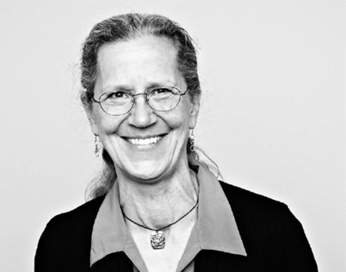


Positive Approach to Care®
The PAC mission is to create a more positive dementia care culture for both the persons living with dementia (PLwD) and those who know and care for them.
Based on the idea that a PLwD experiences the world differently, but is still an individual with wants, needs, likes, and dislikes and deserves the same dignity, autonomy, and respect.
Founded in 2007 by Teepa Snow, MS, OTR/L, FAOTA
  40+ years of OT experience
  Dementia Care Specialist
  Collaborates in over 30 countries
  Leading advocate and educator for PLwD
Teepa’s Snow Approach® methods are radically transforming the experience of dementia by combining knowledge and awareness with practical techniques so that everyone involved not only survives but thrives!
Knowledge – Awareness - Skills
Notes:
Who is Teepa? Occupational therapist & dementia care specialist with 40+ years of experience – she is considered to be a leading expert in brain change and is the founder of PAC
OTR/L – Occupational Therapist, Registered, Licensed
FAOTA – Fellow of the America Occupational Therapy Association
What is PAC? Positive Approach to Care – Teepa’s Snow Approach methods are radically transforming the experience of dementia by combining knowledge and awareness with practical techniques so that everyone involved not only survives but THRIVES
Currrently working with governments, individual families, agencies, facilities, hospital systems, and academic institutions around the US and internationally to implement PAC’s Snow Approach.
Guiding beliefs are :
Understand and destigmatize dementia , help the world to see how valuable PLwD are and how much retained “self” and abilities are still really there
Focus on a care partnering relationship- instead of doing TO the patients, we are doing WITH. One that empowers both those living with dementia as well as those who are caring for them to improve quality of life for everyone involved.
Allowing as much autonomy, dignity, respect as possible to those living with brain changes/dementia. We not only want to help them live, but help them live well!

Slide 4
Normal vs Not Normal Aging
Awareness
Notes:
Noticing something is different – off – “not right”
Aware of behavioral/personality changes
Maybe difficulty with memory, abilities, language, processing
Play video of normal aging @ 0:29-4:17 → discuss with AELC
Play video of not normal aging @ 40:10-46:30 → discuss with AELC

Slide 5

Normal Aging
NOT Normal Aging
Unable to think the same
Unable to do as before
Unable to get started on a task
Will get stuck in a moment of time
Unable to think things out
Unable to successfully place a person
Words won’t come even with visual, verbal, or touch cues
Confused between past and present
Personality and/ or behaviors will be different
Can’t recall a word. Describe the word to get it to pop up.
Give people time to process information. Go more slowly.
Slower to think.
Slower to do.
May hesitate more.
More likely to look before they leap.
Will know the person, but not find the name.
May pause when word finding
New data reminds me of old data
Notes:
Circumlocution – means “talking around what you’re trying to say” – abnormal will be unable to recall or get to the word
Slower to process information- this is normal, we don’t lose function, it just slows. Abnormal aging LOSES function and cannot retain logical thinking.
Compensatory mechanisms (normal aging)- lists, “phone a friend”, tools like calendar/cell phone – abnormal may have lots of lists, but cannot get anything done from them
Moments of forgetfulness but usually can “Click!” back in quickly → abnormal will get easily distressed/lost and may lash out or retreat easily
Questions to prompt?
Could they hold onto 5-8 items in working memory?
Recognize person on the phone by relationship?
Ability to use data provided about who is on phone?
Can they hold onto new or more recent data about places/activities?
Use old information to “lock-in” new data?
Ability to find words, especially nouns?
Ability to describe words with other commonly accepted words?
Ability to control impulsive speech/ideas?
Ability to value relationships and modify behavior to control observations?
Recognize strong visual cues? (coffee cup/TP in closet)?
Ability to use reasonable, logical thinking as to why there is no TP?
Ability to use strong auditory clues to recall recent conversations/details?

Slide 6
Dementia
- OR -
When in doubt, get it checked out!
Hard of hearing
Living with high stress
Acutely ill
New medical illnesses
Medication problems or interactions
Pain or psychological issues
Stroke
Notes:
Could be dementia which is what we will elaborate on further, but also consider what else may mimic signs/symptoms we listed out.
What else could it be?
Let’s move on to talking more about dementia!
What does dementia mean to you??? Let learners answer.
(maybe eventually try to put a wordle type thing here where they can write words and then have them show in a graphic)

Slide 7
What is dementia?
Knowledge
Notes:
Why is this happening?
Why are the behaviors/personality different?
Why can they not think, do, say as before?
Word association game:
ASK learners, what is the first thing that comes to mind when I say dementia?

Slide 8

Dementia does not =
Alzheimers does not =
Memory Problems

Slide 9
Dementia: What is It?
It is both:
    A chemical change in the brain (variable)
- and -
    A structural change in the brain (permanent)
This means:
    It may come and go
    Sometimes they can and sometimes they can’t
Notes:
Structural changes: permanent
Cells are shrinking and dying
Chemical changes: variable
Cells are producing and sending less chemicals
Can‘shine’when least expected due to a chemical rush

Slide 10

Dementia Equals:
Brain Failure
The person’s brain is dying
Notes:
Tissue is actually dying
Fewer/shrinking cells, fewer connections or synapses → less/slower communication between areas
Also producing and sending fewer chemical messages (less neurotransmitter production)
What do we call it when our heart doesn’t pump blood as well as it should? Heart failure
What do we call it when our lungs cannot get enough oxygen into our blood or remove enough carbon dioxide? Respiratory failure
What do we call it when we lose our ability to remove wastes from our body and balance fluids? Kidney failure
So why don’t we call it brain failure?? That’s what is happening when our brain does not carry out normal functions as well as it should!

Slide 11
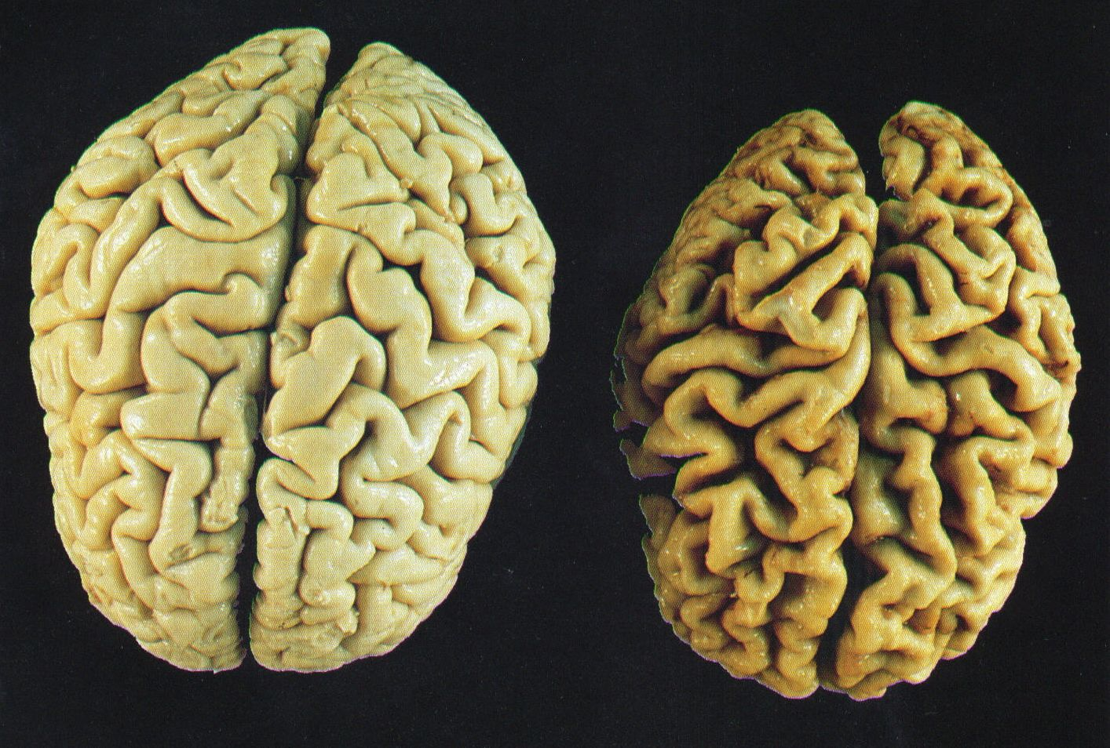
Normal Brain
Alzheimers Brain
Used with permission from Alzheimers:The Broken Brain, 1999 University of Alabama
Notes:
Occipital is TOP
Frontal is bottom
Maybe start out with picture of just the healthy brain→
1) Discuss big brain vs little brain, thinking brain vs primitive brain, neocortex vs limbic system. Use hand motions to describe. (show pic of limbic system here too?)
2) With big brain, talk about grey matter vs white matter. Use city analogy to discuss. Then show side by side of the healthy vs dementia brains and have class discuss.
3) Then move to little brain→ show image? Thrive to survive, flight, fright or fight. Do demo of hippocampus, amygdala, thalamus, hypothalamus and discuss multiple functions of all? (not just hippocampus as I have shown?)
What do you notice?
White matter is connections between- information sending from one part to the next
Grey matter Is actual tissue/storage facilities
City/suburb analogy (buildings are information, roads and highways are white matter connections)
- normal aging – roads are congested, processing slows – “rush hour”
- abnormal aging – roads washed out, pot holes, accidents
White matter gets most attacked
Let’s compare outer with inner a bit and think about it with those videos in mind:
Outside of brain is thinking brain- neocortex
Inside of brain is our survival system → DO DEMO of hippocampus, amygdala, thalamus, hypothalamus
Amygdala (primitive brain) takes over as thinking part of brain dies – threat perceiver and pleasure seeker
As this is triggered, brain will not be able to use thinking brain- no logic, no language, no skill, narrowed visual field- FRIGHT, FIGHT, FLIGHT

Slide 12
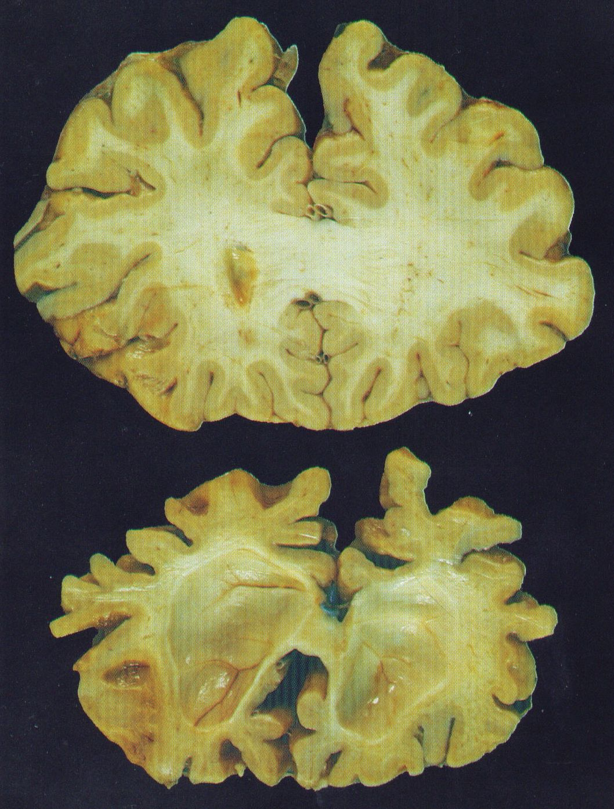
Loss of function results in problems with:
Impulse control
Being logical/reasoning
Making choices
Initiating, sequencing through, and terminating tasks
Self-awareness
See another’s point of view
What is preserved?
Ability to “do” with cued activities
Executive Control Center:
Emotions
Behavior
Judgment
Reasoning
Notes:
Go over each and have group relate to video of abnormal aging.
What was she able to still do in video? Grocery shop for milk and TP, make coffee still (mug was dirty so she has been making/drinking)
Loss of function of frontal lobe/pre-frontal cortex:
Impulses, reason, judgment, logic
Decision making with multiple options
Start-sequence-complete-move on
Self-awareness and ability to see other people’s perspectives- become rigid and inflexible
Ability to manipulate tools and sequencing of tasks

Slide 13
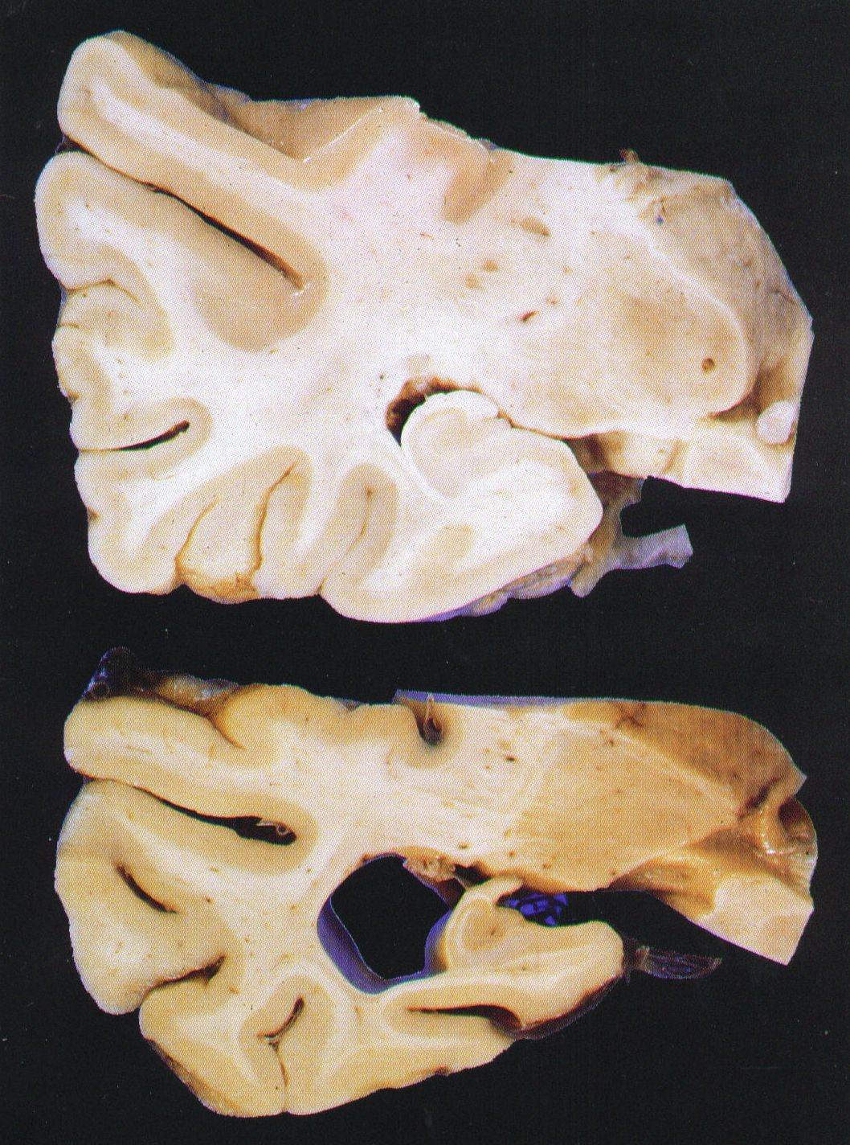
Learning & Memory Center
Hippocampus BIG CHANGE
Primary Functions:
  Learning & Remembering
  Way Finding
  Time
Notes:
Let’s look at a few images related to the memory/frontal lobe function we just saw in those two videos-
Hippocampus is our memory and new learning center- BIG CHANGES.
Loss of function affects
- Learning and remembering… Immediate recall, recent events, relationships
- Time awareness → how long has it been since I saw this person? Showered? Ate? Swallowed? Since I broke my leg?
- Way-finding → (aka spatial orientation) finding way to store, bathroom, bedroom, place to eat, AND then back to a safe place (home, room, table to eat, etc.)
Remember issues with those in the video??
What is preserved?
- Emotional, motor, and long-ago memories
- How they feel about someone- finding a positive connection is key
- “Relationship over agenda”

Slide 14
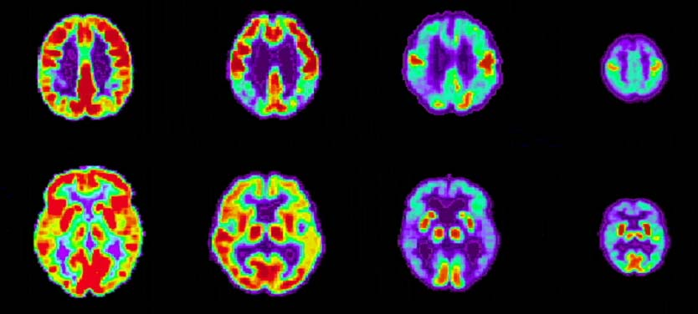
Positron Emission Tomography (PET)
Alzheimer’s Disease Progression vs. Normal Brains
Early Alzheimer’s
Late Alzheimer’s
Normal
Child
G. Small, UCLA School of Medicine.
Notes:
1) Progressive loss of language, memory, vision, sensory, smell, taste
2) Amygdala (primitive brain) takes over as thinking part of brain dies – threat perceiver and pleasure seeker
As this is triggered brain will not be able to use thinking brain- no logic, no language, no skill, narrowed visual field- FRIGHT, FIGHT, FLIGHT
Won’t be able to do anything listed on previous slide – no initiating tasks or sequencing, learning, listening, way finding, etc.
3) **We need to create a safe environment and relationship in order to provide effective, positive care** this is where Teepa comes in
Safe environment and getting connected (forming that relationship) will result in less amygdala stimulation and better care outcomes
Many of these PAC skills are geared toward assisting people with their care without triggering amygdala
Take a break after this slide - 5-8min

Slide 15
Progressive Changes
Sensory Processing
Notes:
What is lost? What is retained?

Slide 16
Vision
The most powerful sensory input
People living with dementia pay more attention to what they see than what they hear
  Loss of peripheral field, depth perception, and object recognition linked to purpose (“what is this and what do I do with it?”)
  Slower to process- scanning and shifting focus
  Progression from tunnel vision to binocular vision to monocular vision
  Vision is a person’s first line of defense: approach is key to patient determining “safe vs unsafe”
Notes:
Less peripheral awareness
Tunnel vision
Binocular vision
Object use confusion
Monocular vision
Limited visual regard
Loss of peripheral field, depth perception, and object recognition linked to purpose (“what is this and what do I do with it?”)
Slower to process- scanning and shifting focus
Progression from tunnel vision to binocular vision to monocular vision
Vision is a person’s first line of defense: approach is key to patient determining “safe vs unsafe”
With each new level of vision change, there is a decrease in safety awareness

Slide 17
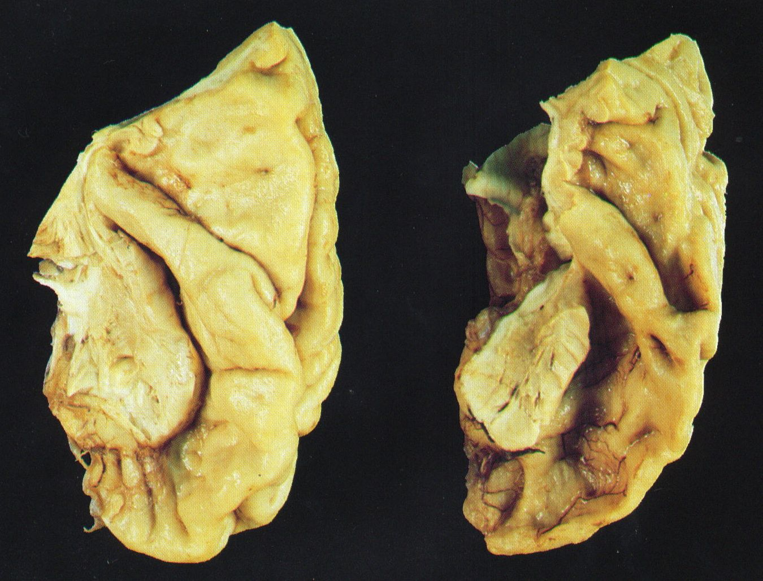
Auditory
Language/Understanding
What do we often do wrong?
Changes
Changes in language skills
  Comprehension
    Can’t interpret words
    Misses 1 out of 4 words
    Gets off target
  Vocabulary & Speech Production
    Can’t find right words
    Word salad
    Can’t make needs known
Preserved
  Hearing remains largely unchanged -
    avoid getting louder!
  Facial expressions
  Tone of voice
  Some non-verbals
  Singing, sounds, some vocalization
  Learns how to cover- confabulation, social chit chat

Slide 18
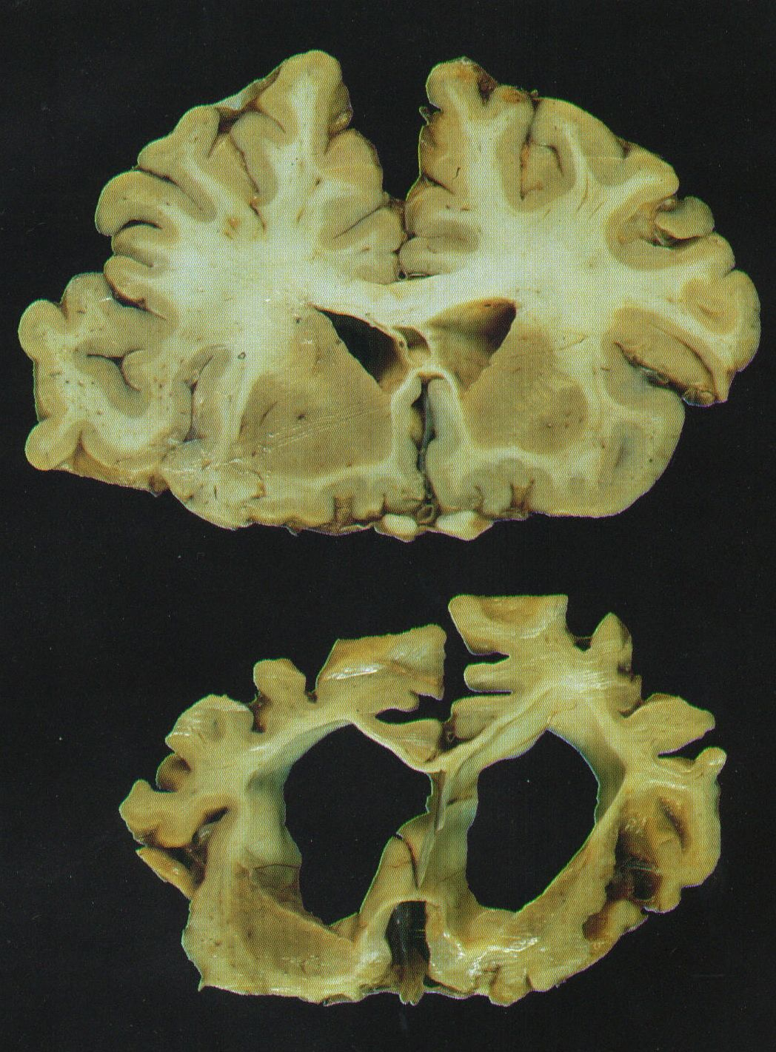
Sensory Strip
Motor Strip
White Matter Connections:
Big Changes
RIGHT
Forbidden words
#!**@#!
2. Automatic speech
Social Chit Chat
3. Rhythm of speech
Speed, intonation
Inflection – question?
4. Music, Poetry, Prayer
5. Autonomic Automatic Movements
LEFT
Vocabulary
Speech Comprehension
Speech Production
Notes:
Let’s compare R to L side
Let’s take this image apart really quick.
Temporal lobes – hearing, language, speech production
Our HEARING tends to remain intact, but not WHAT we are hearing.
Auditory/language processing is in the temporal lobes- L and R have very different jobs
Formal language production/understanding/processing center is on L ------ R side responsible for rhythm, music, automatic speech (hey sweetheart, enjoy your meal- you too!), and EXPLETIVES.
Dementia attacks L + R asymmetrically.
L side of brain in general is attacked more aggressively. Sooner, faster and more devastatingly- we don’t know exactly why.
Autonomic automatic movements… keep that in mind…. (is the reason PPA works!)
Do dance!
“Left, right
Language on the left, rhythm on the right
Lose on the left, retain on the right”

Slide 19
PAC Skills
Skills
Notes:
How can we use our knowledge and awareness of the dementia experience and progression to adapt our care strategies to be more effective and successful for everyone involved

Slide 20

The Basics for Success:
  Be a Detective, not a Judge
  Look, listen, offer, think
  Use your approach as a screening tool
  Always use this sequence for cues:
    1. Visual - Show
    2. Verbal - Tell
    3. Physical – Touch
  Match your help to remaining abilities

Slide 21

Build Skill:
  Positive Physical Approach™
  Supportive Communication
  Consistent and Skill Sensitive Cues:
    Visual, verbal, physical
  Hand-under-Hand®:
    For connection
    For assistance
  Open and Willing Heart, Head and Hands

Slide 22
Relationship Over Agenda
A name and a smile are not enough!
  PLWD can’t process everything you say
  If you go right into your agenda (like taking off their clothes for the shower) the PLWD is going to be confused and likely respond aggressively, fearfully, or with a ‘freeze’ response
  Our approach caused this reaction
  Do not touch until visual and verbal cues have been accepted
What you say:
“Knock knock, it’s Amanda, your nurse. I’m here to give you a nice shower so you can get ready to take a walk today.”
What they hear:
“Knock your nurse. I’m give nice ready take today.”

Slide 23
Approach Matters:
  Use a consistent Positive Physical Approach™
      Approach slowly within visual field
      Pause at edge of public space (6 feet)
      Gesture with still wave and greet by name
      Offer your hand and make eye contact
      Approach slowly within visual range
      Shake hands and maintain Hand-under- Hand® position
      Move to the side
      Get to eye level and respect intimate space (Do not lean)
      Wait for acknowledgement
Notes:
Come from the front – let them know you are coming!
“HI” sign should be still, not aggressively waving – this will distract from message
Offering handshake let’s them know you want to get closer, allows for permission
Moving to the side is supportive vs confrontational

Slide 24
Supportive Communication
Play on the rhythm and social “chit chat” that remains and make a connection
5 ways to make a connection – Positive Personal Connectors:
  Greet – Introduce yourself and use their preferred name
    “Hi (preferred name), I’m (your name).” OR
    “I’m (your name), and you are?”
  Compliment – Indicate something about them of value
    “You are looking really colorful today!”
  Share – First about you, then leave a blank
    “I’m from (state) and you’re from?”
  Notice – Point out something in the environment
    “You must love (item) seeing how well you care for it.”
  Seek – Explore a possible unmet like, want, or need
    “It’s a bit chilly in here, a hot drink would be nice. Do you prefer coffee or tea?”
Notes:
Sounds easy enough right? Well let’s see what happens
5 ways to make a personal connection:
Greet – Introduce yourself and use their preferred name
“Hi (preferred name), I’m (your name).” OR
“I’m (your name), and you are?”
Compliment – Indicate something about them of value
“You are looking really colorful today!”
Share – First about you, then leave a blank
“I’m from (state) and you’re from?”
Notice – Point out something in the environment
“You must love (item) seeing how well you care for it.”
Seek – Explore a possible unmet like, want, or need
“It’s a bit chilly in here, a hot drink would be nice. Do you prefer coffee or tea?”

Slide 25
Keep it Simple:
  Use visual (gesture/point) combined with verbal:
    “It’s about time for… “
    “Let’s go this way…”
    “Here are your socks…”
  Don’t ask questions you don’t want to hear the answer to!
  Acknowledge the response/reaction to your information
  Limit your words: simple is better always
  Wait, pause, slow down

Slide 26
When Doing:
Do ‘with’ them, not ‘to’ them
Give simple and short pieces of information
Offer concrete choices
Ask for their help
Ask the person to try
Break the task down to a single step at a time
Notes:
Positive Action Starters
Help – Be sure to compliment his or her skill in this area, then ask for help with something.
“You are so good at ____, would you please help me?”
Try – Hold up or point to the item you would like to use, possibly sharing in the dislike of the item or task.
“Could we try this?”
Choice – Try using visual cues to offer two possibilities or one choice with something else as the other option.
“This or that?”
“Coffee? Or something else?”
Short and Simple – Give only the first piece of information, maybe offer a time frame of 1-5 minutes
“It’s about time to (first task)”
Step by Step – Only give a small part of the task at first
“Lean forward.”

Slide 27
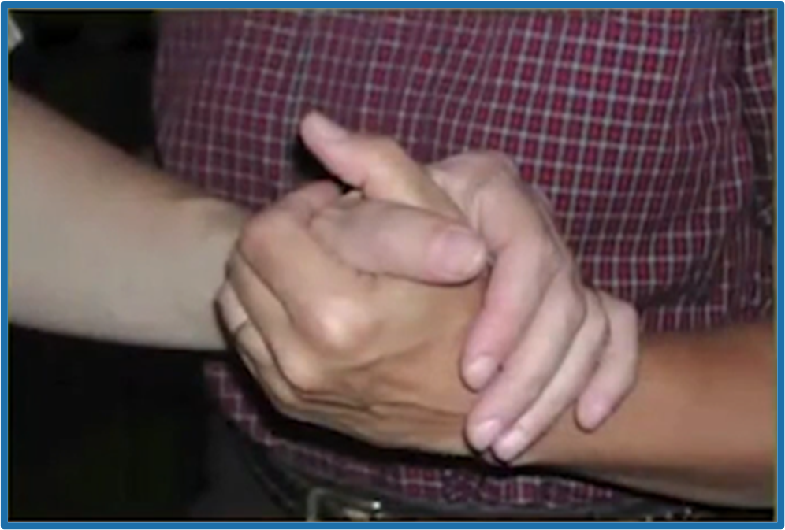
When Words Don’t Work Well:
Hand-under-Hand®:
    Uses established nerve pathways
    Allows the person to feel in control
    Connects you to the person
    Allows you to do ‘with’, not ‘to’
    Gives you advance notice of possible problems
    Connects eye-hand skills
    Use the dominant side of the person
HuH places pressure to the palm of the hand, NOT around the top of the hand, sides, or base of the digit, thus protecting both people from injury.
Notes:
This type of assistance is an evidence-based technique developed by Teepa Snow called Hand-under-Hand:
Discuss skill vs strength/comfort in the palm if haven’t already
A tool for when words don’t work well – everyday ways of communicating are not working – a new approach to support and assist a person living with dementia
Lets person maintain feeling of control and independence - even when you are doing almost everythin
I’m here to guide and assist
I’m NOT here to take over and do things “to” you
I want to do things “with” you
Utilizes muscle memory and established nerve pathways to allow brain to process what it’s doing
Reduces resistant behaviors (or gives advance notice of them!)
If I can get your brain to understand what we’re doing, you’re going to cooperate
You can still give feedback, even when you can’t speak anymore
You can give me feedback that doesn’t result in me getting hit
Useful for:
Connecting: gaining eye contact and attention, comforting, and directing gaze
Guiding and helping with movement
Providing help with fine motor – eating, drinking, bathing, dressing, etc.
***Use dominant side of person, if known!

Slide 28
Hand Under Hand
Turn PPA handshake into a Hand-Under-Hand
Makes the physical connection (following visual and verbal)
Dementia robs skill before strength- use this to provide the “skill” to a patient’s “strength” and assist them to “do with”
Putting it all together- PPA and Hand Under Hand:
https://learn.teepasnow.com/courses/becoming-dementia-aware-online-course/lessons/pac-skills-in-depth-2/
Notes:
Remember the loss of ability to manipulate tools
Teepa123!

Slide 29
PPA and Hand Under Hand
Example Scenarios:
https://learn.teepasnow.com/courses/becoming-dementia-aware-online-course/lessons/becoming-dementia-aware-section-6-the-positive-physical-approach-ppa/ (19:10)
https://learn.teepasnow.com/courses/becoming-dementia-aware-online-course/lessons/becoming-dementia-aware-section-6-the-positive-physical-approach-ppa/ (8:48)
Notes:
Sweater- advanced dementia, they are like a shell- rigid and muscles can’t relax and have a hard time activating muscles- need to be slow and patient

Slide 30
Accomplishing the Agenda
Use visual combined with verbal cues (gesture/point)
Give choices with visual cues (red shirt or blue shirt?)
Don’t ask questions you don’t want the answer to
Don’t try to reason
Wait, pause, SLOW DOWN – if you lose visual field, you must stop and regain it
Do not reality orient but don’t lie, meet where they are at and move forward together
  “It’s about time for”
  “Let’s go this way”
  “Here are your socks”
  Don’t say, “do you want my help?”
“People living with dementia are doing the best they can in any given moment. WE have to be the ones to change.” – Teepa Snow
Notes:
“I have three little babies at home. Oh really, tell me about them.”

Slide 31
Accomplishing the Agenda
Don’t correct behavior- help to refocus
Show them what you want them to do (visual cues); telling them won’t make the connection, use touch as a guide (once touch is accepted)
If they make a mistake, don’t correct them. Instead, say “sorry I forgot to tell you that”
Again, keep agenda in your back pocket and be willing to fail and try again with a different approach
Goal: to find a positive solution that goes with what they want AND your agenda

Slide 32
Accomplishing the Agenda
Using PPA and Hand Under Hand:
https://learn.teepasnow.com/courses/becoming-dementia-aware-online-course/lessons/becoming-dementia-aware-section-7-after-ppa/ (2:30)

Slide 33
Care Partners Need To:
  Take care of yourself!!
  Understand the symptoms and progression
  Build skill in support and caregiving
  Build skill in communication and interactions
  Understand the condition of brain change
  Identify and utilize local resources
  Set limits for yourself

Slide 34
References & Resources
Alzheimer’s: A broken brain. (1995). Dementia Education & Training.
"Alzheimer's & Dementia." Home Instead Senior Care. Home Insead Senior Car, n.d. Web. 30 Oct. 2013. "Latest Facts & Figures Report | Alzheimer's Association." Latest Facts & Figures Report | Alzheimer's Association. N.p., n.d. Web. 30 Oct. 2013
Small, G (n.d.). Positron Emission Tomography (PET) Alzheimer’s Disease Progression vs. Normal Brains. UCLA School of Medicine.
For more information:
Reference handouts provided in class
www.teepasnow.com
Teepa Snow is on Instagram, Facebook, TikTok
YouTube videos from Positive Approach to Care
Handouts are intended for personal use only. Any copyrighted materials or DVD content from Positive Approach, LLC (Teepa Snow) may be used for personal educational purposes only. This material may not be copied, sold or commercially exploited, and shall be used solely by the requesting individual. Copyright 2017, All Rights Reserved Teepa Snow and Positive Approach, LLC Any redistribution or duplication, in whole or in part, is strictly prohibited, without the expressed written consent of Teepa Snow and Positive Approach, LLC

