Slide 1
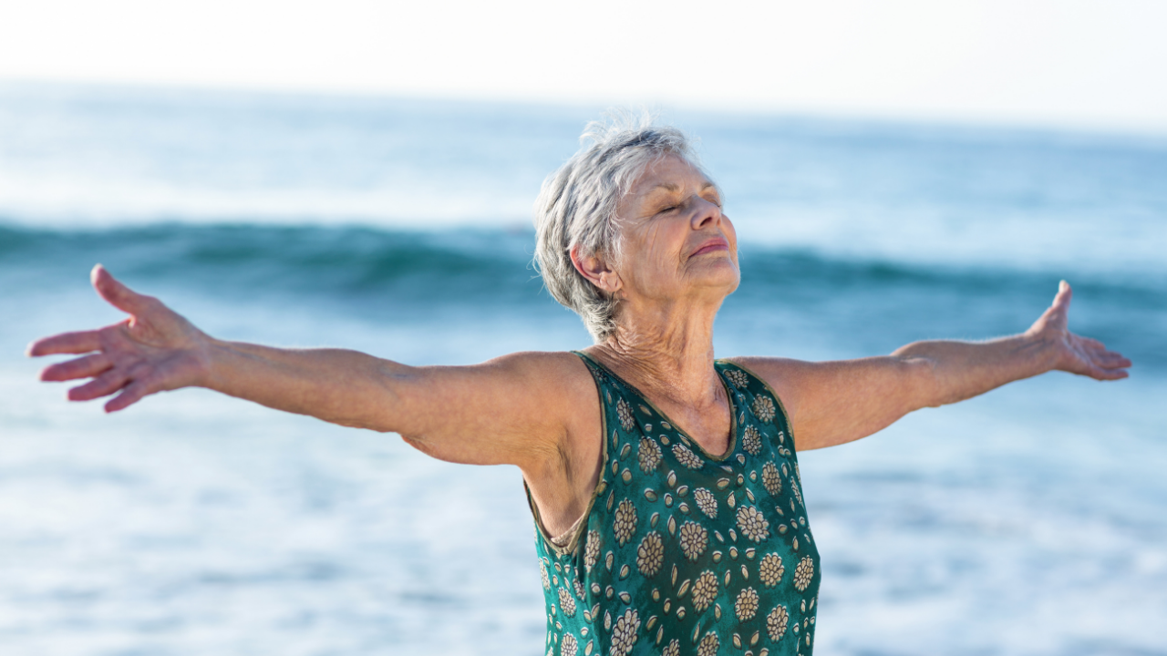


There’s No Expiration Date on Healing & Transformation
What Most Resilient Older Adults Teach Us About Aging
Regina Koepp, PsyD, ABPP
www.mentalhealthandaging.com
Center for Mental Health & Aging

Slide 2
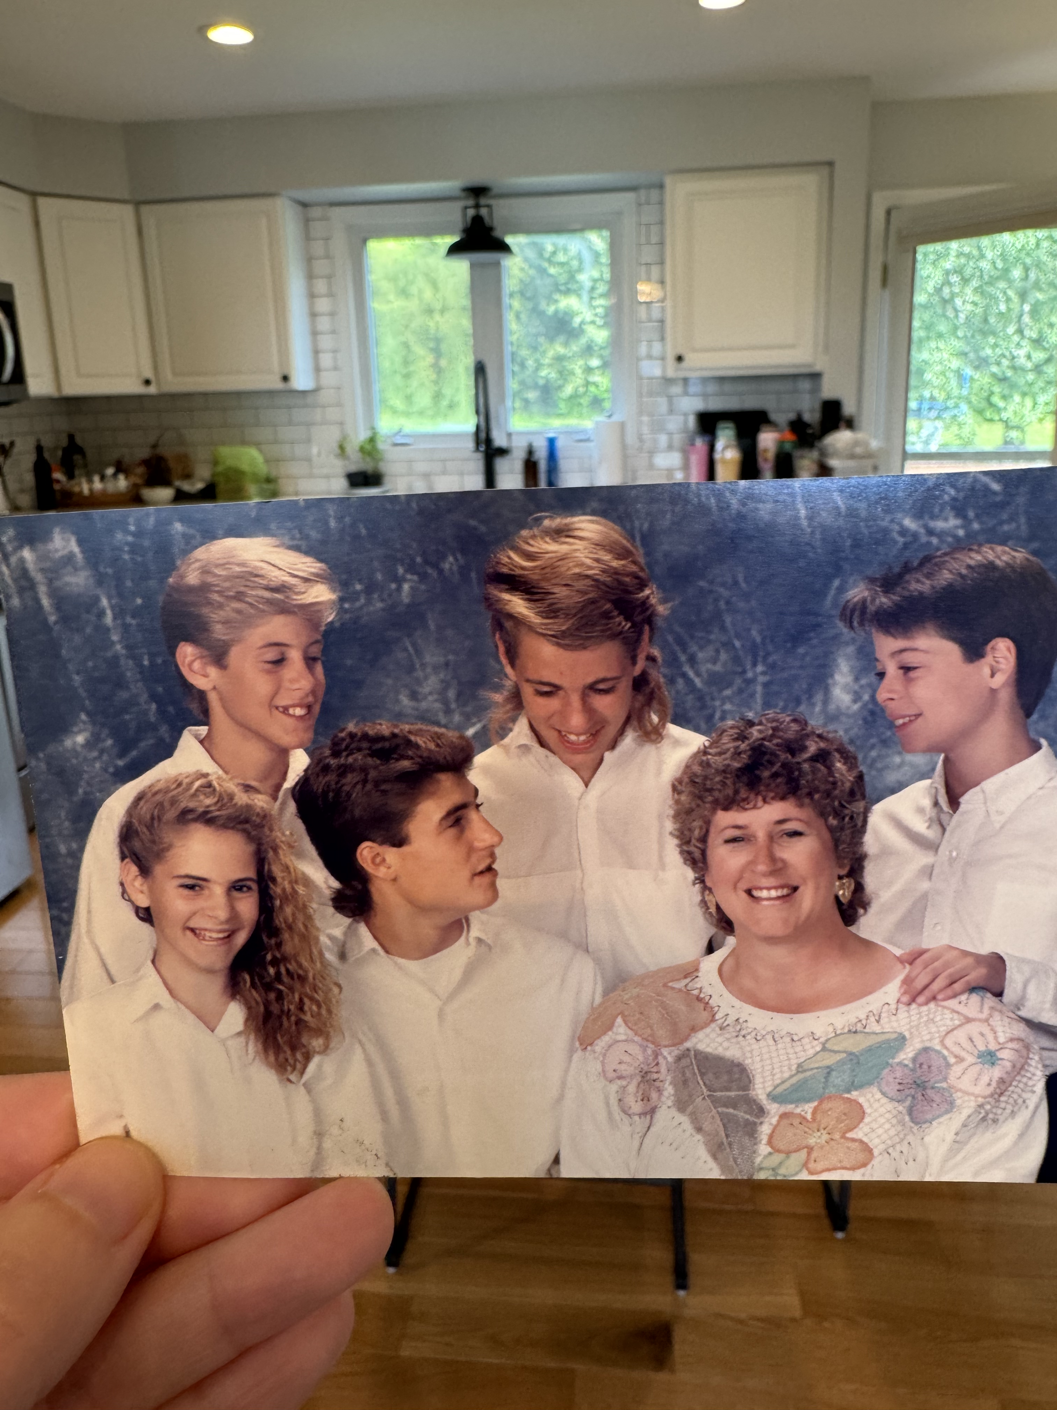

Slide 3
“
When we only focus on what is wrong,
we miss what is strong.
”

Slide 4
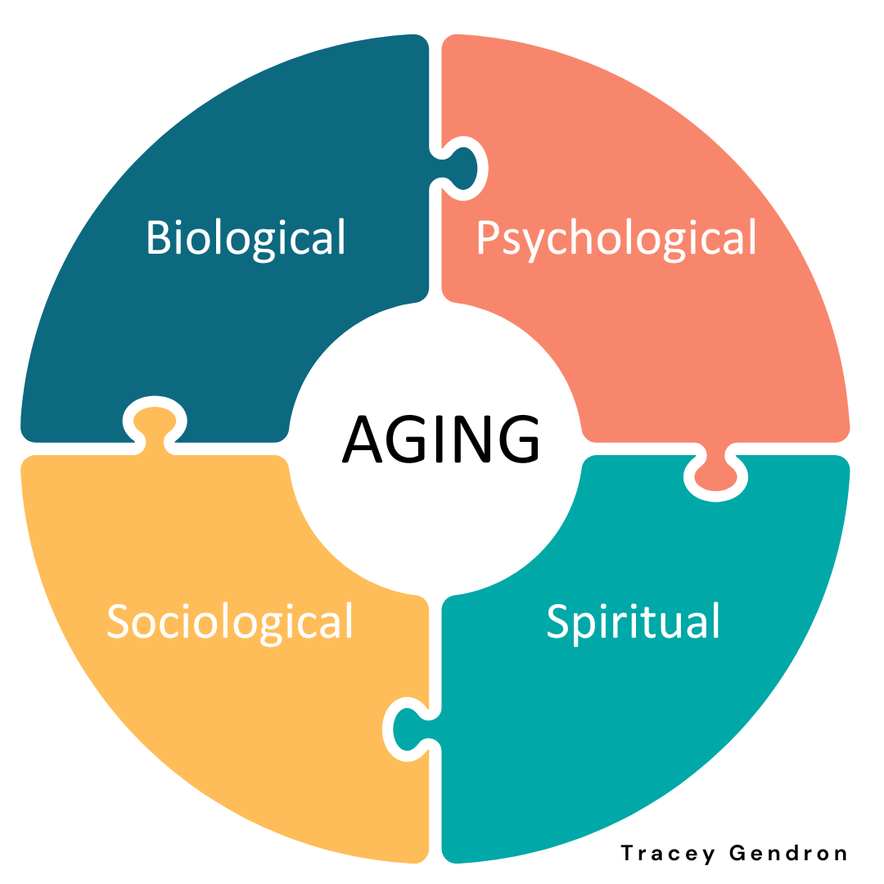

Slide 5
“
We thought they would be more vulnerable to the stress of COVID because they are, by CDC definition, the most vulnerable population, but what we learned is that older adults with depression can be resilient. They told us that coping with chronic depression taught them to be resilient.
Dr. Helen Lavretsky, Aug 2020

Slide 6
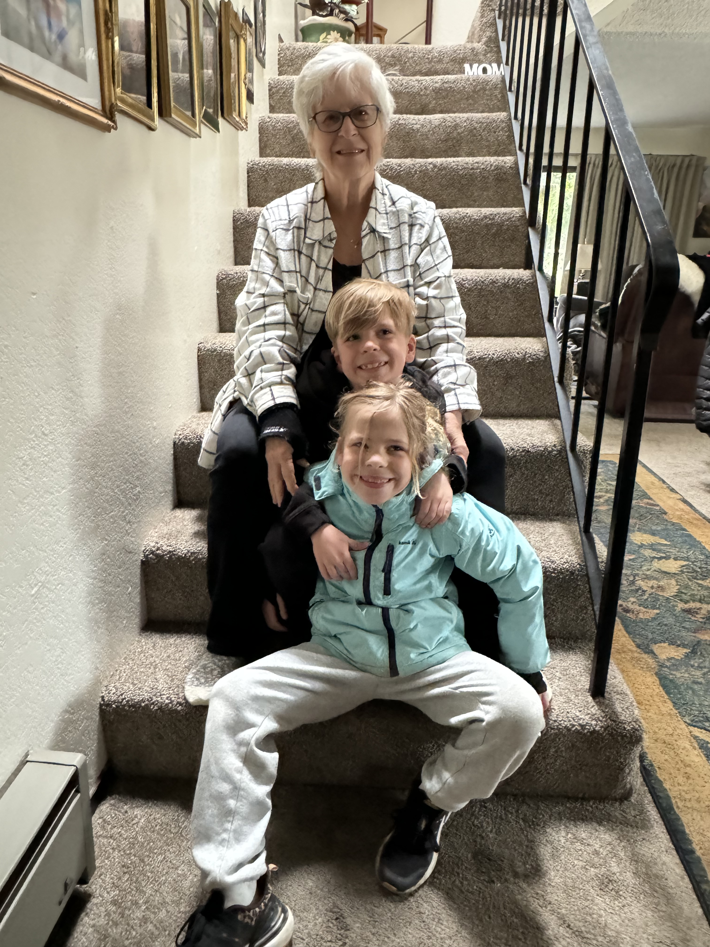
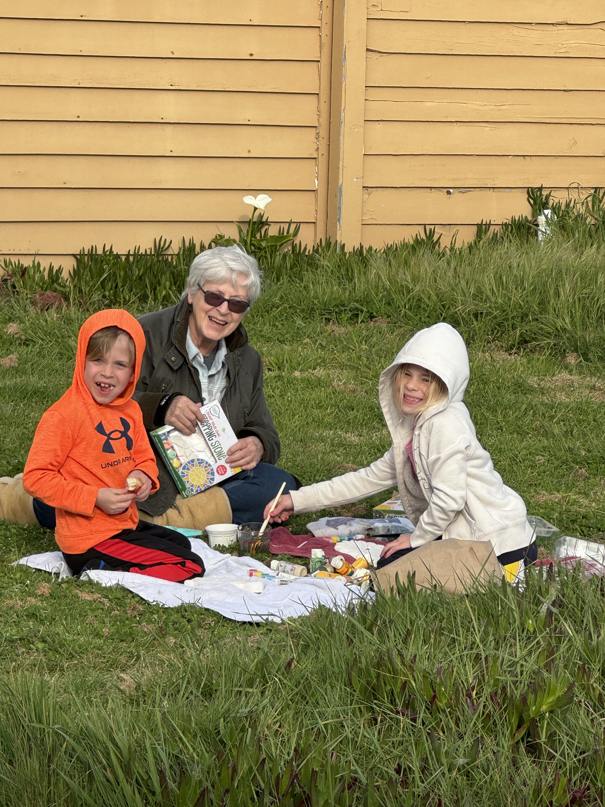

Slide 7
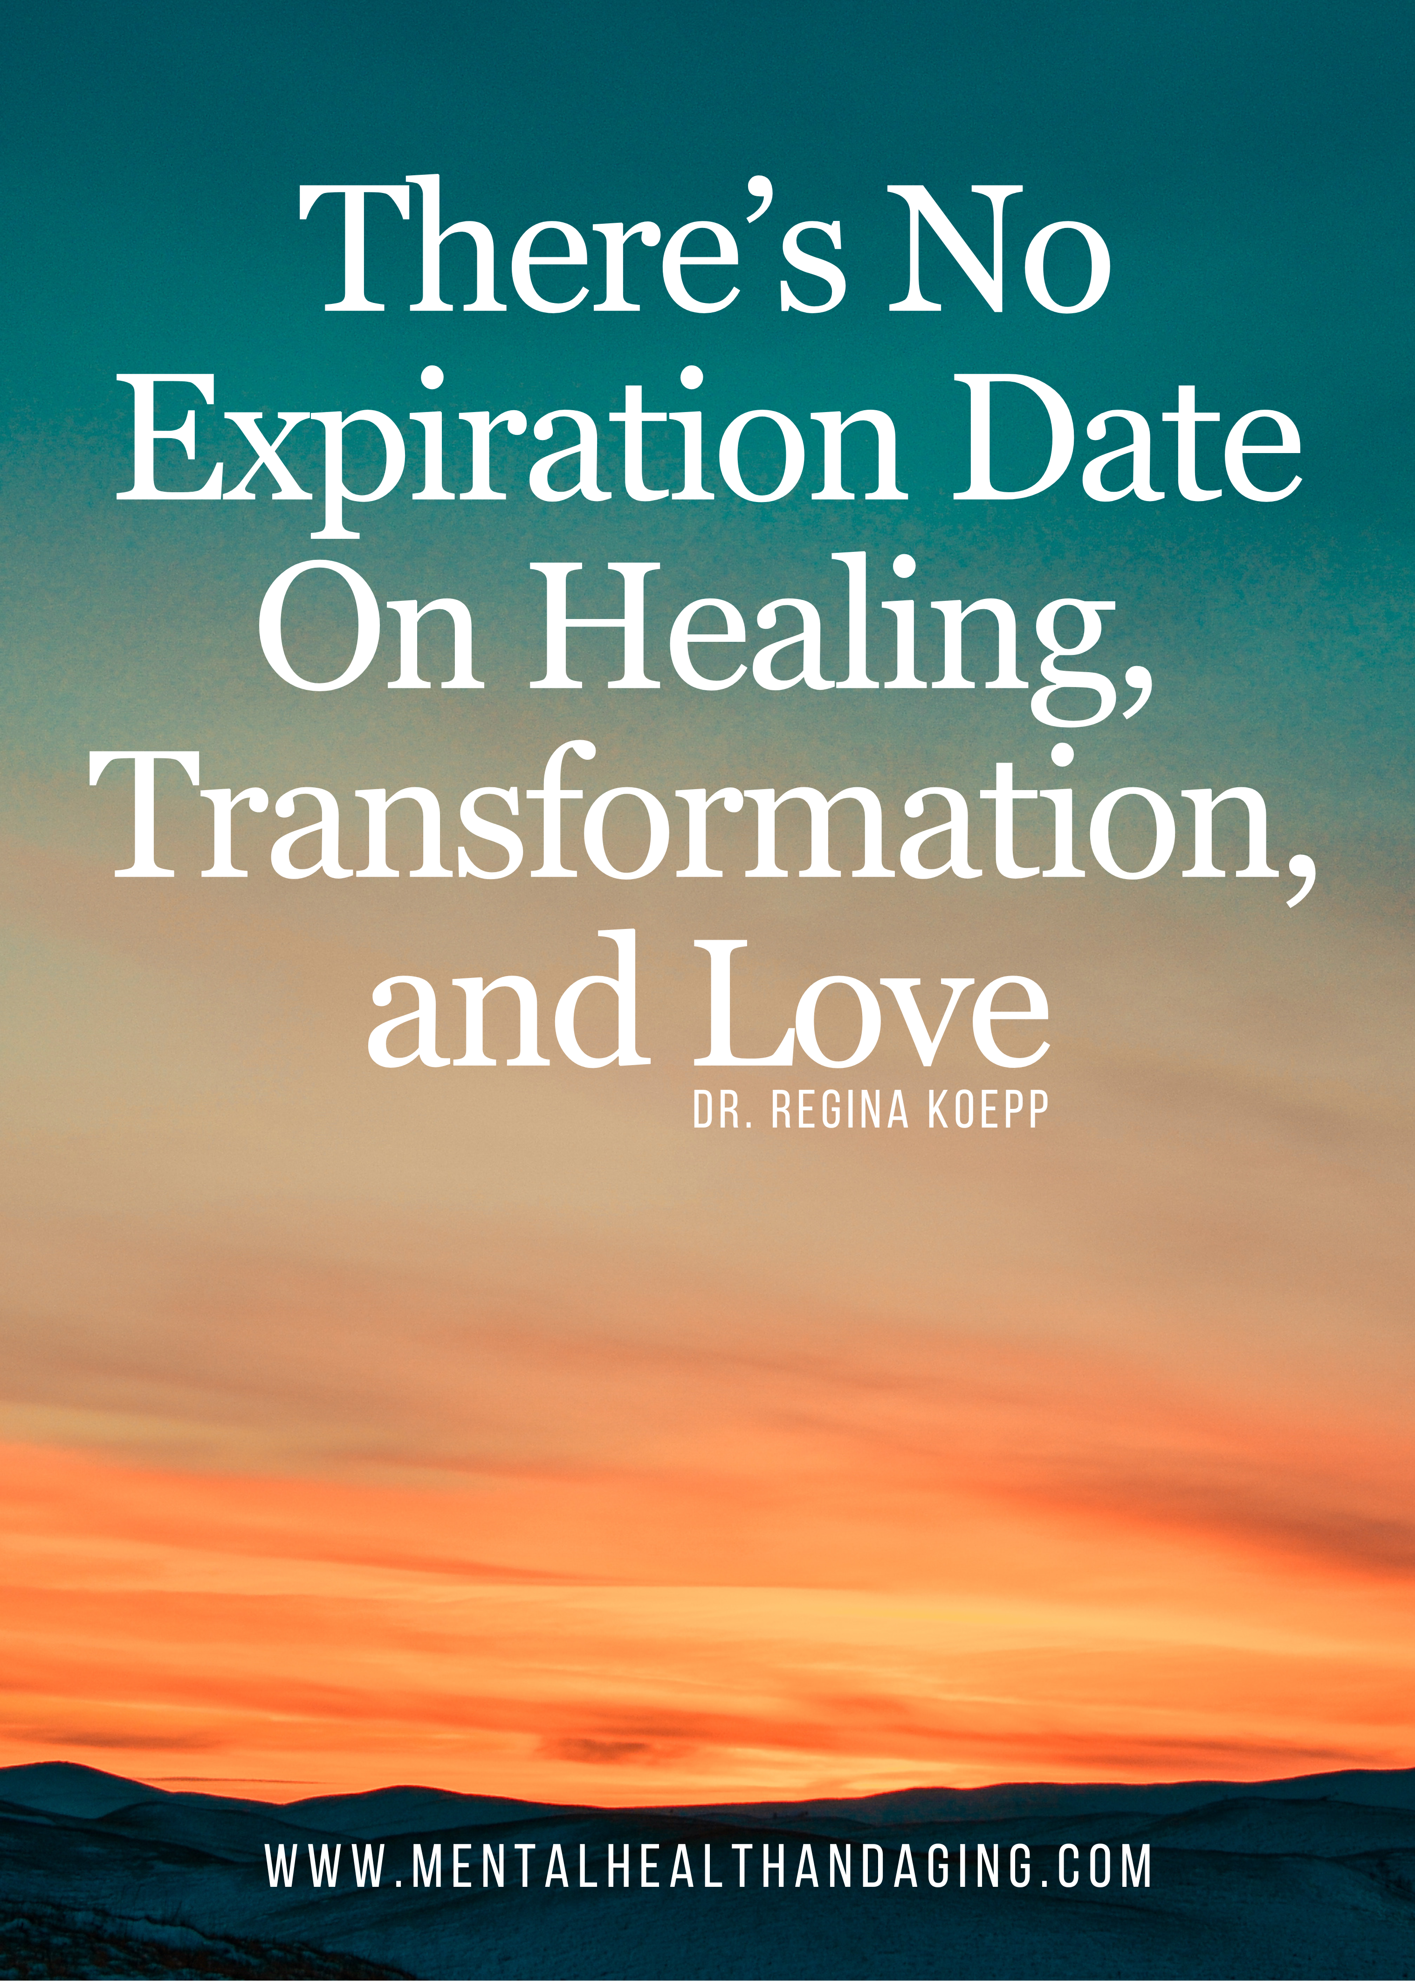
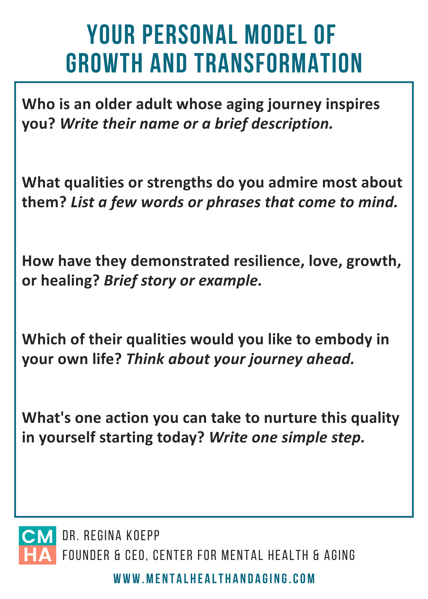

Slide 8
Your Personal Model of Growth + Transformation
Who is an older adult whose aging journey inspires you?
What qualities or strengths do you admire most about them? List a few words or phrases that come to mind.
How have they demonstrated resilience, love, growth, or healing?
Which of their qualities would you like to embody in your own life? Think about your journey ahead.
What's one action you can take to nurture this quality in yourself starting today? Write one simple step.

Slide 9
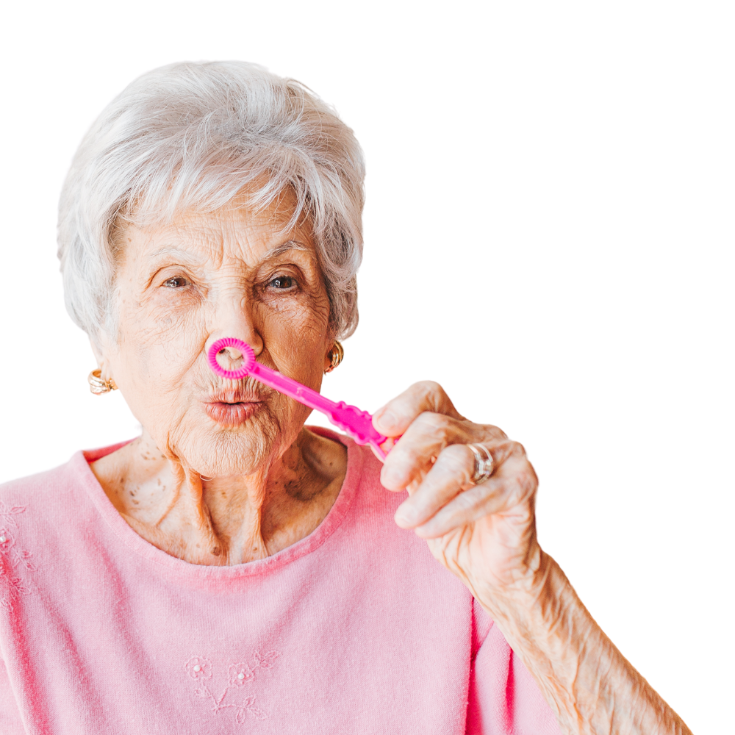
Here’s What We’ll Cover…
01
Trauma & Older Adults
02
5 Principles of post-traumatic growth
03
What post-traumatic growth teaches us about aging well

Slide 10

Trauma & Older Adults

Slide 11
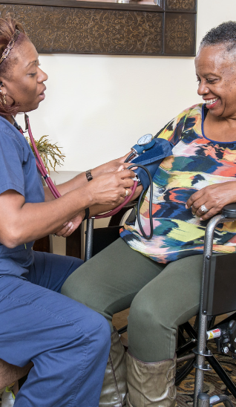
Older Adults & Trauma
Kaiser et al. (2024)
Close to 90% of adults 65+ have been exposed to at least one traumatic event in their lifetime
1.5%-4% of adults 60+ have a PTSD dx
Older adults more likely to have experienced medical trauma
Homebound older adults more likely to experience trauma
Notes:
Kaiser, A. P., Wachen, J. S., Potter, C., Moye, J., & Davison, E. (n.d.). Posttraumatic Stress Symptoms among Older Adults: A Review. National Center for PTSD. Retrieved March 24, 2024, from https://www.ptsd.va.gov/professional/treat/specific/symptoms_older_adults.asp

Slide 12
PTS Sxs Can Emerge With Age
Role changes and loss of independence may make coping with memories of earlier trauma more challenging.
Increase in stressors like retirement, health problems, decreased sensory abilities, reduced income, loss of loved ones, decreased social support, cognitive impairment, etc
Coping strategies used to manage post-traumatic stress symptoms in early and mid-life may be less effective or available in older adulthood.
PTS symptoms may be more severe in people with cognitive impairment and dementia disorders
Reengage with their trauma-related memories in an effort to find meaning and build coherence later in life.
Notes:
Reuman, L., & Davison, E. H. (2022). Delivered as Described: A Successful Case of Cognitive Processing Therapy With an Older Woman Veteran With PTSD. Cognitive and behavioral practice, 29(4), 914–923. https://doi.org/10.1016/j.cbpra.2021.06.004
Kaiser, A. P., Wachen, J. S., Potter, C., Moye, J., & Davison, E. (n.d.). Posttraumatic Stress Symptoms among Older Adults: A Review. National Center for PTSD. Retrieved March 24, 2024, from https://www.ptsd.va.gov/professional/treat/specific/symptoms_older_adults.asp
O’Donnell, M. L., Schaefer, I., Varker, T., Kartal, D., Forbes, D., Bryant, R. A. A., Silove, D., Creamer, M., McFarlane, A., Malhi, G., Felmingham, K., Van Hoof, M., Hadzi-Pavlovic, D., Nickerson, A., & Steel, Z. (2017). A systematic review of person-centered approaches to investigating patterns of trauma exposure. *Clinical Psychology Review, 57*, 208-225. https://doi.org/10.1016/j.cpr.2017.08.009.

Slide 13
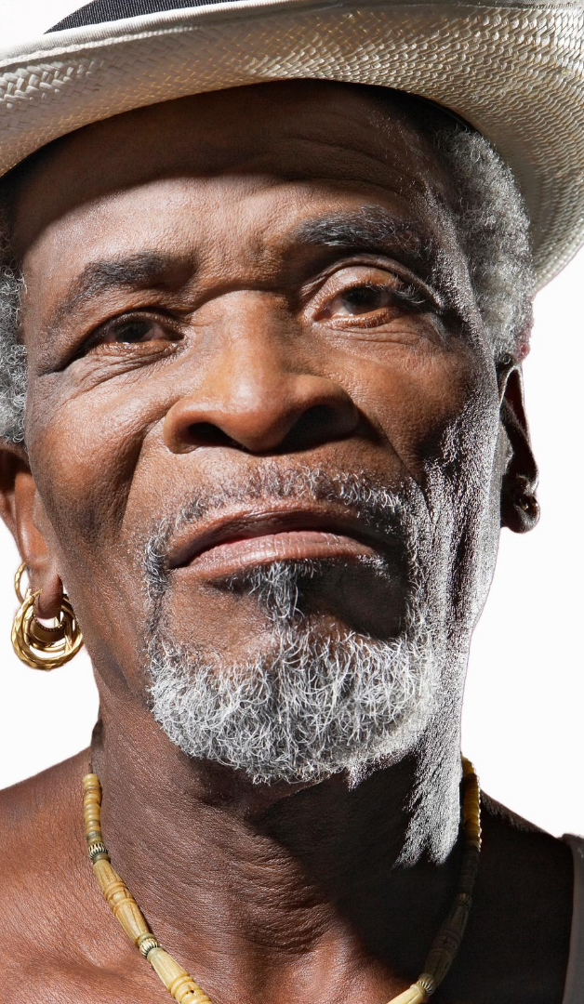
Racism-Related Stress/Trauma
Across the Lifespan
Adomako, F. (2018).
Racism-related stress occurs when an individual experiences or witnesses racist incidents that evoke experiences of racism.
For BIPOC older adults, these encounters are accumulated over the lifespan, stored in memory, and relived with each new racist and discriminatory experience
Limited access to community resources significantly contributes to the experience of racism-related stress and creates barriers to achieving healthy and productive aging.
Notes:
Adomako, F. (2018). How race-related stress impacts older African Americans. APA Office on Aging. Retrieved from https://www.apa.org/topics/aging-older-adults/african-americans-race-related-stress

Slide 14
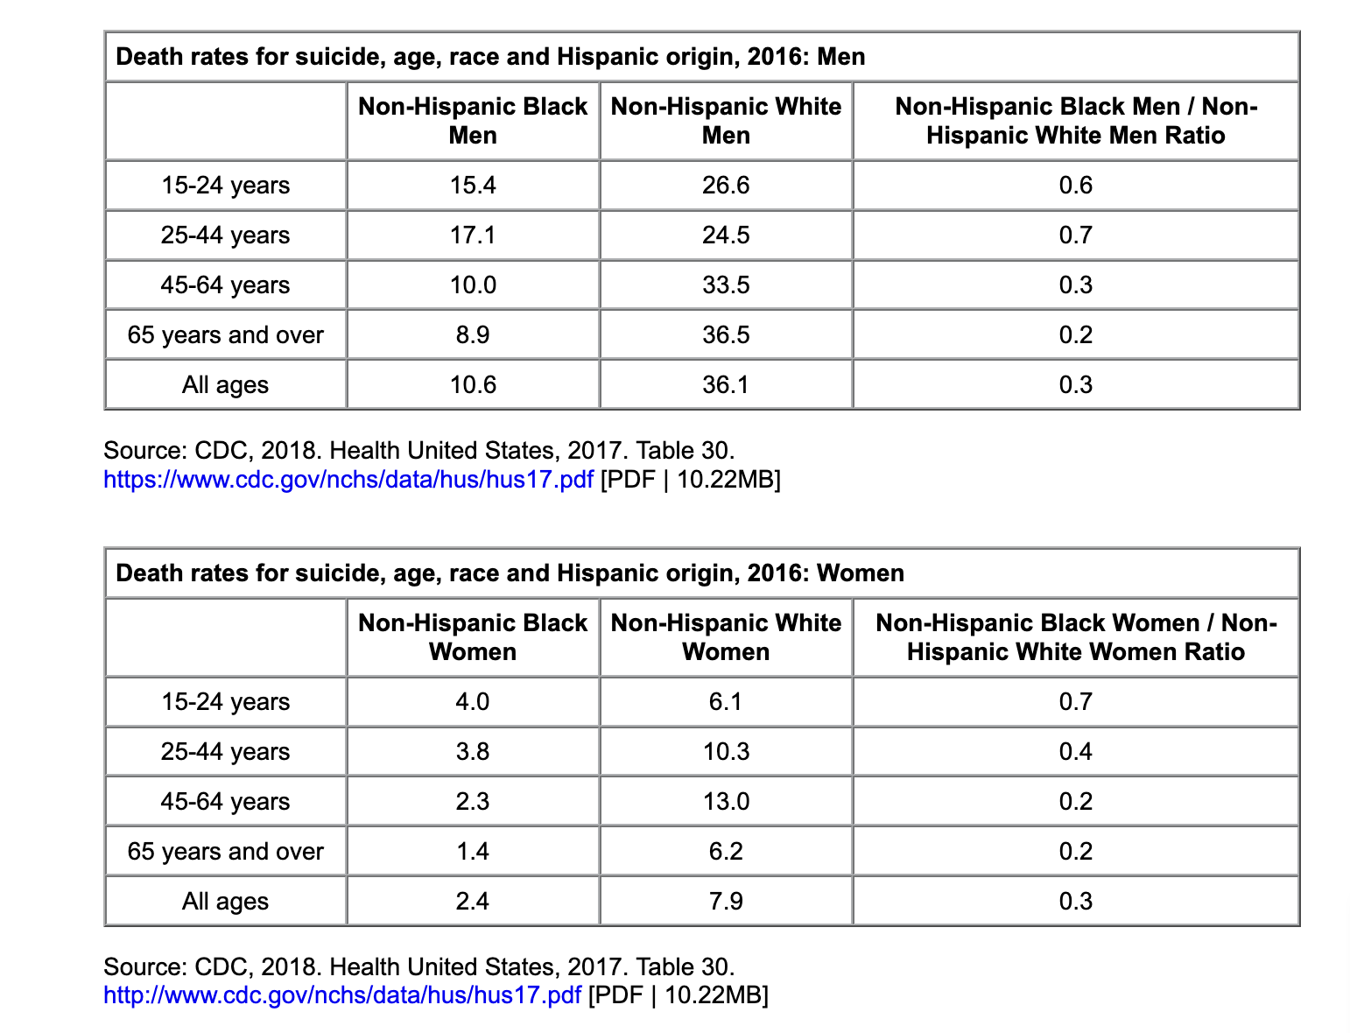
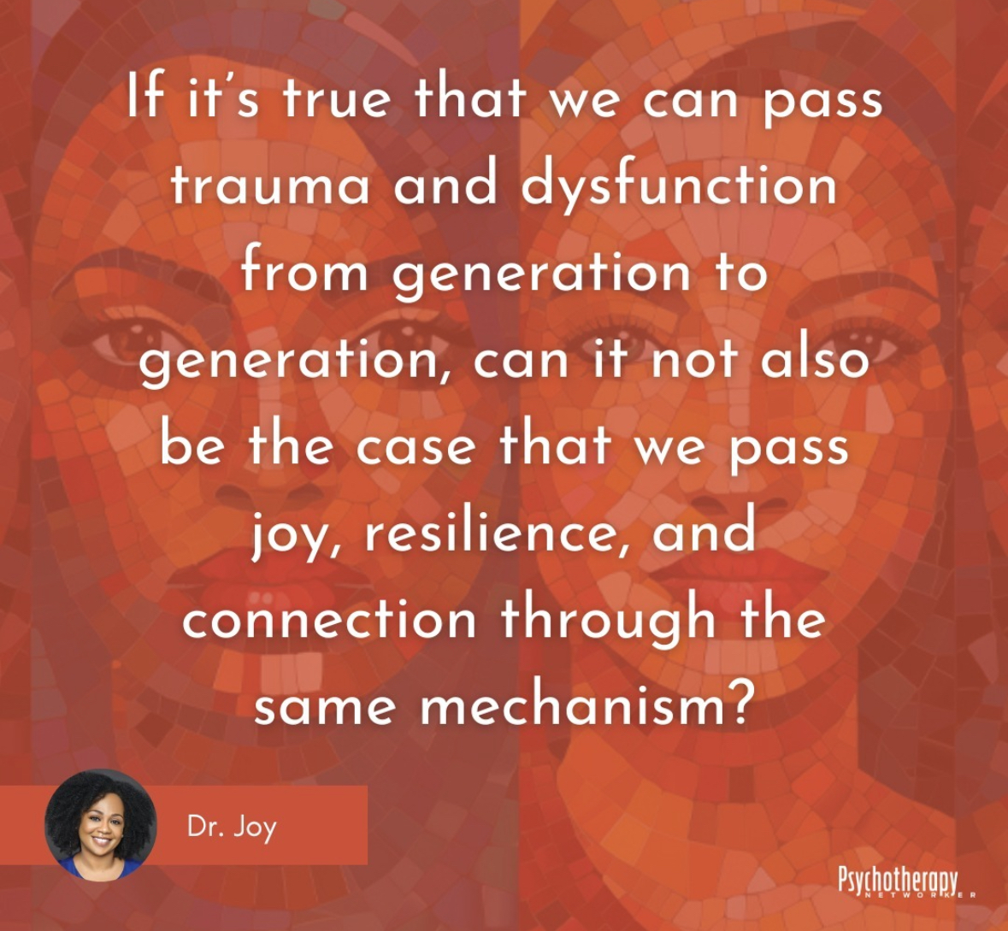
Suicide Rate by Race and Age, US 2016
Men:
Women:

Slide 15
Black Women’s Social &
Spiritual Resistance to Suicide
”Repertoire of resilience" comprising 3 interrelated scripts:
Shared Experiences of Struggle – Drawing strength from collective challenges.
Centuries of Strength Building – Building resilience through generational perseverance.
Counter-Evaluation of Privilege – Reframing marginalizing experiences to cultivate self-empowerment.
  By challenging dominant narratives of privilege and valuing their own lived experiences, Black women foster an empowered self-concept that supports resistance to suicide.
Source: Spates & Slatton, 2023, Social Problems
Notes:
Kamesha Spates, Brittany C Slatton, Repertoire of Resilience: Black Women’s Social Resistance to Suicide, Social Problems, Volume 70, Issue 3, August 2023, Pages 650–664, https://doi.org/10.1093/socpro/spab072

Slide 16



Resilience
Compared to younger LGBT Veterans (<50yo), Older LGTBQ Veterans (>50yo):
  Appeared more resilient over stressors that can impact mental health.
  Experienced less alcohol use and reported less minority stress.
  LGBT identity was more central to older veterans’ overall identity
Lifetime challenges of being a sexual minority may have prepared older LGTBQ Adults with better coping, thus better adjustment in the face of some age-related transitions and stressors.
Jose Cortes BA, Terri L. Fletcher PhD, David M. Latini PhD, MSW & Michael R. Kauth PhD (2019)

Slide 17
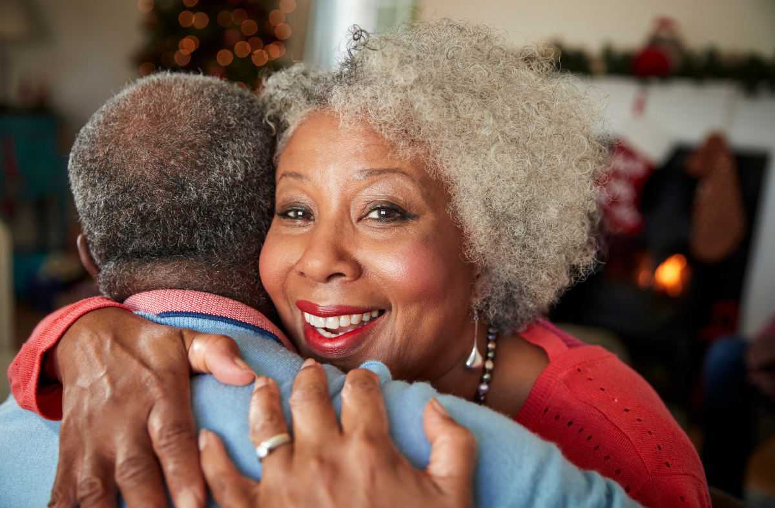
Posttraumatic Growth
As we navigate the aftermath of traumatic events, we often undergo a process of cognitive restructuring wherein we reevaluate our core beliefs, values, and priorities, resulting in growth and transformation.
Notes:
Jayawickreme, E., Infurna, F. J., Alajak, K., Blackie, L. E., Chopik, W. J., Chung, J. M., ... & Zonneveld, R. (2021). Post‐traumatic growth as positive personality change: Challenges, opportunities, and recommendations. Journal of personality, 89(1), 145-165.
Kaiser, A. P., Wachen, J. S., Potter, C., Moye, J., & Davison, E. (n.d.). Posttraumatic Stress Symptoms among Older Adults: A Review. National Center for PTSD. Retrieved March 24, 2024, from https://www.ptsd.va.gov/professional/treat/specific/symptoms_older_adults.asp
Wu, X., Kaminga, A. C., Dai, W., Deng, J., Wang, Z., Pan, X., & Liu, A. (2019). The prevalence of moderate-to-high posttraumatic growth: A systematic review and meta-analysis. Journal of Affective Disorders, 243, 408–415. https://doi.org/10.1016/j.jad.2018.09.023

Slide 18
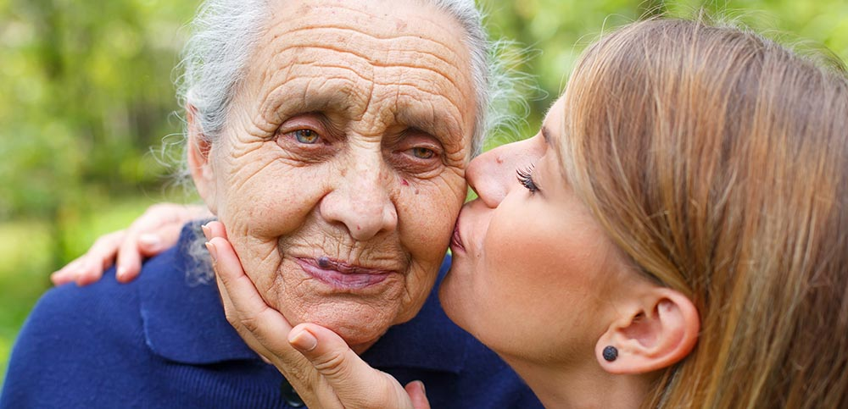
Older Adults & Post-Traumatic Growth
Close to 90% of adults 65+ have been exposed to at least one traumatic event in their lifetime
~ 50% will go on to eventually experience some type of post-traumatic growth
Notes:
Wu, X., Kaminga, A. C., Dai, W., Deng, J., Wang, Z., Pan, X., & Liu, A. (2019). The prevalence of moderate-to-high posttraumatic growth: A systematic review and meta-analysis. Journal of Affective Disorders, 243, 408–415. https://doi.org/10.1016/j.jad.2018.09.023
Kaiser, A. P., Wachen, J. S., Potter, C., Moye, J., & Davison, E. (n.d.). Posttraumatic Stress Symptoms among Older Adults: A Review. National Center for PTSD. Retrieved March 24, 2024, from https://www.ptsd.va.gov/professional/treat/specific/symptoms_older_adults.asp

Slide 19
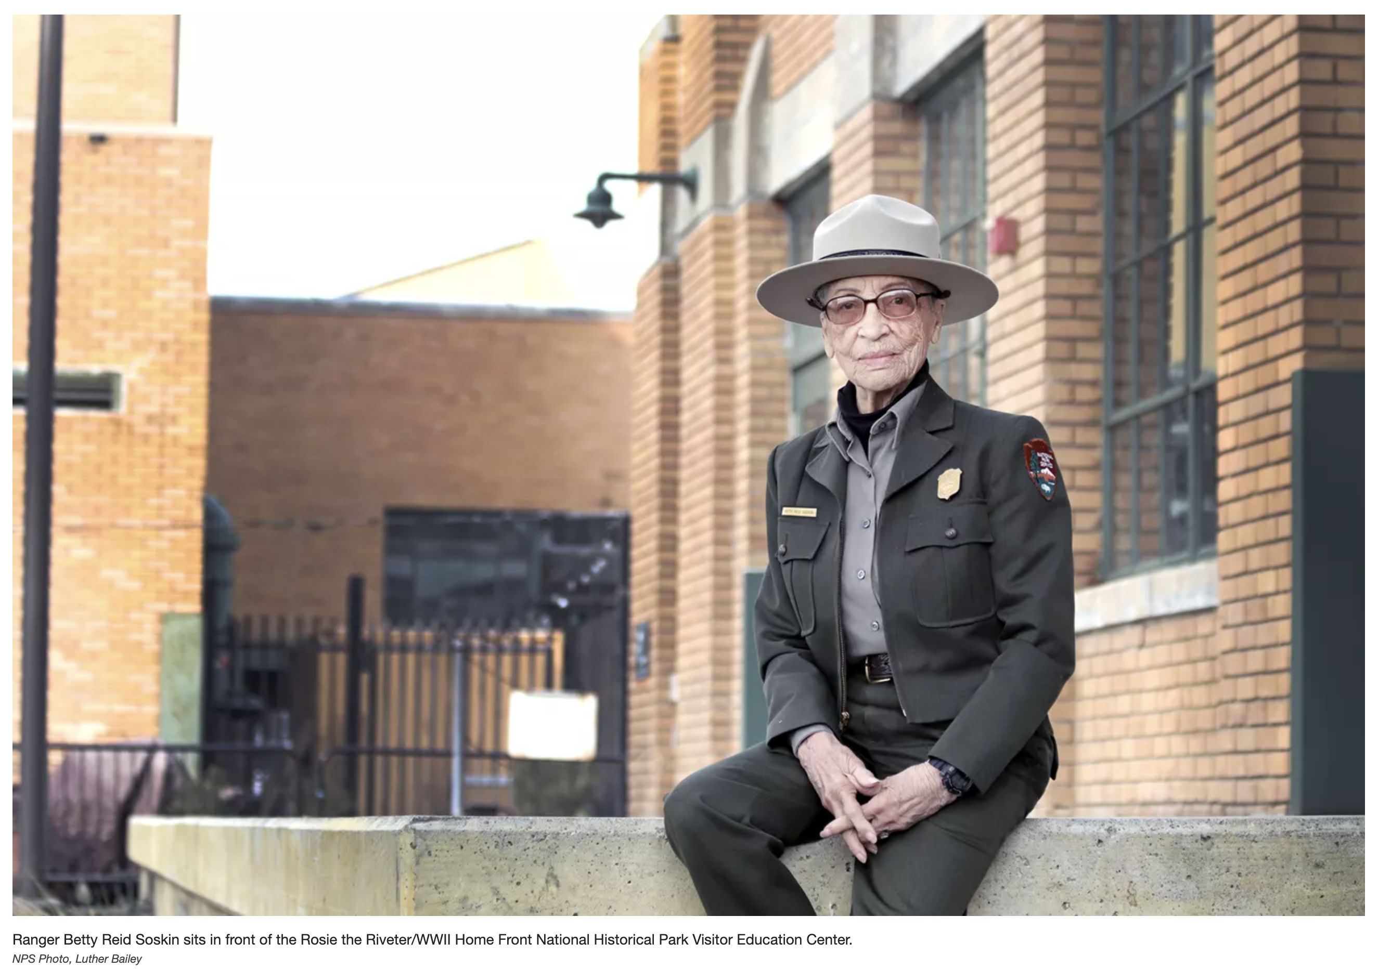

Slide 20

A personal story of Trauma & Post-Traumatic Growth

Slide 21
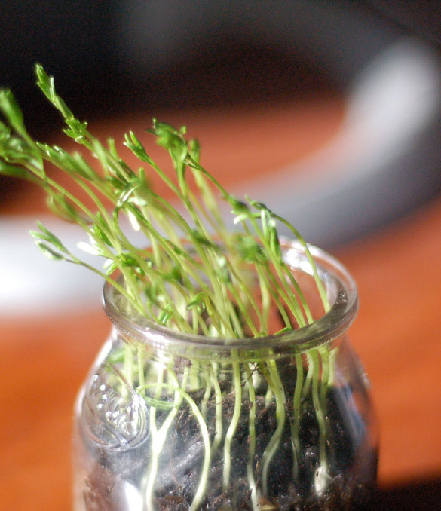
Post-Traumatic Growth
5 distinct domains in which growth occurs following trauma:
Relating to others
New possibilities
Personal strength
Spiritual change
Appreciation of life
Tedeschi and Calhoun (1996) created the "Posttraumatic Growth Inventory (PTGI)"
Notes:
Wu, X., Kaminga, A. C., Dai, W., Deng, J., Wang, Z., Pan, X., & Liu, A. (2019). The prevalence of moderate-to-high posttraumatic growth: A systematic review and meta-analysis. Journal of Affective Disorders, 243, 408–415. https://doi.org/10.1016/j.jad.2018.09.023
Kaiser, A. P., Wachen, J. S., Potter, C., Moye, J., & Davison, E. (n.d.). Posttraumatic Stress Symptoms among Older Adults: A Review. National Center for PTSD. Retrieved March 24, 2024, from https://www.ptsd.va.gov/professional/treat/specific/symptoms_older_adults.asp

Slide 22
1. Relating to Others
Deeper, more meaningful relationships
Increased empathy and emotional closeness
Willingness to seek and offer support

Slide 23
Relating To Others
Meta-analysis of 15 quantitative studies (Kadri et al, 2022)
2 Social processes—SUPPORT AND RECOGNITION—are esp helpful after trauma
1. Social Support
Family, friends, religious/spiritual groups, affinity groups, survivor groups, organizes support groups
Older adults with stronger social networks were more likely to report PTG:
  Feel understood and less alone
  Process trauma through sharing and reflection- Communal Meaning Making
  Maintain hope and purpose
Connection is a Catalyst for Growth
Notes:
Kadri, A., Gracey, F., & Leddy, A. (2022). What Factors are Associated with Posttraumatic Growth in Older Adults? A Systematic Review. Clinical Gerontologist, 48(1), 4–21. https://doi.org/10.1080/07317115.2022.2034200

Slide 24
Relating To Others
Meta-analysis of 15 quantitative studies (Kadri et al, 2022)
2. Social Recognition
Acknowledgment and validation of one's trauma by society or close others.
    Being publicly recognized as a survivor (e.g., veterans, Holocaust survivors)
    Participation in survivor groups
    Receiving honor or social validation (e.g., decorated military veterans)
Social processes create the conditions for psycho-social-spiritual processing necessary for PTG, such as meaning-making and acceptance.
Pain & Suffering Need to Be Acknowledged

Slide 25
Relating To Others
What this teaches us about aging
Healing + Growth Happen in Community
Belonging, validation, and connection allow us to transform traumatic experiences and losses into opportunities for psycho-social-spiritual growth.
Healing + Growth Happen in Community

Slide 26


The Power of Belonging
Meta-analysis of 148 studies, 308,849 participants (Carragher & Ryan, 2020)
Having social relationships increases a person's odds of living longer by 50% compared to those who have weaker or fewer social ties.
The richer and more multifaceted a person's social connections, odds of living longer increased to 91%
50%
91%
Notes:
Carragher, L., & Ryan, C. (2020). Dying to Belong: The Importance of Familiarity in Later Life. Gerontology & geriatric medicine, 6, 2333721420941976. https://doi.org/10.1177/2333721420941976
Research reports most often (81%) considered all-cause mortality, but some restricted evaluations to mortality associated with cancer (9%), CVD (8%), or other causes (2%). Participants were followed for an average of 7.5 years (SD = 7.1, range = 3 months to 58 years), with an average of 29% of the participants dying within each study's follow-up period.
Holt-Lunstad, J., Smith, T. B., & Layton, J. B. (2010). Social relationships and mortality risk: a meta-analytic review. PLoS medicine, 7(7), e1000316. https://doi.org/10.1371/journal.pmed.1000316

Slide 27
Recognize new paths and opportunities
Openness to new roles, activities, or perspectives
Willing to try new things or set new goals
2. New Possibilities

Slide 28
New Possibilities
Study of older adults who underwent stoma surgery due to cancer or other gastrointestinal illnesses (ages 67-92yo; Błaszczyński & Turek, 2013)
Many participants discovered new avenues for personal development and engagement:
  Peer support and advocacy
  Mentoring others facing similar surgeries
  Participating in patient organizations
Others reported taking up new hobbies, volunteering, or pursuing educational opportunities-activities they had not considered before their illness and surgery.
These new roles and pursuits provided a renewed sense of purpose and identity
Notes:
Błaszczyński, Paweł & Turek, Robert. (2013). Better life after trauma: Stomic society as an environment for posttraumatic growth for stomic patients. Psychiatria i Psychologia Kliniczna. 13. 164-173.
Kadri, A., Gracey, F., & Leddy, A. (2022). What Factors are Associated with Posttraumatic Growth in Older Adults? A Systematic Review. Clinical gerontologist, 48(1), 4–21. https://doi.org/10.1080/07317115.2022.2034200

Slide 29
New Possibilities
What this teaches us about aging
For older adults facing significant life transitions such as retirement, health changes, or loss of loved ones, NEW POSSIBILITIES offer a framework for reimagining their future.
Contrary to ageist stereotypes, older adults exhibit robust capacity for post-traumatic growth through reinvention & new possibilities

Slide 30
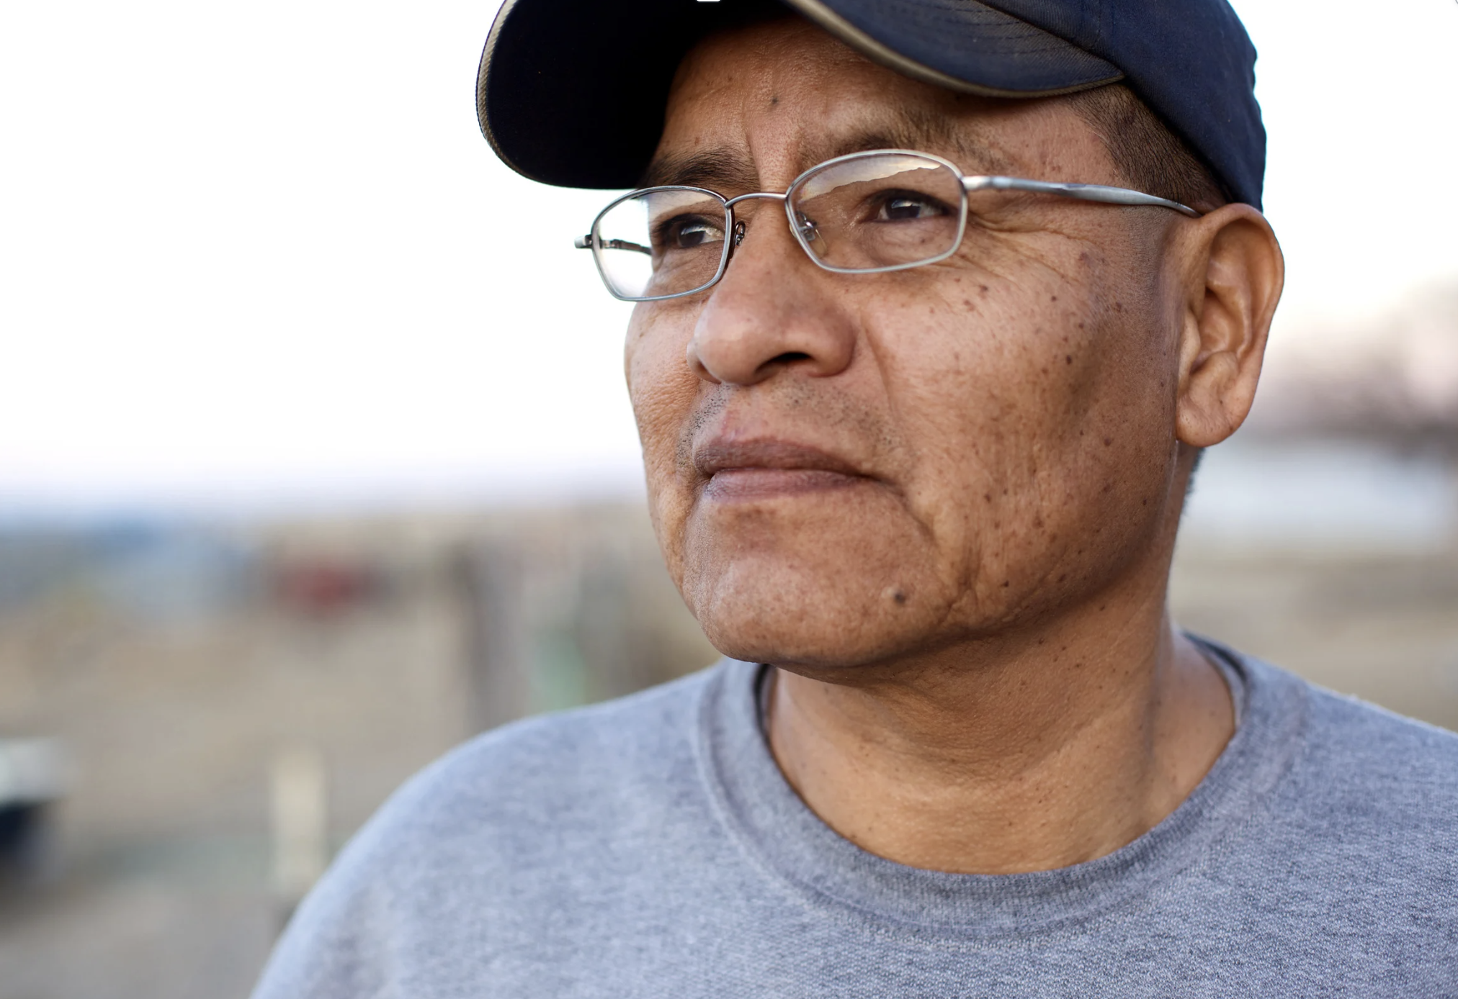
3. Personal Strength
Increased resilience and self-efficacy
Recognize our own ability to overcome adversity
Discover untapped reserves of inner strength

Slide 31
“
Aging is not ‘lost youth’ but a new stage of opportunity and strength.
”
Betty Friedan

Slide 32
Personal Strength
Meta-analysis of 27 studies, ~20,000 Healthcare professionals (2022)
Those over 60 reported 23% higher posttraumatic growth (PTG) scores than their younger counterparts when the trauma reinforced their professional competence. Older workers tended to reflect more deeply on the meaning of their experience, which helped them extract growth from the adversity.
Age-related coping strategies: Older adults disproportionately utilize downward social comparisons (e.g., "Others suffered more”; “at least I survived”) to sustain self-worth post-trauma, a mechanism less prevalent in youth.
Notes:
O'Donovan, R., & Burke, J. (2022). Factors Associated with Post-Traumatic Growth in Healthcare Professionals: A Systematic Review of the Literature. Healthcare (Basel, Switzerland), 10(12), 2524. https://doi.org/10.3390/healthcare10122524

Slide 33
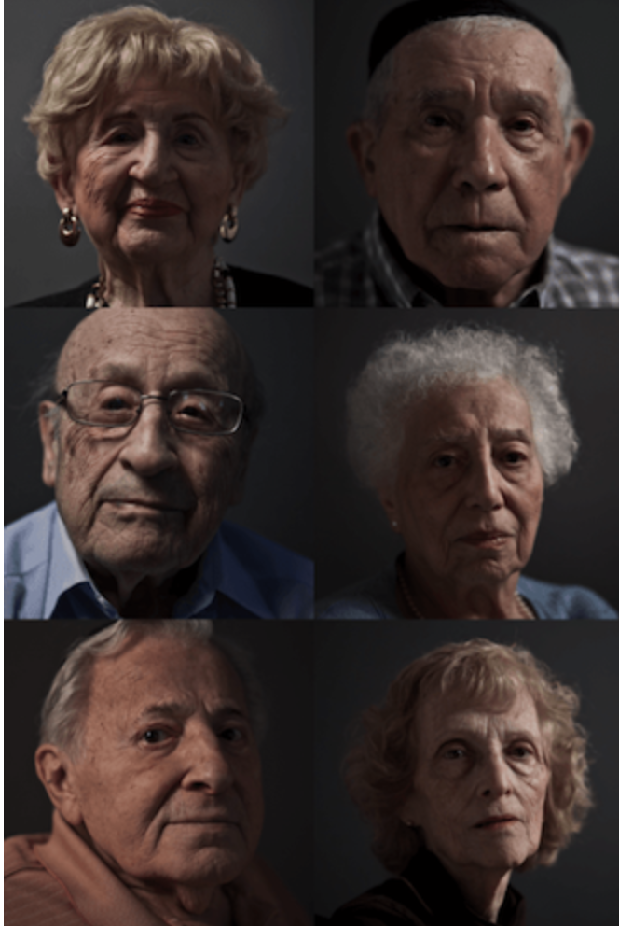
Personal Strength
“I’ve endured worse”
Holocaust survivors with current health limitations scored higher on personal strength domains than healthier peers.
Recalling times in life when we have persevered in the face of hardship bolsters resilience & self-efficacy.
Recognizing our personal strength helps us to reframe accumulated life experiences as sources of wisdom and strength rather than burdens.
Greenblatt-Kimron L. (2021) ; Photo: International March of the Living
Notes:
Greenblatt-Kimron L. (2021). World assumptions and post-traumatic growth among older adults: The case of Holocaust survivors. Stress and health : journal of the International Society for the Investigation of Stress, 37(2), 353–363. https://doi.org/10.1002/smi.3000

Slide 34
Personal Strength
What This Teaches Us About Aging
Personal strength is a powerful counternarrative to views of aging as primarily characterized by decline.
Recognizing our personal strength
  can bolster self-efficacy when facing age-related challenges.
  helps us to reframe accumulated life experiences as sources of wisdom and strength rather than burdens.
Instead of viewing older adults as frail and vulnerable, look for their strength
Notes:
Greenblatt-Kimron L. (2021). World assumptions and post-traumatic growth among older adults: The case of Holocaust survivors. Stress and health : journal of the International Society for the Investigation of Stress, 37(2), 353–363. https://doi.org/10.1002/smi.3000

Slide 35
4. Spiritual Change
Deeper spiritual understanding and existential awareness.
Greater sense of meaning, purpose, or connection
Openness to spiritual or existential exploration

Slide 36
What is Spirituality?
Eames & O'Connor (2022)
Miller (2021)
A feeling of awe or transcendence: movement closer to life’s meaning and purpose.
Moment of deep connection with another being or in nature
An experience of startling synchronicity
A time when you felt held, bolstered, or inspired by something greater than yourself, like…
Higher power
Nature
The universe
Surge of connection
Notes:
Lisa Miller- The Awakened Brain (2021).

Slide 37
Spiritual Change/
Existential Integration
Eames & O'Connor (2022)
Spiritually inclined individuals exhibit stronger PTG when engaging in purposeful reflection about trauma’s meaning
For older adults, spirituality can support identity integration and legacy building
Spirituality helps you grow, not avoid pain
As we approach the end of our days, we need to bring together the strands of our lives
Notes:
Eames, C., & O'Connor, D. (2022). The role of repetitive thinking and spirituality in the development of posttraumatic growth and symptoms of posttraumatic stress disorder. PloS one, 17(8), e0272036. https://doi.org/10.1371/journal.pone.0272036

Slide 38
Spirituality & Aging
Crowther et al., (2002)
Spirituality is highly correlated with positive successful aging.
Spirituality helps us face inevitable losses and impending death, while also finding and maintaining meaningfulness of life.
Older adults who are more spiritual tend to demonstrate greater wellbeing than those who are not.
Notes:
Crowther MR, Parker MW, Achenbaum WA,
Larimore WL, Koenig HG: Rowe and Kahn’s
model of successful aging revisited: positive
spirituality – the forgotten factor.
Gerontologist 42, 613–620 (2002).

Slide 39
Spiritual Change/
Existential Integration
What This Teaches Us About Aging
Cultivating a sense of purpose and significance in our life journey even amidst suffering is critical to aging well.
PTG is not about "moving past" trauma but integrating it into a cohesive life narrative-a process that can deepen with age
As we approach the end of our days, we need to bring together the strands of our lives.

Slide 40
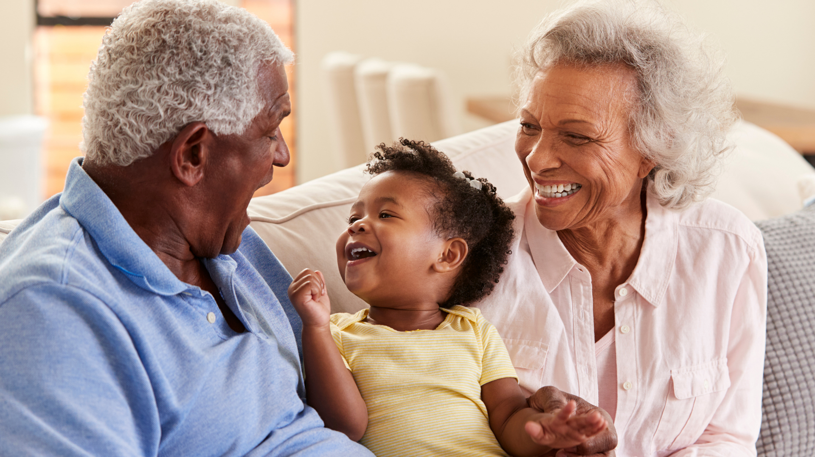
5. Appreciation Of Life
Heightened gratitude for life itself
Greater ability to savor each moment
Shift in understanding of what truly matters

Slide 41
Present-centered savoring: 68% of COVID-19 survivors over 70 reported increased gratitude for mundane pleasures (e.g., family meals), versus 42% of those under 50.
Legacy motivation: Trauma survivors often accelerate legacy-building activities, with 33% initiating memoir writing or ethical wills within two years post-trauma.
Appreciation Of Life
Celdrán, et al (2021); Bouchard & Manning (2019)
Notes:
Celdrán, M., Serrat, R., & Villar, F. (2021). Post-Traumatic Growth among Older People after the Forced Lockdown for the COVID-19 Pandemic. The Spanish journal of psychology, 24, e43. https://doi.org/10.1017/SJP.2021.40
Lauren M Bouchard, Lydia K Manning, RESILIENCE AND POST-TRAUMATIC GROWTH: EXPLORING THE PERCEPTIONS OF GAINS AFTER ADVERSITY IN OLDER ADULTS, Innovation in Aging, Volume 3, Issue Supplement_1, November 2019, Page S720, https://doi.org/10.1093/geroni/igz038.2639

Slide 42
Older Adults Savor Life More Deeply After Trauma
Neuroimaging studies suggest this stems from age-related ventral striatum changes.
The ventral striatum is a part of the brain that helps process reward and motivation.
As we age, this part of the brain becomes more responsive to positive, familiar, and emotionally meaningful experiences (like hearing your grandchild laugh or enjoying morning tea).
As a result, older adults are more neurologically wired to notice and savor the small joys of life, especially after facing trauma.
Appreciation of Life
Meta-analysis of 554 participants with brain injuries 16 to 88 years old (Grace et al, 2015).
Notes:
Grace, J. J., Kinsella, E. L., Muldoon, O. T., & Fortune, D. G. (2015). Post-traumatic growth following acquired brain injury: A systematic review and meta-analysis. Frontiers in Psychology, 6, 1162. https://doi.org/10.3389/fpsyg.2015.01162
Celdrán, M., Serrat, R., & Villar, F. (2021). Post-Traumatic Growth among Older People after the Forced Lockdown for the COVID-19 Pandemic. The Spanish journal of psychology, 24, e43. https://doi.org/10.1017/SJP.2021.40
Lauren M Bouchard, Lydia K Manning, RESILIENCE AND POST-TRAUMATIC GROWTH: EXPLORING THE PERCEPTIONS OF GAINS AFTER ADVERSITY IN OLDER ADULTS, Innovation in Aging, Volume 3, Issue Supplement_1, November 2019, Page S720, https://doi.org/10.1093/geroni/igz038.2639

Slide 43
Appreciation of Life
What This Teaches Us About Aging
Offers a framework for finding joy and meaning in daily experiences despite physical limitations or losses, contributing significantly to well-being in later life.
!! Duality of Man: Appreciation often coexists with mortality awareness-a duality requiring therapeutic support to prevent existential distress and death anxiety.

Slide 44
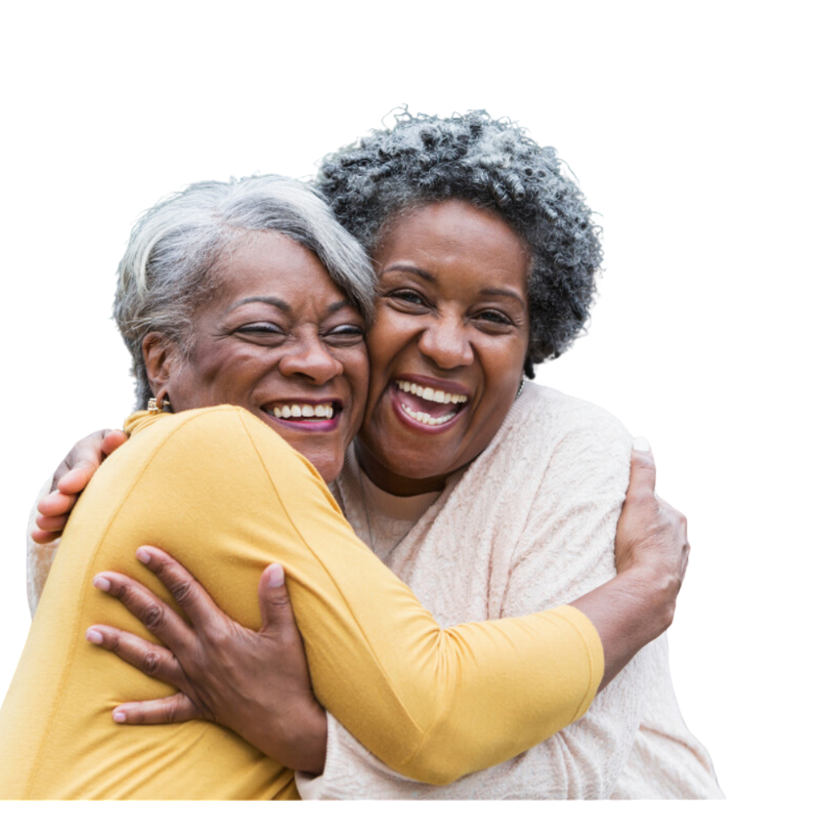
You have an important role!
01
Create spaces for people to connect and heal- communal meaning making. Healing happens in community.
02
Highlight opportunities for growth with new possibilities. Change the narrative about what’s possible with aging.
03
Affirm past examples of resilience and coping, helping clients recognize their own persona strengths and resiliencies.
04
Cultivate Spirituality. Listen to their stories. Inquire about the meaning they make. Doing so will help to bring together the strands of their lives into a cohesive whole
05
Savor moments with your older clients. Appreciate life, share in expressions of gratitude

Slide 45

Because…
There’s no expiration date on healing, transformation, and love

Slide 46
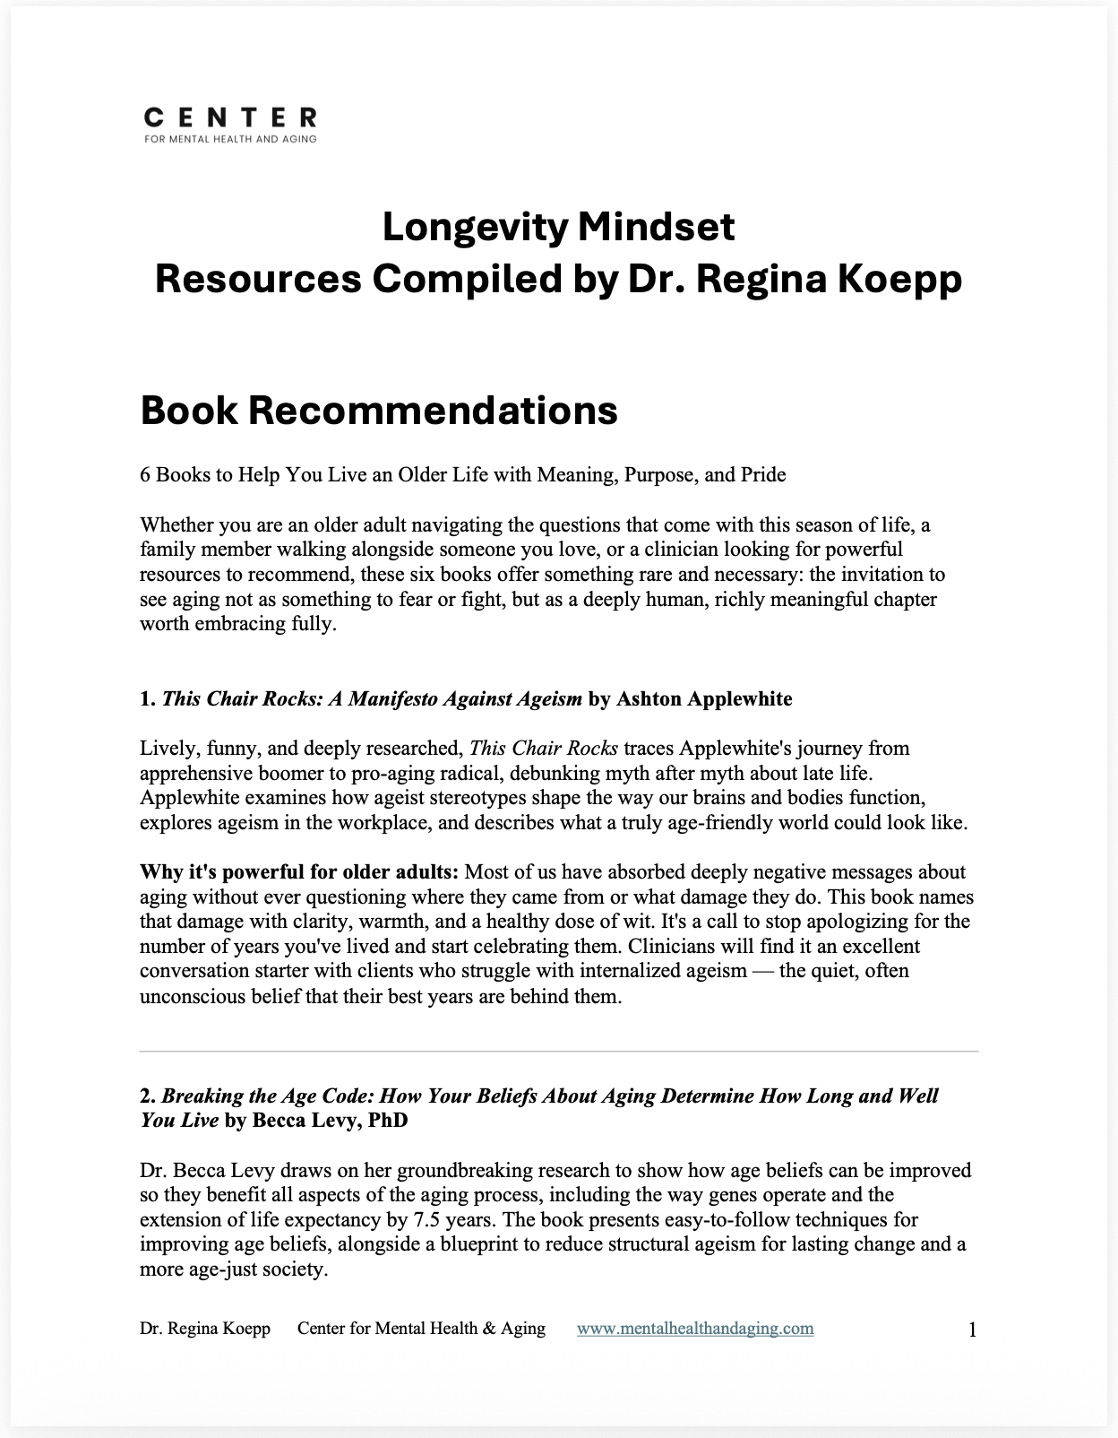
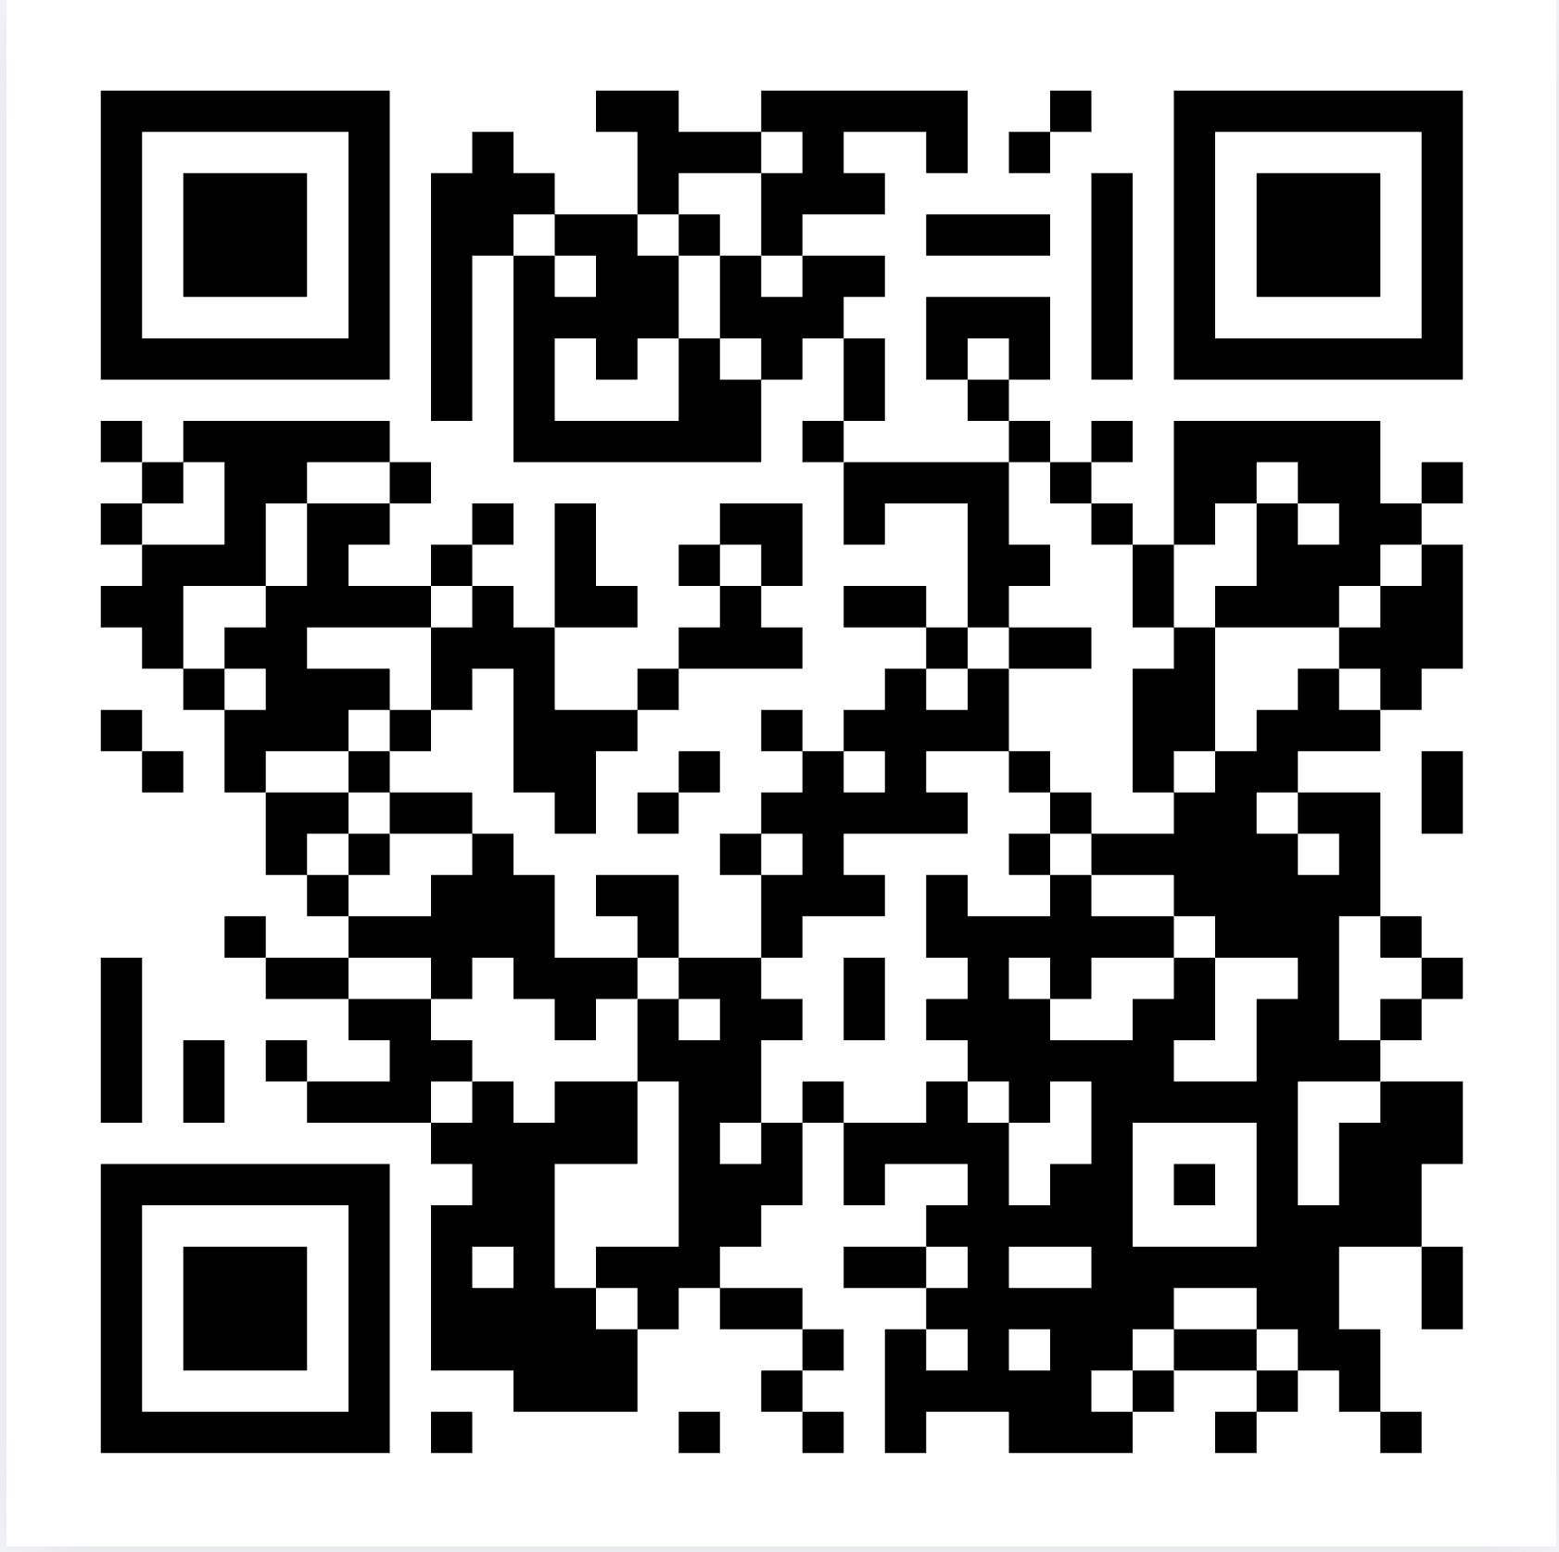
Resources to Continue Your Learning
www.mentalhealthandaging.kit.com/mindset

