Slide 1
Time to Benefit: How to use Prognosis to Provide Person Centered Care
Sarah Hallen, MD, FACP
Maine Geriatrics Conference
May 2026
MaineHealth Maine Medical Center Portland

Slide 2
Disclosures
None

Slide 3
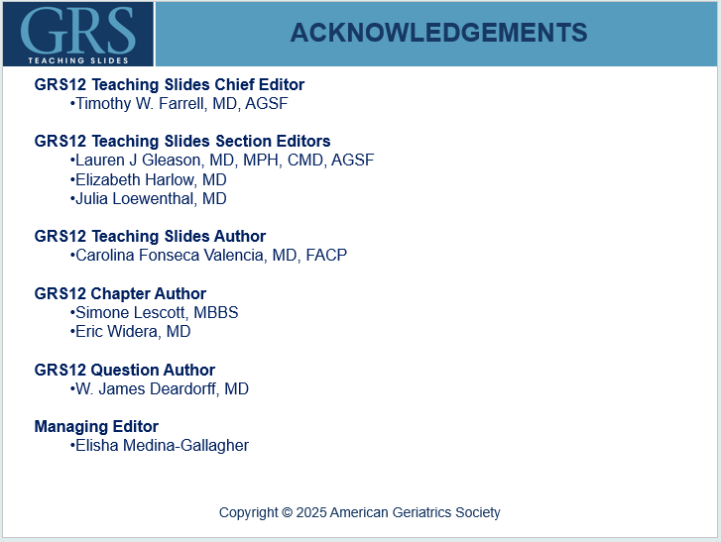
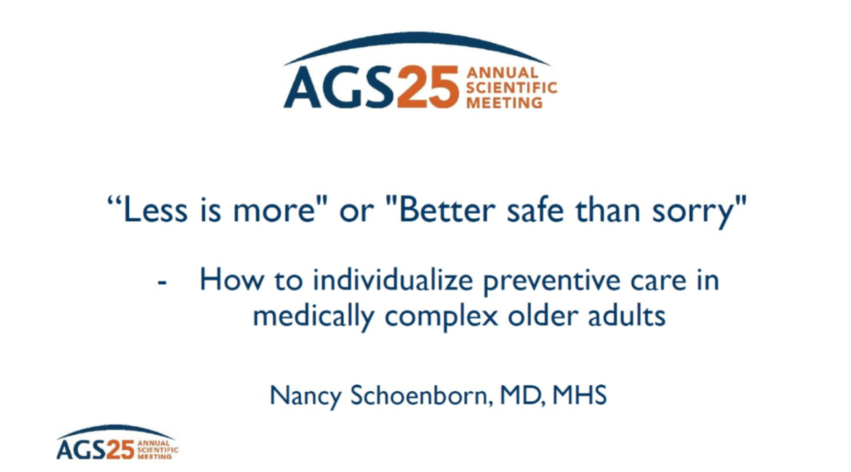

Slide 4
Objectives
Participants will be able define prognosis and describe why developing skills in prognostication are important for guiding patient-centered goal setting and shared decision making
Participants will become familiar with common prognostic tools and how they can be applied to estimate the time to benefit of diagnostic and therapeutic intervention
Participants will learn how to apply communication strategies incorporating prognostic estimates to support individualized care decisions

Slide 5
INTRODUCTION
Prognosis is the prediction of the probability that a particular outcome will develop in an individual over a period of time.
PROGNOSTICATION
ESTIMATION
of prognosis
COMMUNICATION
of prognosis
Prognostication using patient-relevant outcomes, incorporation of lag time to benefit of potential diagnostic or therapeutic interventions, and communication of prognosis can help patients and clinicians in the process of shared decision-making
Notes:
Possible outcomes include time to death and likelihood of significant functional decline.
Developing a prognosis is an important skill that can greatly inform patient-centered goal setting and shared decision-making.
Prognostication is a broader term that incorporates both
estimating and communicating prognosis

Slide 6
Prognostication
  Considered a lost skill, often overshadowed by diagnosis and treatment
  PubMed May 2026 (last 5 years, English)
    Diagnosis articles = 1,993,344
    Therapy = 2,144,586
    Prognosis = 552,210 results

Slide 7
“The 5D’s of Prognostication”
Disease progression/recurrence
  What are the chances this patient will relapse?
Death
  Is this patient eligible for hospice?
Disability/discomfort
  Will this patient with stroke recover?
Drug Toxicity
  How long will the GI upset associated with Aricept last?
Dollars
  Does this patient have enough money to afford around the clock care for the duration of their illness?
Fries JF, Ehrlich GE: Prognosis. Contemporary Outcomes of Disease. Bowie, MD: The Charles Press Publishers, 1981.

Slide 8
IMPORTANCE OF PROGNOSTICATION
Prognosis can significantly affect healthcare decisions by…
Helping delineate realistic and achievable goals of care that could inform care decisions
Helping determine a patient’s eligibility for additional services and benefits (eg, hospice care)
Aiding patients in advance care planning
Helping patient define goals and outcomes that are important for the patient, beyond life expectancy (eg, functional recovery, ability to live independently, or ability to meet a milestone)
Fostering trust in the provider, even in the face of uncertainty

Slide 9
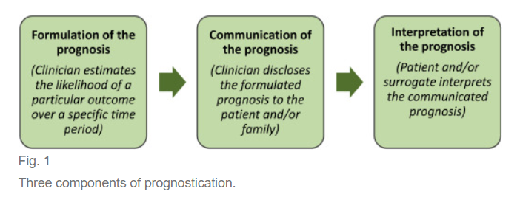
Forseeing
Fortelling
Christakis N. Death foretold: prophecy and prognosis in medical care. Chicago: University of Chicago Press; 1999.
Martin EJ, Widera E. Prognostication in Serious Illness. Med Clin North Am. 2020 May;104(3):391-403

Slide 10
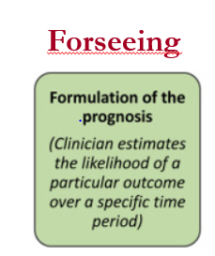

Slide 11
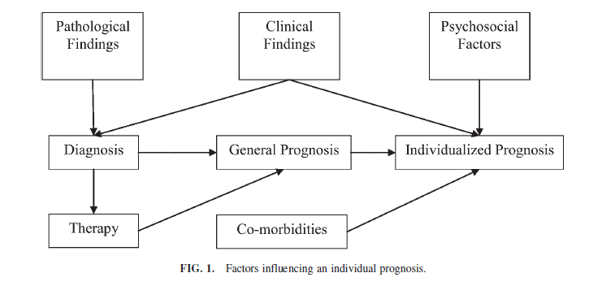
Act of foreseeing:
Glare PA, Sinclair CT. Palliative Medicine Review: Prognostication. J Palliat Med. 2008:11:84-103.

Slide 12

Case
86-year-old woman is hospitalized with rib fractures after a fall from standing
  She has mild dementia (requires some help with IADL’s but independent with her ADL’s)
  She has congestive heart failure
  Her Vitamin D level is within normal limits
  She has no renal failure; she is well-nourished with an albumin of 3.4
  Family asks about preventing further fractures
    Bisphosphonate?

Slide 13
ESTIMATING PROGNOSIS
Prognosis in older adults often goes beyond estimating overall life expectancy and may include other health outcomes and important personal milestones
CLINICAL
JUDGMENT
REFERENCING
PUBLISHED
STUDIES
AGE BASED
LIFE
EXPECTANCY
PUBLISHED
PROGNOSTIC
INDICES
Any combination of these 4 methods can be used to determine the most accurate prognostic prediction

Slide 14
ESTIMATING PROGNOSIS
Experienced-based, where anecdotal cases shape estimation of prognosis in particular groups of patients or specific presentations
CLINICAL JUDGMENT
Pathologic and clinical findings
Diagnoses
Comorbidities
Ongoing and previous therapies
Various psychosocial factors

Slide 15
Clinician’s prediction of survival (CPS)
Studied in multiple settings
Physicians can discriminate (sort) survivors and non-survivors as well as or better than most physiologic models
  Similar performance by fellows, residents, medical students and nurses
Estimates of 6 months or less most accurate
      Less than 25% outlived their prognosis when CPS was 6 months or less
      When CPS exceeds 6 month it has no predictive value
Glare et al. A systematic review of physicians’ survival predictions in terminally ill cancer patients. BMJ 2003;327(7408):195.

Slide 16
CPS
However, clinicians have poor calibration (reliability) and precision
Clinician estimates of “time left” are generally “inconsistent, imprecise and inaccurate”
“Dispassionate specialist physicians” considered most accurate
Clinicians are generally over optimistic
  Only correct within one week in 25% of cases and were correct within two weeks in only 43% of the cases
  Overestimated survival by at least 4 weeks in 27% of cases
  Overestimated survival by an average of 13 days
Glare et al. A systematic review of physicians’ survival predictions in terminally ill cancer patients. BMJ 2003;327(7408):195.

Slide 17
ESTIMATING PROGNOSIS
Average US Life Expectancy by Age (years)
Age | Women | Men
65 | 19.8 | 17.0
70 | 15.9 | 13.7
75 | 12.4 | 10.6
80 | 9.2 | 7.8
85 | 6.5 | 5.5
90 | 4.4 | 3.7
95 | 2.9 | 2.5
Average life expectancy tables provide
Broad estimate of median survival in the general population
Data driven starting point to estimate prognosis
SOURCE: Data from Arias E. National Vital Statistics Reports. Natl Vital Stat Reports. 2020;71(1):1–64.
There is substantial heterogeneity in life expectancy among older adults
within the same age category

Slide 18
ESTIMATING PROGNOSIS (4 of 7)
Provides a more accurate and individualized prognosis provided that a patient’s clinical details closely match those of the study’s patient population
REFERENCING PUBLISHED STUDIES
Especially helpful in rapidly advancing fields, such as oncology
Generalizability in older adults is often of concern because older adults are
often excluded from clinical trials

Slide 19
ESTIMATING PROGNOSIS (5 of 7)
Prognostic indices are validated tools that use select characteristics from a particular patient such as functional status and comorbidities to calculate a prognostic estimate
PUBLISHED PROGNOSTIC INDICES
Use of prognostic indices requires an understanding of the accuracy, validity, and generalizability of a specific index
When used to predict mortality in older adults, tools that incorporate functional status tend to perform better than those that rely solely on factors that are normally captured in an electronic medical record
Notes:
A collection of these types of indices can be found at ePrognosis (https://eprognosis.ucsf.edu).

Slide 20
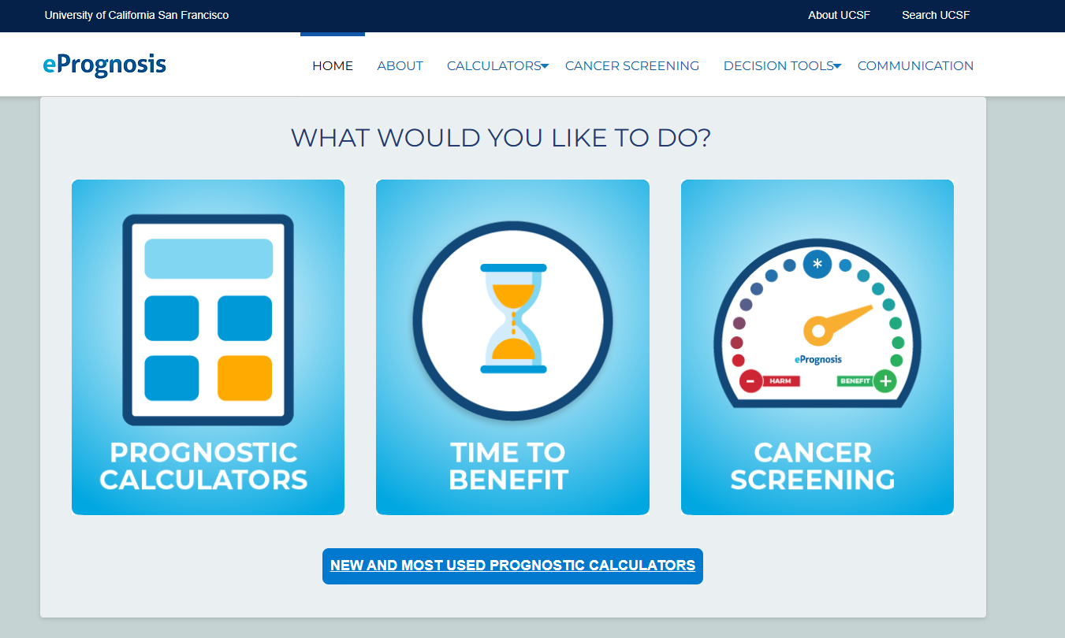
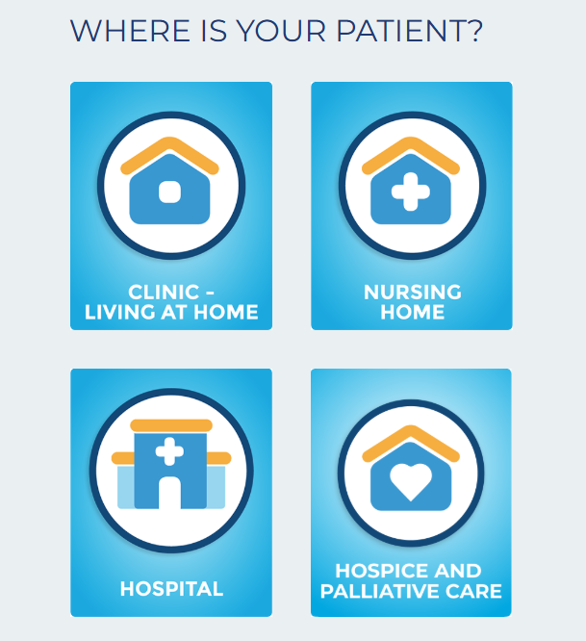

Slide 21
ESTIMATING PROGNOSIS
Disease-specific indices are often more valuable for patients with one dominant life-limiting condition
Disease | Prognostic index | Patient population | Website
Cancer | Palliative Performance Scale | Cancer and noncancer patients in clinics, hospitals, and hospices | www.ePrognosis.org
Heart failure | Seattle Heart Failure Model | Outpatients without significant other comorbidities. May overestimate prognosis in the old-old. | http://depts.washington.edu/shfm
 | EFFECT Model | Inpatients hospitalized with acute decompensated heart failure | http://www.ccort.ca/Research/CHFRiskModel.html
COPD | BODE | Outpatients with COPD. May be more accurate in patients with severe COPD. | Reference.medscape.com/calculator/bode-index-copd
End-stage renal disease | Cohen | Outpatients receiving chronic hemodialysis care | https://qxmd.com/calculate/
Dementia | Advanced Dementia Prognostic Tool (ADEPT) | Nursing-home residents with advanced dementia | www.ePrognosis.org

Slide 22
LAG TIME TO BENEFIT
Intervention
LAG TIME TO BENEFIT
Outcome
Lag time to benefit is defined as the time between an intervention and the time that improved health outcomes may be expected
Notes:
Incorporation of the concept of lag time to benefit is important when discussing decisions around possible diagnostic or therapeutic interventions, especially when the benefits will not be immediate.

Slide 23
LAG TIME TO BENEFIT
Lag Time to Benefit | Common Screening Tests/Clinical Interventions
1 - 2 months | SSRIs for depression
6 months | Statins for secondary prevention of cardiovascular disease Finasteride for benign prostatic hyperplasia
1 year | Bisphosphonates for prevention of nonvertebral fractures in postmenopausal women with osteoporosis
1 - 2 years | Blood pressure control for primary prevention of cardiovascular disease
1 - 3 years | Strict blood pressure and lipid control in type 2 diabetes mellitus Statins for primary prevention of cardiovascular disease
8 - 10 years | Tight glycemic control for prevention of microvascular complications in type 2 diabetes mellitus
10 years | Colon and breast cancer screening for reducing cancer mortality
Notes:
See Table 1 in GRS Chapter.

Slide 24
LAG TIME TO BENEFIT
LIFE EXPECTANCY
LAG TIME TO BENEFIT
Benefits > Harms
Benefits < Harms
Advise IN FAVOR OF intervention
SHARED DECISION MAKING
Advise AGAINST intervention
Notes:
When discussing whether to pursue diagnostic or therapeutic interventions, weighing the likelihood that a patient may live long enough to benefit from the proposed intervention can greatly aid clinical decision-making.
If a patient’s life expectancy is significantly less than the lag time to benefit of a preventive intervention, the likelihood of the patient being harmed rather than benefiting from an intervention is high, and one might consider recommending against the intervention.
If a patient’s remaining life expectancy significantly exceeds the lag time to benefit, the likelihood of benefiting from the intervention is now much higher, and the patient might be encouraged to pursue the intervention.
In instances when remaining life expectancy is close to lag time to benefit, further discussion of prognosis and the patient’s goals regarding his or her care may help guide clinical decision-making (Table 22.1)

Slide 25
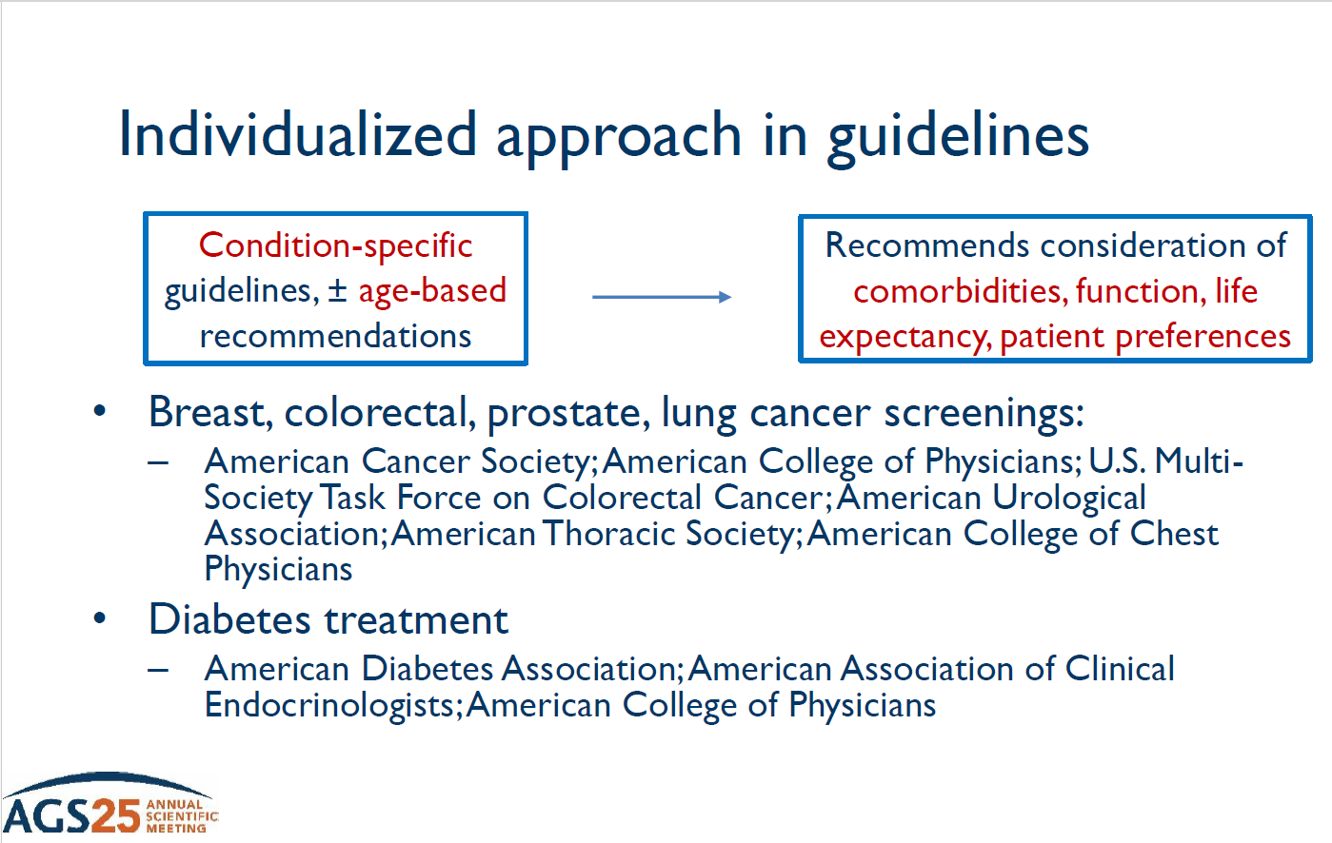

Slide 26
Case
86-year-old woman is hospitalized with rib fractures after a fall from standing
  She has mild dementia (requires some help with IADL’s but independent with her ADL’s)
  She has congestive heart failure
  Her Vitamin D level is within normal limits
  She has no renal failure; she is well-nourished with an albumin of 3.4
  Family asks about preventing further fractures
    Bisphosphonate?

Slide 27
LAG TIME TO BENEFIT
Lag Time to Benefit | Common Screening Tests/Clinical Interventions
1 - 2 months | SSRIs for depression
6 months | Statins for secondary prevention of cardiovascular disease Finasteride for benign prostatic hyperplasia
1 year | Bisphosphonates for prevention of nonvertebral fractures in postmenopausal women with osteoporosis
1 - 2 years | Blood pressure control for primary prevention of cardiovascular disease
1 - 3 years | Strict blood pressure and lipid control in type 2 diabetes mellitus Statins for primary prevention of cardiovascular disease
8 - 10 years | Tight glycemic control for prevention of microvascular complications in type 2 diabetes mellitus
10 years | Colon and breast cancer screening for reducing cancer mortality
Notes:
See Table 1 in GRS Chapter.

Slide 28
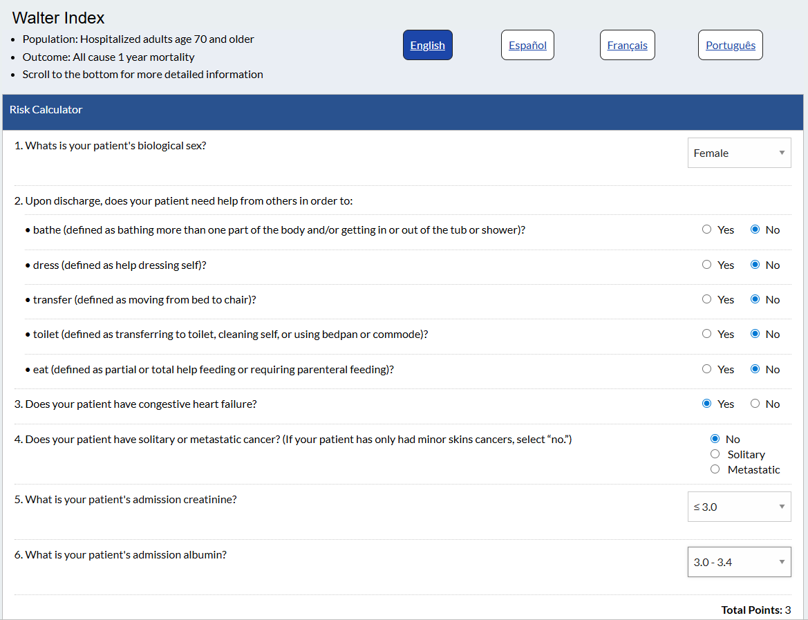

Data

Slide 29
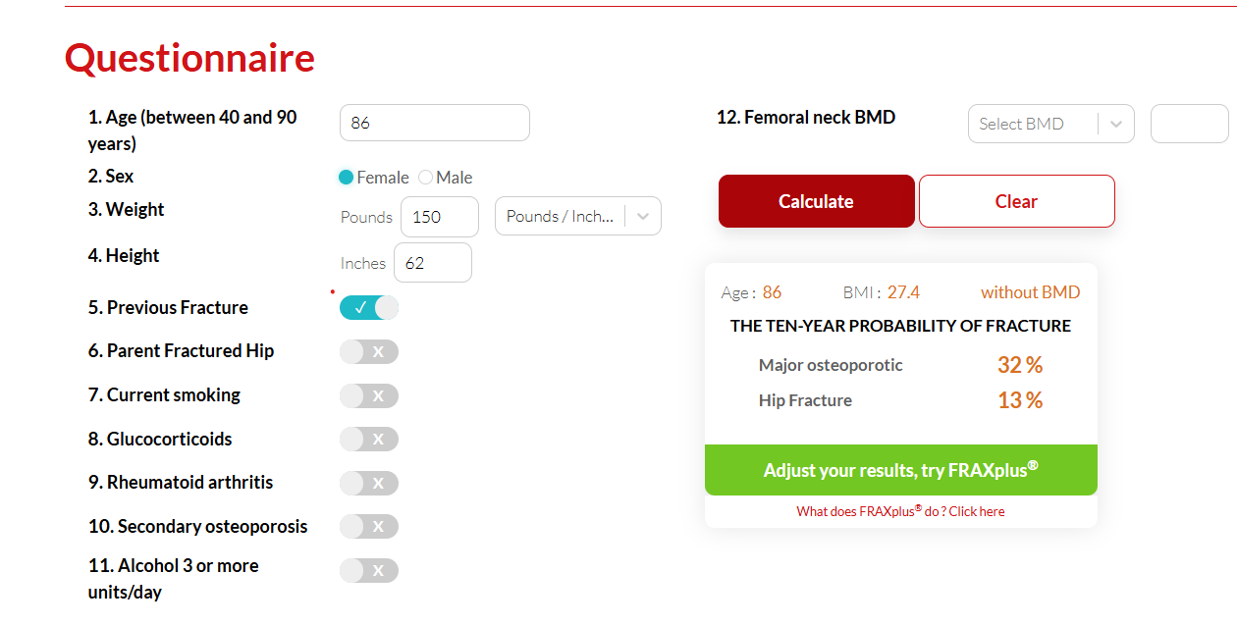

Slide 30

Case: Prognosis
Would this patient benefit from a bisphosphonate?
What is your prognosis for future fracture?
This Photo by Unknown Author is licensed under CC BY-NC-ND

Slide 31
Forseeing
Fortelling
Christakis N. Death foretold: prophecy and prognosis in medical care. Chicago: University of Chicago Press; 1999.
Martin EJ, Widera E. Prognostication in Serious Illness. Med Clin North Am. 2020 May;104(3):391-403

Slide 32
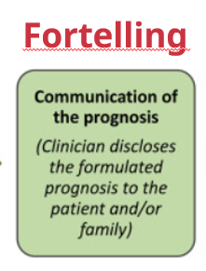

Slide 33
COMMUNICATING PROGNOSIS
Communicating prognosis can be difficult
Use communication structures that emphasize alignment with patient understanding, expectations, and emotion
Focus on patient-centered care delivery
Using tools previously discussed
make well-informed estimates of prognosis
Place prognosis into the context of
lag time to benefit
Patient centered
clinical decision-making

Slide 34
BARRIERS TO PROGNOSTICATION
Evidence encourages discussions about prognosis given that…
…they do not negatively impact hope or overall ability to cope with illness
…patients and families often want to discuss prognosis to get help with planning and decision making
Practitioners shy away from this discussions due to:
  Uncertainty
  Fear of being inaccurate
  Preconceived biases
Patients and families look to practitioners for prognostic information because practitioners are most knowledgeable and best equipped to estimate it
Notes:
Despite the evidence showing that discussion of prognosis does not negatively impact hope or overall ability to cope with illness, and that patients and their families often want to discuss prognosis to help with planning and decision-making, clinicians commonly shy away from having these discussions because of preconceived biases and uncertainty around prognosis. Although estimations of prognosis may
not always be completely accurate, patients and families look to practitioners for prognostic information because practitioners are best equipped to make these estimations.

Slide 35
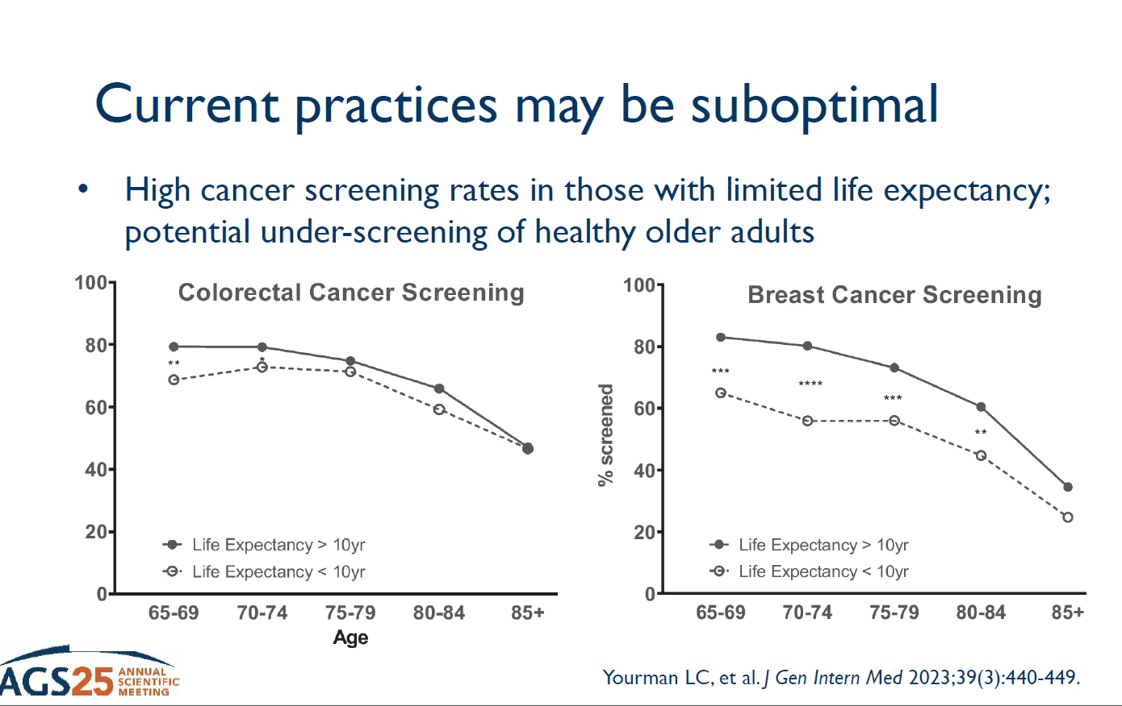
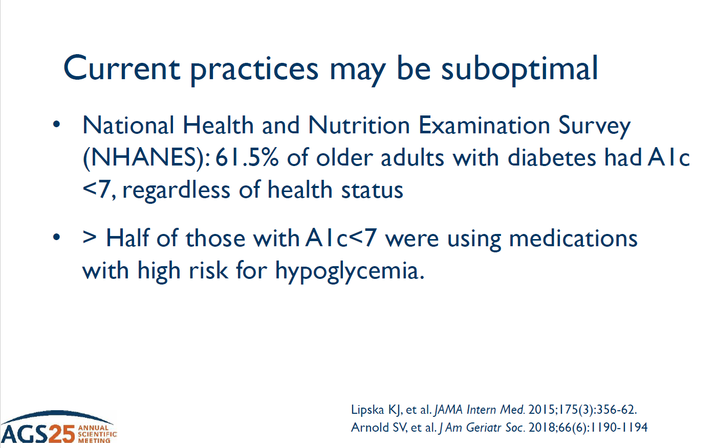

Slide 36
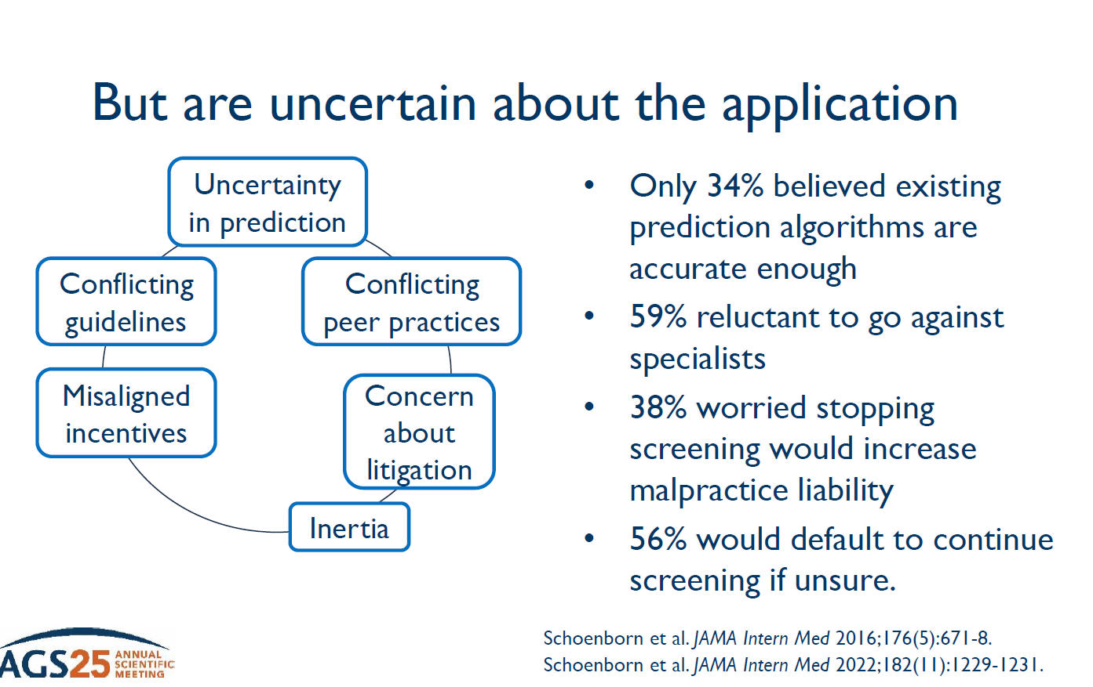

Slide 37
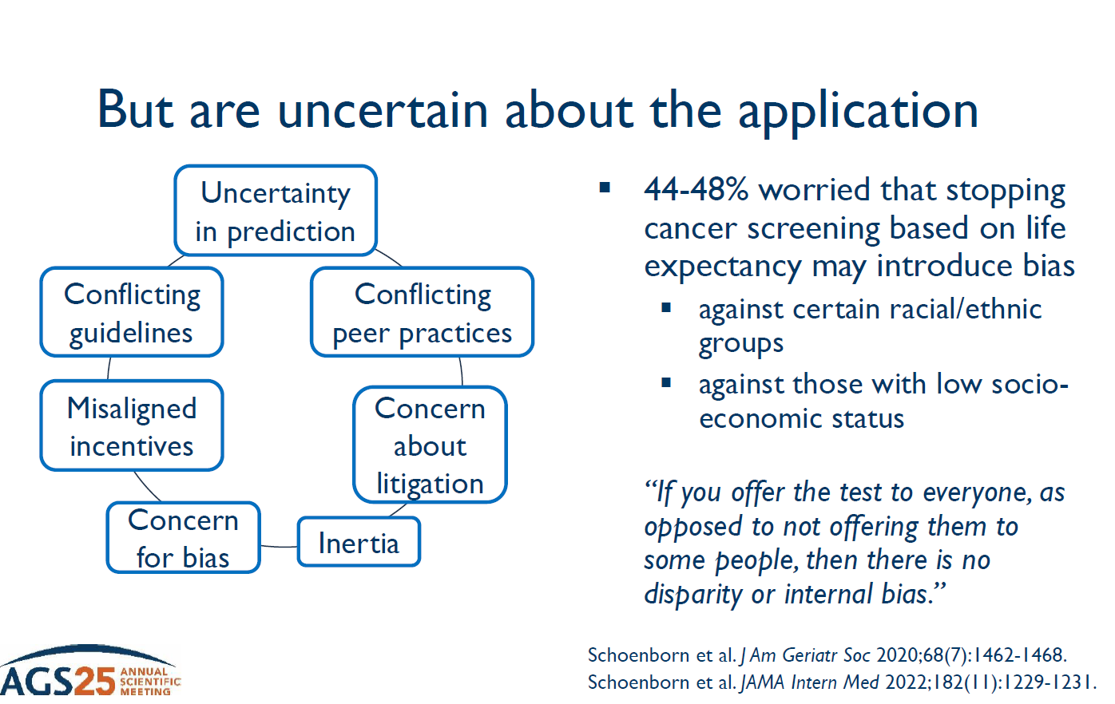

Slide 38
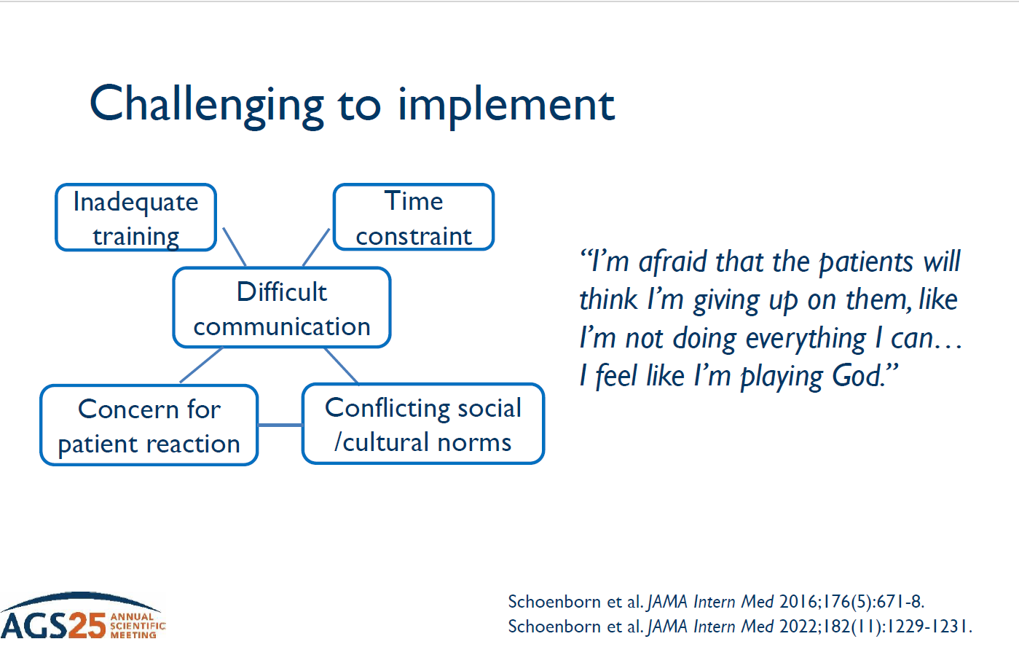

Slide 39
Key lessons
Patients amenable to stop cancer screening
  “Trusting relationship” with provider
  Support individualized care (sickness, not age)

Slide 40
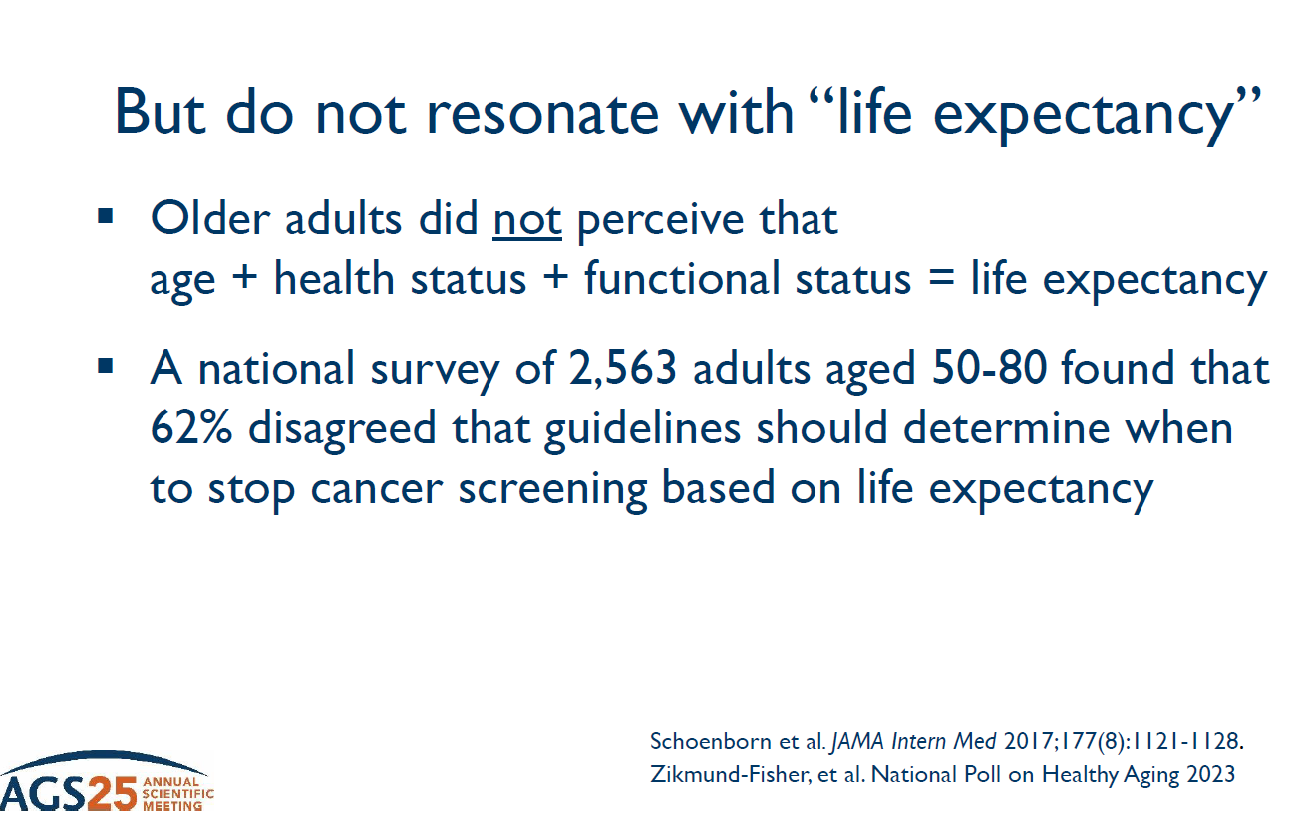

Slide 41
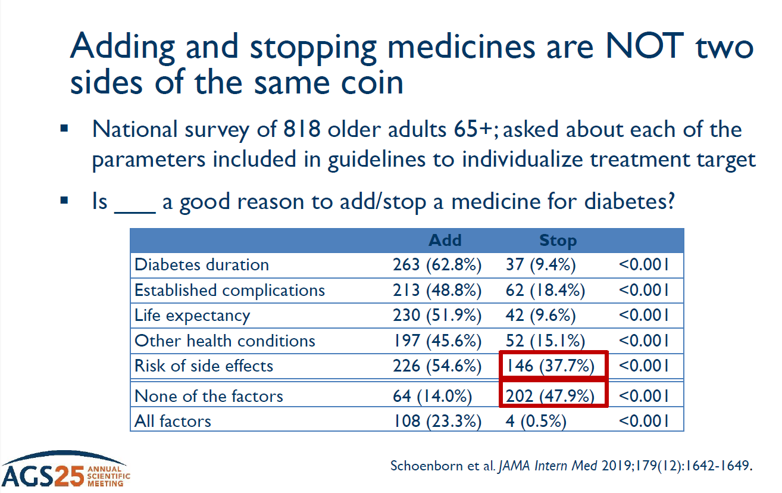

Slide 42
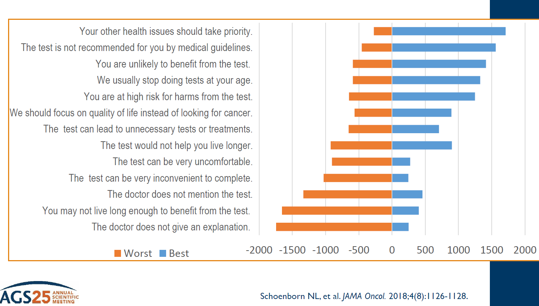

Slide 43
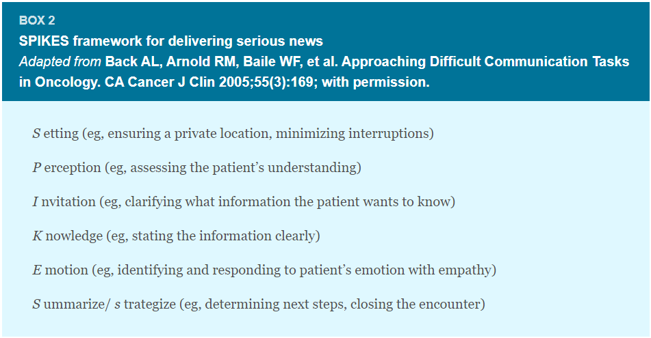
Martin EJ, Widera E. Prognostication in Serious Illness. Med Clin North Am. 2020 May;104(3):391-403.

Slide 44
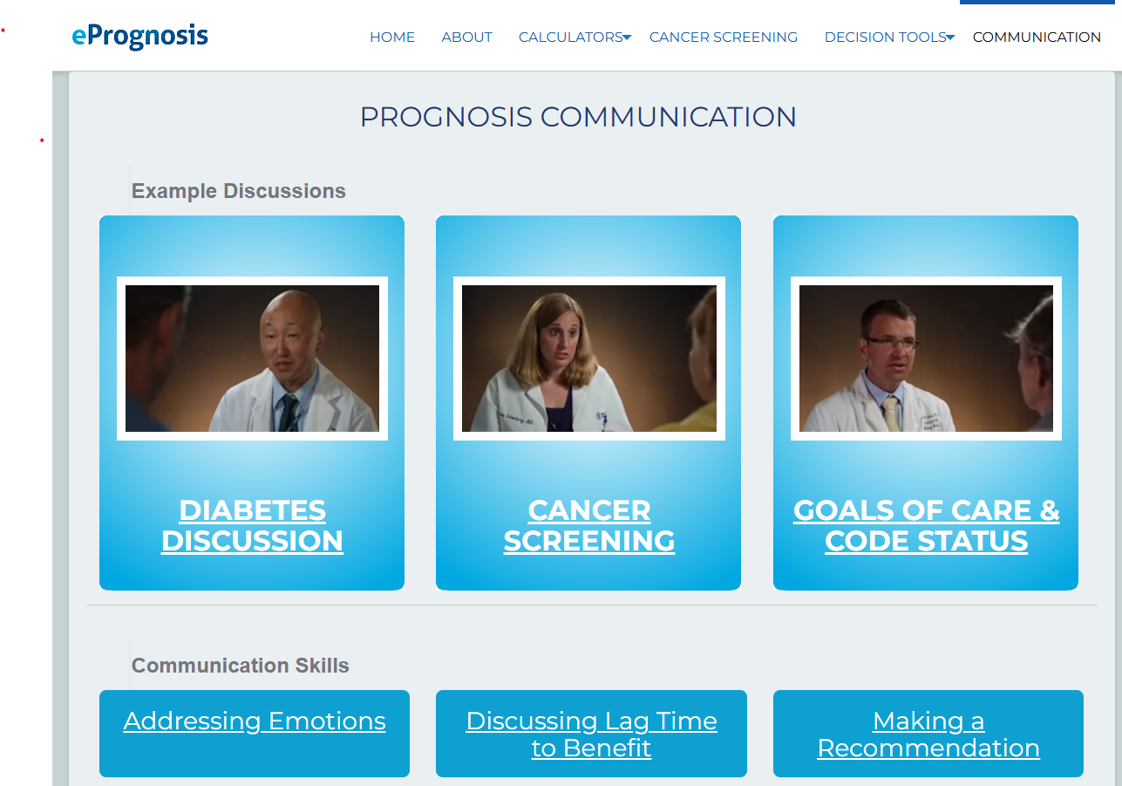
Video examples demonstrating the use of prognostication in clinical decision-making can be found at ePrognosis (https://eprognosis.ucsf.edu/communication/)

Slide 45
Case
86-year-old woman is hospitalized with rib fractures after a fall from standing
  She has mild dementia (requires some help with IADL’s but independent with her ADL’s)
  She has congestive heart failure
  Her Vitamin D level is within normal limits
  She has no renal failure; she is well-nourished with an albumin of 3.4
  Family asks about preventing further fractures
    Bisphosphonate?

Slide 46

Case: Practice
How would you approach this conversation?
How would you discuss the data?
  ~ 20% 1-year life mortality
  Women at age 85 live an average of 6.5 years
  1 year lag-to-benefit for bisphosphonates
  32% chance of a major osteoporotic fracture and 13% of a hip fracture in the next 10 years
What would you want to know from your patient?
What would you want to hear as a patient?
This Photo by Unknown Author is licensed under CC BY-SA-NC

Slide 47
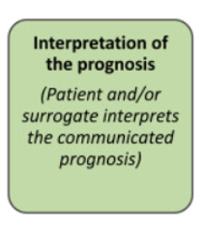

Slide 48
SHARED DECISION-MAKING
This continuous process allows for:
Deliberate engagement of patients and caregivers,
Understanding patient and caregivers’ context for decision-making,
Alignment of medical decisions with patient priorities and preferences for patient-centered care
Incorporate preferences and prognosis into clinical decision-making
Elicit
values, goals and care preferences
PATIENT CENTERED CARE
React to life changes
Notes:
Communication prognosis is often tied to medical decision-making.
A recent Executive Summary from the American Geriatrics Society provides a framework and process for clinicians who provide care to older adults with multiple chronic conditions (see the chapter on Multimorbidity).
This process is part of Age Friendly Health, assessing “what matters” and considering multicomplexity.

Slide 49

Interpreting Evidence for Patients
Acknowledge limitations of the literature and uncertainty
  Clinical Practice Guidelines = Management of one disease
  Many studies were not designed to evaluate interventions in older adults with multimorbidity
Prognosis should INFORM but not DICTATE management
Clinical decisions should maximize benefit and minimize harm => improvement in quality of life
Consider treatment complexity, feasibility
  Nonpharmacologic interventions may be more burdensome than beneficial, if inconsistent with patient preferences

Slide 50
Summary
Prognostication includes both forseeing and fortelling
Understanding lag-time to benefit is important for recommendations, but for communication should be put in context re: outcomes important for the patient
  Just another critical conversation
There are many tools online to assist with prognosis and communication
  ePrognosis
  Specialty sites

Slide 51
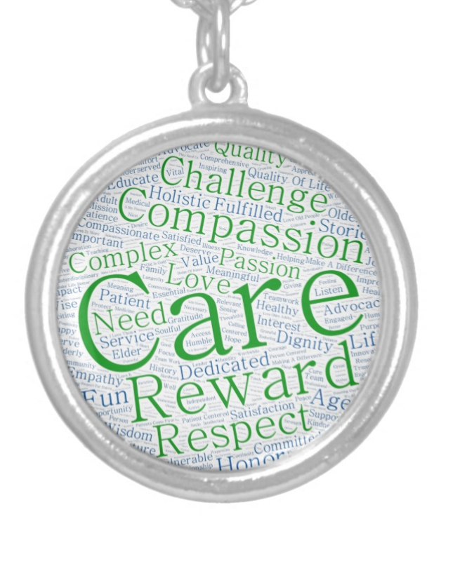

Questions?
Hazzard WR. I am a Geriatrician. JAGS 52:161, 2004

